Slide 1
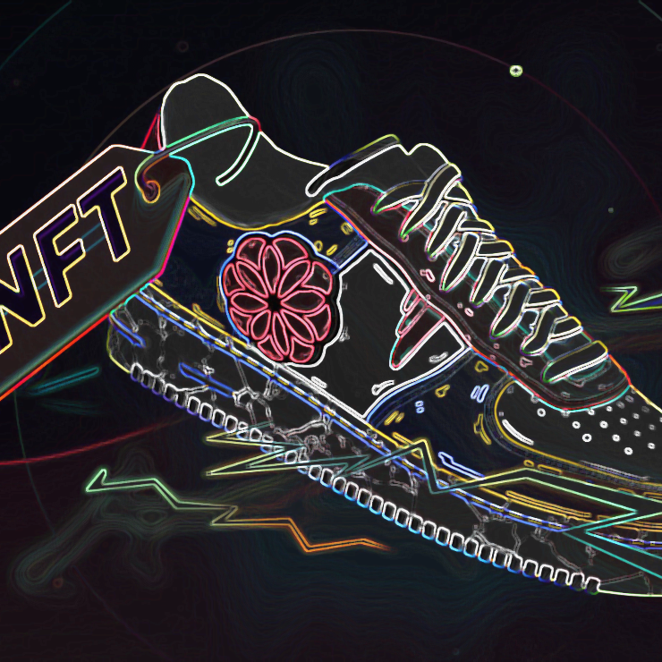
Non Fungible Fashion
Team
Adam Westlake
Ganesh Bashyal
Garry Comber
Orlando Sagrillo
Angus Clark

Slide 2
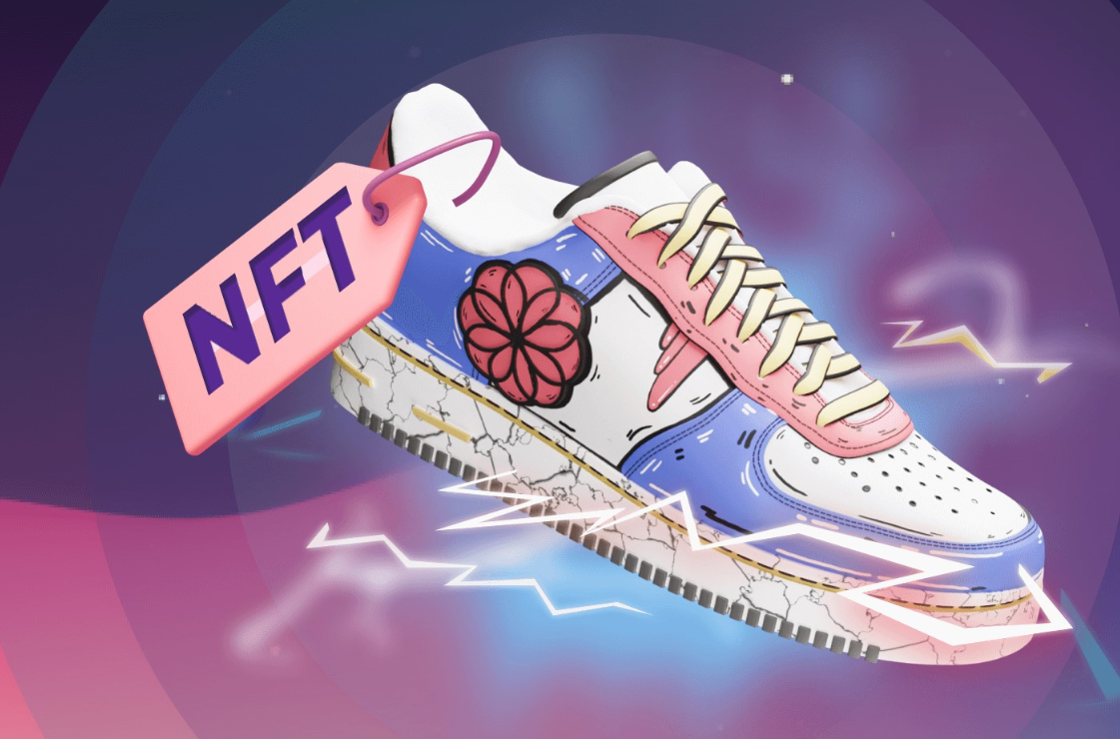
Project Scope
To let the user select and buy the merchandise of their choice and create a Non Fungible Token (NFT) as a proof of ownership generated with the purchase of a good and transfer the token to user specified wallet address.
User has the option to swap sell donate and burn the token.

Slide 3
Objectives
Allow user to buy their choice of merchandise
Acquire Image
Acquire Details
Generate a Certificate of ownership
Transfer to user specified Wallet

Slide 4
Non Fungible Tokens
Digital Asset with unique data on the blockchain
Secure blockchain based certificate
Transferability
Authenticity
Economic opportunities

Slide 5
Blockchain and Proof of ownership
Transparency
Security
Efficiency
Trust
Public or Private
Permissionless
Borderless
Censorship Resistant

Slide 6
Solidity
Simple and easy to use
Open Source
Application Binary Interface (ABI ) to avoid syntax errors
Contract Inheritance
Gas fees can be coded in the smart contracts

Slide 7
Streamlit & Python
Python based Dashboarding
Free and open source
No call-backs
No hidden state

Slide 8
IPFS and Pinata
Inter Planetary File System – single global network
Decentralised, Peer to Peer file sharing network
Content addressing to uniquely identify each file in a global namespace
Pinata enables NFT Storage on the IPFS network

Slide 9
Fashion and NFT
High end luxury good markets is worth USD 349.1 Billion in 2022 (Statista 2022)
CAGR of 3.7% will make it worth USD 419 Billion in 2027 (Statista 2022)
Fake luxury goods cost high end fashion house more than 30 Billion each year (OECD 2019).
NFT will be a blockchain proof of ownership
Tokens will provide cryptographic transparent digital scarcity.
Excellent opportunity to capture some of evolving opportunity.

Slide 10
Challenges

Slide 11
Demo

Slide 12
Optimisation

Slide 13
Questions?

