Slide 1
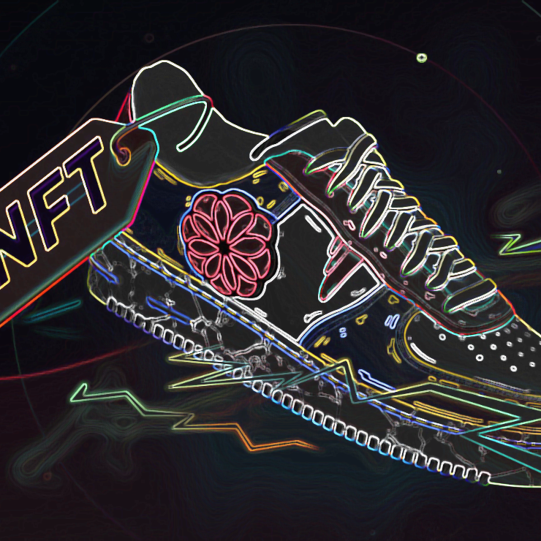
Non Fungible Fashion
Team
Adam Westlake
Ganesh Bashyal
Garry Comber
Orlando Sagrillo
Angus Clark

Slide 2
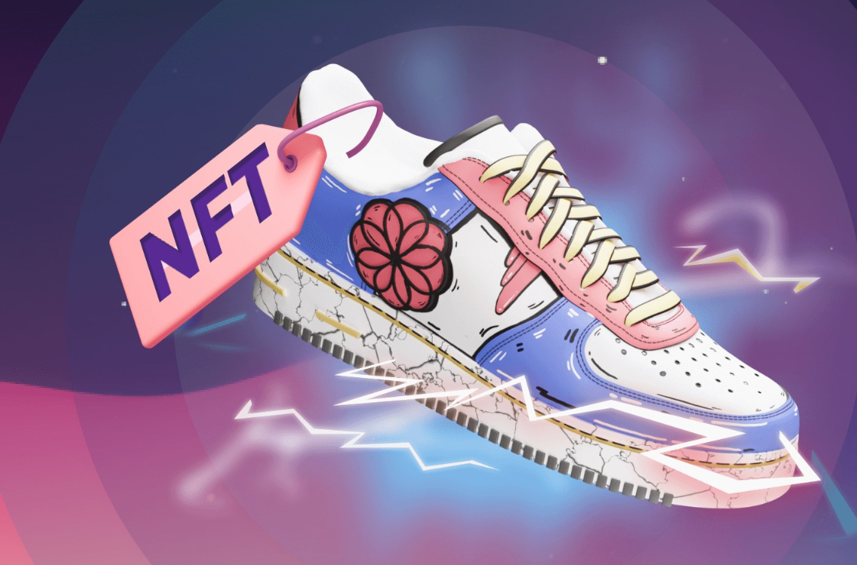
Project Scope
To let the user select and buy the merchandise of their choice and create a Non Fungible Token (NFT) as a proof of ownership generated with the purchase of a good and transfer the token to user specified wallet address.
User has the option to swap sell donate and burn the token.

Slide 3
Objectives
Allow user to buy their choice of merchandise
Acquire Image
Acquire Details
Generate a Certificate of ownership
Transfer to user specified Wallet

Slide 4
Non Fungible Tokens
Digital Asset with unique data on the blockchain
Secure blockchain based certificate
Transferability
Authenticity
Economic opportunities

Slide 5
Blockchain and Proof of ownership
Transparency
Security
Efficiency
Trust
Public or Private
Permissionless
Borderless
Censorship Resistant

Slide 6
Solidity
Simple and easy to use
Open Source
Application Binary Interface (ABI ) to avoid syntax errors
Contract Inheritance
Gas fees can be coded in the smart contracts

Slide 7
Streamlit & Python
Python based Dashboarding
Free and open source
No call-backs
No hidden state

Slide 8
IPFS and Pinata
Inter Planetary File System – single global network
Decentralised, Peer to Peer file sharing network
Content addressing to uniquely identify each file in a global namespace
Pinata enables NFT Storage on the IPFS network

Slide 9
Challenges

Slide 10
Optimisation

Slide 11
Questions?

