Slide 1

Luke Holmes
Dennis Aurelian Leancu
Janelle Cueto
Daia Elsalaymeh

Slide 2
“Luke Holmes” is a single player point-and-click game targeting boys & girls between ages 8 and 14.

Slide 3
Story
Leukocyte “Luke” Holmes, private investigator, is tasked with discovering the source of an infection in his city. Initially believed to be no cause for alarm, it turns out the infection is due to deadly virus, Marburg. Luke must decipher various clues & cryptic messages with his companions to put a stop to the virus.

Slide 4
Formal Elements
Players
Single player vs. game
Objectives
Exploration & solution
Procedures
Point and click & various for mini-games
Rules
Each “city” has a certain number of obtainable clues
Fail a clue and it cannot be tried again
Winning requires certain number of total clues (difficulty level)
Notes:
click to move?

Slide 5
Formal Elements Cont.
Resources
Clues: Story progression
Conflict
Primary: Stop Marburg from taking over the whole body
Outcome
Primary: Marburg is either stopped in time or not
Secondary: Successful or not on puzzles/clues/mini-games

Slide 6
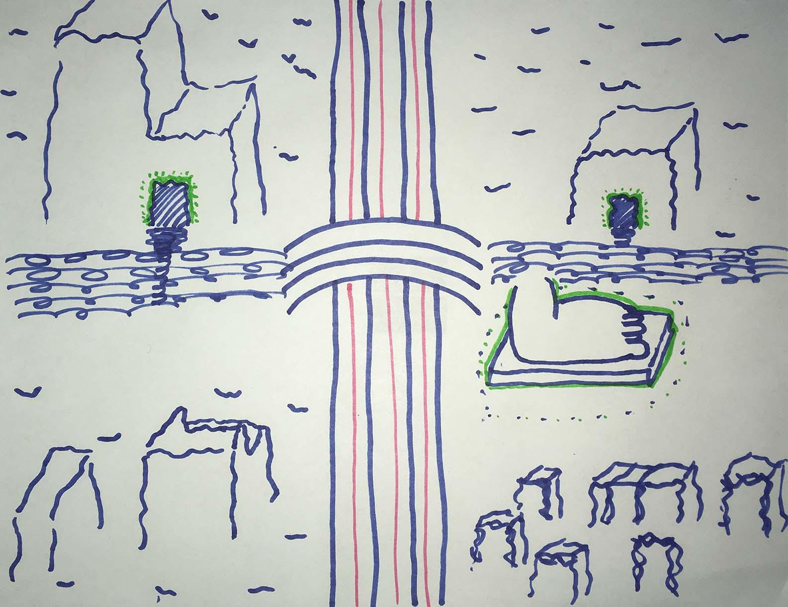
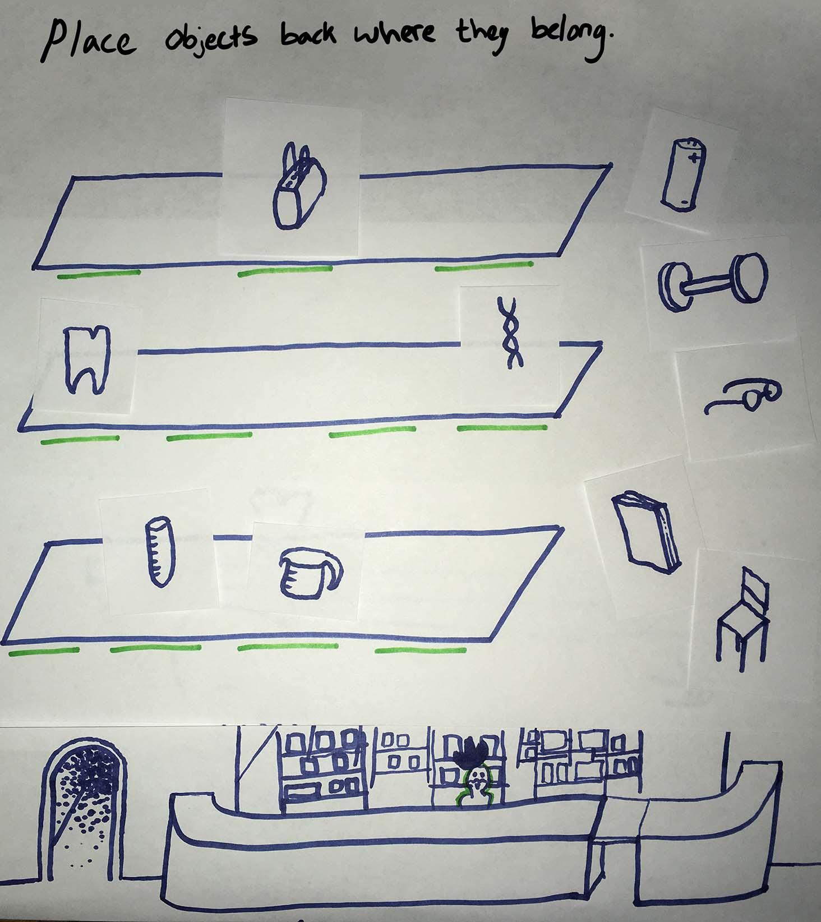
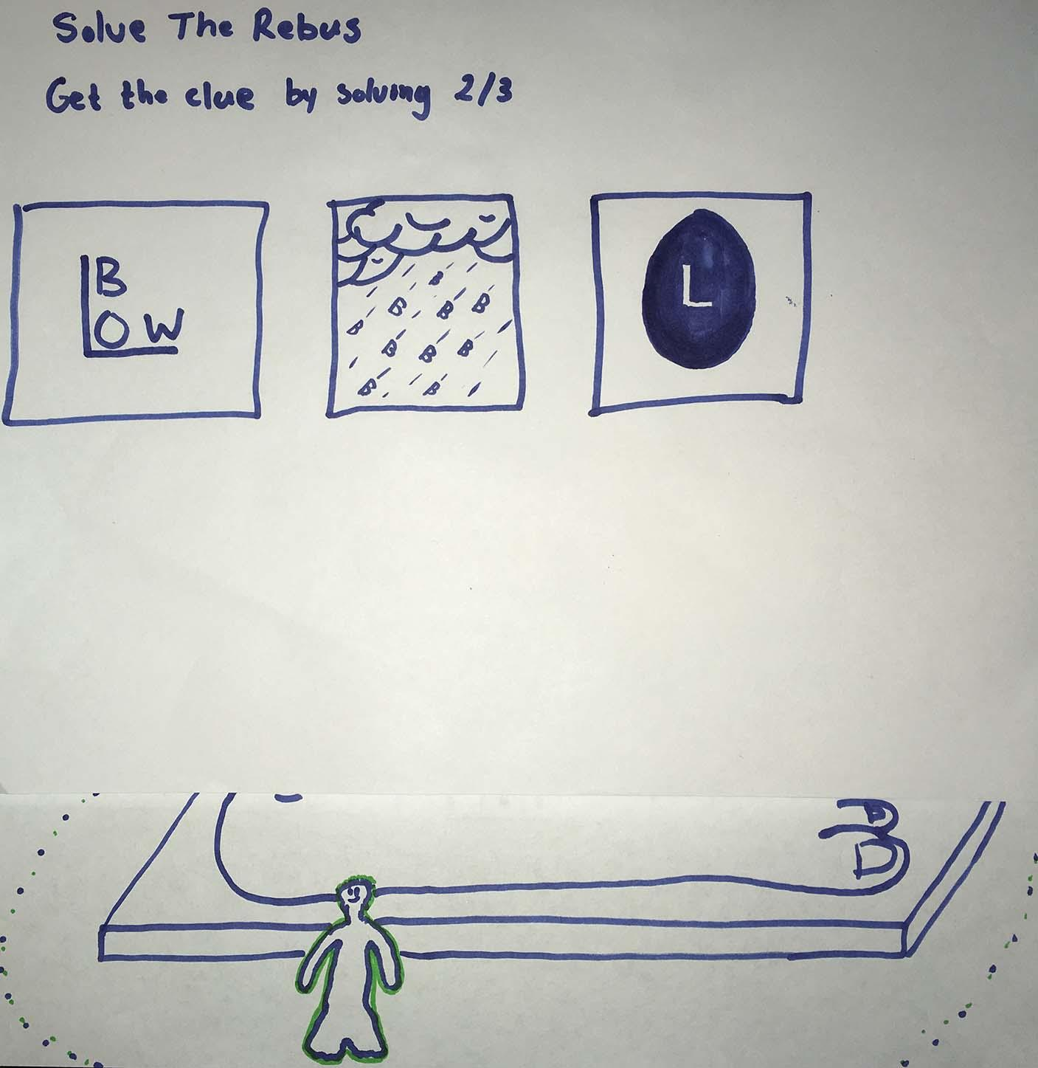
Prototyping

Slide 7
Major Components
Scene Manager
NavMesh
Character Animation
Notes:
https://docs.unity3d.com/Manual/nav-BuildingNavMesh.html
Scene manager - switching between game zones or from puzzle to game world
NavMesh - navigating the game/body
Character Animation - believable NPCs, player character

Slide 8
Artwork
Character models primarily needed
Textures
Unity Asset Store
http://kenney.nl/
http://opengameart.org/
http://www.textures.com/
Models
http://opengameart.org/
https://www.turbosquid.com
Notes:
we can probably make our own character models, i have a few ideas. And for each puzzle/level/gamezone whatever, are we also gonna do that on our own?
-create/find simple models to represent player character and NPCs
-create a simple ‘world’
-expand and improve on both as we go

Slide 9
Development Layer Plan
Functional Minimum
Main menu with story text
Character control in overworld
1 NPC
1 Puzzle/Mini-game
Alpha
Main menu music
1 game zone complete
5 NPC’s
5 Puzzle/Mini-games
Different music for each major location
Notes:
character switching from scene to scene?
fixed camera position (to keep it ‘2D’)?
Also what kind of genre of music?

Slide 10
Development Layer Plan Cont.
Beta
2 game zones complete
Public
3 game zones complete
Final boss puzzle/mini-game
Simple intro cinematic
Extras
Character voice overs
Main character companions
Puzzles involving overworld & spanning game timeline

Slide 11
Responsibilities
Puzzles/Mini-games
Dennis & Daia
NPC Design
Dennis & Janelle
Music
All
Character Control
Daia
Overworld Design
Dennis & Janelle
Menu
Dennis & Daia
Cinematic Elements
Janelle
Notes:
There can be a little cutscene before the final boss. Or little dialogue scenes before puzzles

Slide 12
References
http://remf.dartmouth.edu/Blood_cells_SEM/images/01%20Lung2-RedBloodcells-1.jpg
https://upload.wikimedia.org/wikipedia/commons/a/a4/Misc_pollen.jpg
http://media.istockphoto.com/vectors/white-blood-cell-happy-face-vector-id509187946?k=6&m=509187946&s=170667a&w=0&h=xNx325IIdW4-CZFnnu0gabWrqivPp8Ssl0oAbKyfeW8=

