Slide 1

通用型总结报告模板
您的LOGO
c
本模板有完整的思路及框架，更贴近实用
汇报人：XXX 201X年X月

Slide 2
add_text_by_shape 0
add_text_by_shape 1
add_text_by_shape 3
add_text_by_shape 2
add_text_by_shape 4
add_text_by_shape 5

Slide 3
add_text_by_palceholder 0
add_text_by_palceholder 1
add_text_by_palceholder 3
add_text_by_palceholder 2
add_text_by_palceholder 4
add_text_by_palceholder 5

Slide 5
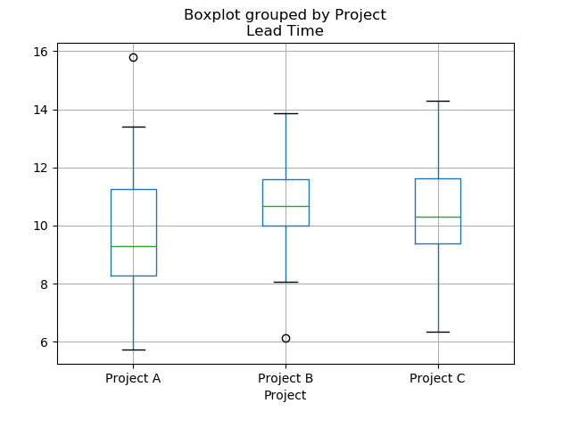
箱线图示例

