Slide 1
EU Vocabularies related to role
Controlled Vocabulary | URL | Included* | Comments
role The Roles Named Authority List (NAL) or authority table is a controlled vocabulary listing the roles relevant for the descriptive metadata used at the Publications Office and the core metadata used in the data exchange between the institutions involved in the legal decision-making process. | https://op.europa.eu/en/web/eu-vocabularies/at-concept-scheme/-/resource/authority/role/?target=Browse&uri=http://publications.europa.eu/resource/authority/role | YES | The only role related to procurement would be ‘SIGN’ (Signatory)
organisation-subrole This table provides the list of the different sub-functions of the organisations in a procurement procedure. | https://op.europa.eu/en/web/eu-vocabularies/at-dataset/-/resource/dataset/organisation-subrole | YES | Defines also ‘signatory’ in the context of procurement.
buyer-legal-type This table provides a list of the the type of procuring authorities within the domain of public procurement according to legislation. | https://op.europa.eu/en/web/eu-vocabularies/at-dataset/-/resource/dataset/buyer-legal-type?target=About | YES | In the taxonomy proposed these codes are located at different levels
Role nature The Role nature NAL provides a list of values used for controlling the attribution of roles. | https://op.europa.eu/en/web/eu-vocabularies/at-dataset/-/resource/dataset/role-nature?target=About |  | It defines only two values: ENTITY and PERSON
Role qualifier This table provides the quality of the interveners at the Court of Justice. | https://op.europa.eu/en/web/eu-vocabularies/at-concept-scheme/-/resource/authority/role-qualifier/?target=Browse&uri=http://publications.europa.eu/resource/authority/role-qualifier |  | The only concept similar to one of ours is ‘team-leader’

Slide 2
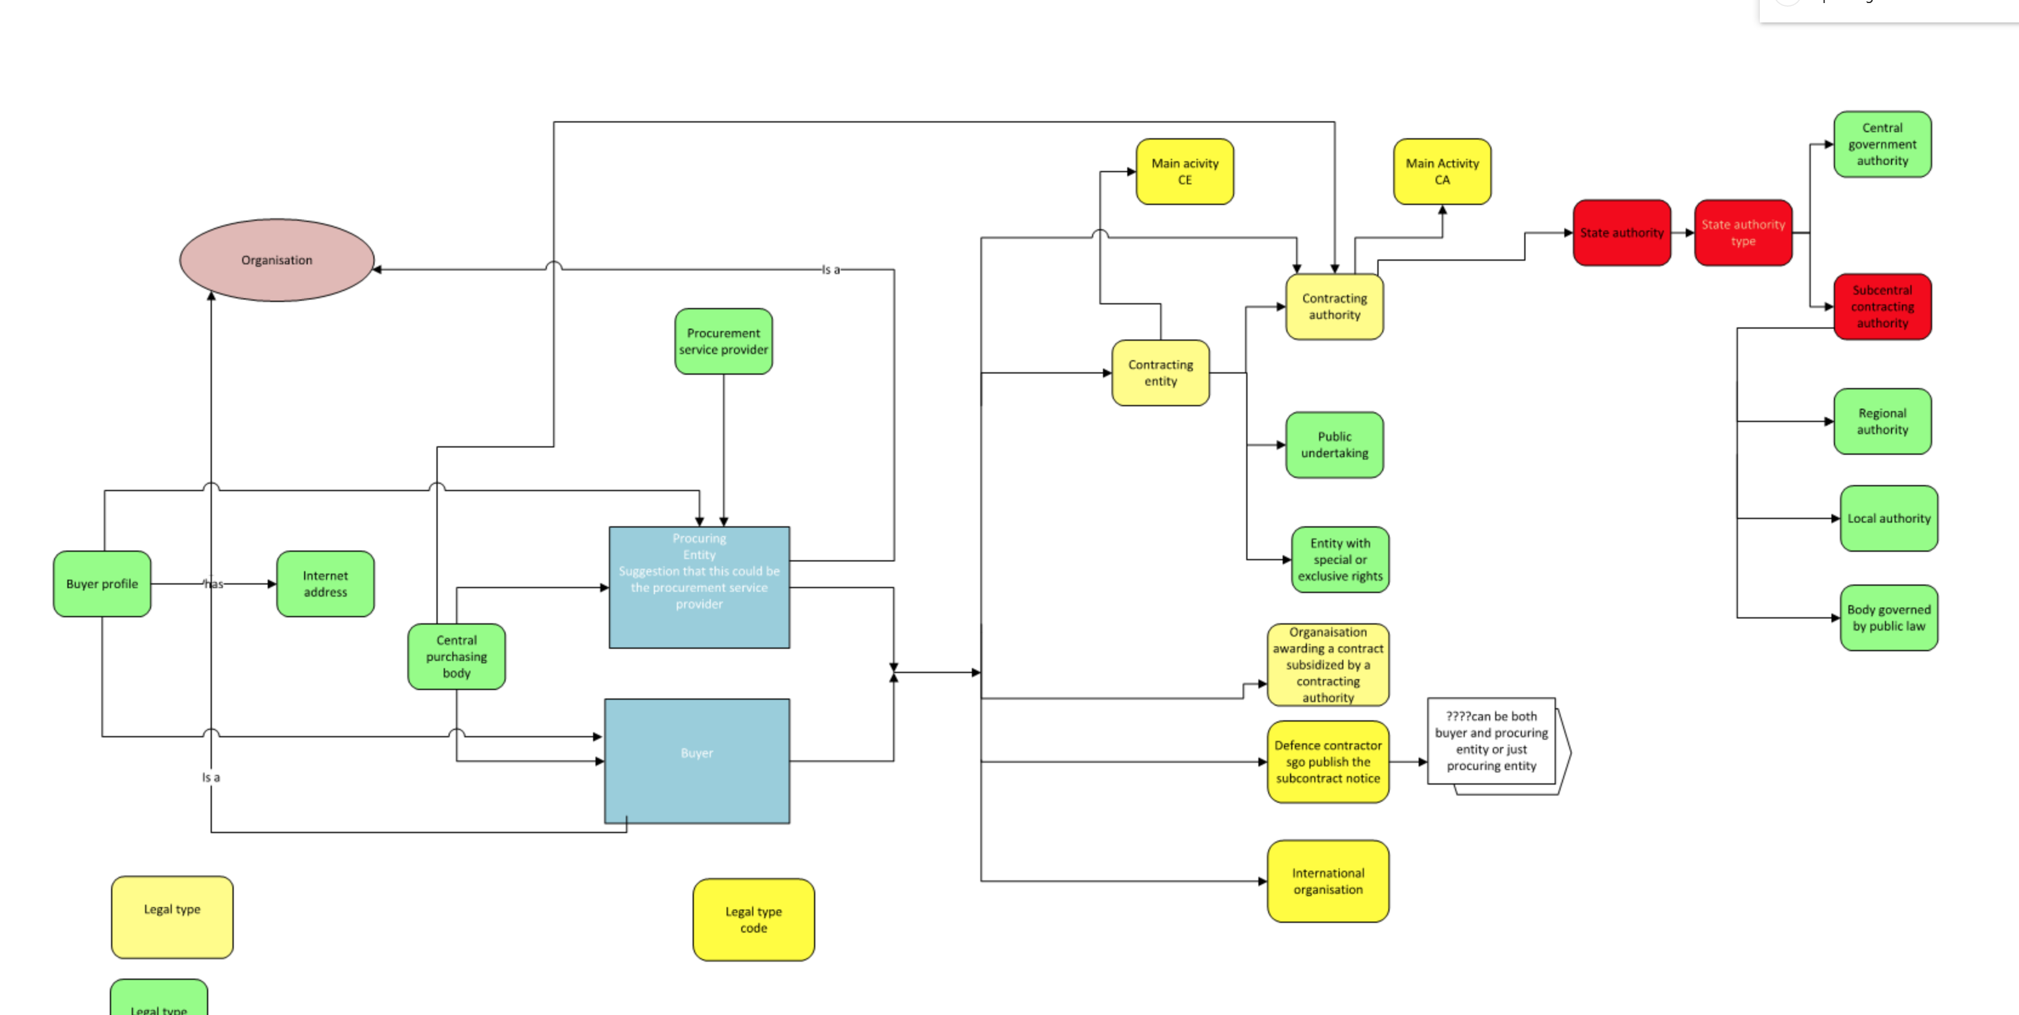
Organisations, Roles and Activities as per the Directives (source: Manuela Cruz and Natalie Muric)

Slide 3
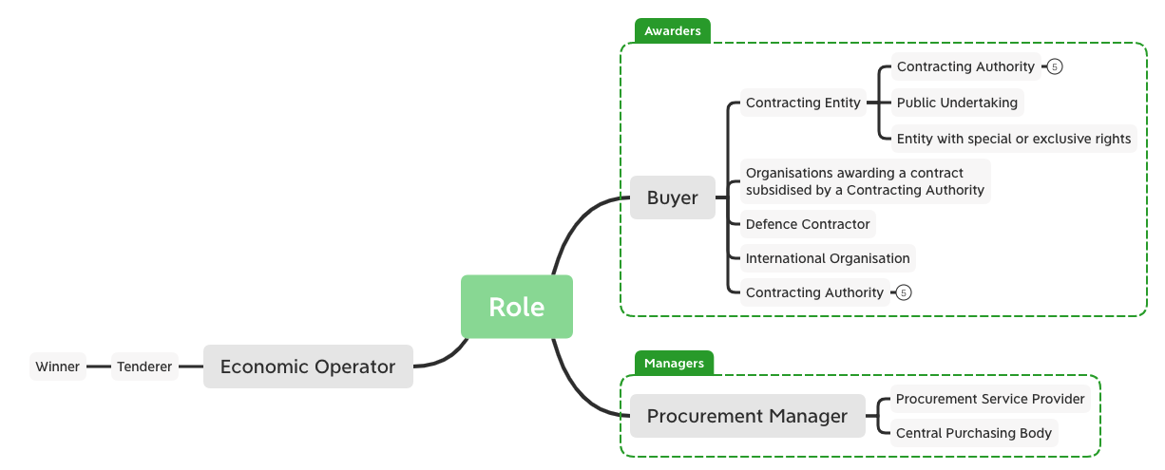

Slide 4
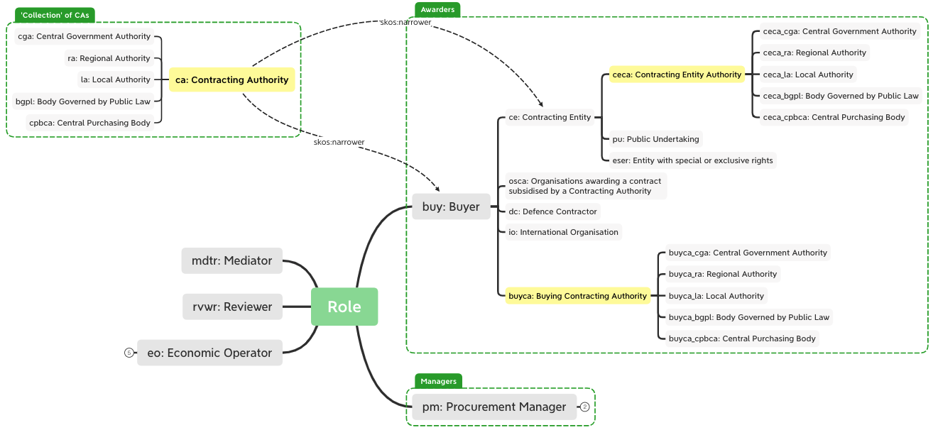
Roles, presented as a taxonomy, according to the previous slide
The relations are all ‘transitive broader/transitive narrower’

Slide 5
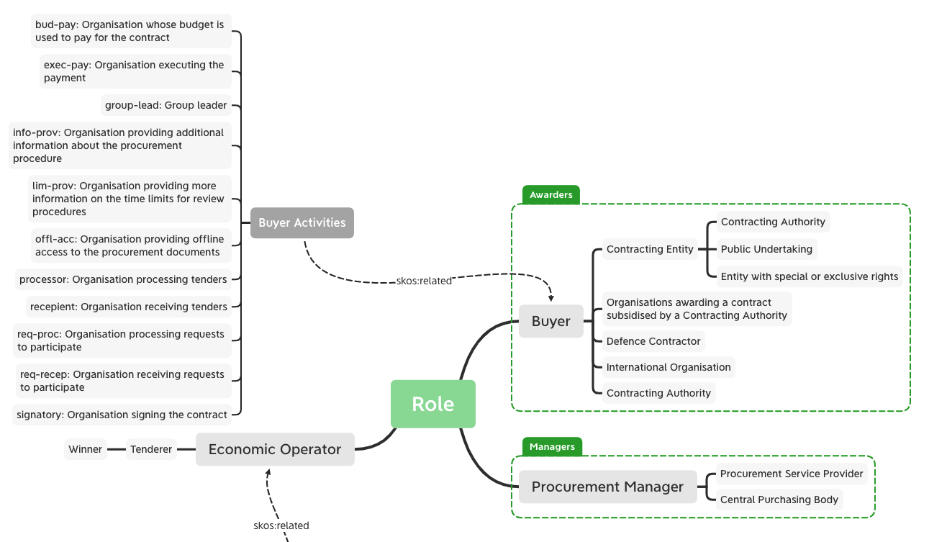
Activities performed by the buyer
The relations are all ‘transitive broader/transitive narrower’

Slide 6
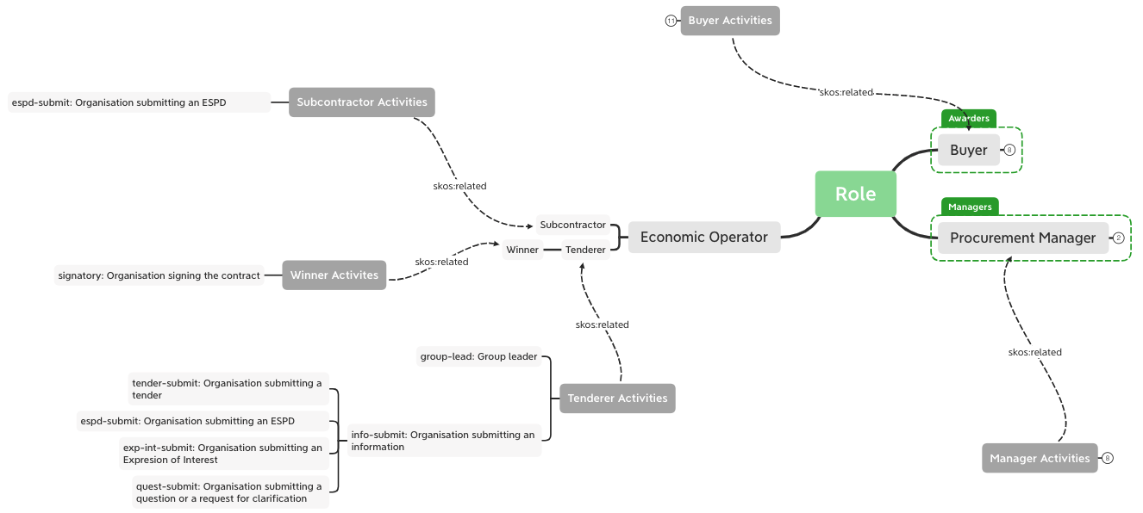
Activities performed by the tenderer, the winner and the subcontractor

Slide 7
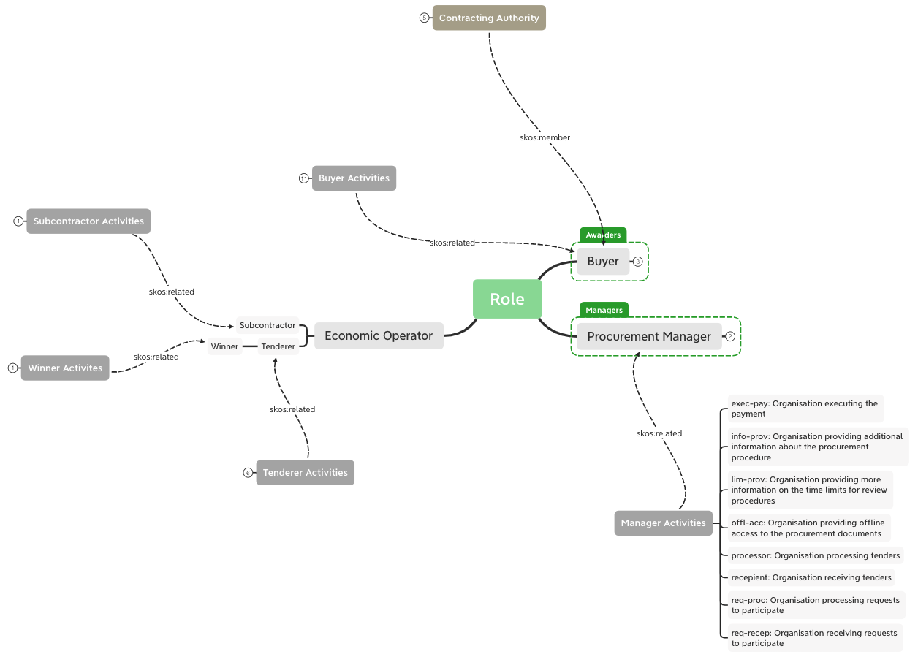
Activities performed by the procurement manager

Slide 8
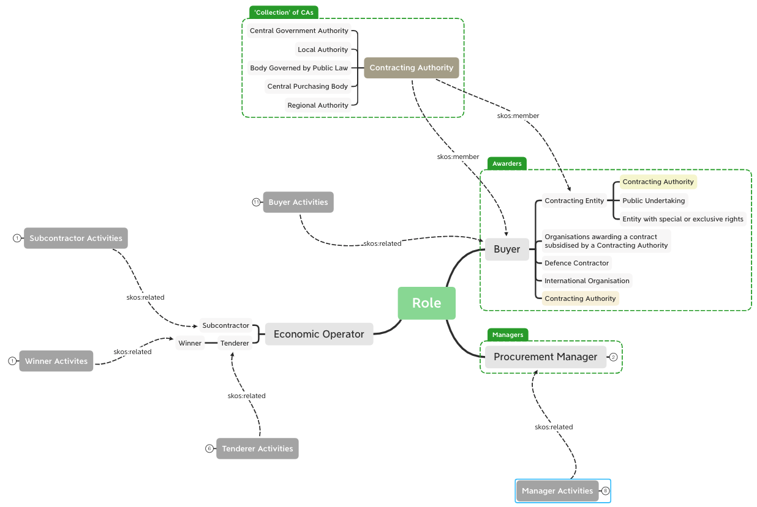
Sub-types of CA

Slide 9
Procedure Event Reification (CHEN E/R View)
In a given Procedure, an Agent performs and action (i.e. a function) related to one or more objects of the procedure (e.g. Lots) when playing one specific Role
Agent
1..*
N:M:X:Y:Z
Procedure Event Reification
RoleTaxonomy
ContactPoint
0..*
0..*
1..*
0..*
Thing
(e.g., Lot)
Period
”rules” are still necessary to control which combinations of subroles and roles are coherent.

