Slide 1
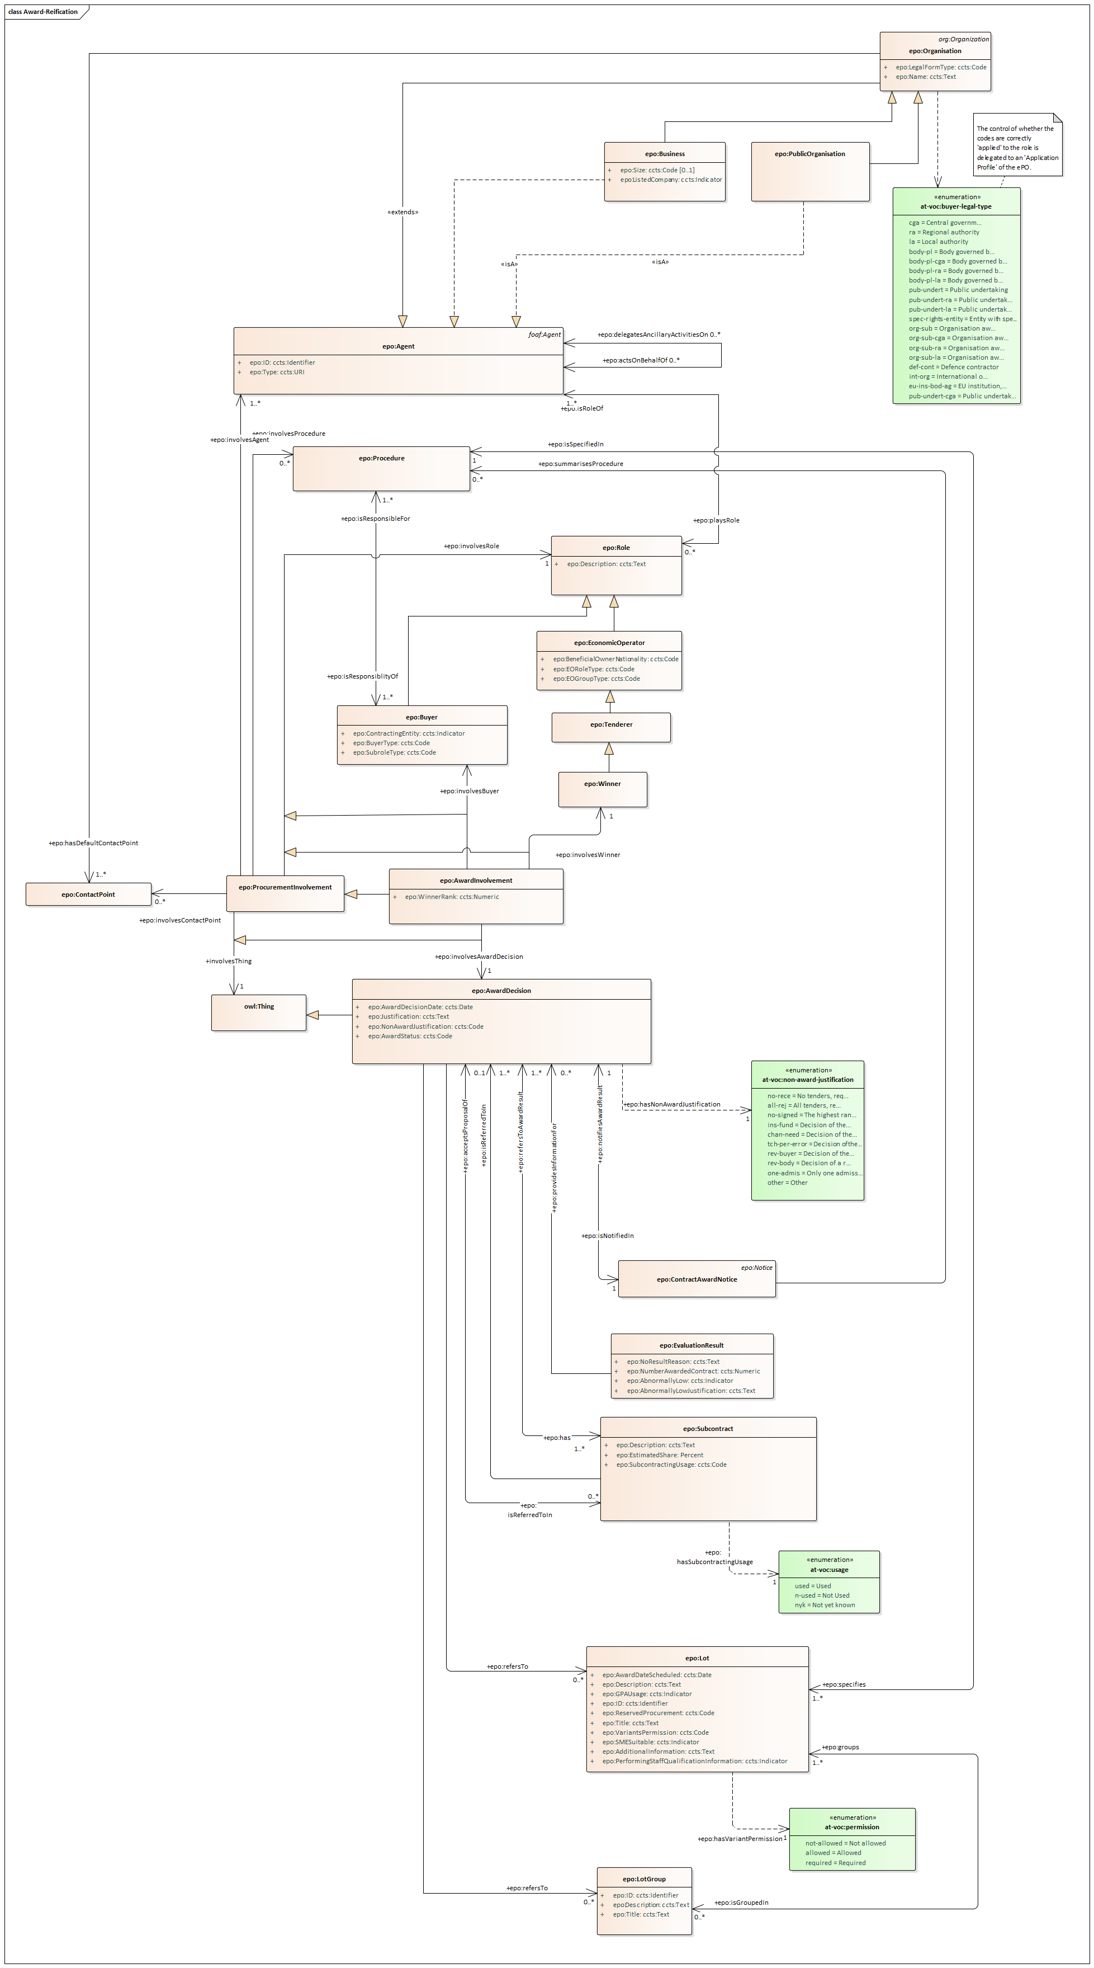
AwardDecisionInvolvement: Roles as Classes (20201013)

Slide 2
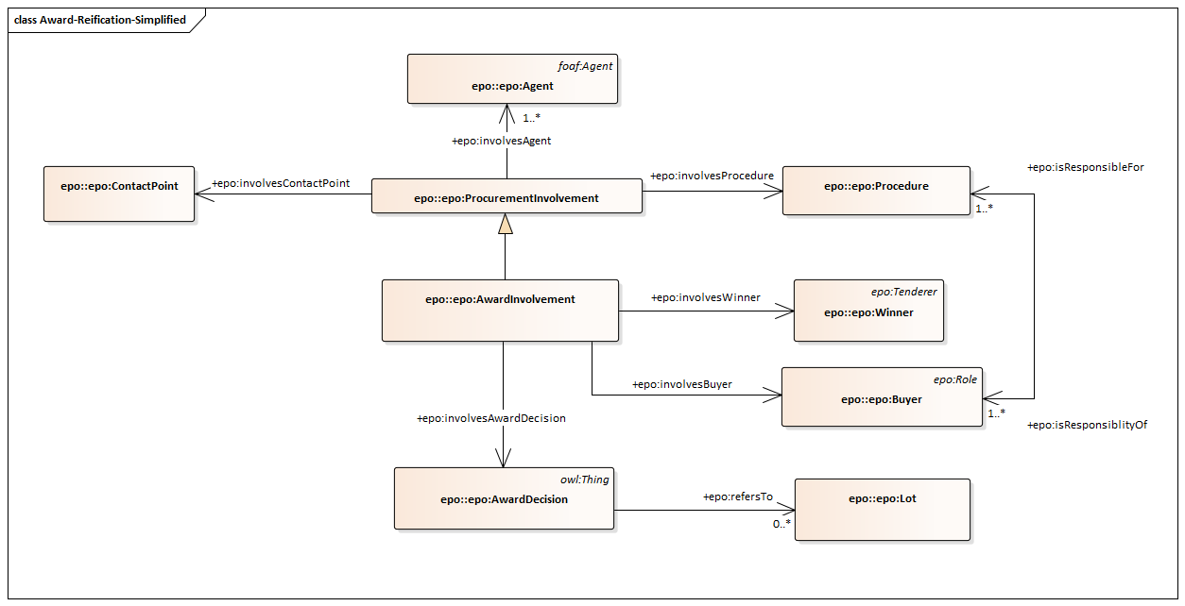
AwardDecisionInvolvement simplified (20201013)
Question: May one AwardDecision refer to different Winners of Different Lots? Or…one winner → one Award Decision?

Slide 3
AwardDecisionInvolvement simplified (20201013)
Question: May one AwardDecision refer to different Winners of Different Lots? Or…one winner → one Award Decision?
1. If one award decision refers only to one winner and one winner, the lots can be accessed based on the predicate ‘AwardDecision refersTo Lot’.
2. If one award decision refers to more than one winner then the Lots need to be referred to by the reification!

Slide 4
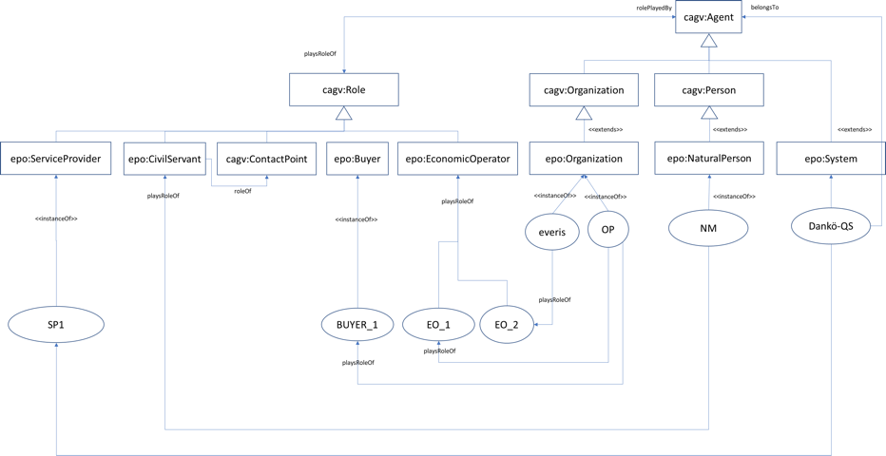
Hierarchy of classes as in v2.0.2 (prior to the ‘role-taxonomy’)

Slide 5
Buyer
Contracting Authority
Contracting Entity
Subsidised Organization
Defence Contractor
International Organization
Contracting Entity Authority
Pubic Undertaking
Special Entity

Slide 6
EU Vocabularies related to role
Controlled Vocabulary | URL | Included* | Comments
role The Roles Named Authority List (NAL) or authority table is a controlled vocabulary listing the roles relevant for the descriptive metadata used at the Publications Office and the core metadata used in the data exchange between the institutions involved in the legal decision-making process. | https://op.europa.eu/en/web/eu-vocabularies/at-concept-scheme/-/resource/authority/role/?target=Browse&uri=http://publications.europa.eu/resource/authority/role | YES | The only role related to procurement would be ‘SIGN’ (Signatory)
organisation-subrole This table provides the list of the different sub-functions of the organisations in a procurement procedure. | https://op.europa.eu/en/web/eu-vocabularies/at-dataset/-/resource/dataset/organisation-subrole | YES | Defines also ‘signatory’ in the context of procurement.
buyer-legal-type This table provides a list of the the type of procuring authorities within the domain of public procurement according to legislation. | https://op.europa.eu/en/web/eu-vocabularies/at-dataset/-/resource/dataset/buyer-legal-type?target=About | YES | Alternative 1: Add this to the taxonomy proposed, but located at different levels Alternative 2: Attach these codes only to Public Organization Attach a LegalForm codelist to Business
Role nature The Role nature NAL provides a list of values used for controlling the attribution of roles. | https://op.europa.eu/en/web/eu-vocabularies/at-dataset/-/resource/dataset/role-nature?target=About |  | It defines only two values: ENTITY and PERSON
Role qualifier This table provides the quality of the interveners at the Court of Justice. | https://op.europa.eu/en/web/eu-vocabularies/at-concept-scheme/-/resource/authority/role-qualifier/?target=Browse&uri=http://publications.europa.eu/resource/authority/role-qualifier |  | The only concept similar to one of ours is ‘team-leader’

Slide 7
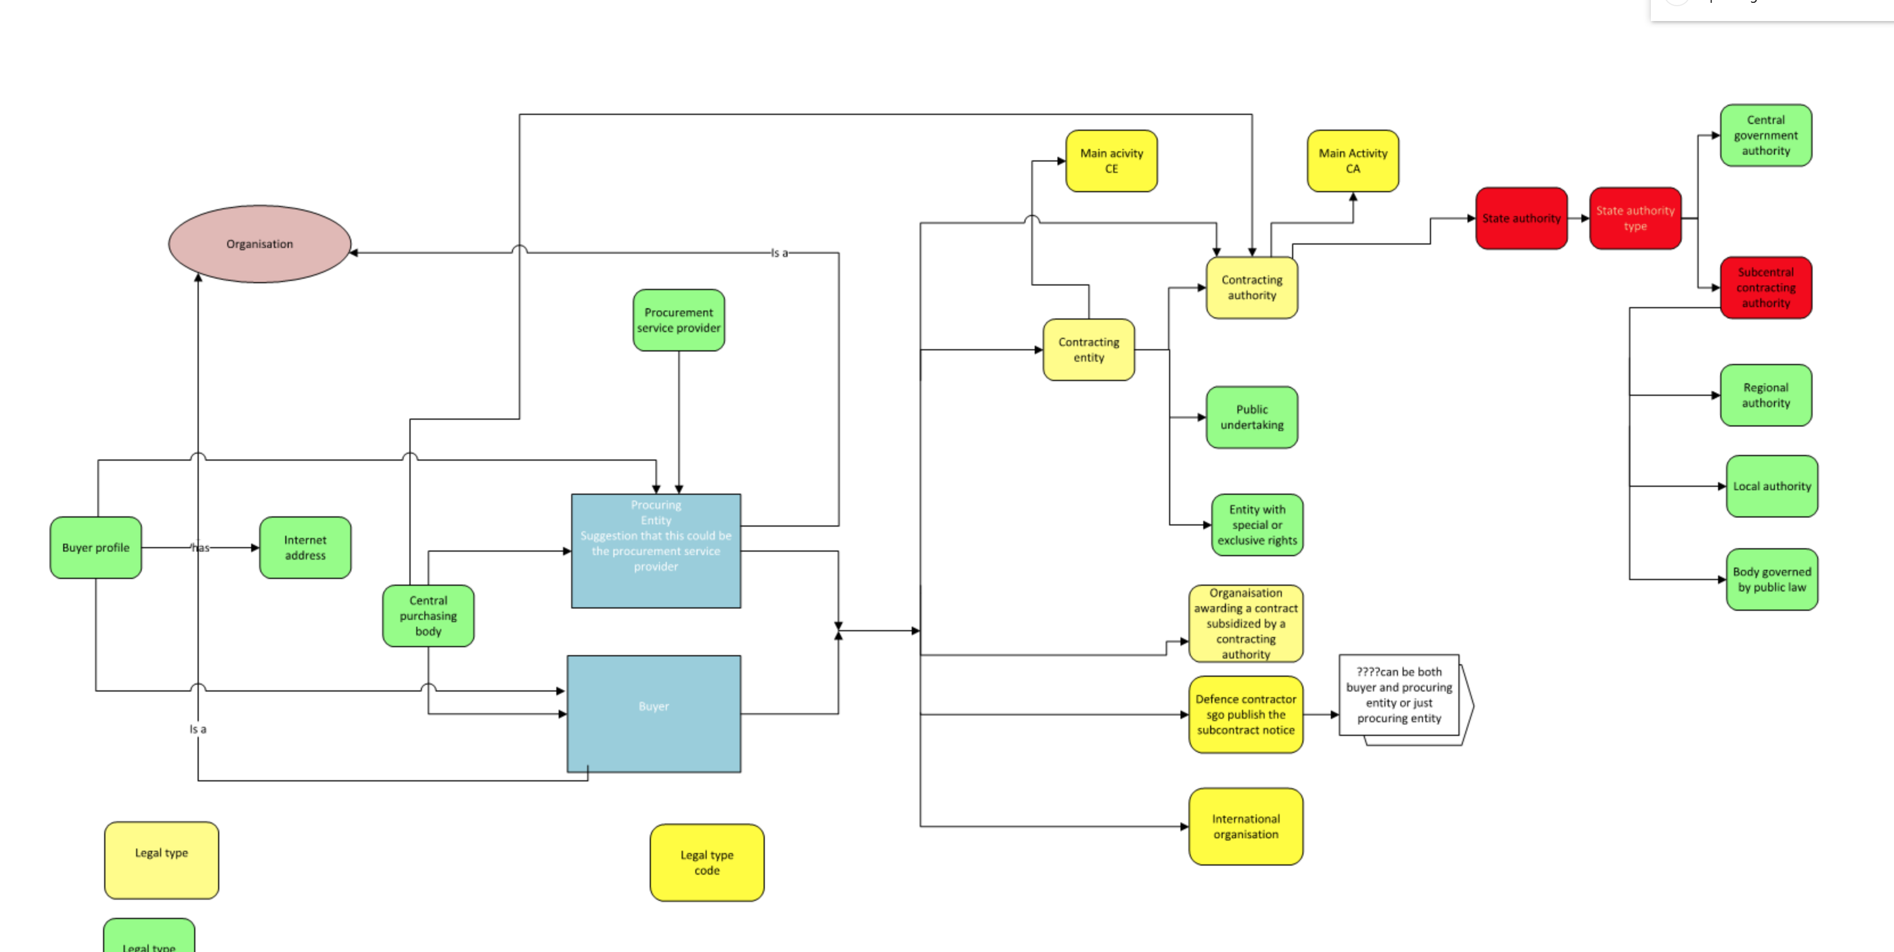
Organisations, Roles and Activities as per the Directives (source: Manuela Cruz and Natalie Muric)c

Slide 8
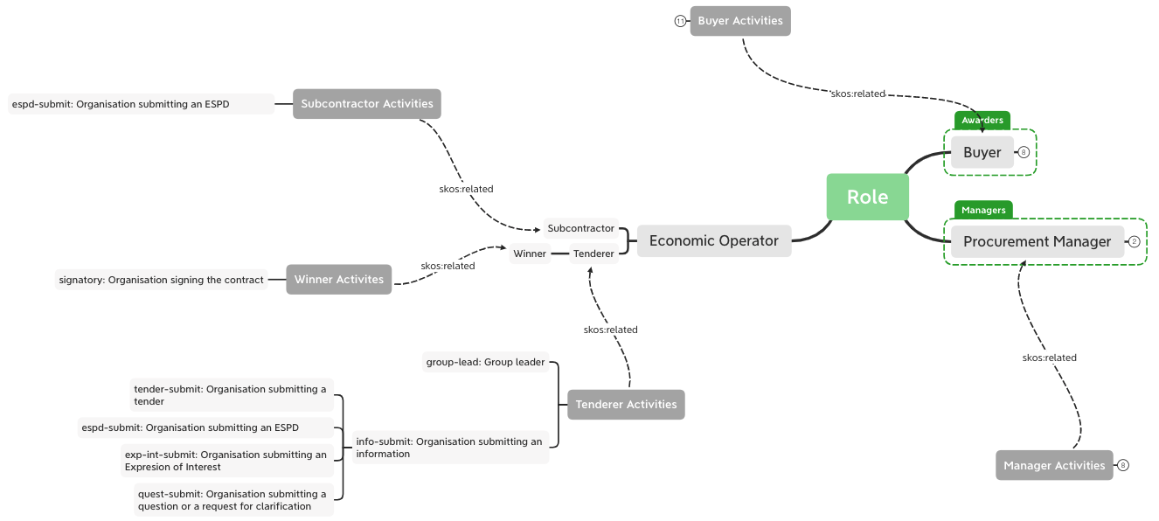
Activities performed by the tenderer, the winner and the subcontractor
(difficult to query, and does not solve all the situations; unless the activities are involved separetly in the reification, which entails specific rules for the association between role and subrole-activity)

Slide 9
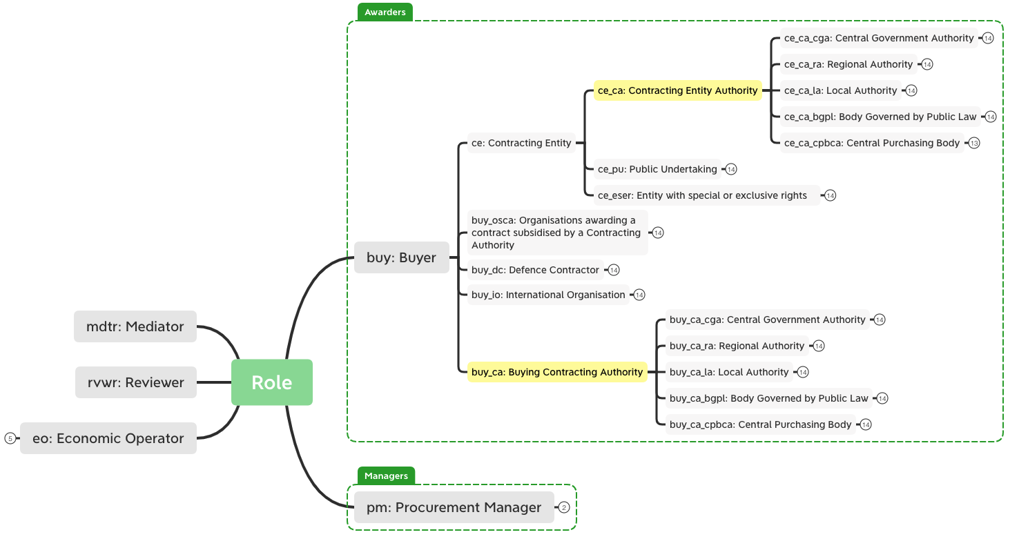
Solution to previous approach: combination of role, organisation-subrole and buyer-legal-type, aligned to precedent Manuela’s and Natalie’s slide (1/2) (Easy to query)
(this approach facilitates greatly the queries, but generates a huge taxonomy, which implies manual maintenance/curation)

Slide 10
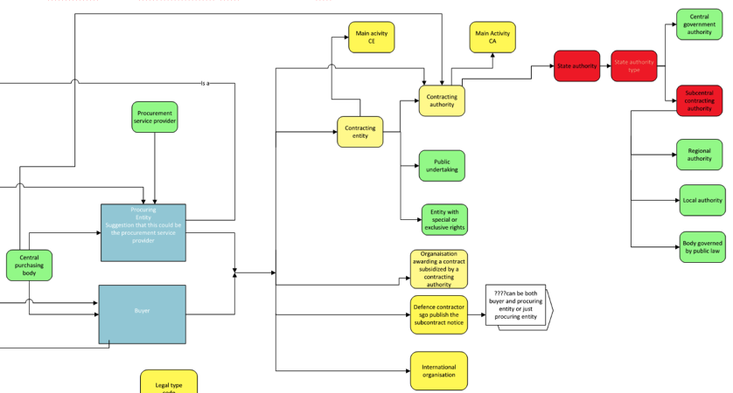
Alignment to the Directives
(this approach is also aligned to the Directives)

Slide 11
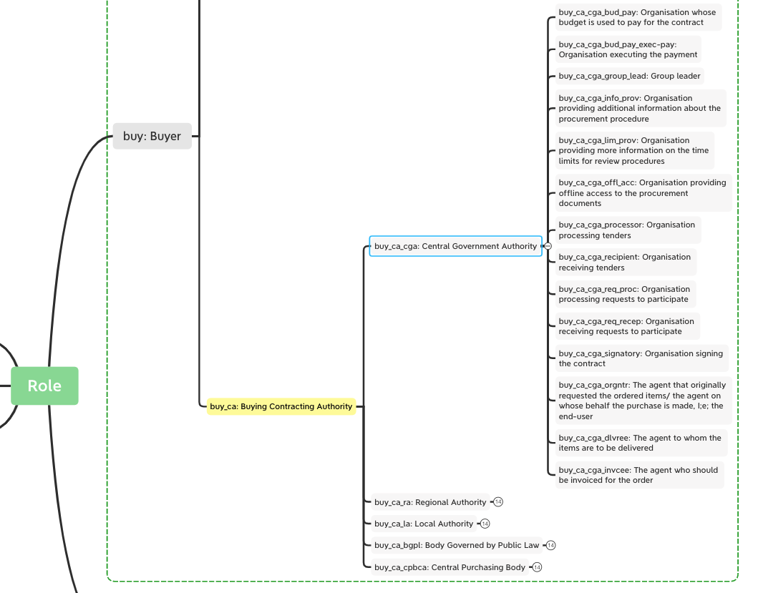
Combination of role, organisation-subrole and buyer-legal-type, aligned to precedent Manuela’s and Natalie’s slide (2/2)

Slide 12
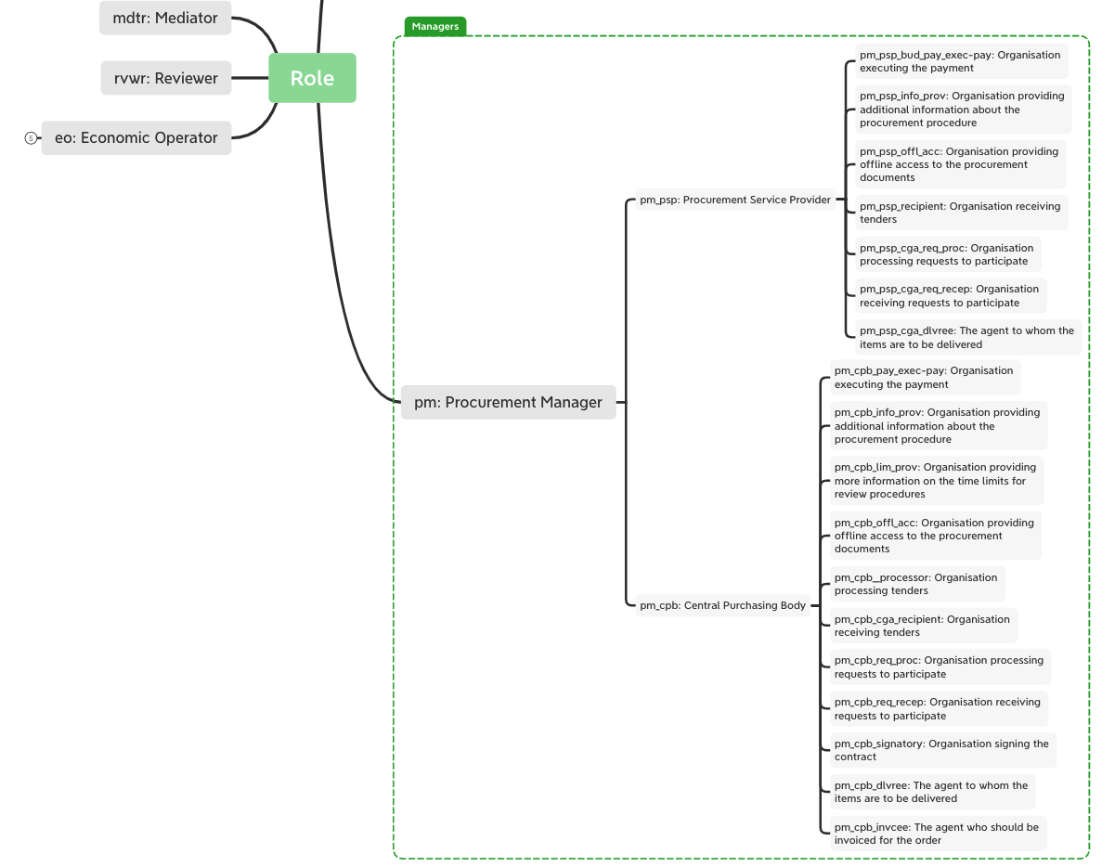
Procurement Managers: PSP and CPB

Slide 13
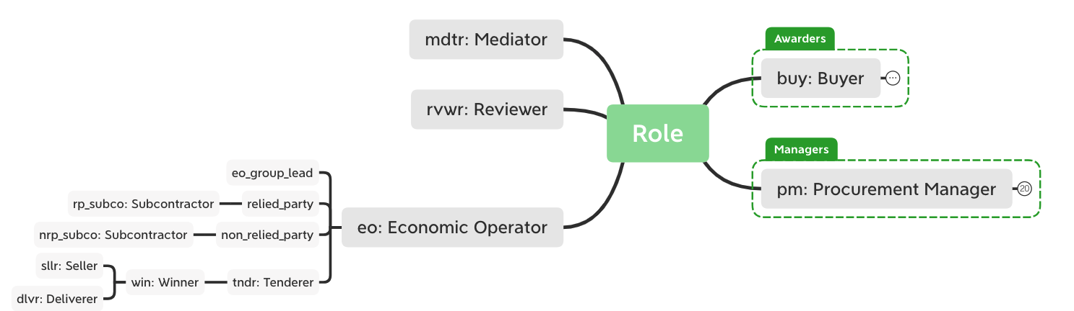
EO roles and subroles

Slide 14
Procurement Event Reification (CHEN E/R View)
In a given Procedure, an Agent performs and action (i.e. a function) related to one or more objects of the procedure (e.g. Lots) when playing one specific Role
Agent
1..*
N:M:X:Y:Z
Procedure Event Reification
RoleTaxonomy
ContactPoint
0..*
0..*
1..*
0..*
Thing
(e.g., Lot)
Period
”rules” are still necessary to control which combinations of subroles and roles are coherent.

Slide 15
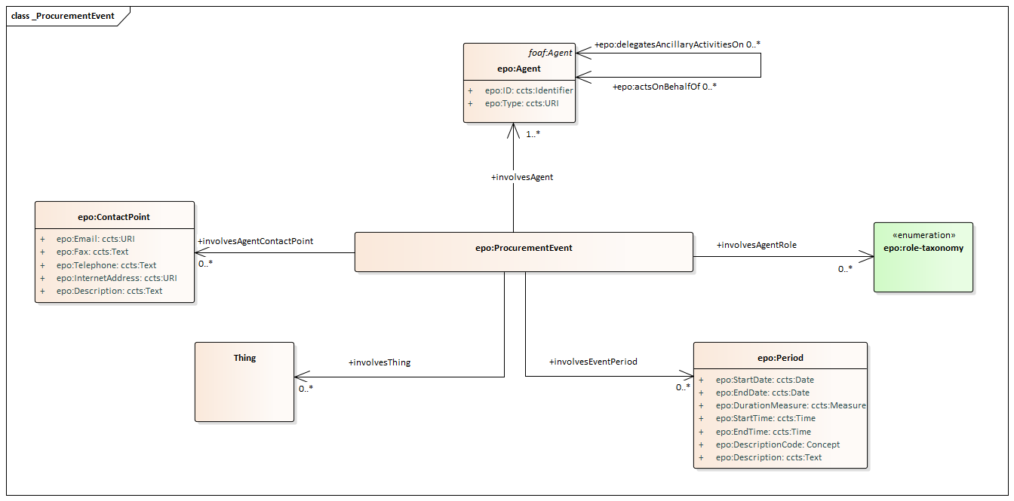
Procurement Event Reification (UML View)
In a given Procedure, an Agent performs and action (i.e. a function) related to one or more objects of the procedure (e.g. Lots) when playing one specific Role
activity

Slide 16
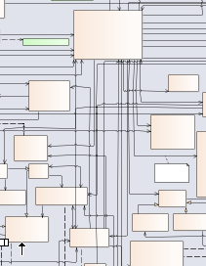
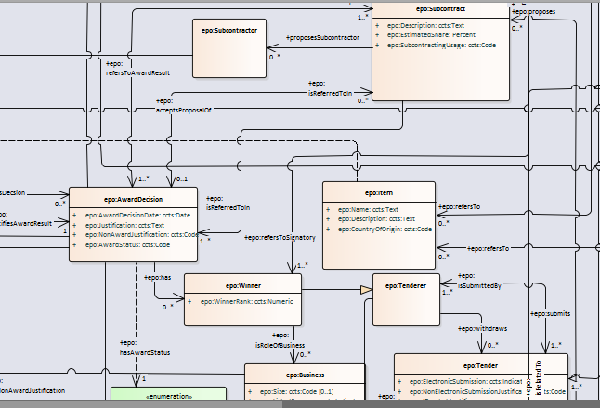
Diagram ‘Results’ (focus on Buyer and Winner + Award Decision + subcontractor)

Slide 17
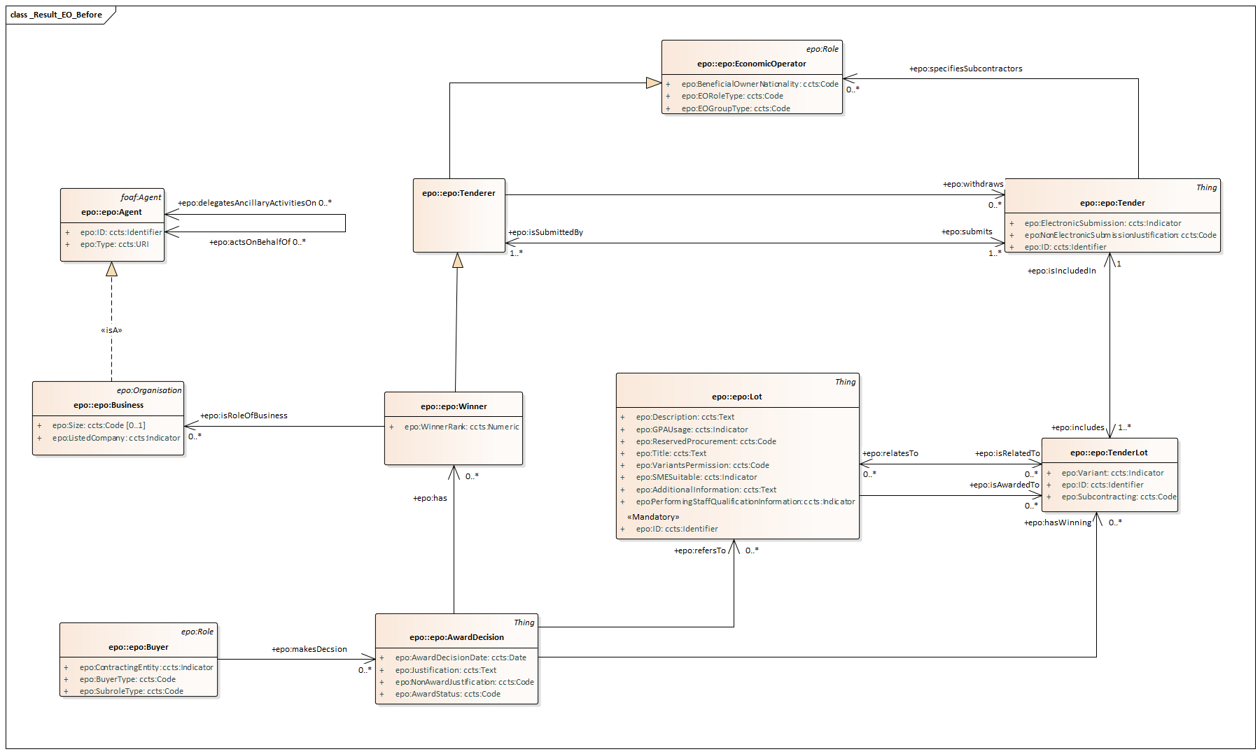
Diagram ‘Result’, before the role-taxonomy (focus on EO, Tenderer, Winner)

Slide 18
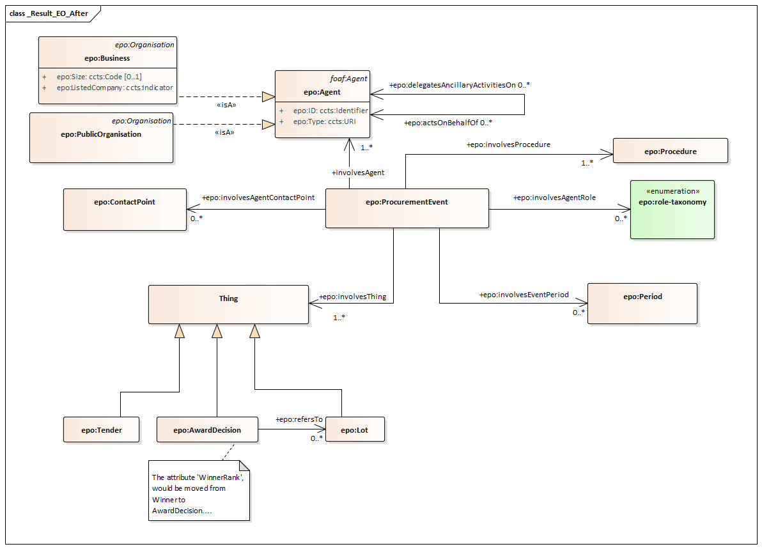
Diagram ‘Result’, using the role-taxonomy (focus on EO, Tenderer, Winner)
activity

Slide 19
We have three things:
1. An organisation
2. Which has one or more Role
3. In a given complex context (Procedure, Lot in the Procedure, in a process
Related to a procedure or a lot of the procedure, etc…
1. Who (agent and result)
2. Does what (activity)
3. Where/When (particular context)
4. …and what are the results?

Slide 20
Procedure 1-Procurement Event 1 (pev1-proc1): Tenderer submits tender related to XML FA the 10th. of Feb. , please contact Xavi
Business
isA
everis
SLU
(legal form)
hasLegalForm
submits
tenderer
involvesAgent
involvedAction
involvesAgentRole
Xavi
involvesAgentContactPoint
Procurement Event 1
involvedProcedure
Procedure
XML FA
involvesThing
involvesPeriod
everis Tender Lot 1 to
XML FA
10/02/2020
involvesThing
involvesThing
everis Tender Lot 3 to XML FA
everis Tender Lot 5 to XML FA

Slide 21
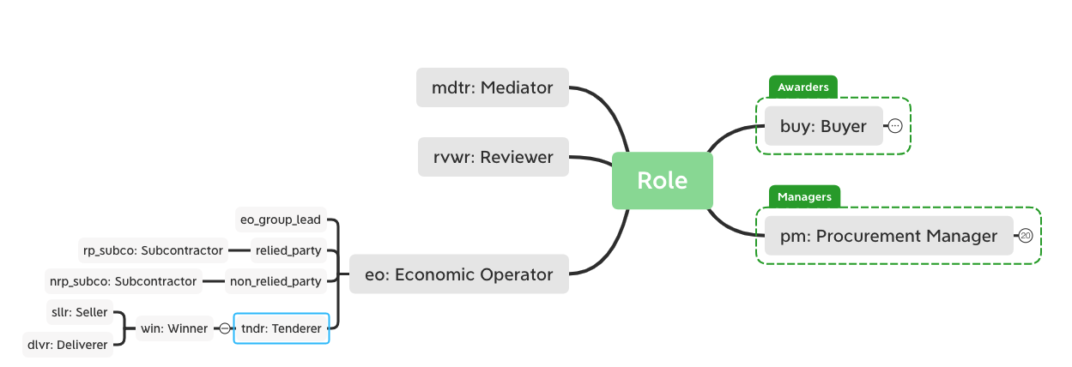
Role ’Tenderer’, the agent that submits a tender

Slide 22
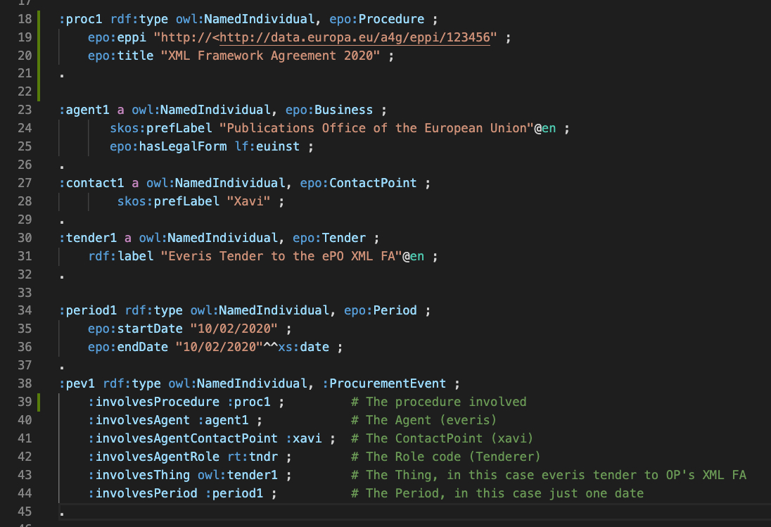
Procurement Event 1 (pev1): Tenderer submits tender related to XML FA the 10th. of Feb. , please contact Xavi

Slide 23
Procedure 1-Procurement Event 2 (pev2-proc1): OP makes award decision on the XML FA the 1st. of Sept. , please contact Natalie
Public Organisation
OP
European Institution
(legal form)
buy_ca
submits
involvedAction
involvesAgentRole
Natalie
Procurement Event 2
XML FA
Award Decision
1/9/2020

Slide 24
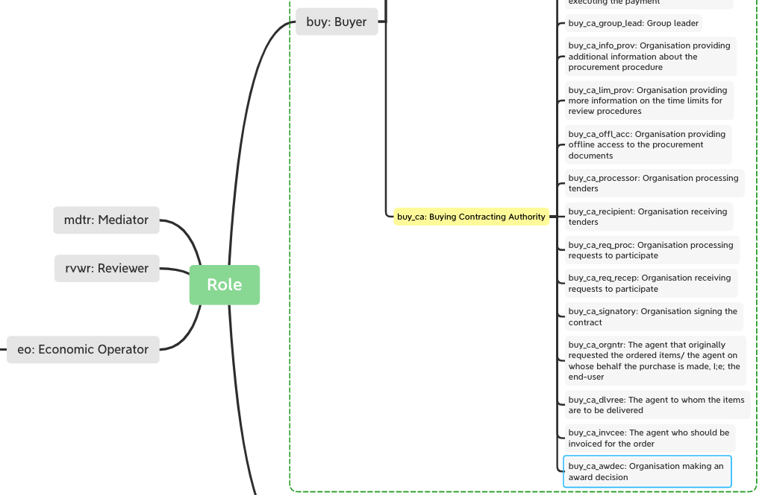
Role ‘awarder’ (buy_ca_awdec): the buying Contracting Authority that makes the award decision

Slide 25
Procedure 1-Procurement Event 3 (pev3-proc1): who will execute the payments for certain Lots for the duration of the FA (as notified in CAN)
Public Organisation
OP
European Institution
(legal form)
Accounting Dpt.
Procurement Event 3
Payment Executor
(role buy_ca_execpay)
Lot 1
Lot 3
Lot 5
2020-2024
optional

Slide 26
Procedure 1-Procurement Event 4 (pev4-proc1): who will execute the payments for Lots 2 and 4 for the duration of the FA (as notified in CAN)
Public Organisation
DIGIT
organisationForm
European Institution
(legal form)
isA
exec_pay
buy_ca
(Buying Contracting Authority)
involvedAgent
involvedAction
involvedRole
Angelo
Procurement Blah 4
involvedProcedure
Procedure
XML FA
involvedContactPoint
involvedThing
involvedThing
involvedPeriod
Lot 2
Lot 4
2020-2024

Slide 27
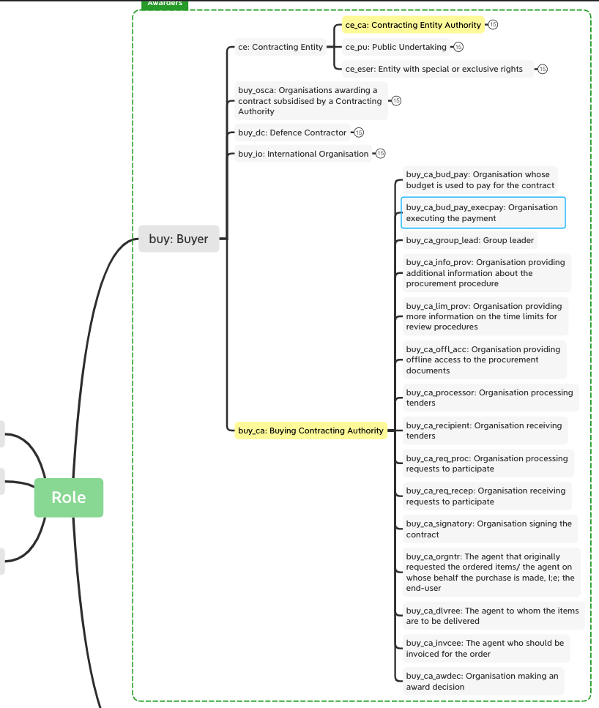
Role payer executor’, the agent that will execute the payment

Slide 28
Procedure 1-Procurement Event 5 (pev5-proc1): everis wins lots 1 and 3
Business
everis
organisationForm
SLU
(legal form)
isA
submitter
winner
involvedAction
involvedRole
Sergi
Procurement BlahBlah 5
Procedure
XML FA
involvedContactPoint
involvedProcedure
involvedThing
involvedThing
involvedPeriod
Lot 1
Lot 3
01/09/2020

Slide 29
Procedure 1-Procurement Event 6 (pev6-proc1): Trasys wins lots 2, 4 and 5
Business
Trasys
Ltd
(legal form)
Procedure
XML FA
Sergi
Procurement Event 6
Winner of…
(role winner)
Lot 2
Lot 4
Lot 5
01/09/2020

Slide 30
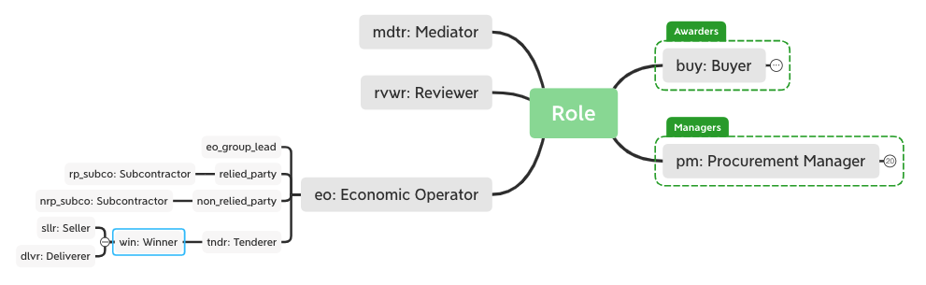
Role ‘winner’ (win): the organisation that has been awarded

Slide 31
Procedure 2-Procurement Event 7 (pev7-proc2): A CPB manages the procurement of a group of buyers (1/2)
Central Government
Public Organization
CONSIP
Procedure
Clean Cars Purchase
Daniel
Procurement Event 7
pm_cpb
(Procurement Manager CPB)
2020-2022

Slide 32
Procedure 2-Procurement Event 8 (pev8-proc2): A group of buyers buy through a CPB (2/2)
Regional Government
Lombardia Gov.
Roma Gov.
Sicilia Gov.
Procedure
Clean Cars Purchase
Daniel
Procurement Event 8
buy_ca
(Role buyer contracting authority)
2020-2022

Slide 33
Procedure 3-Procurement Event 9 (pev9-proc2): A CPB buying and awarding on behalf of a group of buyers (1/3)
Central Government
Public Organization
CONSIP
Procedure
IT Services
Daniel
Procurement Event 9
buy_cpb
(role buyer CPB)
2020-2022

Slide 34
Procedure 3-Procurement Event 10 (pev10-proc2): Authorities buying through CONSIP, which awards the contract (2/3)
Regional Government
Napoli Municipality
Milan Municipality
Trieste Municipality
Procedure
IT Services
Daniel
Procurement Event 10
buy_ca
(Buying Contracting Authority)
2020-2022

Slide 35
Procedure 3-Procurement Event 11 (pev11-proc2): A CPB awarding on behalf of a group of buyers (3/3)
Public Organisation
CONSIP
Central Government
Procedure
IT Services
Daniel
Procurement Event 11
Awarder
(role buy_cpb_awdec)
IT Service
Award Decision
Lot1
(procedure 3)
3/10/2020

Slide 36
Procedure 3-Procurement Event 12 (pev12-proc3): The winner of the Procedure is…
Business
isA
everis Italia
sa
(legal form Società Anonima)
hasLegalForm
Procedure
IT Services
involvesAgent
involvesProcedure
Xavi
involvesAgentContactPoint
Procurement Event 12
winner
(role)
involvesAgentRole
involvesThing
involvesPeriod
Lot 1 to
IT Services
10/02/2020

Slide 37
Competency questions and queries
Story 1: I want to see all the events of one specific procedure (1-alleventsinproc.sparql)
Story 2: I want to see which are the buyers of a procedure managed by CONSIP
Story 3: I want to see the buyers of a Joint procurement
Story 4: I want to see who’s won all the procedures

Slide 38
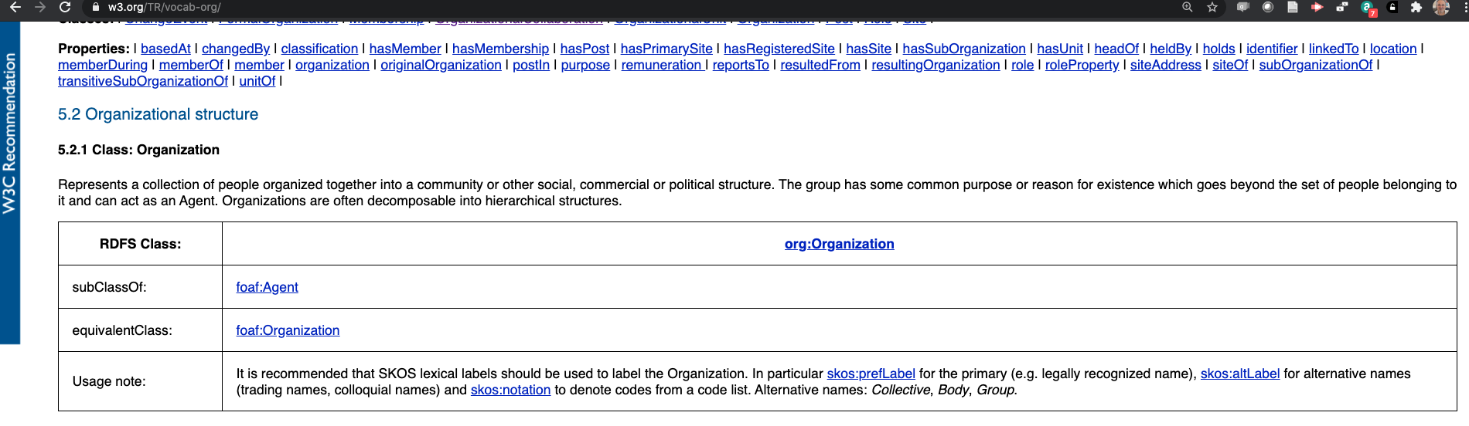
About the name of an Organization

