Slide 1

APIs, REST, JSON and
JavaScript / Node
Day 2
Lucas Jellema
AMIS Talent Launch, September 2017 , AMIS, The Netherlands

Slide 2
Agenda DAY two
Introduction of server side javascript
Working with (JSON) files
Handling http requests
Calling out to backend systems
Implement the self designed api
(Re)implement API against various backends
Publish your API

Slide 3

the HRM API
The
HRM
System
API
SCOTT
EMP/
DEPT

Slide 4



API Implementation
Local files
1
Mock (static response)
2
.json
Local File
.json
3
Call out to external REST API
http
4
Interact with MongoDB
REST API

Slide 5

JavaScript
Notes:
https://www.w3.org/community/webed/wiki/A_Short_History_of_JavaScript

Slide 6
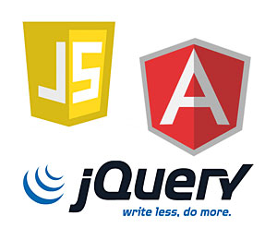

JavaScript in enterprise architecture
DB
Mobile Client
Web Tier
Static file serving
REST APIs
Business Tier
Integration
Orchestration/ BPM
Background Jobs
ERP
Browser
SaaS
External Service
External Service

Slide 7
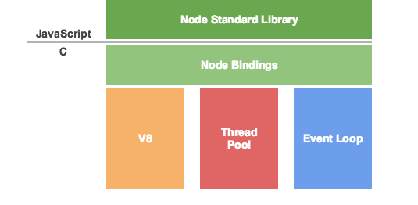

Node.js is like a JS-DK – JavaScript Virtual Machine
Custom Node.js app
Custom Node.js app
Custom Node.js app
machine code
Notes:
See: http://khan.io/2015/02/25/the-event-loop-and-non-blocking-io-in-node-js/

Slide 8
Brief History of Node.js
2009 – unveiled by Ryan Dahl, written on Linux, leveraging Google V8
2010
Initial release of express – the default web application server framework
2011
package manager npm introduced – to publish and share open-source Node.js libraries and simplify installation, updating and uninstallation of libraries
Native Windows implementation of Node.js released
2011-2015 Many Cloud Platforms supporting Node.js
Heroku, Joyent, Cloud Foundry, Nodester, NodeJitsu, Microsoft Azure, IBM BlueMix, Google AppEngine, AWS, …
Notes:
https://github.com/oracle/node-oracledb

Slide 9
Brief History of Node.js
2015
Various forks brought back together: Node v4.0 including V8 with ES6 features
Open Source under Governance by the Node.js Foundation under Linux Foundation
Support for ARM processors
Oracle releases node-oracledb Database Driver for Node.js
2016/2017
Node is gradually becoming the new denominator (taking over from Node.JS)
Major steps in JavaScript (ES6)
More Tool support for Node
Node one of primary technologies for Serverless Computing (e.g. AWS Lambda) as well as for microservices
Rapid evolution of Node releases
Current release: 6.10.3 (LTS) and 7.4.0 (Current)
Notes:
https://github.com/oracle/node-oracledb

Slide 10

Hello World
// my first Node.js program
console.log("Hello World!");

Slide 11

Hello World – using a function
function greeting() {
console.log("Hello World!");
}
greeting();

Slide 12

Hello World – read commandline arguments
function greeting(greetedPerson) {
console.log("Hello "+ greetedPerson + "!");
}
// assume command line: node hello-world-3.js someName
var greetee = process.argv[2];
greeting(greetee);

Slide 13

Hello World – pass around a function reference
var g = function greeting(greetedPerson) {
console.log("Hello "+ greetedPerson + "!");
}
var greetee = process.argv[2];
g(greetee);

Slide 14

Hello World – have one function execute [a reference to ] another
var g = function greeting(greetedPerson) {
console.log("Hello "+ greetedPerson + "!");
}
var greetee = process.argv[2];
function reception( greetFunction, greetee) {
greetFunction(greetee); // execute the passed in function
}
reception(g, greetee);

Slide 15
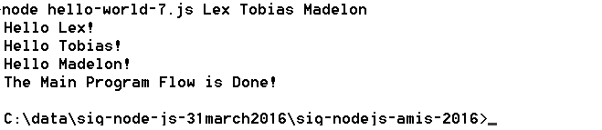
Hello World – callback functions and time outs – no state yet
// callback functions used with timeout
var g = function (greetedPerson) {
console.log("Hello "+ greetedPerson + "!");
}
var r = function ( greetFunction, greetee) {
greetFunction(greetee);
}
for (var i=2;i<process.argv.length;i++) {
setTimeout( r(g, process.argv[i]), i*1500);
}
console.log('The Main Program Flow is Done!');

Slide 16
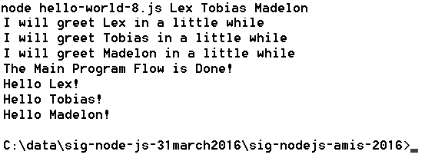
Hello World – closures with state executed on time out
var g = function (greetedPerson) {
console.log("Hello "+ greetedPerson + "!");
}
function getGreeter ( greetee, greetFunction) {
console.log('I will greet '+ greetee + ' in a little while');
return function () { greetFunction(greetee)}; // the closure }
for (var i=2;i<process.argv.length;i++) {
setTimeout( getGreeter( process.argv[i], g), i*1500);
}
console.log('The Main Program Flow is Done!');

Slide 17
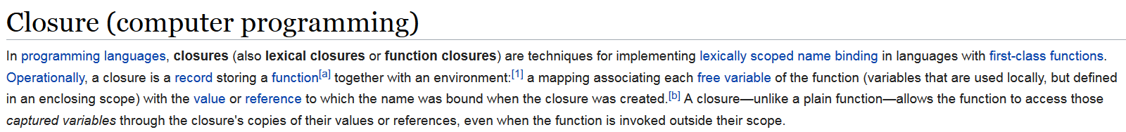
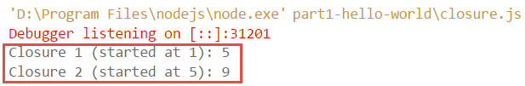
Closure
function startAt(x) {
function incrementBy(y) {
return x + y;
}
return incrementBy
}
closure1 = startAt(1);
closure2 = startAt(5);
console.log( "Closure 1 (started at 1): "+ closure1(4));
console.log( "Closure 2 (started at 5): "+ closure2(4));
Closure
(function to execute with context to execute in)

Slide 18
Modules
Node programs can be organized in modules
A module is file that exports a scope that may contain (public) functions and shared objects
Modules are ‘imported’ through the require function
Add a line such as var localRef = require(‘moduleName’); in a file to get access at runtime to all the goodies from the module
Node ships with a set of core modules that can be required into any program – without additional installation or configuration; for example:
fs: file system operations
path: string transformations around file system operations
os: access to some operating systems details
util: utility functions, for example util.log to log messages to console with timestamp
http: for HTTP protocol based network operations

Slide 19
File manipulation from Node.js - using core module fs
//write a file with all command line arguments on separate lines
var fs = require('fs')
, util = require('util');
process.argv.slice(2).forEach(function (val) {
fs.appendFileSync("./output.txt", val + "\n");
});
util.log('The Main Program Flow is Done!');

Slide 20
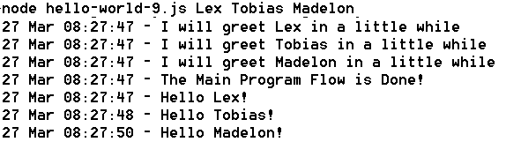
Hello World – using core module util
var util = require('util');
var g = function (greetedPerson) {
util.log(util.format('Hello %s!', greetedPerson));
}
function getGreeter ( greetee, greetFunction) {
var toGreet = greetee;
util.log( util.format('I will greet %s in a little while', toGreet));
return function () { greetFunction(toGreet)};
}
process.argv.slice(2).forEach(function (val, index, array) {
setTimeout( getGreeter(val, g), index*1500);
});
util.log('The Main Program Flow is Done!');

Slide 21
Custom module greeter-module exposing reusable functions
var greeter = module.exports;
greeter.g = function (greetedPersoon) {
console.log("Hello " + greetedPersoon + "!");
localPrivateFunction();
}
greeter.getGreeter = function (greetee, greetFunction) {
console.log('I will greet ' + greetee + ' in a little while');
return function () { greetFunction(greetee) };
}
function localPrivateFunction() {
// this function does nothing useful and is not accessible outside this module
console.log('localPrivateFunction: Only local calls (from inside the module).');
}

Slide 22
Leverage Custom module greeter-module exposing reusable functions
var greeter = require("./greeter-module.js");
var args = process.argv.slice(2); // loose first two elements
// loop over all command line arguments passed into this program
// and execute anonymous function on each argument
args.forEach(function (val, index, array) {
setTimeout( greeter.getGreeter(val, greeter.g), index*1500);
});
console.log('The Main Program Flow is Done!');

Slide 23
Packages
A package is a bundle of resources that supports development of a node application
Design time (test, code analyze, format, browserify, package, …)
Run time
A package can contain one or more modules that may or may not be intended to be ‘required’ into a node application
Packages are [downloaded and] added to the source folders of a node application
Package management can be tricky
An application can depend on multiple packages
Packages can depend on multiple [versions of] packages themselves
Gathering and keeping up to date all compatible versions of all required packages is potentially complex, time consuming and error prone
Enter: npm
and package.json – the closest thing to a pom-file

Slide 24
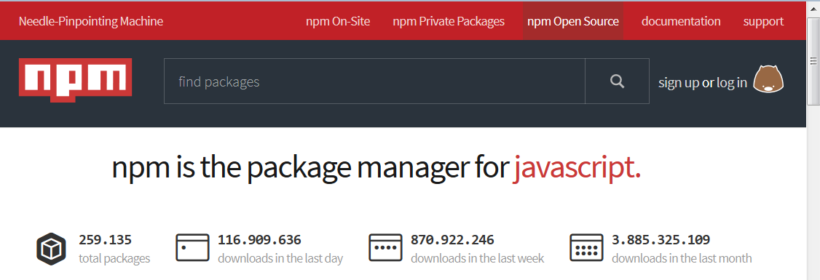
Reusing node modules
“So that's what npm is. It's a way to reuse code from other developers, and also a way to share your code with them, and it makes it easy to manage the different versions of code.”
www.npmjs.org

Slide 25
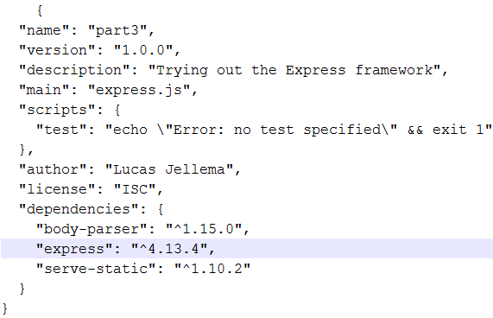
npm
Bring in a package to your current application
npm install <package name> The package is downloaded and installed in folder node_modules
Create a new application with a neat description
npm init This will create a package.json file that describes the [Node.js] application and its dependencies
Use
npm install <package name> --save To have dependencies on the package added to the package,json file
npm install To have all packages listed in package.json installed or updated into the node_modules folder

Slide 26
Lab 6
Getting started with Node

Slide 27
Node.js can handle incoming HTTP requests
Similar to a Java Servlet or PHP page, a Node.js application can contain logic to interpret and respond to an HTTP request
Web Tier
Static file serving
REST APIs
Browser
http request
Any other HTTP client

Slide 28
Core Modules for (inbound & outbound) networking: http, https, net, dgram
No separate installation required (included with core Node.js)
Handle incoming request and/or make outbound request
Handle URL (path, query parameters, post payload or Form encoding or file upload)
Handle headers, encoding, compression, …
Web Tier
http(s) request
http(s) request

Slide 29

Simplest form of HTTP handling
// invoke from browser or using curl: curl http://127.0.0.1:3000
var http = require('http');
var server = http.createServer(function handleRequest(req, res) {
res.write('Hello World!');
res.end();
}).listen(3000);
console.log('server running on port 3000');
Web Tier
http(s) request

Slide 30

Interpret request and respond appropriately
// invoke: curl http://127.0.0.1:3000/do/me/a/resource?name=Lex
var http = require('http')
, url = require('url') ;
var server = http.createServer(function handleRequest(req, res) {
console.log('URL '+ req.url);
var queryObject = url.parse(req.url,true).query;
var name = queryObject.name;
console.log('path: '+url.parse(req.url).pathname);
console.log('queryObject: '+JSON.stringify(queryObject));
res.write('Hello '+ name + '!');
res.end();
}).listen(3000);
Web Tier
http(s) request

Slide 31
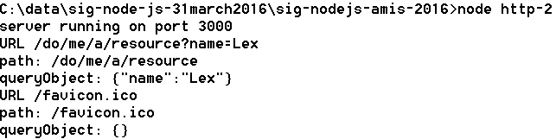
Interpret request and respond appropriately
// invoke: curl http://127.0.0.1:3000/do/me/a/resource?name=Lex
var http = require('http')
, url = require('url') ;
var server = http.createServer(function handleRequest(req, res) {
console.log('URL '+ req.url);
var queryObject = url.parse(req.url,true).query;
var name = queryObject.name;
console.log('path: '+url.parse(req.url).pathname);
console.log('queryObject: '+JSON.stringify(queryObject));
res.write('Hello '+ name + '!');
res.end();
}).listen(3000);
Web Tier
http(s) request

Slide 32
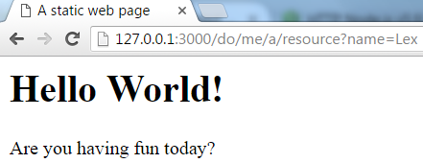
Static File Serving
// serve static file: /public/index.html
var http = require('http')
, fs= require('fs');
var server = http.createServer(function handleRequest(req, res) {
res.writeHead(200, { 'content-type': 'text/html' });
fs.createReadStream('./public/index.html').pipe(res);
}).listen(3000);
console.log('server running on port 3000');
Web Tier
http(s) request
Local file system
index.html

Slide 33
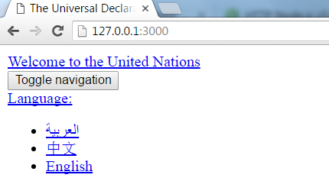

Remote Resource Serving – http in and http out
var http = require('http');
var options = {
host: 'www.un.org', path: '/en/universal-declaration-human-rights/' };
var server = http.createServer(function handleRequest(req, res) {
res.writeHead(200, { 'content-type': 'text/html' });
http.get(options, function handleRemoteResponse(resp) {
var body="";
resp.on("data", function(chunk) { //response returned in chunks
body = body+chunk;
});
resp.on("end", function() { //when response is complete, pass it on
res.end(body);
});
}).on('error', function(e) {
console.log("Got error: "+ e.message);
});
}).listen(3000);
Remote Website
http
request

Slide 34

Express web application framework
Fast, unopinionated, minimalist web framework for Node.js
Framework on top of core Node.js top facilitate incoming HTTP requests
“Express provides a thin layer of fundamental web application features, without obscuring Node.js features that you know and love.”
Convenient for
Web Server for static files
API implementation (REST)
Any incoming HTTP request handling
Express is distributed as npm package
npm install express

Slide 35
Express - Simplest form of HTTP handling
// invoke from browser or using curl: curl http://127.0.0.1:3000
var express = require('express')
, http = require('http');
var app = express()
.use(function (req, res, next) {
res.end('Hello World!');
});
// Create HTTP server with Express app as the request listener
http.createServer(app)
.listen(3000);
Web Tier
http(s) request

Slide 36
Express – Even simpler form of HTTP handling (or at least simpler code)
// invoke from browser or using curl: curl http://127.0.0.1:3000
var express = require('express');
express().use(function (req, res, next) {
res.end('Hello World!');
}).listen(3000);
console.log('server running on port 3000');
Web Tier
http(s) request

Slide 37

Static File Serving
// static file server for all resources in public and below
// will server public/index.html when invoked at http://127.0.0.1:3000
var express = require('express'); //npm install express
express().use(express.static(__dirname + '/public'))
.listen(3000);
console.log('server running on port 3000');
Integration Tier
Local file system
http(s) request
index.html
image.jpg
some-pdf.pdf

Slide 38

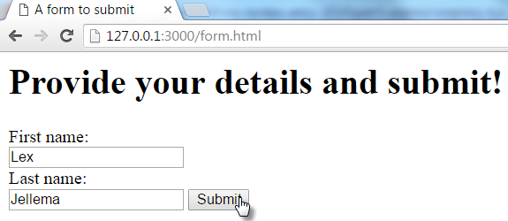
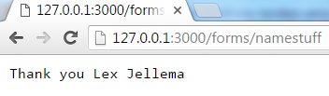
Handling Form Submit and other HTTP POST requests
// static file server for all resources in public and below
// AND handle forms submission to path /forms/...
var express = require('express'); //npm install express
var bodyParser = require('body-parser'); // npm install body-parser
var app = express()
.use(bodyParser.urlencoded({ extended: true}))
.post('/forms/*', function (req, res) { //process
console.log(JSON.stringify(req.body));
res.end('Thank you '+ req.body.firstname +' '+req.body.lastname);
})
.use(express.static(__dirname + '/public'))
.listen(3000);
Integration Tier
Local file system
POST request

Slide 39
Handling REST GET requests
var express = require('express'), fs = require('fs');
var departments= JSON.parse(fs.readFileSync('departments.json', 'utf8'));
var app = express()
.get('/departments/:departmentId', function (req, res) {
var department = getDepartment(req.params['departmentId']);
console.log(JSON.stringify(department));
res.send( department);
})
.get('/departments', function (req, res) {
res.send( departments);
})
.use(express.static(__dirname + '/public'))
.listen(3000);
function getDepartment(depIdentifier) {
for (var i=0; i< departments.length; i++) {
if (departments[i].DEPARTMENT_ID == deptIdentifier) {
return departments[i];
}//if
}//for
}// getDepartment
Integration Tier
Local file system
GET request
departments .json

Slide 40
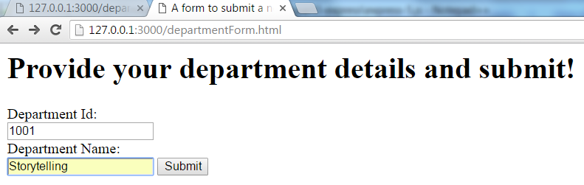
Handling REST GET & Form POST requests
var express = require('express'),bodyParser = require('body-parser') , fs = require('fs');
var app = express()
.use(bodyParser.urlencoded({ extended: true}))
.post('/forms/department', function (req, res) { //process
console.log(JSON.stringify(req.body));
departments.push( {"DEPARTMENT_ID":req.body.departmentId ,"DEPARTMENT_NAME":req.body.departmentName}); res.end('Thank you for the new department '+ req.body.departmentId+" "+req.body.departmentName);
}) .get('/departments/:departmentId', function (req, res) {
…
.listen(3000);
Integration Tier
Local file system
GET request
Form Submit
departments .json

Slide 41
Lab 7 & 8
Handling HTTP Requests (without and with Express)

Slide 42

Single thread heavy on Callbacks
Warehouse
shopping area
cash registers
waiting area
desk to collect
large pieces
Only a single desk to handle all customers who want to have stuff from the warehouse brought to them – compare with over a dozen cash registers
Exit

Slide 43
Asynchronously assembling the HTTP response
Receive HTTP request
Possibly leverage cookie to re-establish state/context
Set work in motion to collect data (remote API call, DB call) and register callback – with original request scope
Stop processing, vanish, release resources
When callback is invoked, use response to construct the response
Complete and send the response
Callback == Closure
(function to execute with context to execute in)

Slide 44
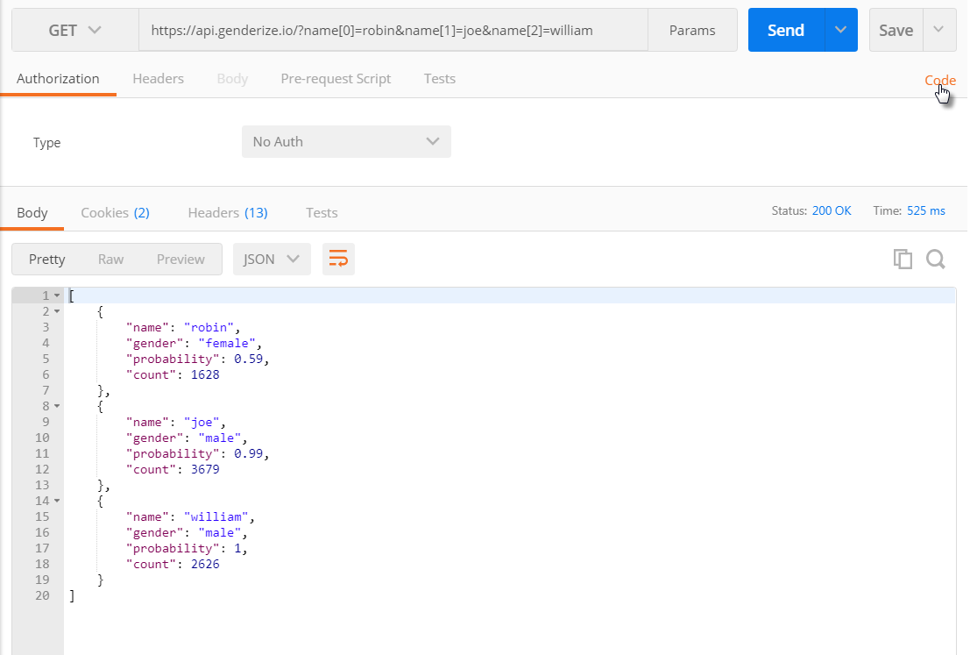
Genderize API

Slide 45
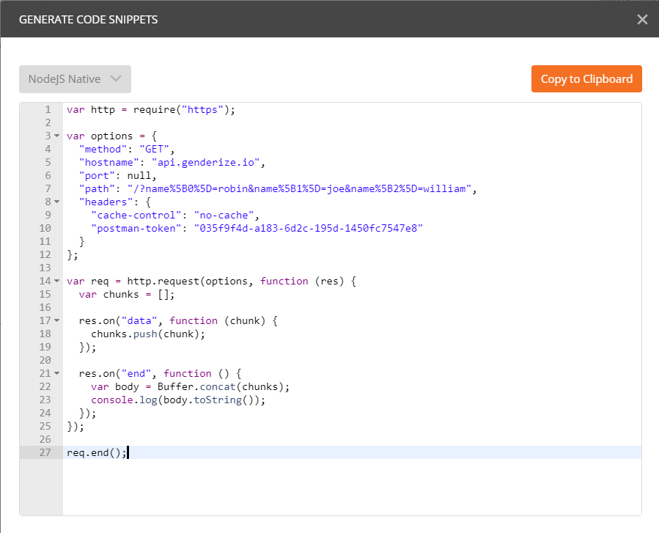
Genderize API

Slide 47
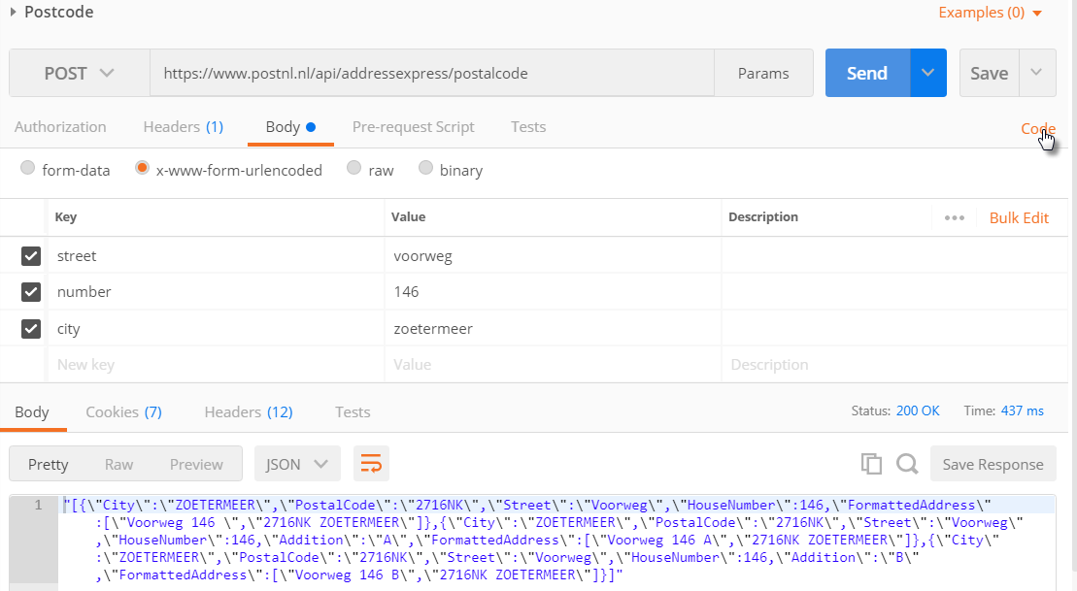
Postcode Post RequesT

Slide 48
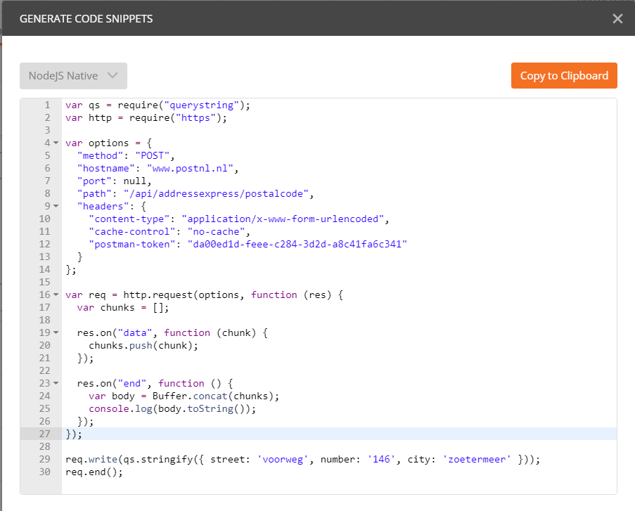

Slide 49
Serve Department details – retrieved from external REST API
var express = require('express'),bodyParser = require('body-parser') , fs = require('fs') var app = express()
.get('/departmentdetails/:departmentId', function (req, res) { var departmentId = req.params['departmentId'];
var department = getDepartment(departmentId); // read department from file
// get employee details for department from remote API
… })
.listen(3000);
REST API
Integration Tier
Local file system
GET request
departments .json

Slide 50
Serve Department details – retrieved from external REST API
var express = require('express'),bodyParser = require('body-parser') , fs = require('fs'), https = require('https');
var app = express()
.get('/departmentdetails/:departmentId', function (req, res) { var departmentId = req.params['departmentId'];
var department = getDepartment(departmentId);
// get employee details for department from remote REST API
https.get({ host: 'data-api-oraclecloud.com', port: 443,
path: '/departments/'+departmentId, method: 'GET'
}, function handleRemoteResponse(resp) { …
})
.listen(3000);
REST API
Integration Tier
Local file system
GET request
departments .json

Slide 51
Serve Department details – retrieved from external REST API
...
var app = express()
.get('/departmentdetails/:departmentId', function (req, res) { var departmentId = req.params['departmentId'];
var department = getDepartment(departmentId);
// get employee details for department from remote API
https.get({ host: 'data-api-oraclecloud.com', port: 443,
path: '/departments/'+departmentId, method: 'GET'
}, function handleRemoteResponse(resp) {
var body="";
resp.on("data", function(chunk) {body += chunk; });
resp.on("end", function() {
department.employees = JSON.parse(body);
res.send(department); });
});
})
.listen(3000);
REST API
Integration Tier
Local file system
GET request
departments .json

Slide 52
Lab 9
Making HTTP Requests – Calling out to APIs

Slide 53
Lab 11
Implementation of your own API (with Mock Response)
1
Mock (static response)
http

Slide 54
Lab 12
Publication of your own API

Slide 55
Lab 13
Implementation of your own API (against 3rd part back end API)
Local files
1
Mock (static response)
2
.json
Local File
.json
3
Call out to external REST API
http
REST API

Slide 56
API Implementation
Local files
1
Mock (static response)
2
.json
Local File
.json
3
Call out to external REST API
http
4
Interact with MongoDB
REST API

Slide 57
API implementation
Implement in Node
Run locally, test locally
Run Postman Collection (to test)
Run User Interface Web App to leverage API
Deploy API on Cloud
For example Now!
Run locally, expose on internet using ngrok
Try out each others’ API implementations
Notes:
https://technology.amis.nl/2017/09/01/rapid-and-free-cloud-deployment-of-node-applications-and-docker-containers-with-now-by-zeit/
https://technology.amis.nl/2016/12/07/publicly-exposing-a-local-service-to-nearby-and-far-away-consumer-on-the-internet-using-ngrok/

Slide 58



Resources: https://github.com/lucasjellema/nodejs-introduction-workshop-may2017
Blog: technology.amis.nl
Email: lucas.jellema@amis.nl
: @lucasjellema
: lucas-jellema
: www.amis.nl, info@amis.nl +31 306016000 Edisonbaan 15, Nieuwegein

