Slide 1
WORLD STATISTICS DATA
SUBMITTED BY:
Shivani Bokka
Rohith Gannoju
Jaideep Reddy Gade
Indra Charan Reddy

Slide 2
DATASET LINK:
https://www.kaggle.com/datasets/mutindafestus/world-statistics-dataset-from-world-bank?resource=download
https://www.kaggle.com/datasets/umairnasir14/population-growth-of-top-25-countries
DATASET DESCRIPTION:
The dataset used in this project was created by combining two sources: the World Bank's World Statistics data and a dataset ranking countries by population. The final dataset was created by merging the two data sources and thoroughly cleaning and pre-processing it using Python and Tableau Prep Builder
The goal of this dataset is to visualize various general statistics, including birth rate, death rate, population growth, agricultural land use, and more, over the period of 1995-2015. Post-preprocessing, the data is structured in Excel to allow easy access and manipulation.

Slide 3
SYSTEM ARCHITECTURE AND DESCRIPTION:
Data from 18 countries has been analyzed, covering statistics over a 20-year period from 1995 to 2015
Birth Rate and Death Rate (Country-wise): A comparative histogram bar graph illustrates the relationship between the average birth rate and death rate, using green for birth rate and red for death rate to enhance pre-attentive processing. To further aid quick comprehension, the corresponding values are displayed above each bar for easy reading.
GDP per Capita: A world map visualizes GDP per capita by country, using varying shades of the same color to enable instant comparison of GDP intensity across countries. For enhanced pre-attentive processing, the labels display both the values and corresponding country names.
Agricultural Land Use: A tree-map with heat mapping is used to display the average agricultural land area for each country, with labels showing the country name and its agricultural land area. The tree-map enables instant pre-attentive processing, as the size of each block visually represents the area.

Slide 4
Change in Rural Population: A bar graph is used to illustrate the rate of change in the rural population, with values represented as both positive and negative. To enhance immediate pre-attentive processing, the values are also labeled on the graph.
Comparing Average Population to the Surface Area: Two line-graphs are used to compare the total average population with the surface area of each country. Together, they highlight which countries have a higher population density by examining both graphs separately. For enhanced pre-attentive processing, the countries and their respective values are labeled.
Total Population 1995 and 2015: A pie chart is used to display a single variable—the total population of each country in 2015. The size of each pie segment clearly highlights which countries have the largest populations. For instant comprehension, the countries and their respective population values are labeled.
Infant Mortality Rate: A bubble chart with varying color intensity is used to visualize the infant mortality rate. Both the size of the bubbles and the color shading enhance pre-attentive processing for quick interpretation. For easy comprehension, the mortality rates and country names are also labeled.

Slide 5
VISUALIZATION SLIDES

Slide 6
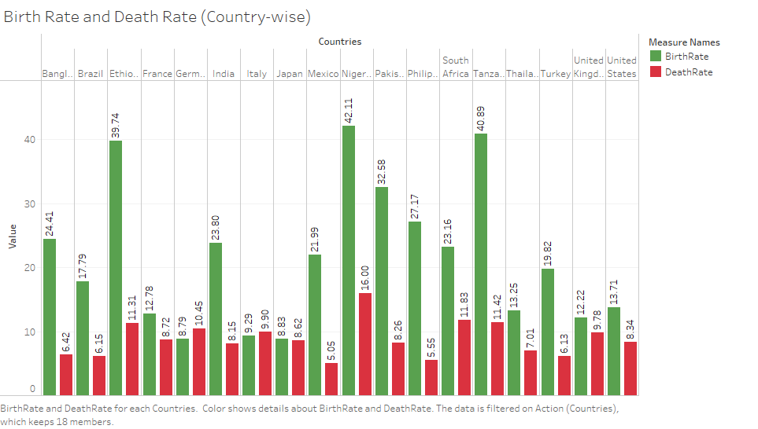

Slide 7
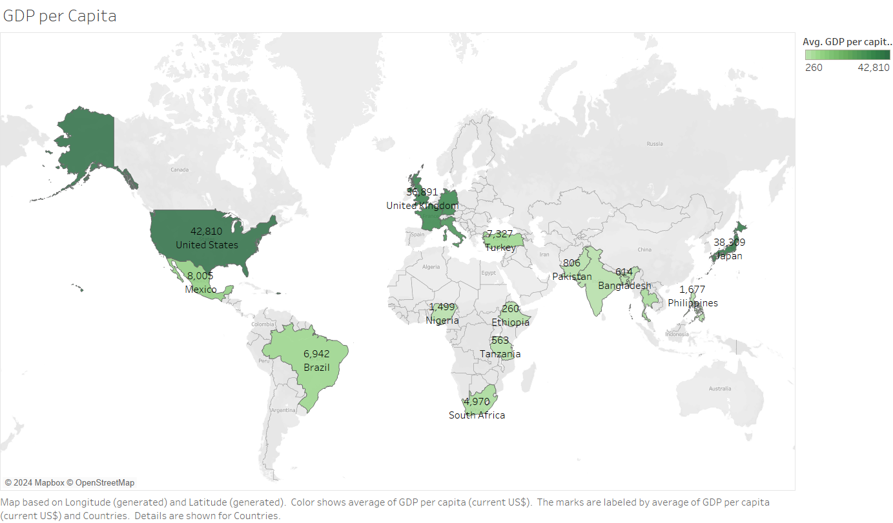

Slide 8
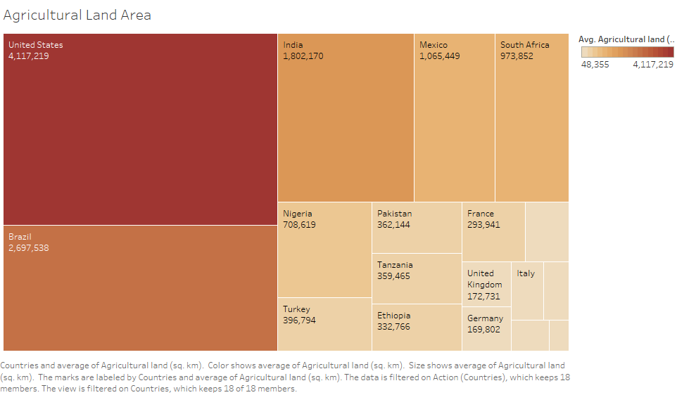

Slide 9
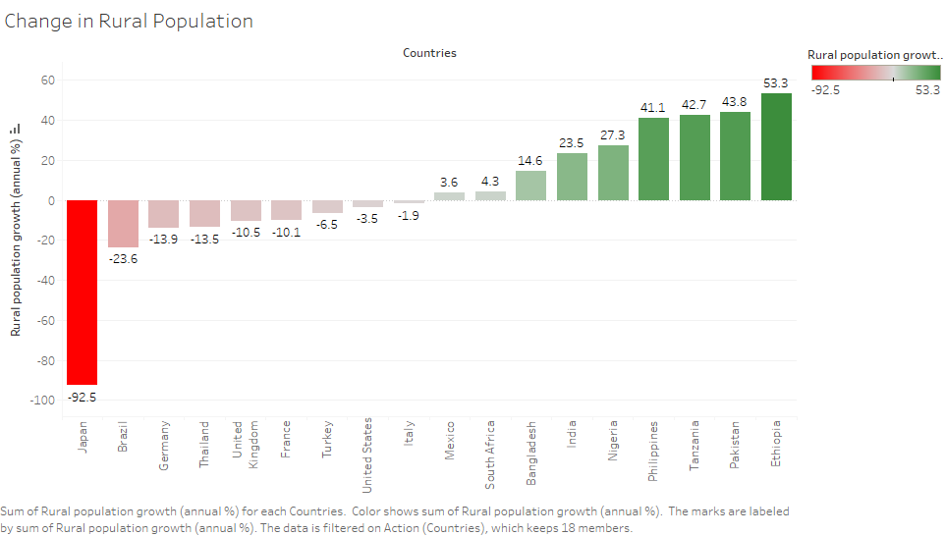

Slide 10
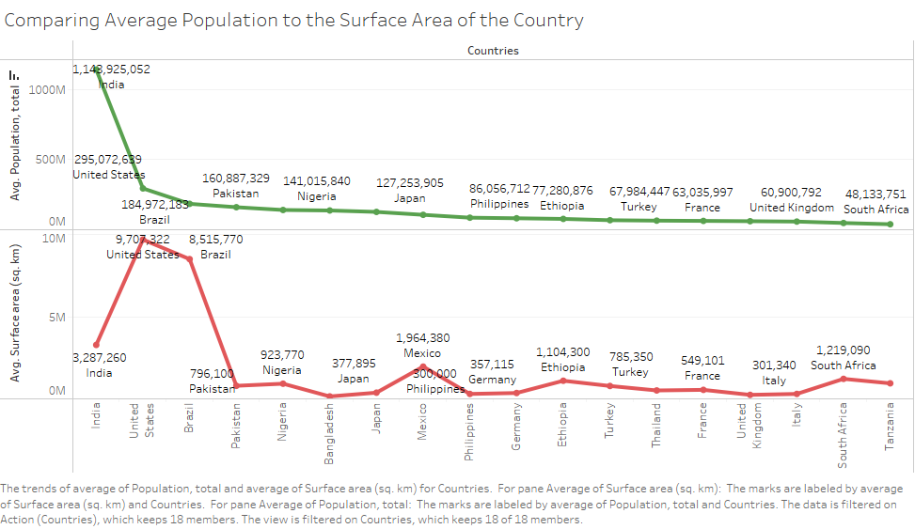

Slide 11
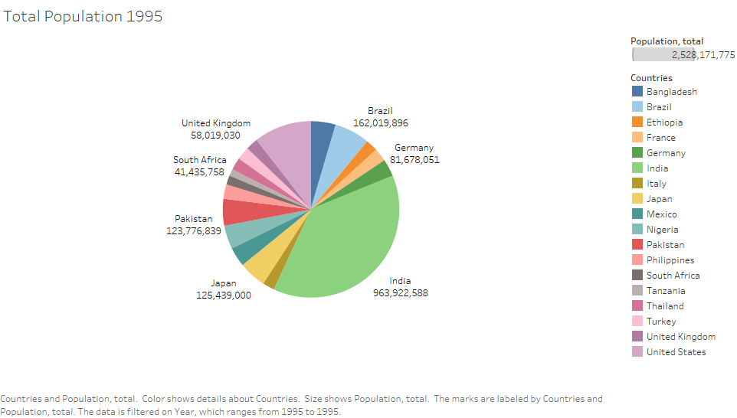

Slide 12
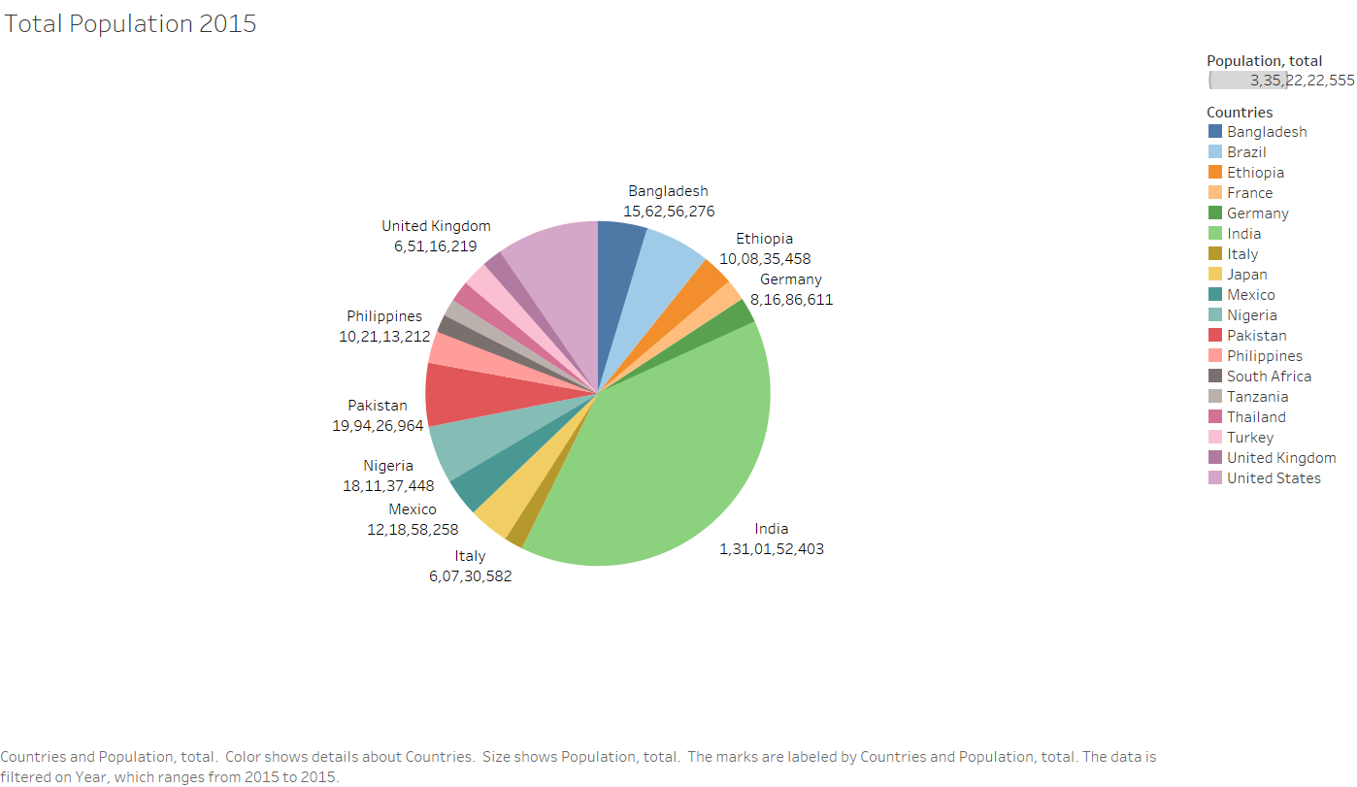

Slide 13
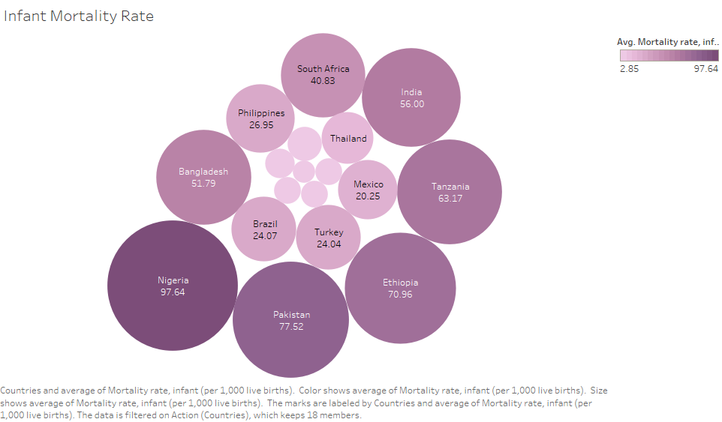

Slide 14
DASHBOARD SLIDES
Population Dashboard: This dashboard links the two variables—total population and the change in rural population—for each country.
Birth, Death Mortality Rate Dashboard: This dashboard connects the variables of birth rate, death rate, and infant mortality rate for each country.
Surface Area Dashboard: his dashboard connects the variables of average population, surface area, and agricultural land use.

Slide 15
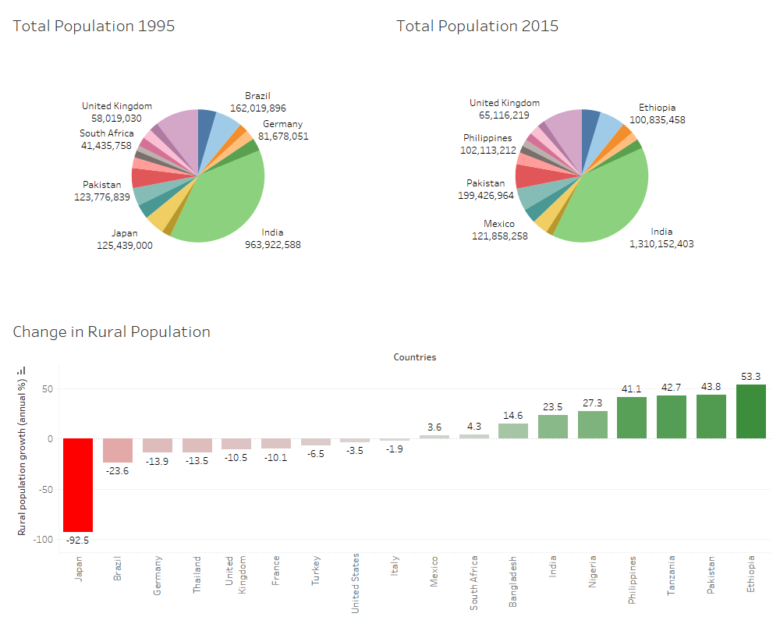

Slide 16
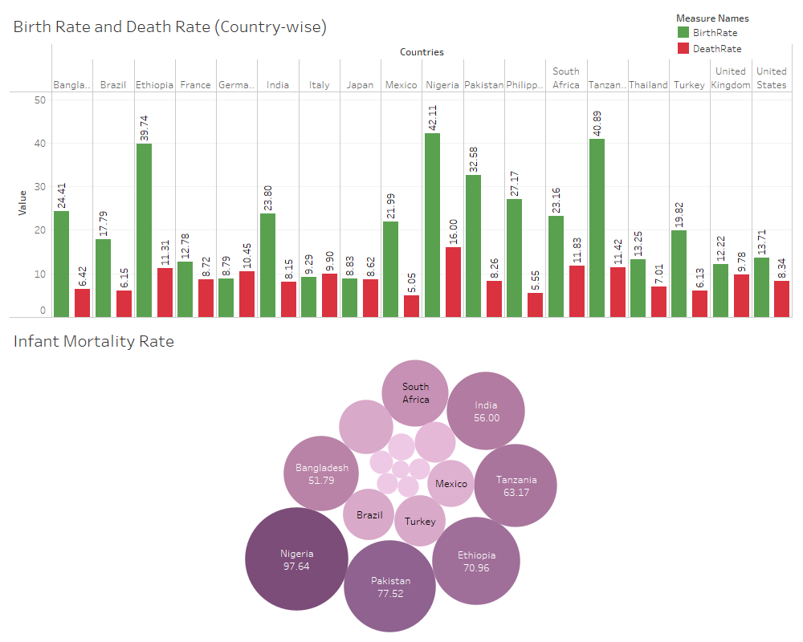

Slide 17
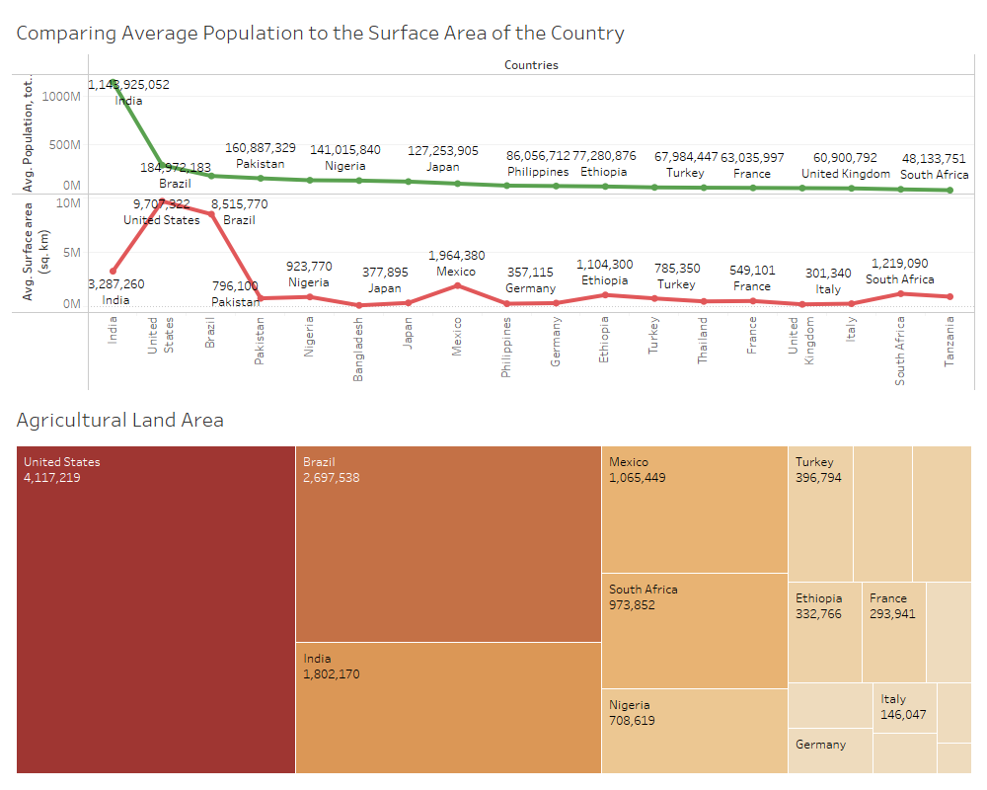

Slide 18
CONCLUSION:
The visualizations present various statistics across different countries, comparing key factors such as GDP, birth rate, death rate, and more using diverse graph types. These visual representations simplify the understanding of multiple variables and country-specific data. The use of color and varying graph sizes enhances pre-attentive processing, making the information easy to grasp at a glance.
The interactive dashboard allows users to view the values of all variables simultaneously for any selected country.
Our primary goal with this visualization is to simplify the interpretation of these variables and provide insight into how countries are progressing across various fields.

