Slide 1
GymApp: Swift-based Fitness Application
Welcome to GymApp, a iOS fitness application built using Swift and MVVM architecture. This presentation will showcase its features, architecture, and future potential.
by JAI DEEP REDDY(id- 924283318) INDRA CHARAN REDDY(ID - 924305548)

Slide 2
Key Features of GymApp
User-friendly Interface
Workout Management
Intuitive design tailored for gym enthusiasts, ensuring easy navigation and interaction.
Comprehensive system for displaying and managing workout schedules and routines.
Progress Tracking
MVVM Architecture
Advanced tools to monitor fitness progress and set achievable goals.
Utilizes Model-View-ViewModel for efficient code separation and maintainability.

Slide 3



GymApp Architecture Overview
View
1
UI components defined in the app
ViewModel
2
Handles business logic and updates the View
Model
3
Represents fitness data and user progress
The MVVM architecture ensures clear separation of concerns, enhancing code maintainability and testability.

Slide 4

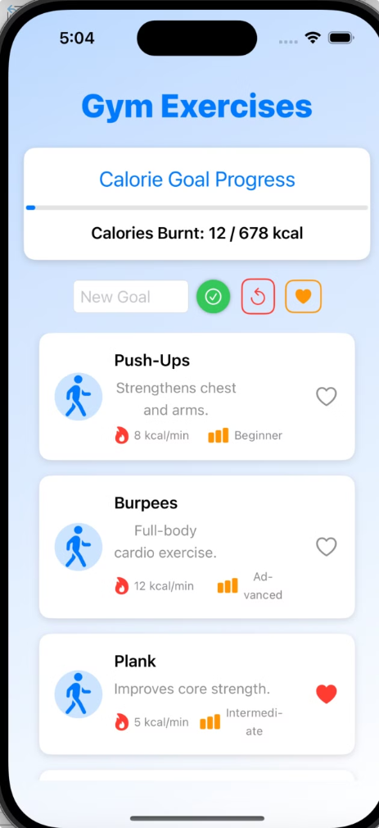



User Interface Showcase
GymApp features a sleek, user-friendly interface designed for optimal user experience.
Home Screen
Quick access to main features and daily overview
Workout Planner
Customizable workout schedules and routines
Progress Tracker
Visual representation of fitness goals and achievements

Slide 5
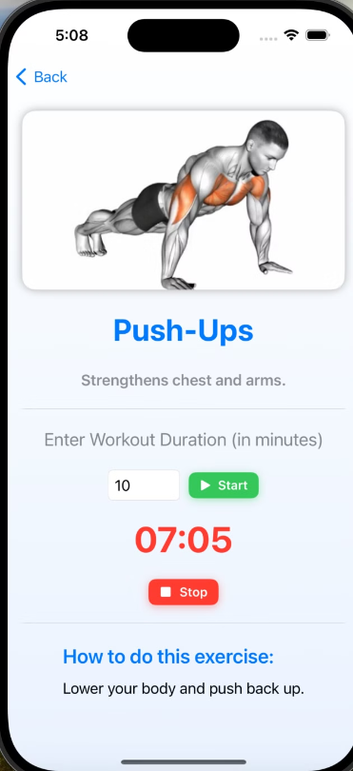
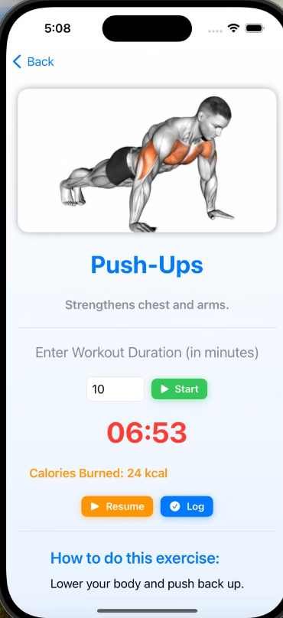
Detailed Screen Views
Workout Details
Progress Visualization
Users can view and modify specific workout routines, including exercise sets, reps, and rest periods.
Interactive charts and graphs provide a clear view of user's fitness journey over time.

Slide 6



GymApp Summary
Modern iOS App
Built using Swift for optimal performance on iOS devices
MVVM Architecture
Ensures scalability and maintainability of the codebase
User-Centric Design
Intuitive interface for seamless user experience
GymApp combines cutting-edge technology with user-friendly design to deliver a comprehensive fitness tracking solution.

Slide 7

Current Limitations
Limited Features
No User Authentication
Basic workout tracking without advanced analytics
Lack of user profiles and secure login functionality
iOS Only
Internet Dependency
Currently optimized for iOS devices, limiting user base
Some features require active internet connection

Slide 8

Future Development Roadmap
1
Advanced Analytics
Implement AI for personalized workout suggestions and in-depth performance analysis
2
User Authentication
Add secure login and user profiles for personalized experience
3
Cross-Platform Support
Expand to Android devices to reach a wider audience
4
Offline Mode
Enable core features to function without internet connection

