Slide 1
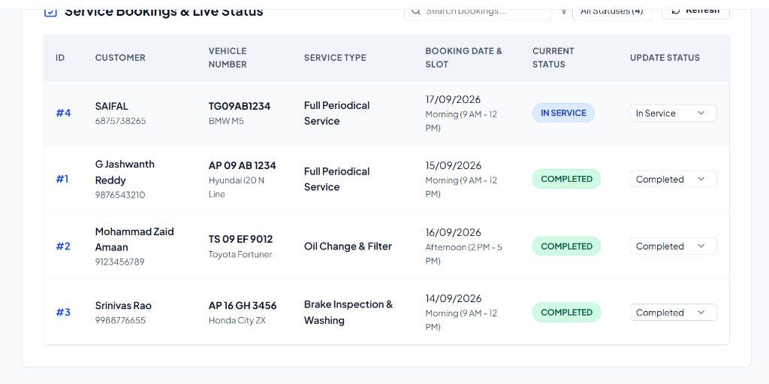
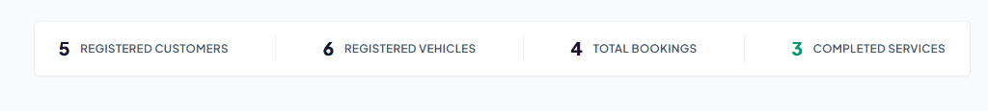
Vehicle Service Booking & Tracking System
Team ID: 18 | Section: S__ | Members: G Jashwanth Reddy (2520030426), Mohammad Zaid Amaan (2520030382) | Guide: Dr. ______
Database Systems Engineering and Distributed Backend Development (25CS1302E) | KLH Bachupally Campus, CSE | PBL 2026-27
Abstract
Tools & Technologies
A full-stack vehicle maintenance and service tracking platform for automotive service centers, built with React.js, Express.js, and MySQL 8.
Centralizes customer onboarding, vehicle management, service bookings, and booking status tracking using a structured relational database.
• Front-End: React.js, Vite, HTML5, CSS3, Lucide React Icons
• Back-End: Node.js, Express.js, RESTful APIs
• Database: MySQL 8 (3 relational tables, indexed FKs)
• Tools & Security: Git, GitHub, Postman, VS Code, mysql2
Problem Statement & Objectives
System Architecture (Three-Tier Tree View)
Problem: Service centers struggle with paper registers, missing records, scheduling conflicts, and data inconsistencies.
• Objective 1: Design a normalized MySQL 8 schema with 3 relational tables (customers, vehicles, service_bookings).
• Objective 2: Develop REST APIs in Express.js with input validation and mysql2 connection pool.
• Objective 3: Build an interactive React.js dashboard for booking services and tracking status updates.
• Scope: Customer registration, vehicle fleet management, package booking, and admin status console.
👤 USER
↓
PRESENTATION LAYER (React.js Frontend)
Customer Mgmt
Vehicle Mgmt
Service Booking
Status Tracking
⬇ HTTP / REST API (JSON) ⬇
APPLICATION LAYER (Node.js + Express.js)
Customer API
Vehicle API
Booking API
Input Validation
Existing vs Proposed System
⬇ mysql2 Connection Pool ⬇
Feature | Existing System | Proposed System
Organization | Manual paper registers & physical files | Centralized MySQL database with validated data
Vehicle Mapping | Paper cards; difficult history lookup | Relational mapping (customers 1:N vehicles)
Service Booking | Phone calls; scheduling conflicts | Online form with package & slot selection
Status Tracking | No visibility for customers or staff | Booking status tracking (PENDING → COMPLETED)
Data Integrity | Redundant paper logs; dummy numbers | MySQL 8 relational schema with unique keys
DATABASE LAYER (MySQL 8 - vehicle_service_db)
customers
(PK: id)
vehicles
(FK: customer_id)
service_bookings
(FKs: customer, vehicle)
ER Diagram & Relational Database Schema
CUSTOMERS (1)
🔑 id (PK)
👤 name
📧 email
📞 phone
🏠 address
📅 created_at
VEHICLES (N)
🔑 id (PK)
🔗 customer_id (FK)
🚗 vehicle_number
🏷️ brand / model
⛽ fuel_type
📅 mfg_year
SERVICE_BOOKINGS
🔑 id (PK)
🔗 customer_id (FK)
🔗 vehicle_id (FK)
🛠️ service_type
📅 booking_date
⚡ status / notes
Feasibility Study
RELATIONSHIPS & CARDINALITY:
customers (1) ─── (N) vehicles | customers (1) ─── (N) service_bookings (N) ─── (1) vehicles
• Technical: Built on Node.js 18+, Express.js, React.js, and MySQL 8 with connection pooling.
• Economic: 100% open-source tech stack deployable on local development tools.
• Operational: Clean, role-based UI (Customer/Staff) requiring zero user training.
• Schedule: Completed within semester timeline across schema, REST API, UI, and testing phases.
Implementation Screenshots
Results & Testing
Conclusion
Future Scope
• Complete CRUD verified across all 3 relational database tables.
• Input validation and database constraints were verified during testing.
• Verified React ➔ Express ➔ MySQL data flow with mysql2 connection pool.
• Engineered a centralized vehicle service booking system.
• Met all course objectives with relational integrity & modern UI.
• AI-driven service recommendations based on vehicle history.
• Automated WhatsApp / SMS notifications for completed servicing.
References: [1] Silberschatz et al., Database System Concepts, 7th ed. [2] Express.js & React Docs [3] MySQL 8 Reference Manual
GitHub:
Vehicle-Service

