Slide 1
Paper Title:
Social Media Hate Speech Detection Using Explainable Artificial Intelligence (XAI)
Slide No.1
Team No. 2
Presented By
Golam Kibria Anim
ID: 23341034
ST: Abid Hossain
RA: Sania Azhmee Bhuiyan

Slide 2
Research Objective:
To explore the decision-making process of complex AI models in hate speech detection
To demonstrate the application of Explainable AI (XAI) techniques in improving interpretability
To provide insights into the challenges and future directions of XAI in decision-making
Slide No.2

Slide 3
Dataset Used:
Google Jigsaw Dataset:
User discussions from English Wikipedia talk pages
Pre-existing models applied: decision trees, k-nearest neighbors, multinomial naïve Bayes, random forest, logistic regression, and LSTM
LSTM achieved an accuracy of 97.6%
HateXplain Dataset:
Posts from Twitter and Gab
XAI models applied: BERT + ANN and BERT + MLP
Achieved an accuracy of 93.67% using ERASER benchmark
Slide No.3

Slide 4
Literature Review:
Slide No. 4
Reviewed Key Research Papers :
Automated hate speech detection and the problem of offensive language.
Detection of offensive content and identification of potential offensive users.
A feature attribution method for explainability.
Detecting bullying and aggressive behavior on Twitter.
A unified deep learning architecture for abuse detection.

Slide 5
Slide No.5
Findings and Limitations:
Different machine learning algorithms and techniques were tested for various tasks.
Limitations in defining hate speech, detecting offensive content, and explaining complex ML models.
Data limitations, lack of diversity, and challenges in accessing network-related metadata.
Implications of the Reviewed Research:
Inaccuracies in hate speech detection and identification of offensive content.
Challenges in explaining complex machine learning models and RNN predictions.
Misclassifications and limited accessibility of data representations.

Slide 6
Slide No. 6
Opportunities and Challenges:
Need for improved definitions and detection methods for hate speech and offensive content.
Exploration of alternative explainability approaches beyond SHAP and LIME.
Addressing data limitations, diversity, and computational challenges.
Future Directions:
Develop robust and accurate models for hate speech detection and offensive content identification.
Enhance explainability methods to align better with human intuition.
Expand datasets to include a variety of demographic groups and network-related metadata.

Slide 7
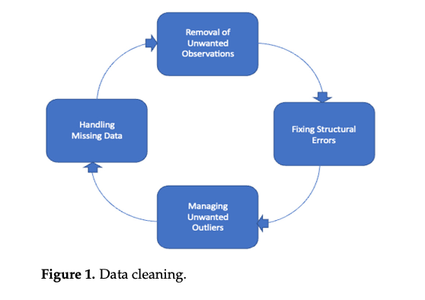
Data Preprocessing:
Cleaning data to remove inconsistencies and irrelevant information
Text cleaning of tweets, tokenization, and lemmatization
Simplifying categorical variables for training purposes
Slide No.7

Slide 8
Exploratory Data Analysis (EDA):
Uncovering patterns and insights in the datasets
Understanding data better, identifying anomalies, and validating assumptions
Explainable AI (XAI):
An emerging field that provides explanations for AI model decisions
Varied applications in healthcare, law and order, defense, and more
Bridge between AI models and human understanding
Slide No.8

Slide 9
Methods Used:
LIME (Local Interpretable Model-Agnostic Explanations): Explainability method applied to HateXplain dataset
BERT (Bidirectional Encoder Representations from Transformers): Language model for hate speech detection with high explainability
Other XAI models: Layer-wise relevance propagation and Deep LIFT
Slide No.9

Slide 10
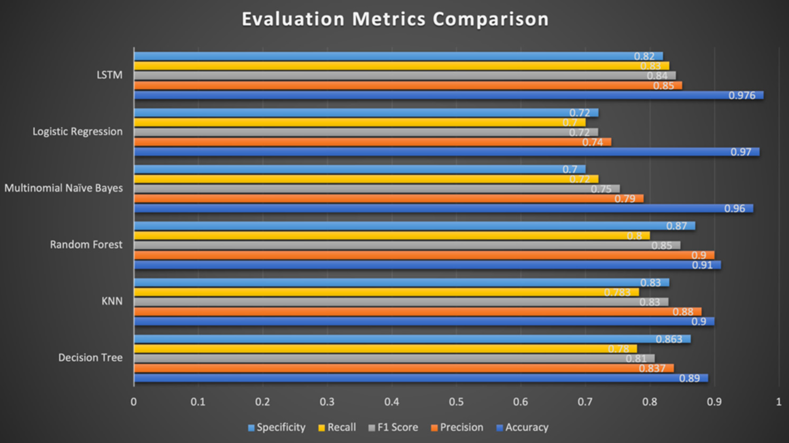
Result:
1. Model Performance and Explainability:
LSTM achieved the highest accuracy of 97.6% on the Google Jigsaw dataset.
BERT + MLP and BERT + ANN models achieved accuracies of 93.67% and 93.55% on the HateXplain dataset.
LIME model provided explainability and interpretability by assigning weights to words in comments.
Plausibility and faithfulness were measured using the ERASER benchmark.
Slide No.10

Slide 11
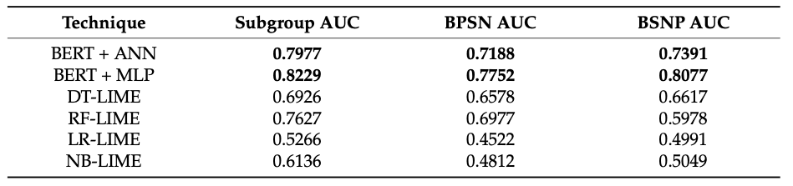
Slide 2: Bias Analysis and Conclusion:
BERT variants showed significantly higher accuracy in bias-based metrics compared to other linear models.
BERT + MLP had the highest values for subgroup AUC, BPSN AUC, and BSNP AUC.
The research contributes to the development of more effective and efficient machine learning methods.
Explainability and interpretability are crucial for understanding and managing complex AI models.
Further research is needed to address limitations and challenges in combining conventional AI with explainable AI (XAI).
Slide No.11

Slide 12
Conclusion:
The research study showcased the effectiveness of XAI in hate speech detection.
LSTM and BERT variants demonstrated high accuracy, bias reduction, and explainability.
Further advancements in XAI can contribute to the development of robust and fair hate speech detection models.
Slide No.12

Slide 13
Davidson, T.; Warmsley, D.; Macy, M.; Weber, I. Automated Hate Speech Detection and the Problem of Offensive Language. Available online: http://arxiv.org/abs/1703.04009 (accessed on 11 August 2022).
Chen, Y.; Zhou, Y.; Zhu, S.; Xu, H. Detecting offensive language in social media to protect adolescent online safety. In Proceedings of the 2012 ASE/IEEE International Conference on Privacy, Security, Risk and Trust and 2012 ASE/IEEE International Conference on Social Computing, SocialCom/PASSAT, Amsterdam, The Netherlands, 3–5 September 2012; pp. 71–80. [Google Scholar] [CrossRef]
Balkir, E.; Nejadgholi, I.; Fraser, K.C.; Kiritchenko, S. Necessity and sufficiency for explaining text classifiers: A case study in hate speech detection. arXiv 2022, arXiv:2205.03302. [Google Scholar]
Chatzakou, D.; Kourtellis, N.; Blackburn, J.; de Cristofaro, E.; Stringhini, G.; Vakali, A. Mean birds: Detecting aggression and bullying on Twitter. In WebSci 2017—Proceedings of the 2017 ACM Web Science Conference; Association for Computing Machinery: New York, NY, USA, 2017; pp. 13–22. [Google Scholar] [CrossRef]
Founta, A.M.; Chatzakou, D.; Kourtellis, N.; Blackburn, J.; Vakali, A.; Leontiadis, I. A Unified Deep Learning Architecture for Abuse Detection. In WebSci 2019—Proceedings of the 11th ACM Conference on Web Science; Association for Computing Machinery: New York, NY, USA, 2018; pp. 105–114. [Google Scholar] [CrossRef]
Slide No. 13
Bibliography:

Slide 14
Lundberg, S.M.; Lee, S.I. A unified approach to interpreting model predictions. Adv. Neural Inf. Process. Syst. 2017, 30. [Google Scholar]
Arras, L.; Montavon, G.; Müller, K.R.; Samek, W. Explaining recurrent neural network predictions in sentiment analysis. In EMNLP 2017—8th Workshop on Computational Approaches to Subjectivity, Sentiment and Social Media Analysis, WASSA 2017—Proceedings of the Workshop; Association for Computational Linguistics: Copenhagen, Denmark, 2017. [Google Scholar] [CrossRef]
Mahajan, A.; Shah, D.; Jafar, G. Explainable AI approach towards toxic comment classification. In Emerging Technologies in Data Mining and Information Security; Springer: Singapore, 2021; pp. 849–858. [Google Scholar]
Ribeiro, M.T.; Singh, S.; Guestrin, C. “Why Should I Trust You?”: Explaining the Predictions of Any Classifier. In Proceedings of the NAACL-HLT 2016—2016 Conference of the North American Chapter of the Association for Computational Linguistics: Human Language Technologies, Proceedings of the Demonstrations Session, San Francisco, CA, USA, 13–17 August 2016; pp. 1135–1144. [Google Scholar] [CrossRef]
Samek, W.; Montavon, G.; Lapuschkin, S.; Anders, C.J.; Müller, K.-R. Toward Interpretable Machine Learning: Transparent Deep Neural Networks and Beyond. Available online: https://doi.org/10.48550/arXiv.2003.07631 (accessed on 11 August 2022). [CrossRef]
Slide No. 14

Slide 15
Thank You
Slide No.15

