Slide 1
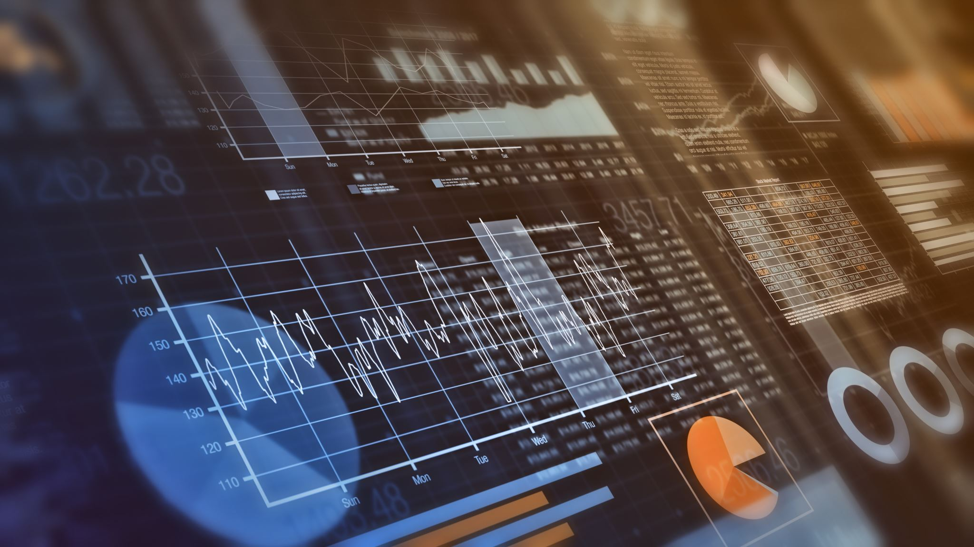
Five-class classification of ECG signals
Automated Classification of ECG Signals Using CNN and TQWT

Slide 2
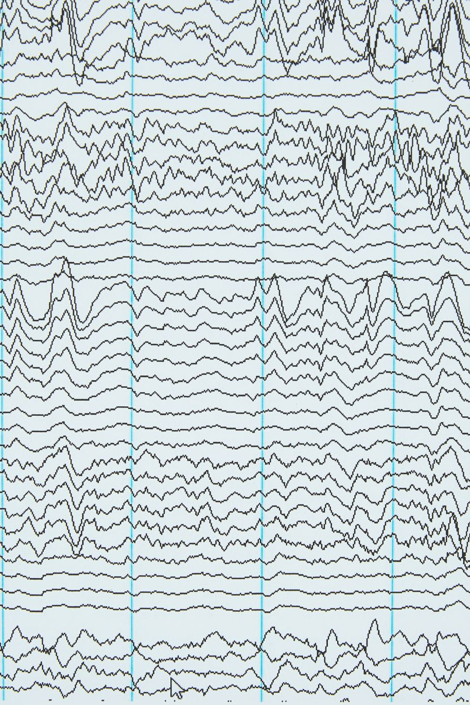
Introduction
Objective:
The purpose of this slide is to introduce the audience to the problem statement and objectives of the project.
It provides an overview of why automated ECG signal classification is important and outlines the goals of the project.
Content:
Importance of automated ECG signal classification: This section highlights the significance of automating the process of interpreting ECG signals. It may discuss the challenges associated with manual interpretation, such as subjectivity, time-consuming nature, and potential for errors.
Objectives of the project: This section outlines the specific goals and objectives of the project. It may include objectives such as developing a CNN model for accurate classification of ECG signals, improving diagnostic accuracy, and facilitating early detection of cardiac conditions.
This slide sets the context for the rest of the presentation by explaining why the project is important and what its objectives are. It helps the audience understand the motivation behind the research and what they can expect to learn from the presentation.

Slide 3
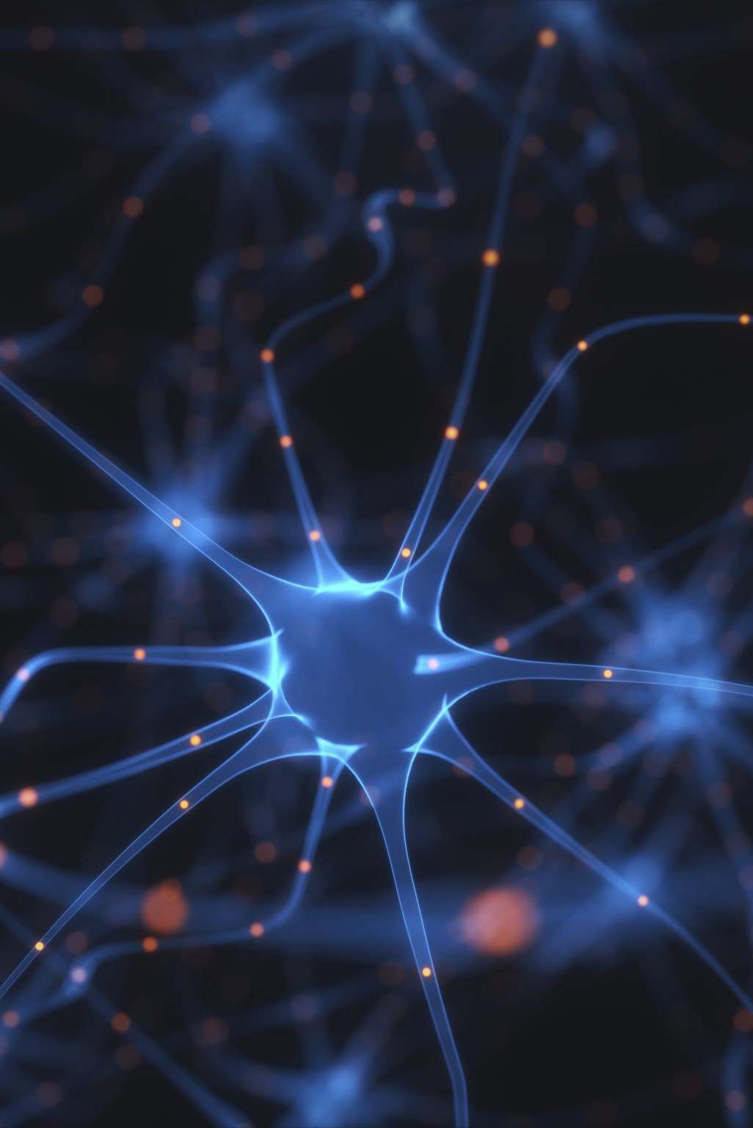
Problem Statement and Significance
Problem Statement:
Manual interpretation of ECG signals poses challenges: It can be subjective due to differences in interpretation among clinicians and time-consuming, leading to potential delays in diagnosis.
Accurate classification of cardiac conditions from ECG signals is essential: Timely and accurate diagnosis is critical for effective treatment and management of cardiovascular diseases.
Significance:
Automated ECG signal classification offers solutions: By automating the classification process, we can overcome the limitations of manual interpretation, streamline diagnosis, and reduce errors.
Leveraging deep learning techniques: We aim to harness the power of Convolutional Neural Networks (CNNs) to develop a robust model capable of accurately classifying ECG signals into different cardiac conditions.

Slide 4

Proposed Method/ Algorithm
CNN Model Architecture:
Convolutional Layers: Extract spatial features using filters to capture hierarchical patterns.
Pooling Layers: Downsample feature maps, preserving essential information and reducing computation.
Activation Functions: ReLU introduces non-linearity, aiding in learning complex patterns.
Batch Normalization: Normalize activations, stabilizing training and improving convergence.
Dropout Regularization: Randomly deactivate neurons, preventing overfitting and promoting generalization.

Slide 5

Proposed Method/ Algorithm
Random Forest Model Architecture:
Decision Trees: Ensemble of decision trees trained on bootstrap samples of the dataset.
Feature Randomness: Randomly select features at each split, improving diversity and reducing overfitting.
Voting Mechanism: Combine predictions from multiple trees to make final classification decision.
Hyperparameters: Tune parameters like the number of trees and maximum depth to optimize performance.

Slide 6
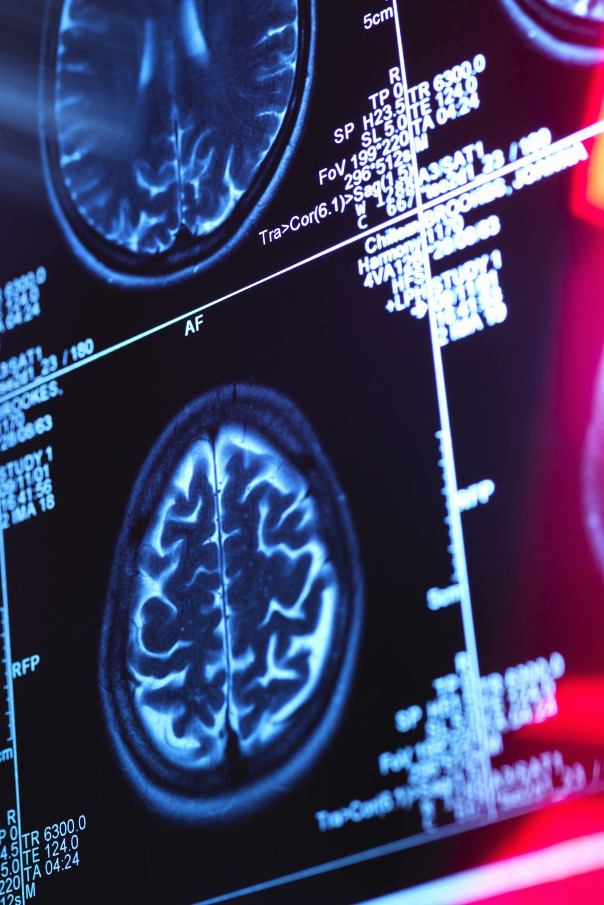
Data Description
Dataset Overview:
Description of the dataset: Information about the origin, size, and characteristics of the ECG signals.
Representation of cardiac conditions: Explanation of the different cardiac conditions present in the dataset, such as normal rhythm, cardiomyopathy, hypertrophy, myocardial infarction, and ST-T changes.
Data Preprocessing Steps:
Extraction of individual leads: Explanation of how the ECG signals were preprocessed to extract 12 individual leads, each representing a specific aspect of cardiac activity.
Preprocessing: Clean ECG signals to remove noise and baseline wander.
TQWT Decomposition: Transform signals, adjusting Q-factor for frequency resolution.
Features: Extract time-domain (e.g., R-wave amplitude) and frequency-domain features (e.g., dominant frequencies).
Importance of Dataset Quality:
Discussion about the importance of dataset quality and relevance to the task of automated ECG signal classification.
Emphasis on the significance of preprocessing steps in ensuring the quality and suitability of the dataset for model training and evaluation.

Slide 7
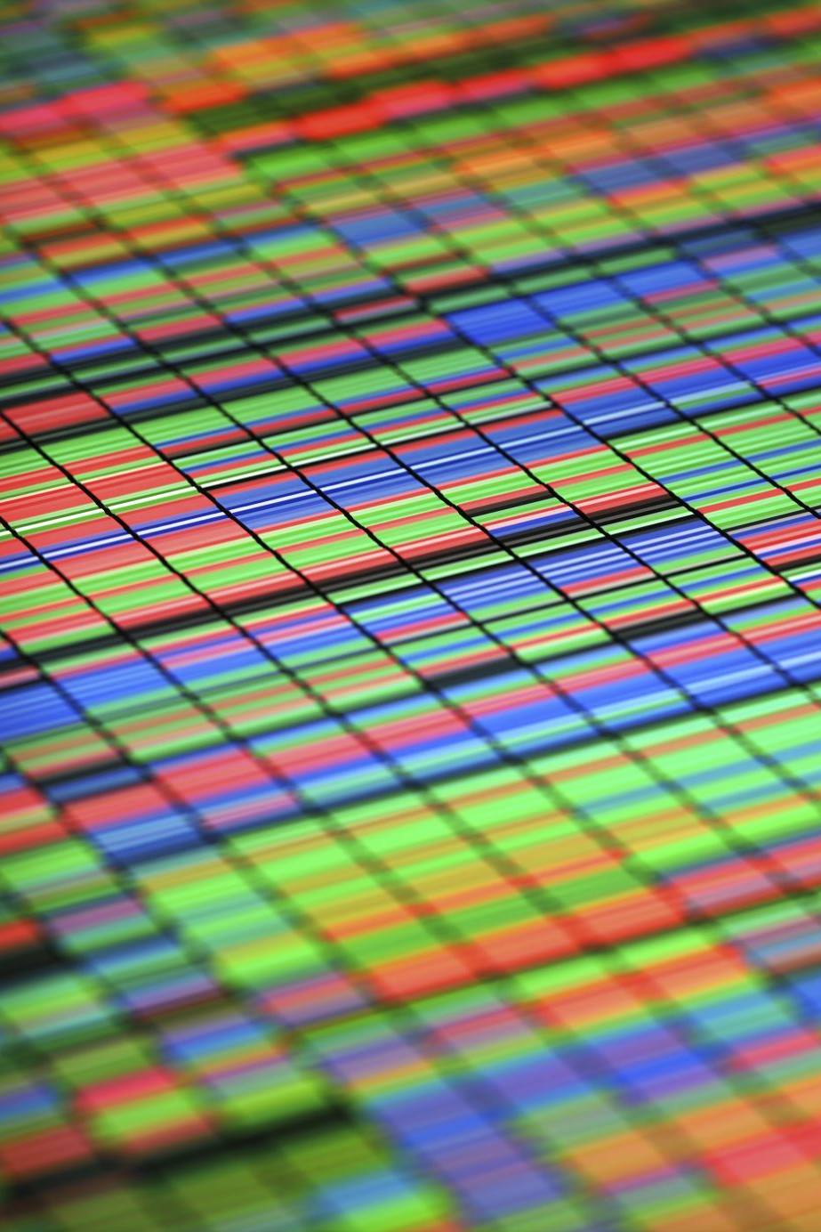
Model Training
Training-Validation Split:
Explanation of how the dataset was split into training and validation sets, typically using a predefined ratio (e.g., 70-30 or 80-20).
Rationale behind the split: Discussion about the importance of having separate training and validation sets for model training and evaluation to prevent overfitting.
Training Procedure:
Hyperparameters: Description of key hyperparameters such as learning rate, batch size, and number of epochs used for training the model.
Batch size: Explanation of the number of samples processed in each training iteration.
Number of epochs: Definition of the number of times the entire training dataset is passed forward and backward through the neural network.
Optimization Techniques:
Description of the optimizer used (e.g., Adam) and its parameters.
Discussion about any additional optimization techniques employed during training, such as early stopping or learning rate scheduling.

Slide 8
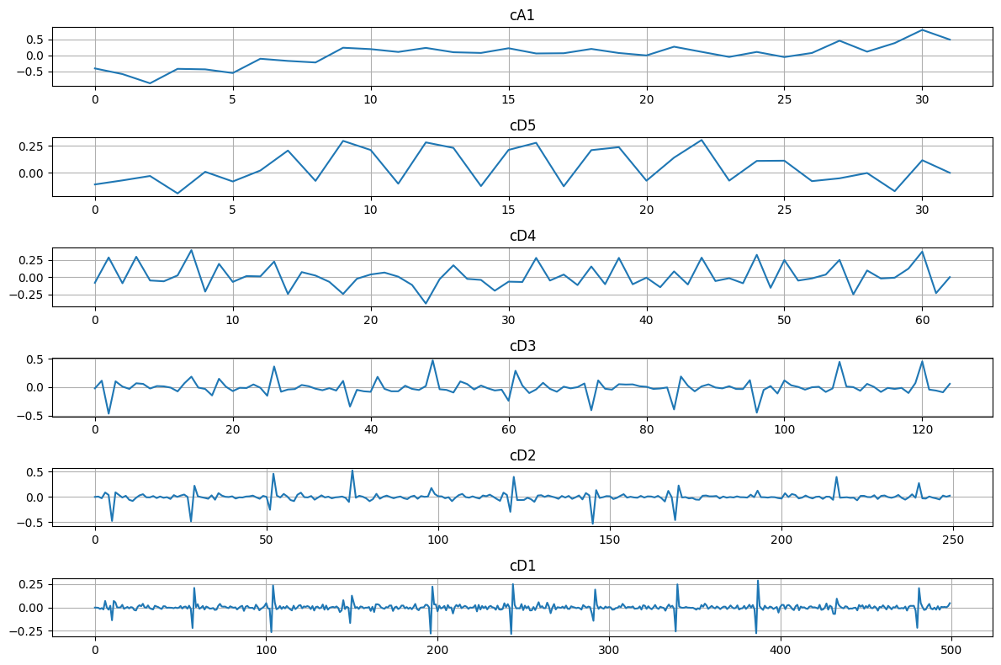
Level Wise Approximation Cofficients

Slide 9
Tunable Q-factor Wavelet Transform
TQWT adjusts the Q-factor parameter for flexible control over frequency and time resolution.
Traditional wavelet transforms have fixed resolutions determined by the wavelet and scale parameters.
TQWT addresses the need for customizable resolution adjustments.
Users can tune the Q-factor to balance frequency and time resolutions.
Higher Q-factor: narrower frequency bands, better frequency resolution, poorer time resolution.
Lower Q-factor: wider frequency bands, better time resolution, poorer frequency resolution.

Slide 10
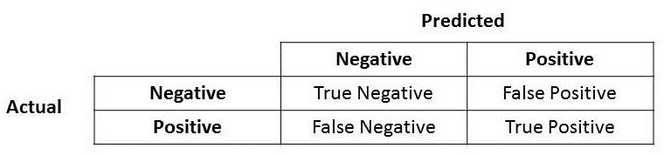

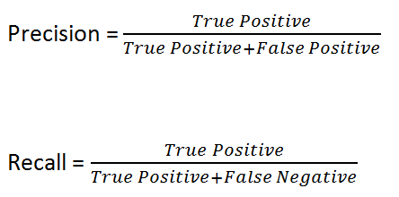
Formula Performance Metrics

Slide 11
Performance Metrics
Precision
Recall
f1_score
Lead No. | Lead Names | Random classifier | CNN | Random classifier | CNN | Random classifier | CNN
0 | I | 0.343437 | 0.303890 | 0.411511 | 0.550939 | 0.374405 | 0.391715
1 | II | 0.356054 | 0.481678 | 0.446907 | 0.554632 | 0.396341 | 0.400772
2 | III | 0.362491 | 0.408596 | 0.393660 | 0.551862 | 0.377433 | 0.393236
3 | aVR | 0.352274 | 0.379154 | 0.439212 | 0.554940 | 0.390969 | 0.404272
4 | aVL | 0.354110 | 0.303873 | 0.385349 | 0.551247 | 0.369070 | 0.391779
5 | aVF | 0.354763 | 0.343243 | 0.420129 | 0.551247 | 0.384689 | 0.392482
6 | V1 | 0.455951 | 0.303873 | 0.413666 | 0.551247 | 0.387435 | 0.391779
7 | V2 | 0.447326 | 0.343337 | 0.411511 | 0.551247 | 0.375585 | 0.392560
8 | V3 | 0.470804 | 0.303873 | 0.436750 | 0.551247 | 0.399017 | 0.391779
9 | V4 | 0.526121 | 0.402832 | 0.445060 | 0.559557 | 0.404238 | 0.411497
10 | V5 | 0.368415 | 0.435268 | 0.453370 | 0.577101 | 0.406501 | 0.455998
11 | V6 | 0.357857 | 0.582927 | 0.449369 | 0.580486 | 0.398426 | 0.458250
2,4,6,12 |  | 0.6919893753655412 | 0.4431524319869994 | 0.6620498614958449 | 0.5063096337334565 | 0.025626130354158557 | 0.46316064892333586

Slide 12
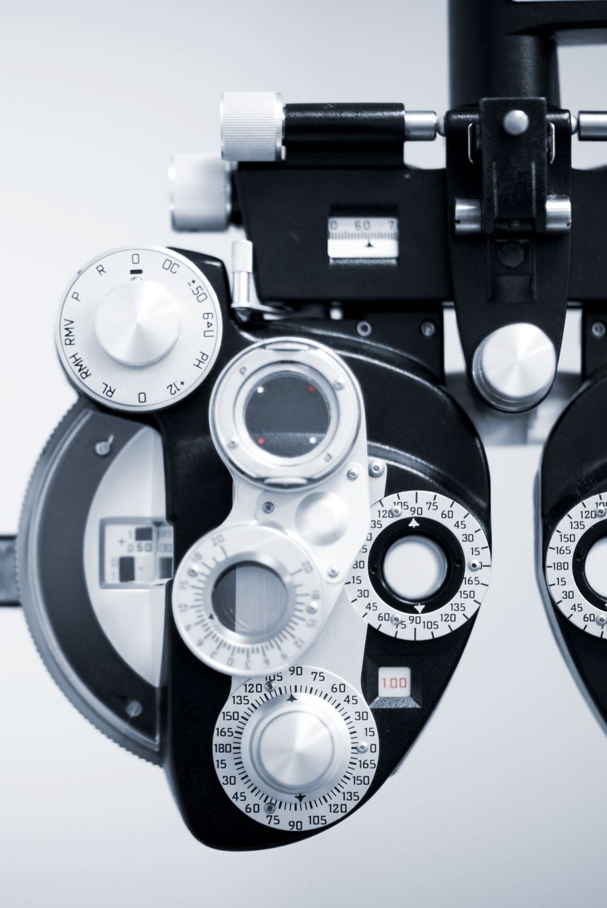
Results
ACCURACY
LEAD NO. | LEAD NAME | CNN | Random Forest classifier
0 | I | 0.562327 | 0.611881
1 | II | 0.572176 | 0.639581
2 | III | 0.563866 | 0.633426
3 | aVR | 0.592490 | 0.626039
4 | aVL | 0.556787 | 0.618960
5 | aVF | 0.551862 | 0.629117
6 | V1 | 0.571868 | 0.627578
7 | V2 | 0.577101 | 0.619575
8 | V3 | 0.586950 | 0.669437
9 | V4 | 0.568175 | 0.667590
10 | V5 | 0.598030 | 0.664820
11 | V6 | 0.604186 | 0.659895
ALL 12 LEADS | ALL | 0.4488 | 0.7122191443521083
2,4,6,12 | II,aVR,aVF,V6 | 0.5361 | 0.6620498614958449

Slide 13
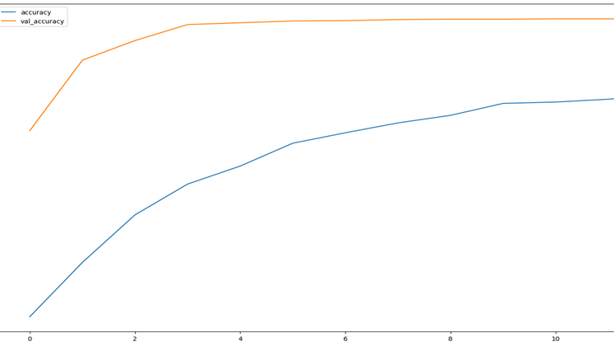
ACCURACY vs VAL_ACCURACY
Val_Accuracy turns almost to a constant level after certain epochs indicating that that the model is overfitted and unable to learn new features and take decisions based on it.

Slide 14

Discussion
Initial Low Accuracy: CNN alone yielded a low accuracy of around 30% on the given dataset, indicating difficulty in capturing relevant features from ECG signals.
Application of TQWT: TQWT, known for its ability to capture time and frequency-domain information, was introduced, resulting in improved feature extraction.
Large Dataset Utilization: Transitioning to a larger dataset of 21,799 samples improved model generalization and performance.
Comparison with VGG16 + Random Classifier: VGG16 architecture coupled with a Random Forest classifier did not significantly outperform CNN, with accuracy ranging between 51%-55%.
Optimal Performance with Random Classifier: Using only a Random Forest classifier yielded the best accuracy of 71%, especially when applied to all leads simultaneously, showcasing the effectiveness of ensemble learning.
Limitations of CWT: Continuous Wavelet Transform (CWT) was considered but limited by hardware constraints for such a large dataset.
In summary, integrating TQWT with CNN and employing a Random Forest classifier yielded the best accuracy for ECG classification, highlighting the importance of diverse techniques and model optimization.

Slide 15

Conclusion
Summary of Key Findings:
Recap of the project's objectives, methodology, and main findings.
Brief overview of the achieved accuracy and areas for improvement identified during the analysis.
Implications and Significance:
Discussion on the importance of the project's findings in the context of automated ECG signal classification and cardiovascular healthcare.
Reflection on how the project contributes to advancing the field and addressing existing challenges.
Call to Action:
Encouragement for further research and collaboration to address the identified limitations and improve model performance.
Invitation for feedback and discussion from the audience to foster knowledge exchange and innovation.

Slide 16

References
ECG Signal Classification Using Deep Learning Techniques Based on the PTB-XL Dataset. Available at: https://www.ncbi.nlm.nih.gov/pmc/articles/PMC8469424/
Python methods and libraries. Available at: https://www.python.org/
Sample codes Provided along with the projects. (Reference to provided materials by Teaching Assistants)
4. Some AI Tools

