Slide 1
GAMAT401:MATHEMATICS FOR COMPUTER AND INFORMATION SCIENCE-4
KSRTC BUS ROUTE OPTIMIZATION
Submitted to
JEEVAN PRAKASH
HOD MATHEMATICS DEPT. NSSCE
BY GROUP 2
S4 CSEB

Slide 2
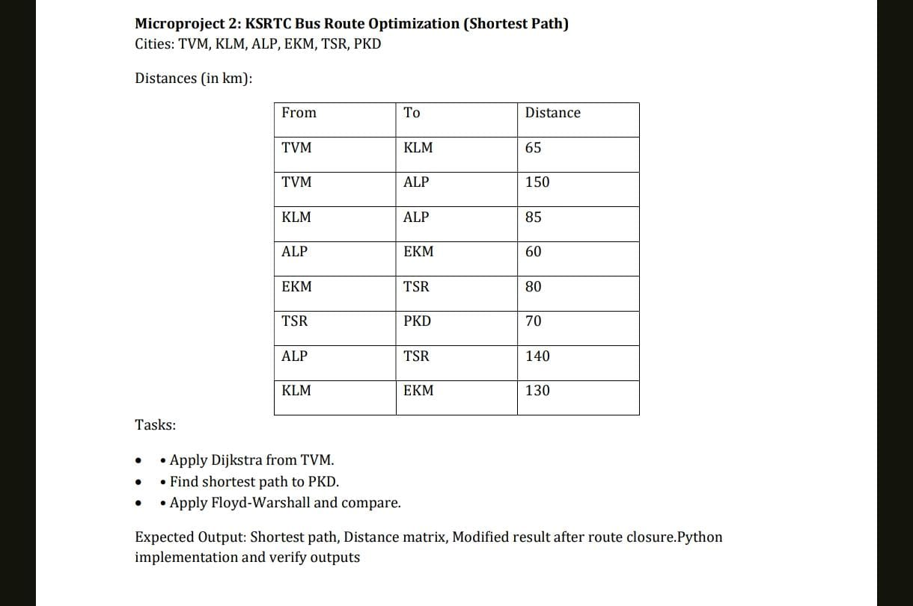
KSRTC Bus Route Optimization

Slide 3
Problem Statement
Goal: Find the shortest bus route from TVM to PKD.
We are given distances between cities.
We model the problem as a weighted graph.
Vertices = Cities
Edges = Bus routes
Weights = Distance (km).

Slide 4
Cities and Distances
TVM–KLM: 65 km
TVM–ALP: 150 km
KLM–ALP: 85 km
ALP–EKM: 60 km
EKM–TSR: 80 km
TSR–PKD: 70 km
ALP–TSR: 140 km
KLM–EKM: 130 km

Slide 5
Graph Representation
Each city is a node.
Each road is an edge.
The number on the edge represents distance.
This forms a weighted undirected graph.

Slide 6
Dijkstra Algorithm – Theory
Dijkstra finds the shortest path from one source node
to all other nodes in a weighted graph.
It works only with non‑negative weights.
It always selects the closest unvisited node.

Slide 7
Dijkstra Algorithm – Steps
1. Assign distance 0 to source node.
2. Assign infinity to all other nodes.
3. Choose the smallest unvisited node.
4. Update its neighbors' distances.
5. Repeat until all nodes are visited.

Slide 8
Dijkstra Step Table – Initialization
City Distance
TVM 0
KLM ∞
ALP ∞
EKM ∞
TSR ∞
PKD ∞

Slide 9
Dijkstra Step – After Visiting TVM
TVM → KLM = 65
TVM → ALP = 150
Distances:
TVM = 0
KLM = 65
ALP = 150

Slide 10
Dijkstra Step – After Visiting KLM
KLM → ALP = 65 + 85 = 150
KLM → EKM = 65 + 130 = 195
EKM distance updated to 195

Slide 11
Dijkstra Step – Continue Process
ALP → TSR = 150 + 140 = 290
EKM → TSR = 195 + 80 = 275
Better path chosen: 275

Slide 12
Final Dijkstra Result
Shortest Path:
TVM → KLM → EKM → TSR → PKD
Total Distance:
65 + 130 + 80 + 70 = 345 km

Slide 13
Floyd–Warshall Algorithm – Theory
Floyd–Warshall finds shortest paths
between all pairs of vertices.
It uses dynamic programming.

Slide 14
Floyd–Warshall Update Rule
For every pair of cities (i,j):
Check if going through another city k
gives a shorter path.

Slide 15
Mathematical Formula
dist[i][j] = min(dist[i][j], dist[i][k] + dist[k][j])

Slide 16
Initial Distance Matrix(D1)
TVM: [0,65,150,∞,∞,∞]
KLM: [65,0,85,130,∞,∞]
ALP: [150,85,0,60,140,∞]
EKM: [∞,130,60,0,80,∞]
TSR: [∞,∞,140,80,0,70]
PKD: [∞,∞,∞,∞,70,0]

Slide 17
Distance Matrix(D2)
TVM: [0,65,150,∞,∞,∞]
KLM: [65,0,85,130,∞,∞]
ALP: [150,85,0,60,140,∞]
EKM: [∞,130,60,0,80,∞]
TSR: [∞,∞,140,80,0,70]
PKD: [∞,∞,∞,∞,70,0]

Slide 18
Distance Matrix(D3)
TVM: [0,65,150,195,∞,∞]
KLM: [65,0,85,130,∞,∞]
ALP: [150,85,0,60,140,∞]
EKM: [195,130,60,0,80,∞]
TSR: [∞,∞,140,80,0,70]
PKD: [∞,∞,∞,∞,70,0]

Slide 19
Distance Matrix(D4)
TVM: [0,65,150,195,290,∞]
KLM: [65,0,85,130,225,∞]
ALP: [150,85,0,60,140,∞]
EKM: [195,130,60,0,80,∞]
TSR: [290,225,140,80,0,70]
PKD: [∞,∞,∞,∞,70,0]

Slide 20
Distance Matrix(D5)
TVM: [0,65,150,195,275,∞]
KLM: [65,0,85,130,210,∞]
ALP: [150,85,0,60,140,∞]
EKM: [195,130,60,0,80,∞]
TSR: [275,210,140,80,0,70]
PKD: [∞,∞,∞,∞,70,0]

Slide 21
Final Distance Matrix
TVM: [0,65,150,195,275,345]
KLM: [65,0,85,130,210,280]
ALP: [150,85,0,60,140,210]
EKM: [195,130,60,0,80,150]
TSR: [275,210,140,80,0,70]
PKD: [345,280,210,150,70,0]

Slide 22
Algorithm Comparison
Dijkstra:
Single source
Faster for route finding
Floyd‑Warshall:
All city pairs
Useful for full network analysis

Slide 23
Graph Visualization (Python)
Python libraries used:
networkx – build graph
matplotlib – visualize graph
Shortest path edges highlighted in red.

Slide 24
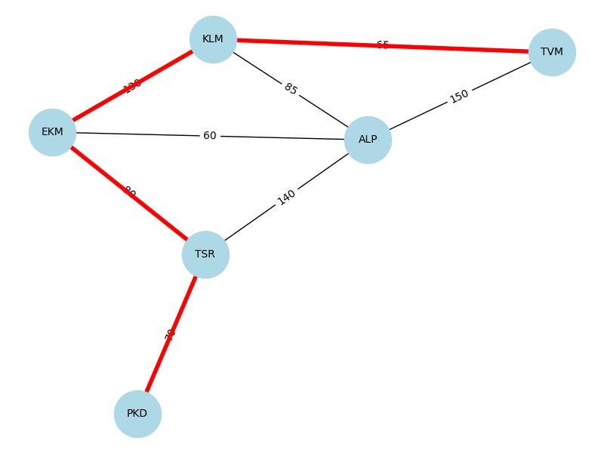

Slide 25
Conclusion
Shortest Route:
TVM → KLM → EKM → TSR → PKD
Distance = 345 km
Both algorithms give the same optimal solution.

Slide 26
THANK YOU

