Slide 1
PillSync
Intelligent Medicine Reminder & Tracking Platform
Milestone 1:
Role-based access control(patient/caregiver/admin)
&
User profile management
Intern : Rajasri Nallamilli
Branch : intern/03-rajasri-nallamilli
Submitted on:31-08-2026

Slide 2
01. INTRODUCTION
Project Overview & Milestone 1 Scope
🎯 Problem Statement & Goal
• Challenge: Medication non-adherence leads to severe health complications and preventable hospitalizations.
• Solution: PillSync is an intelligent multi-role platform that automates daily dose reminders, stock refill predictions, prescription OCR scanning, and caregiver alerts.
👤 Milestone 1 Deliverables
☑ Frontend Application Setup: Vite, React 18, Custom CSS Tokens (#ED4264, #DC143C).
☑ Workflow Architecture Planning: 4 core sequence & flowchart diagrams.
☑ Role-Based Direct URL Routing: Clean navigation (/patient, /caregiver, /admin).

Slide 3
02. ARCHITECTURE
Design Aesthetics & URL Routing Architecture
🎨 Color Palette & Aesthetics
• Primary Crimson: #ED4264 & #DC143C • Soft Rose Background: #FFF1F2
• Glassmorphic cards with subtle borders.
• Curved category headers & high contrast text.
🌐 Direct URL Routing
• Configured react-router-dom BrowserRouter.
• Direct URL paths (/patient, /caregiver, /admin).
• Bypasses OAuth blockers for instant UI testing.
• Fully responsive across mobile & desktop.
⚙️ Clean Empty State Design
• 100% Manual Data Entry controls.
• Zero hardcoded default dummy data.
• Interactive Add/Edit forms for Patients, Medicines, Caregivers & Admins.

Slide 4
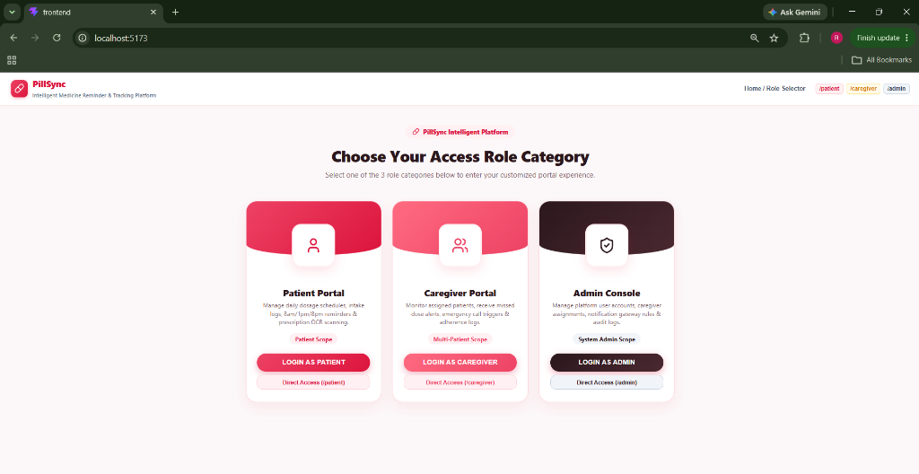
03. UI WIREFRAMES
Landing Page — Role Category Selection Hub
🔑 Role Category Selection Hub
• Single Landing Page serving as the central portal entry point.
• Features 3 role category cards with curved top headers:
1. Patient Portal (Login & /patient direct route)
2. Caregiver Portal (Login & /caregiver direct route)
3. Admin Console (Login & /admin direct route)
• High visual impact matching intern reference design requirements.
• Direct access shortcuts in top header bar.

Slide 5
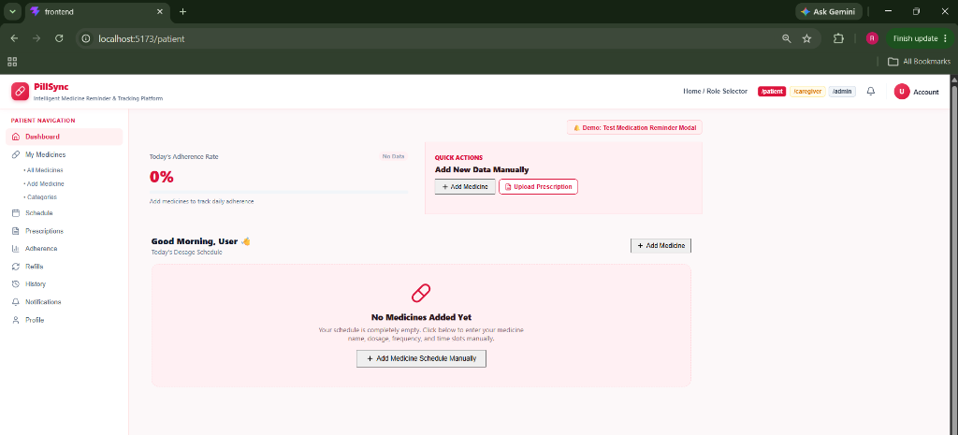
04. PATIENT SCOPE
Patient Portal — Dosage Schedule & Health Management
💊 Patient Dashboard & Profile Hub
• 100% Clean Empty State — No hardcoded dummy medicines.
• Interactive Quick Actions: [ + Add Medicine ] and [ Upload Prescription ].
• Dual Add Method: Manual Entry form & AI/OCR Prescription Image Upload.
• 1-Click Dosage Logger: [ Taken ], [ Missed ], [ Snooze 15m ].
• Consolidated Profile Sub-tabs: Personal Info, Adherence %, Refill Engine, History Logs.

Slide 6
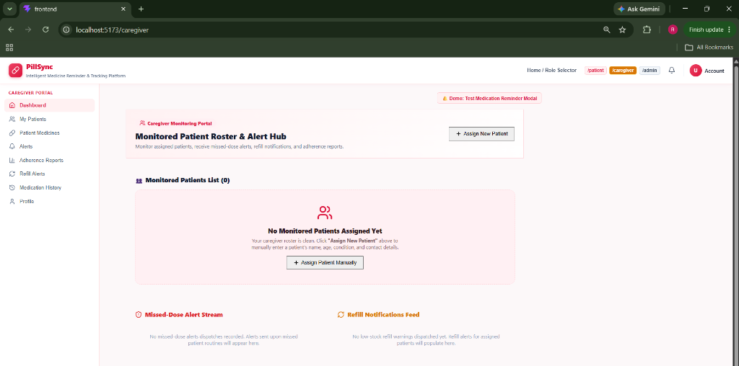
05. CAREGIVER SCOPE
Caregiver Portal — Patient Roster & Alert Hub
👥 Caregiver Dashboard & Alert Feeds
• Monitored Patient Roster: Clean empty state with [ + Assign New Patient ] form.
• Patient Details Page (/caregiver/patients): View compliance, adherence %, and emergency contact info.
• Missed-Dose Alert Stream: Real-time log of missed patient routines.
• Refill Notifications Feed: Stock depletion warnings.
• Caregiver Actions: [ Send Nudge ] & [ Emergency Call Patient ].

Slide 7
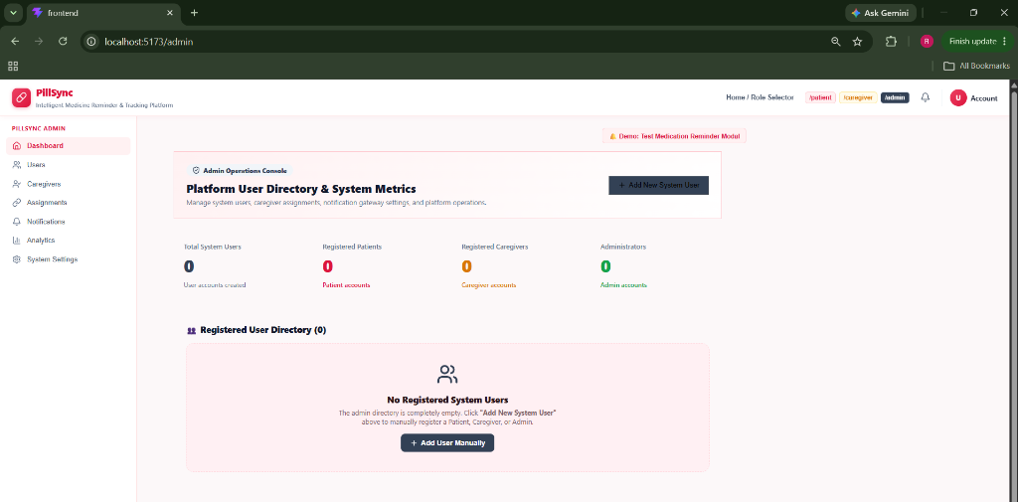
06. ADMIN SCOPE
Admin Console — User Management & System Controls
⚙️ System Administration Console
• Dynamic Metric Counters: Users (0), Patients (0), Caregivers (0), Admins (0) — calculated live from user entries.
• Registered User Directory: Manage user roles and permission states.
• Manual User Registration: Form to register Patient, Caregiver, or Admin accounts.
• Account Controls: 1-click [ Block ], [ Unblock ], or [ Delete ] user actions.
• Notification Gateway: Toggle Push, Email, and SMS notification channels.

Slide 8
07. WORKFLOWS
System Workflows & Architecture Planning
🔐 1. Authentication Flow
Role Category Selection ➔ Login Page ➔ Role Verification ➔ Redirect to /patient, /caregiver, or /admin.
⏰ 2. Reminder & Schedule Flow
Add Medicine Form ➔ Daily Routine Setup (8am/1pm/8pm) ➔ Trigger Reminder Modal ➔ Log Intake (Taken/Missed/Snooze).
📷 3. Prescription OCR Flow
Upload Prescription Image ➔ AI/OCR Parsing ➔ Extract Name, Dosage, Stock ➔ Review & Save to Schedule.
🚨 4. Caregiver Escalation Flow
Patient Misses Dose ➔ Log Missed Event ➔ Dispatch Alert to Caregiver Stream ➔ Caregiver Triggers Nudge / Call.

Slide 9
08. VERIFICATION
Quality Assurance, Testing & Git Deliverables
🧪 Automated Test & Build Verification
✅ npm run format:check — Passed cleanly
✅ npm run test — Passed cleanly
✅ npm run build — 0 Errors (Production bundle generated)
✅ Secret & Hygiene Check — Zero credentials committed
✅ Responsive Layout Test — Verified across viewport sizes
🚀 GitHub Repositories Pushed
1. Personal & Team Repository: • URL: github.com/rajasrinallamilli/pillsync2 • Branches: main & rajasri
2. Official Mentor Internship Repository: • URL: github.com/GKSJ-Deepvision/PillSync • Branch: intern/03-rajasri-nallamilli • Fully compliant with INTERN_GUIDE.md roster rules.

Slide 10
09. CONCLUSION
Conclusion & Milestone 2 Roadmap
Milestone 1 Successfully Completed!
• All assigned Milestone 1 frontend components, 25-screen wireframe blueprints, and system workflow diagrams are 100% complete and verified.
• 🚀 Milestone 2 Roadmap Ahead (Weeks 3–4):
- Integrate frontend UI with Teammates' REST API endpoints & PostgreSQL database schema.
- Connect JWT Authentication tokens & Role-based Access Control (RBAC) middleware.
- Implement live push, email, and SMS reminder notifications.
- Enhance AI/OCR prescription scanning engine & refill predictions.
Thank you! Questions & Feedback.

