Slide 1

- Sirajuddeen

Slide 2
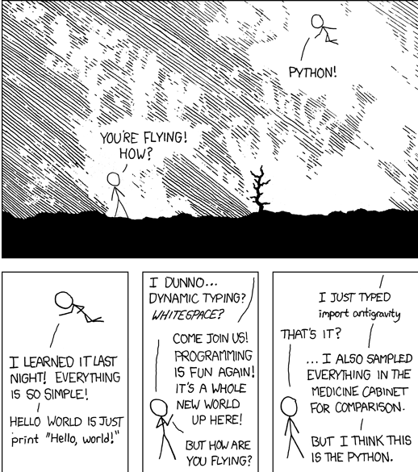

Python ????? !!!!!!!!!!!!!!! #$%#$%^
"Life's better without braces"(Bruce)

Slide 3
Salient Features of Python :
It Runs on Any Platform
Simple, Easy to Learn
Free and Open Source , High-level Language
Interpreted , Portable
Object Oriented , Extensible
Embeddable , Extensive Libraries

Slide 4
What is Python ?
According Python.Org
Python is an interpreted, object-oriented, high-level programming language with dynamic semantics. Its high-level built in data structures, combined with dynamic typing and dynamic binding, make it very attractive for Rapid Application Development

Slide 5
Core Concepts
Data Structures
List
String
Tuple
Dictionary
Set

Slide 6
Python - List
How to create a list?
How to access elements from a list?
How to slice lists in Python?
How to change or add elements to a list?
Python List Methods

Slide 7
Python - Strings
What is String in Python?
How to create a string in Python?
How to access characters in a string?
How to change or delete a string?
Python String Operations
Concatenation of Two or More Strings
String Membership Test

Slide 8
Python - Tuple
What is tuple?
Creating a tuple
Accessing Elements in a Tuple
Indexing
Negative Indexing
Slicing
Changing a tuple
Deleting a Tuple

Slide 9
Python - Set
What is a set in Python?
How to create a set?
How to change a set in Python?
How to remove elements from a set?

Slide 10
Python - Dictionary
What is dictionary in Python?
How to create a dictionary?
How to access elements from a dictionary?
How to change or add elements in a dictionary?
How to delete or remove elements from a dictionary?
Python Dictionary Methods

Slide 11
Functions
def function_name(parameters): """doc string""" statement(s) return ""
Keyword - def
function name should be uniquely identify it.
Parameter - optional
: - mandatory
doctring - optional
return statement - optional

Slide 12
Why Numpy ??
It consumes less memory. It is fast as compared to the python List. It is convenient to use. Now, let's write small programs to prove that NumPy multidimensional array object is better than the python List.
Fast Computation
NumPy is Convenient to use

Slide 13
PYTHON - Numpy
NumPy stands for ‘Numerical Python’ or ‘Numeric Python’. It is an open source module of Python which provides fast mathematical computation on arrays and matrices.
NumPy provides the essential multi-dimensional array-oriented computing functionalities designed for high-level mathematical functions and scientific computation.

Slide 14
Key Features of Numpy
Ndim: displays the dimension of the array
Shape: returns a tuple of integers indicating the size of the array
Size: returns the total number of elements in the NumPy array
Dtype: returns the type of elements in the array, i.e., int64, character
Itemsize: returns the size in bytes of each item
Reshape: Reshapes the NumPy array

Slide 15
Accessing Array - Numpy Indexing
NumPy array elements can be accessed using indexing. Below are some of the useful examples:
A[2:5] will print items 2 to 4. Index in NumPy arrays starts from 0
A[::-1] will print the array in the reverse order
A[1:] will print from row 1 to end

Slide 16
PYTHON- Pandas
Similar to NumPy, Pandas is one of the most widely used python libraries in data science. It provides high-performance, easy to use structures and data analysis tools. Unlike NumPy library which provides objects for multi-dimensional arrays, Pandas provides in-memory 2d table object called Dataframe. It is like a spreadsheet with column names and row labels.

Slide 17
Key Features of Pandas
Some commonly used data structures in pandas are:
Series objects: 1D array, similar to a column in a spreadsheet
DataFrame objects: 2D table, similar to a spreadsheet
Panel objects: Dictionary of DataFrames, similar to sheet in MS Excel

Slide 18
Useful Functions - Pandas
head(): returns the top 5 rows in the dataframe object
tail(): returns the bottom 5 rows in the dataframe
info(): prints the summary of the dataframe
describe(): gives a nice overview of the main aggregated values over each column.

Slide 19
Trainer Credentials
LinkedIn : https://www.linkedin.com/in/muhammad-sirajuddeen .
Github : https://github.com/sirajtechy .
E-mail : sirajtechy@gmail.com .
Phone : 91+ 7010811417 .

Slide 20
Q & A

