Slide 1
ZilaLens
Women’s Financial Inclusion and Empowerment Across Indian Districts, NFHS-4 (2015-16) to NFHS-5 (2019-21)
Kanishk Gupta | https://github.com/GKanishk16
ZilaLens | Kanishk Gupta 01
Notes:
Interim edition, 18 October 2026.

Slide 2
NFHS-5 is the missing input for all two-round findings
The official data.gov.in workbook resource returned HTTP 403 in this environment.
Catalog resource: “India Districts Factsheets of NFHS-5, 2019-2021”; exact destination is recorded in README and DATA_SOURCES.
ZilaLens | Kanishk Gupta 02
Notes:
Catalog resource: “India Districts Factsheets of NFHS-5, 2019-2021”; exact destination is recorded in README and DATA_SOURCES.

Slide 3
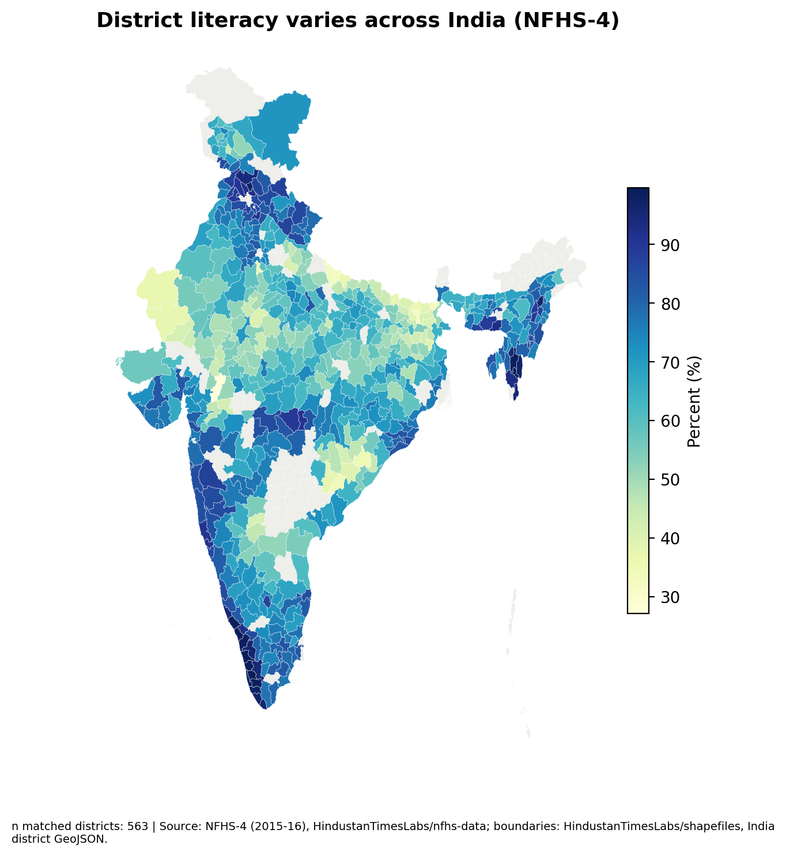
NFHS-4 provides a usable district baseline for selected indicators
59,241 district-indicator rows and 93 district indicators are present in the specified NFHS-4 compilation.
Source: HindustanTimesLabs nfhs_district-wise.csv and README. Counts describe the input file, not a population finding.
ZilaLens | Kanishk Gupta 03
Notes:
Source: HindustanTimesLabs nfhs_district-wise.csv and README. Counts describe the input file, not a population finding.

Slide 4
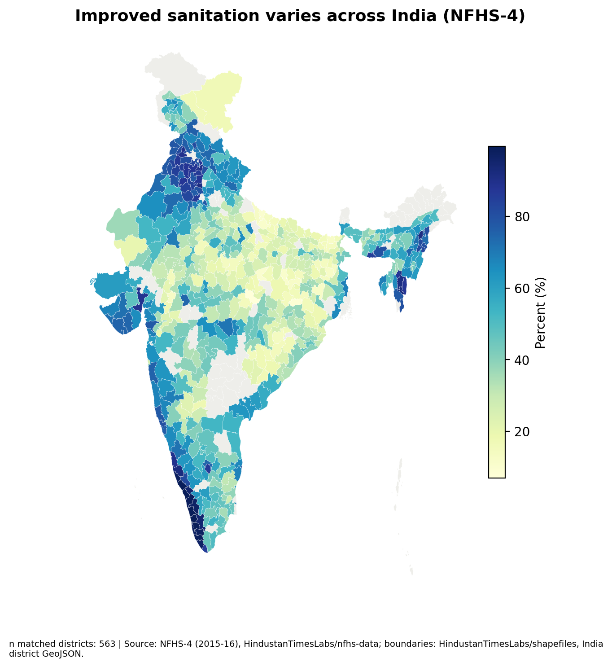
Improved sanitation varies across mapped districts at baseline
The interim map joins 563 district estimates to the available public district GeoJSON.
Source: NFHS-4 compilation and HindustanTimesLabs district GeoJSON. Boundary vintage is not confirmed as survey-equivalent.
ZilaLens | Kanishk Gupta 04
Notes:
Source: NFHS-4 compilation and HindustanTimesLabs district GeoJSON. Boundary vintage is not confirmed as survey-equivalent.

Slide 5
Common indicators must be confirmed from both factsheet rounds
NFHS-4 includes literacy, schooling, early marriage, clean fuel and improved sanitation indicators.
Bank-account and mobile phone measures were not identified under the requested wording in the NFHS-4 compilation; exact NFHS-5 labels remain unverified.
ZilaLens | Kanishk Gupta 05
Notes:
Bank-account and mobile phone measures were not identified under the requested wording in the NFHS-4 compilation; exact NFHS-5 labels remain unverified.

Slide 6
Name similarity cannot resolve parent and child districts by itself
Current crosswalk uses normalized names and retains fuzzy suggestions for review.
Document the selected parent/child mapping and any assumptions before calculating change.
ZilaLens | Kanishk Gupta 06
Notes:
Document the selected parent/child mapping and any assumptions before calculating change.

Slide 7
The 112-district roster needs a reviewed NFHS crosswalk
The NITI 2022 roster has 112 entries; 96 match NFHS-4 state–district names exactly.
Sixteen names remain unresolved by exact matching; source list and project crosswalk are cited in the report. This is a roster coverage statistic, not an outcome estimate.
ZilaLens | Kanishk Gupta 07
Notes:
Sixteen names remain unresolved by exact matching; source list and project crosswalk are cited in the report. This is a roster coverage statistic, not an outcome estimate.

Slide 8
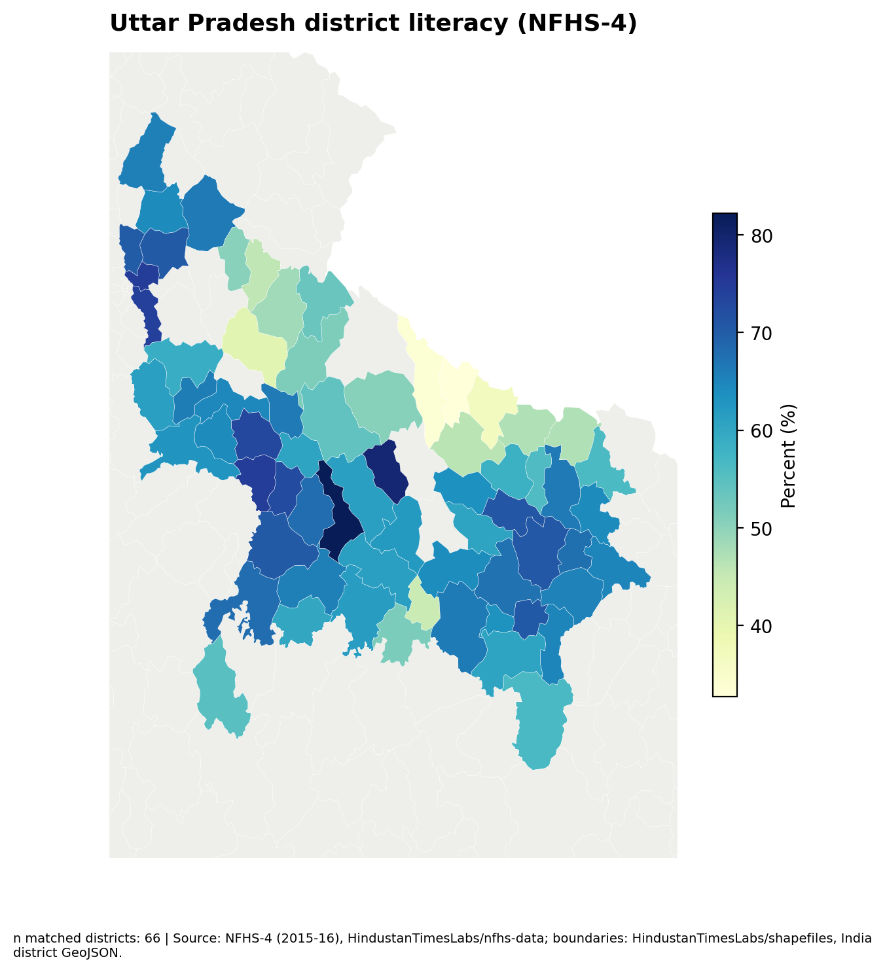
UP change rankings wait for the paired NFHS-5 estimates
Ghaziabad and Gautam Buddha Nagar can be compared with state and national benchmarks only after harmonization.
The interim UP map shows NFHS-4 baseline literacy only.
ZilaLens | Kanishk Gupta 08
Notes:
The interim UP map shows NFHS-4 baseline literacy only.

Slide 9
Policy documents point to reach, connectivity and delivery capacity
The PMJDY brochure describes branch and Bank Mitra reach and notes telecom constraints in some locations.
PMJDY Mission Document/Brochure, physical pp. 18, 20 and 30; NITI/UNDP ADP appraisal, physical pp. 15, 20 and 28. Paraphrases are in the coding matrix.
ZilaLens | Kanishk Gupta 09
Notes:
PMJDY Mission Document/Brochure, physical pp. 18, 20 and 30; NITI/UNDP ADP appraisal, physical pp. 15, 20 and 28. Paraphrases are in the coding matrix.

Slide 10
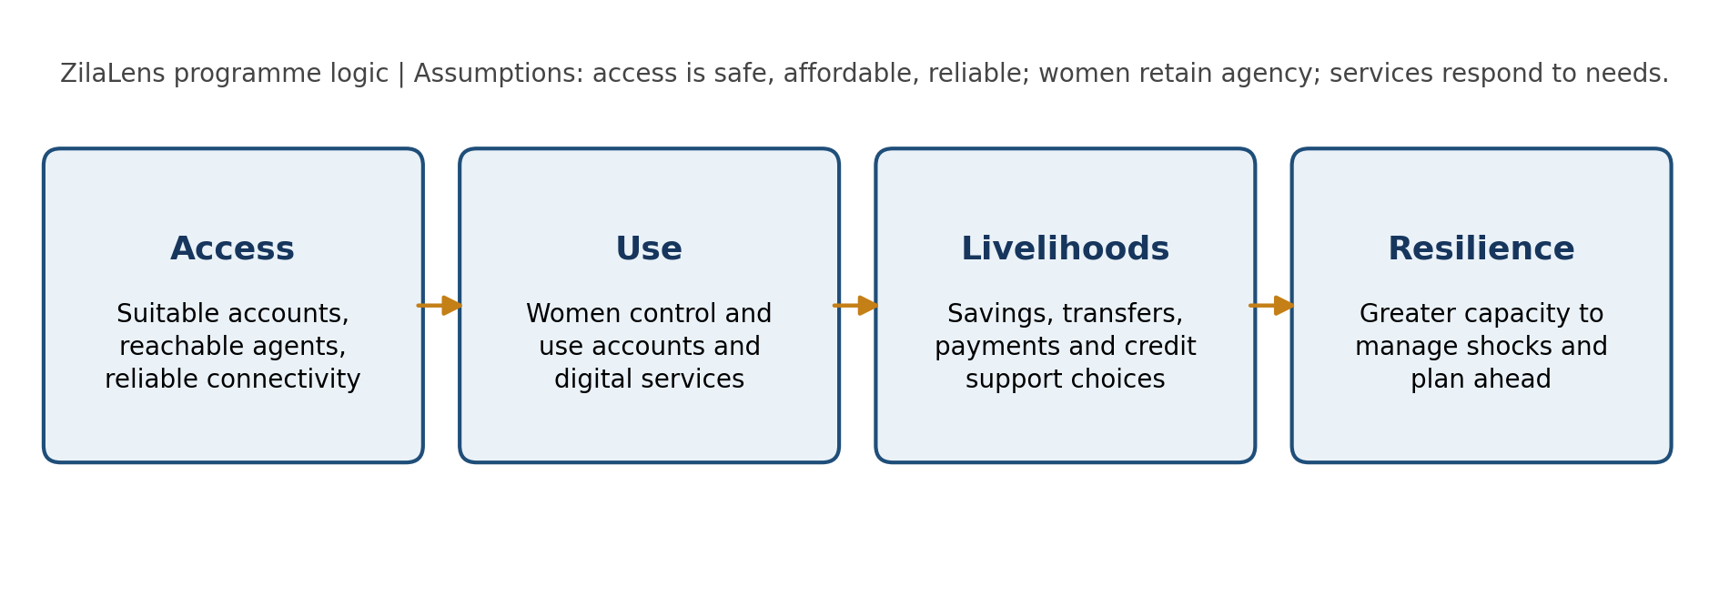
The intervention should measure use and control alongside access
Proposed pathway: reachable service → women’s independent use → financial options → resilience.
ZilaLens | Kanishk Gupta 10
Notes:
The theory of change states assumptions. No programme effect is claimed.

Slide 11
Field validation can test whether ownership translates into use
The bilingual XLSForm asks about recent transactions, decision control, phone access, service failures, help needs and barriers.
Consent gate and skip logic are included; pyxform conversion succeeded without warnings.
ZilaLens | Kanishk Gupta 11
Notes:
Consent gate and skip logic are included; pyxform conversion succeeded without warnings.

Slide 12
District selection and final recommendations follow verified comparison
Provide the official workbook, then review the crosswalk and common indicators before selecting 3–5 UP districts.
Results remain descriptive. Aspirational District comparisons are not causal.
ZilaLens | Kanishk Gupta 12
Notes:
Results remain descriptive. Aspirational District comparisons are not causal.

