Slide 1
Exam 70-774 Perform Cloud Data Science with Azure Machine Learning
Prepare Data for Analysis in Azure Machine Learning and Export from Azure Machine Learning
Develop Machine Learning Models
Operationalize and Manage Azure Machine Learning Services
Use Other Services for Machine Learning
Speaker Information:
https://www.microsoft.com/en-us/learning/exam-70-774.aspx
Notes:
Presentation: 105 minutes
Lab: 50 minutes
After completing this module, students will be able to:
Identify suitable workloads for the cloud.
Identify services and capabilities that Microsoft Azure provides.
Use Azure portals to manage Azure services and subscriptions.
Use Windows PowerShell to manage Azure services and subscriptions.
Use Azure Command-Line Interface (CLI) to manage Azure services and subscriptions.
Describe the primary characteristics of Azure Resource Manager.
Use Azure services to enhance management and monitoring of Azure.
Required materials
To teach this module, you need the Microsoft PowerPoint file 20533D_01.pptx.
Preparation tasks
To prepare for this module, you should:
Read all this module’s materials.
Practice performing the demonstrations and labs.
Work through the Module Review and Takeaways section to determine how you will use the information to reinforce student learning and promote knowledge transfer to on-the-job performance.
As you prepare for this class, it is imperative that you complete the labs yourself. This gives you an understanding of how the labs work, as well as the concepts that each lab covers. This enables you to provide meaningful hints to students who might have issues while working in the labs. Furthermore, it will help guide your lecture to ensure that you discuss the concepts that the labs cover.
20533D
1: Introduction to Microsoft Azure

Slide 2
Operationalize and Manage Azure Machine Learning Services
Deploy models using Azure Machine Learning
Manage Azure Machine Learning projects and workspaces
Consume Azure Machine Learning models
Consume exemplar Cognitive Services APIs
https://www.microsoft.com/en-us/learning/exam-70-774.aspx

Slide 3
Operationalize and Manage Azure Machine Learning Services
Deploy models using Azure Machine Learning
Publish a model developed inside Azure Machine Learning, publish an externally developed scoring function using an Azure Machine Learning package, use web service parameters, create and publish a recommendation model, create and publish a language understanding model
Manage Azure Machine Learning projects and workspaces
Create projects and experiments, add assets to a project, create new workspaces, invite users to a workspace, switch between different workspaces, create a Jupyter notebook that references an intermediate dataset
Consume Azure Machine Learning models
Connect to a published Machine Learning web service, consume a published Machine Learning model programmatically using a batch execution service, consume a published Machine Learning model programmatically using a request response service, interact with a published Machine Learning model using Microsoft Excel, publish models to the marketplace
Consume exemplar Cognitive Services APIs
Consume Vision APIs to process images, consume Language APIs to process text, consume Knowledge APIs to create recommendations
https://www.microsoft.com/en-us/learning/exam-70-774.aspx
Notes:
The following topics are not included in this presentations due to time constrains
publish an externally developed scoring function using an Azure Machine Learning package
create a Jupyter notebook that references an intermediate dataset
publish models to the marketplace

Slide 4
Deploy models using Azure Machine Learning
Publish a model developed inside Azure Machine Learning, publish an externally developed scoring function using an Azure Machine Learning package, use web service parameters, create and publish a recommendation model, create and publish a language understanding model
https://www.microsoft.com/en-us/learning/exam-70-774.aspx

Slide 5
Deployment overview
Training experiment
Predictive experiment
Web service
New
Classic
Notes:
20774A
10: Using Azure Machine Learning Models

Slide 6
Using web service parameters
Web service parameters can:
Increase the number of features
Change the export destination
Notes:
https://docs.microsoft.com/en-us/azure/machine-learning/studio/web-service-parameters
20774A
10: Using Azure Machine Learning Models

Slide 7
Deploying and publishing experiments
Create a new standard Machine Learning Workspace
Open a sample experiment
Publish the experiment as a web service
Add export path as a web service parameter
Deploy the web service
Notes:
Demonstration Steps
Create a new standard Machine Learning Workspace
On the 20774A-LON-DEV virtual machine, in Microsoft Internet Explorer®, in the address bar, type http://azure.microsoft.com, click Portal, and then sign in using the Microsoft account that is associated with your Azure Learning Pass subscription.
In the Azure Portal, click +New, click Data + Analytics, click See all, click Machine Learning Workspace, and then click Create.
Enter the following workspace information:
Workspace name: <your name>-workspace
Subscription: Azure Pass
Resource group: (create new) workspacerg
Location: choose the nearest location
Storage account: (create new) accept default <unique>
Workspace pricing tier: Standard
Web service plan: (create new) accept default
Click web service plan pricing tier, click DevTest Standard, and then click Select.
Click Create.
Wait until the workspace has been deployed.
Open a sample experiment
Click All resources, and then click the workspace.
Click Launch Machine Learning Studio.
Click Sign In.

Slide 8
Notes:
In Machine Learning Studio, click + NEW, then in the search box, type sample, and then click Sample 6: Train, Test, Evaluate for Regression: Auto Imports Dataset, and then click OPEN IN STUDIO.
This sample takes raw automobile details and attempts to predict the price of an automobile. It trains two machine learning models, Poisson Regression and Decision Forest Regression, and compares the results.
Point out the key features in the model; use the descriptions given for the main modules to help you with this.
Run the experiment, by clicking RUN at the bottom of the page.
Publish the experiment as a web service
When the experiment has finished running, click the Train Model module for Decision Forest Regression, at the bottom of the page click SET UP WEB SERVICE, and then click Predictive Web Service (Recommended).
In the predictive experiment, connect the Web service input module to the right-hand input port of the Score Model module.
In the Search experiment items box, start to type Export, and then from the module list, drag Export Data on to the experiment canvas, below the Score Model module.
Connect the Score Model output to the Export Data module.
Add export path as a web service parameter
Switch to the Azure Portal, and on the Overview page for your workspace, click the storage account.
Under SETTINGS, click Access keys, and click the Click to copy icon for key1.
Switch to Machine Learning Studio, and click the Export Data module.
(More notes on the next slide)
20774A
10: Using Azure Machine Learning Models

Slide 9
Notes:
In the Properties pane, enter the following information:
Azure account name: <your storage account>
Azure account key: paste key1
Path to Blob beginning with container: container1/output1.csv
Above the path to Blob beginning, on the hamburger menu, click Set as Web Service Parameter.
The web service parameter is now listed at the bottom of the properties box; click the web service parameter, and then change its name to blobpath.
At the bottom of the page, click RUN to run the predictive experiment.
Deploy the web service
When the experiment has finished running, at the bottom of the page click DEPLOY WEB SERVICE, and then select New Web Services Experience Preview.
If you get a pop-up dialog box, click Allow.
On the Web Services Management page, if you get an option to select a price plan, in the Price Plan list, select your price plan, and then click Deploy.
Leave this service running and continue to the next lesson.
(More notes on the next slide)
20774A
10: Using Azure Machine Learning Models

Slide 10
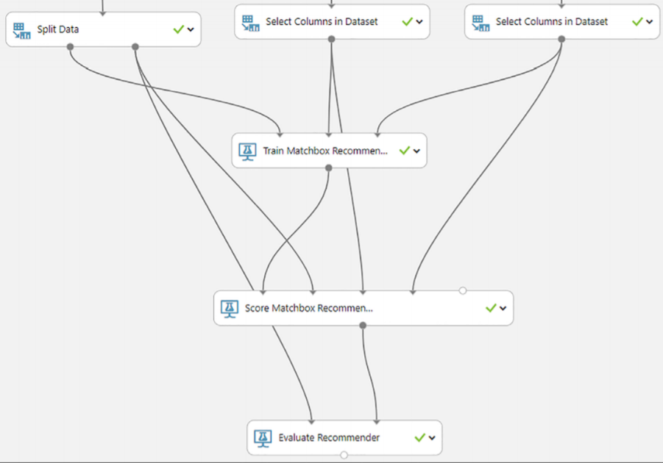
Create and publish a recommendation model
Content-based
Collaborative filtering
Matchbox recommender
The first dataset: user-item-rating
The second data: user features
The third data: item features
Notes:
A recommendation system is used to solve this problem prioritizing and delivering information relevant to users based on their characteristics, either historical data or attributes related to the final recommendation.
Matchbox recommender, a Microsoft Research implementation for recommenders that combines collaborative filtering with a content-based approach. It is a hybrid recommendation
20774A
10: Using Azure Machine Learning Models

Slide 11
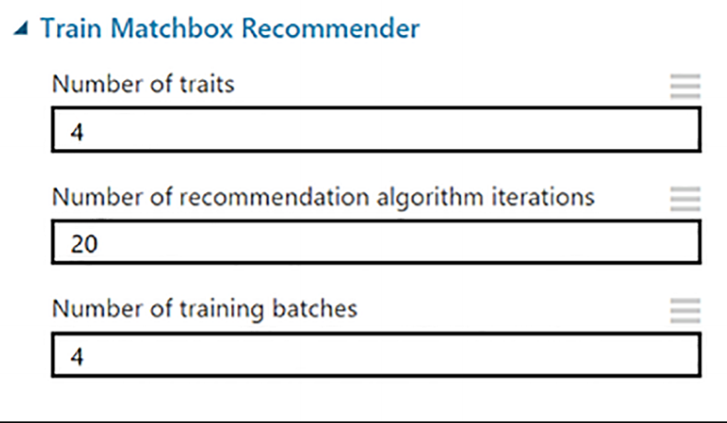
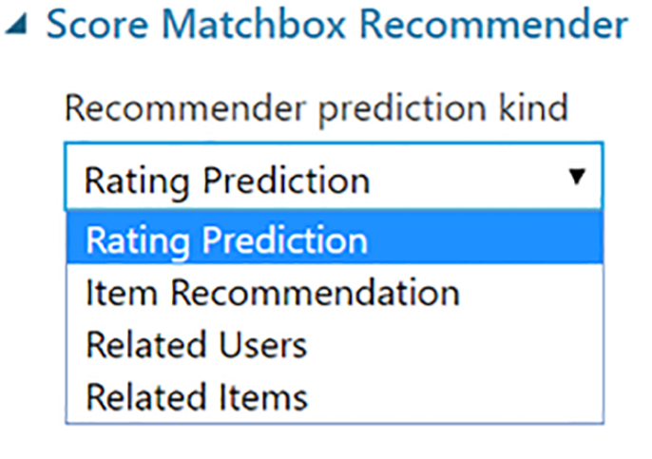
Create and publish a recommendation model
Train Matchbox recommender
Score Matchbox recommender
Notes:
■ Number Of Traits The number of characteristics that should be learned for each user and item.
■ Number Of Recommendation Algorithm Iterations This is the number of times the algorithm processes the data.
■ Number Of Training Batches This is the number of batches for dividing the data during training because the Train Matchbox Recommender runs batches in parallel.
20774A
10: Using Azure Machine Learning Models

Slide 12
Create and publish a language understanding model
https://docs.microsoft.com/en-us/azure/cognitive-services/luis/luis-get-started-create-app

Slide 13
Which stage of the Machine Learning deployment process can score input data through an HTTP endpoint?
Training experiment
Predictive experiment
Web service
API deployed

Slide 14
Which stage of the Machine Learning deployment process can score input data through an HTTP endpoint?
Web service

Slide 15
Manage Azure Machine Learning projects and workspaces
Create projects and experiments, add assets to a project, create new workspaces, invite users to a workspace, switch between different workspaces, create a Jupyter notebook that references an intermediate dataset

Slide 16
Introduction to Machine Learning Studio
Machine Learning Studio graphical tool used throughout the machine learning development life cycle:
Data import
Data preprocessing
Feature selection
Algorithm selection
Model testing
Model deployment
Model retraining and redeployment
Notes:
In the Machine Learning Studio interface, you drag datasets, data preprocessing modules, machine
learning algorithms, and other functions onto an experiment canvas.
It is possible, therefore, to build and test a machine learning model without writing any program code,
20774A
2: Introduction to Azure Machine Learning

Slide 17
Workspaces
Machine Learning workspace
Container for projects, experiments, and models
Linked to Microsoft account—can be shared
Storage
Free: uses default storage account (10 GB maximum)
Standard: requires storage account
Roles
User
Owner
Notes:
Workspaces are associated with an Azure region, and everything in the workspace is local to that region.
• User. Workspace users can create, open, modify, and delete experiments, datasets, and other
elements.
• Owner. Workspace owners have all the same abilities as a regular user, but can also add and remove
users in the workspace. The account used to create the workspace is automatically a workspace
owner.
20774A
2: Introduction to Azure Machine Learning

Slide 18
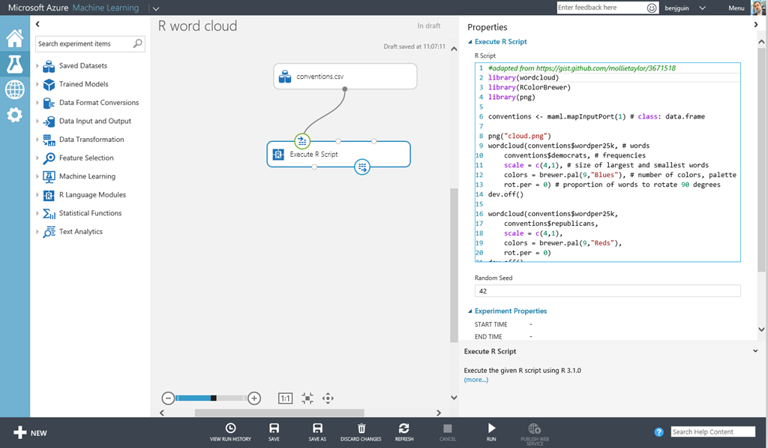
Workspaces
Notes:
Workspaces are associated with an Azure region, and everything in the workspace is local to that region.
• User. Workspace users can create, open, modify, and delete experiments, datasets, and other
elements.
• Owner. Workspace owners have all the same abilities as a regular user, but can also add and remove
users in the workspace. The account used to create the workspace is automatically a workspace
owner.
20774A
2: Introduction to Azure Machine Learning

Slide 19
Experiments and projects
Machine Learning experiments:
Comprise at least one dataset and one module
Datasets can only be connected to modules
Modules connect to datasets or to other modules
Input ports on all modules must be connected to the data flow
Mandatory parameters on modules must be configured
Machine Learning projects:
Experiments, datasets, notebooks
Notes:
An experiment represents the execution of one or more machine learning algorithms against all or some of a prepared dataset.
Machine Learning Studio maintains full run history, which includes the dataset(s) used, and details of all modules, together with their port connections and
parameters.
You can also save a local copy of the experiment in JSON format.
20774A
2: Introduction to Azure Machine Learning

Slide 20
Modules
Modules:
Execute a specific machine learning algorithm, function, or other code
Perform actions on data, or as part of working with other modules
Can operate independently
Can be connected with other modules as part of a machine learning workflow
Can be configured using parameters
Custom modules can be built using R
Notes:
The libraries and APIs in Machine Learning modules are derived from sources such as Microsoft Research
Machine Learning modules provide a range of machine learning functions, including:
• Data import and export.
• Data normalization, grouping, and scaling.
• Statistical analysis and distributional plots.
• Data conversions to other formats.
• Feature selection.
• Text analytics.
• Dimensionality reduction.
20774A
2: Introduction to Azure Machine Learning

Slide 21
Using Machine Learning Studio
Sign in to a Machine Learning Studio account
Clone a sample experiment
View the modules in an experiment
Notes:
Preparation Steps
Ensure that the MT17B-WS2016-NAT, 20774A-LON-DC, and 20774A-LON-DEV virtual machines are running, and that you are logged on to 20774A-LON-DEV as ADATUM\AdatumAdmin.
Demonstration Steps
Sign into your Microsoft Azure Machine Learning Studio account
On the Start menu, start to type Internet Explorer, and then click Internet Explorer.
In Internet Explorer®, in the address bar, type https://studio.azureml.net, and press Enter.
On the Microsoft Azure Machine Learning Studio page, click Sign In.
Sign in using the Microsoft account that is associated with your Azure Learning Pass subscription.
Clone a sample experiment
In the Microsoft Azure Machine Learning Studio workspace, in the left-hand pane, click EXPERIMENTS.
On the experiments page, click SAMPLES.
In the list of samples, click Recommender: Movie recommendation.
At the bottom of the workspace, click SAVE AS.
In the SAVE AS dialog box, type My Movie Recommender, and then click OK (the tick).
View the modules in the experiment
Zoom in, so that the names of the modules are visible.
Point out that Movie Ratings and IMDB Movie Titles are the datasets.
Briefly explain the purpose of the following modules:
Edit Metadata
Join Data
Briefly explain the purpose of the following modules:
Edit Metadata
Join Data
Select Columns in Dataset
Remove Duplicate Rows
Split Data
Partition and Sample
Train Matchbox Recommender
Score Matchbox Recommender
Evaluate Matchbox Recommender
Close Internet Explorer.

Slide 22
Introduction to Machine Learning
Exercise 1: Using Machine Learning Studio Exercise 2: Clone and run a simple experiment
Estimated Time: 45 minutes
https://github.com/MicrosoftLearning/20774_Perform-Cloud-Data-Science-with-Azure-Machine-Learning/blob/master/Instructions/20774A_LAB_AK_01.md

Slide 23
Consume Azure Machine Learning models
Connect to a published Machine Learning web service, consume a published Machine Learning model programmatically using a batch execution service, consume a published Machine Learning model programmatically using a request response service, interact with a published Machine Learning model using Microsoft Excel, publish models to the marketplace

Slide 24
Lesson 2: Consuming experiments
Consuming a published experiment Using Excel with a published model Using the Export Data module Demonstration: Consuming Machine Learning experiments
Notes:
Question
Where can’t the Export Data module export?
( )Option 1: Azure SQL Database
( )Option 2: Azure Cosmos DB
( )Option 3: Azure Blob storage
( )Option 4: Azure Table storage
Answer
(√ ) Option 2: Azure Cosmos DB
20774A
10: Using Azure Machine Learning Models

Slide 25
Consuming a published experiment
Request-Response Service
Batch Execution Service
Batch Pool
Notes:
https://docs.microsoft.com/en-us/azure/machine-learning/studio/consume-web-services
20774A
10: Using Azure Machine Learning Models

Slide 26
Using Excel with a published model
Excel add-in
Macro version
New and classic web services
Notes:
20774A
10: Using Azure Machine Learning Models

Slide 27
Using the Export Data module
Export Data module
Hive query
Azure SQL Database
Azure Table
Azure Blob storage account
Notes:
20774A
10: Using Azure Machine Learning Models

Slide 28
Consuming Machine Learning experiments
Use the API testing console to send test requests to an experiment
View the test results
Notes:
The source data refers to “alfa romero”, which is why this value is used in the demo.
Demonstration Steps
Use the API testing console to send test requests to an experiment
On the 20774A-LON-DEV virtual machine, ensure that you are in Machine Learning Studio.
In the left-pane, click WEB SERVICES.
In the web services list, click Sample 6: Train, Test, Evaluate for Regression: Auto Imports Dataset (Predictive Exp.).
In the REQUEST/RESPONSE row, click the second Test link.
On the Machine Learning Web Services page, input the following values into the input area:
symbolling: 3
normalized-losses: 147
make: alfa-romero
fuel-type: gas
aspiration: std
body-style: convertible
drive-wheels: rwd
engine-location: front
wheel-base: 88.6
length: 168.8
width: 64.1
height: 48.8

Slide 29
Notes:
curb-weight: 2548
engine-type: dohc
num-of-cylinders: four
engine-size: 130
fuel-system: mpfi
bore: 3.47
stroke: 2.68
compression-ratio: 9
horsepower: 111
peak-rpm: 5000
city-mpg: 21
highway-mpg: 27
price: 123
Blobpath: container1/blob123
View the test results
Click Test Request-Response.
The Scored Label Mean and Scored Label Standard Deviation columns will be returned in the output pane.
In Internet Explorer, switch to the Azure Portal.
Click All resources.
Click the storage account associated with your Machine Learning workspace.
(More notes on the next slide)
20774A
10: Using Azure Machine Learning Models

Slide 30
Notes:
Under BLOB SERVICE, click Containers.
Click container1, then click blob 123, and then click Download.
The data for blob 123 will open in a new page; point out that it has stored the features along with the predicted values.
Close the blob data tab.
20774A
10: Using Azure Machine Learning Models

Slide 31
Where can’t the Export Data module export?
Azure SQL Database
Azure Cosmos DB
Azure Blob storage
Azure Table storage

Slide 32
Where can’t the Export Data module export?
Azure Cosmos DB

Slide 33
Consume exemplar Cognitive Services APIs
Consume Vision APIs to process images, consume Language APIs to process text, consume Knowledge APIs to create recommendations

Slide 34
What is a cognitive service?
Cognitive Services:
Vision. Analyze photos and videos
Speech. Convert speech to text and text to speech
Language. Understand intent from language
Knowledge. Find academic papers and make recommendations
Search. Find information on the web using Bing
Notes:
20774A
11: Using Cognitive Services

Slide 35
Customer scenarios
Uber driver identification
Wingtip Toys recommendations
Starship Commander voice control
Notes:
20774A
11: Using Cognitive Services

Slide 36
Language
Natural Language Processing
Part of speech
Nouns
Adjectives
Verbs
Tokens
The yellow fox can’t jump = The – yellow – fox – can –’t –jump
Notes:
20774A
11: Using Cognitive Services

Slide 37
Learning to talk
Bing Spell Check
Linguistic analysis
Text analysis
Translator
WebLM
Notes:
20774A
11: Using Cognitive Services

Slide 38
Using language to make decisions
Utterances are translated to intents
Intents drive app decisions
Entities describe information about the intent
Features help identify intents and entities
Notes:
20774A
11: Using Cognitive Services

Slide 39
Cognitive Services
Explore Cognitive Services
https://azure.microsoft.com/en-us/services/cognitive-services/

Slide 40
Face
Person and person groups
Face detection
Face verification
Face identification
Similar face searching
Face grouping
Notes:
20774A
11: Using Cognitive Services

Slide 41

Emotion
"faceRectangle": {
"left": 488,
"top": 263,
"width": 148,
"height": 148
},
"scores": {
"anger": 9.075572e-13,
"contempt": 7.048959e-9,
"disgust": 1.02152783e-11,
"fear": 1.778957e-14,
"happiness": 0.9999999,
"neutral": 1.31694478e-7,
"sadness": 6.04054263e-12,
"surprise": 3.92249462e-11
}
Notes:
20774A
11: Using Cognitive Services

Slide 42
Content moderator
Automated
Human
Hybrid
Content Moderator UI
Image moderation
Text Moderation
Notes:
20774A
11: Using Cognitive Services

Slide 43
Video
Face detection and tracking
Motion detection
Stabilization
Video thumbnail
Notes:
20774A
11: Using Cognitive Services

Slide 44
Computer Vision
Computer Vision
Tagging images
Categorizing images
Generating descriptions
Notes:
20774A
11: Using Cognitive Services

Slide 45
Product recommendations
Frequently bought together recommendations
Item-to-item recommendations
Customer-to-item recommendations
Notes:
20774A
11: Using Cognitive Services

Slide 46
Using the Cognitive Services Recommendations API
Create a model
Import catalog data
Import usage data
Build a recommendation model
Consume recommendations
Notes:
20774A
11: Using Cognitive Services

Slide 47
Using Cognitive Services
Exercise 1: Build a language application Exercise 2: Build a face detection application Exercise 3: Build a recommendation application
Estimated Time: 60 minutes
https://github.com/MicrosoftLearning/20774_Perform-Cloud-Data-Science-with-Azure-Machine-Learning/blob/master/Instructions/20774A_LAB_AK_11.md

