Slide 1
Retail Rover
A POS System

Slide 2

Group Number : G2_WD11
Group Members:
Registration Number | Name
SA22446626 | G. Kavinesh
SA22447098 | V. Thujithra
SA22448088 | K. Diluksha
SA22493606 | P. Manav Pranavin
SA22494078 | S. Vickash

Slide 3
Project powered by

Slide 4
Introduction to SRS and Project scope
Modeling Diagrams
Functional Requirements
Non-functional Requirements
Technologies and Techniques

Slide 5
Introduction
The SRS document is the blueprint outlining both functional and non-functional requirements for software development projects."
"It bridges communication between stakeholders, ensuring a shared understanding of project goals and scope."
Each section offers detailed information on various software aspects, ensuring clear and comprehensive requirements representation.
Describes user interaction via interfaces like GUIs, command-line interfaces, or APIs.
It forms the basis for subsequent software development lifecycle activities, including design, coding, testing, and maintenance.

Slide 6
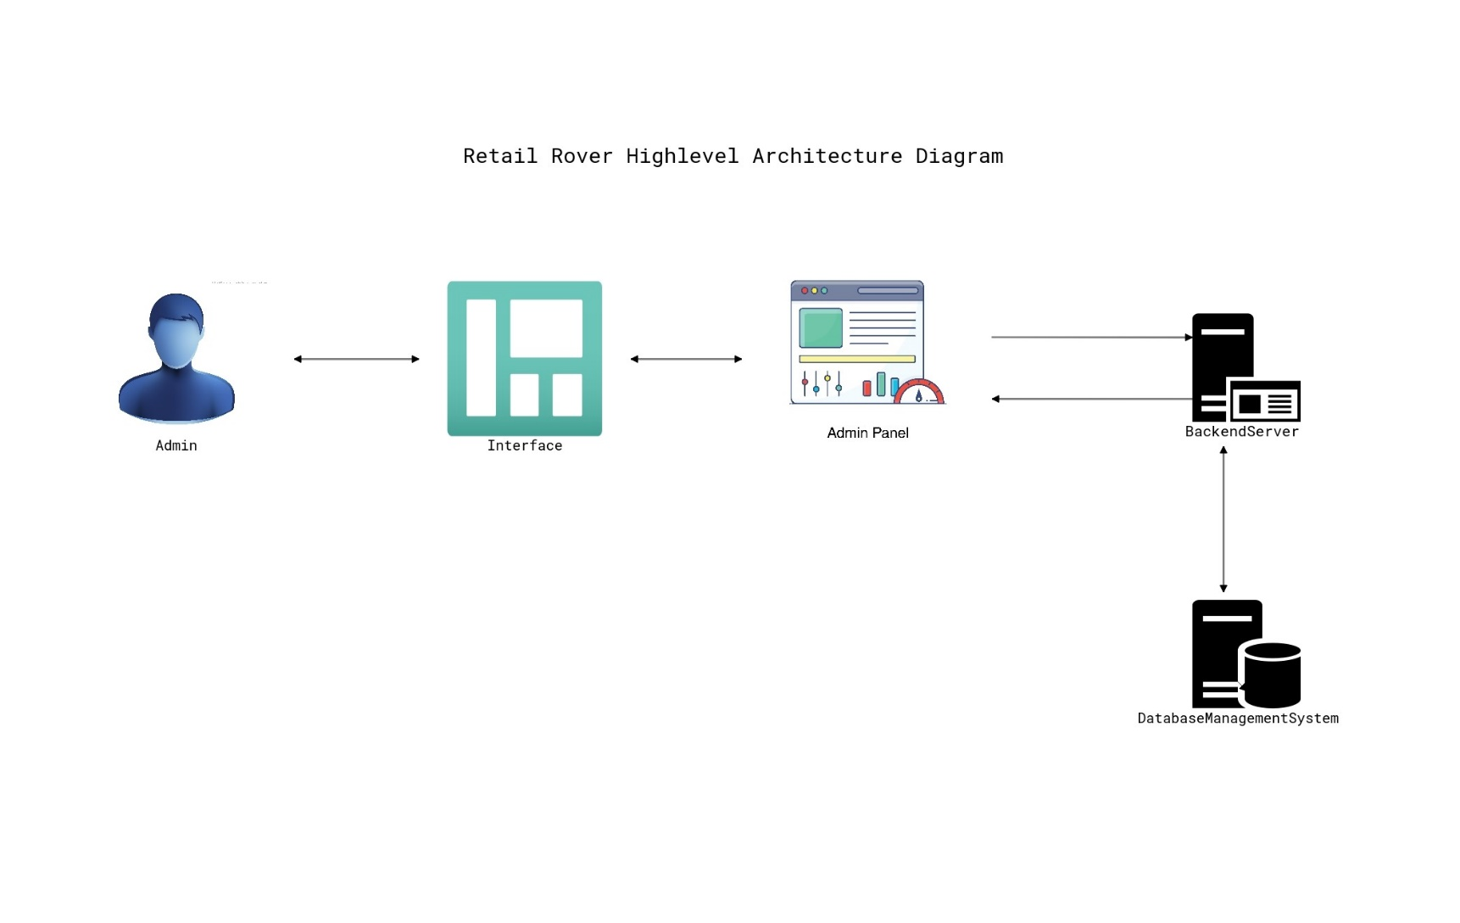
Modeling Diagrams
High Level Architecture Diagram

Slide 7
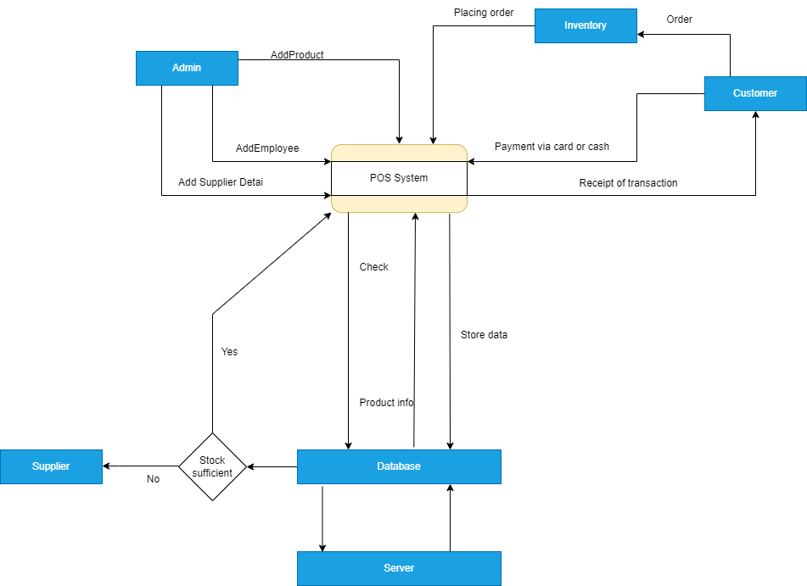
Data Flow Diagram

Slide 8
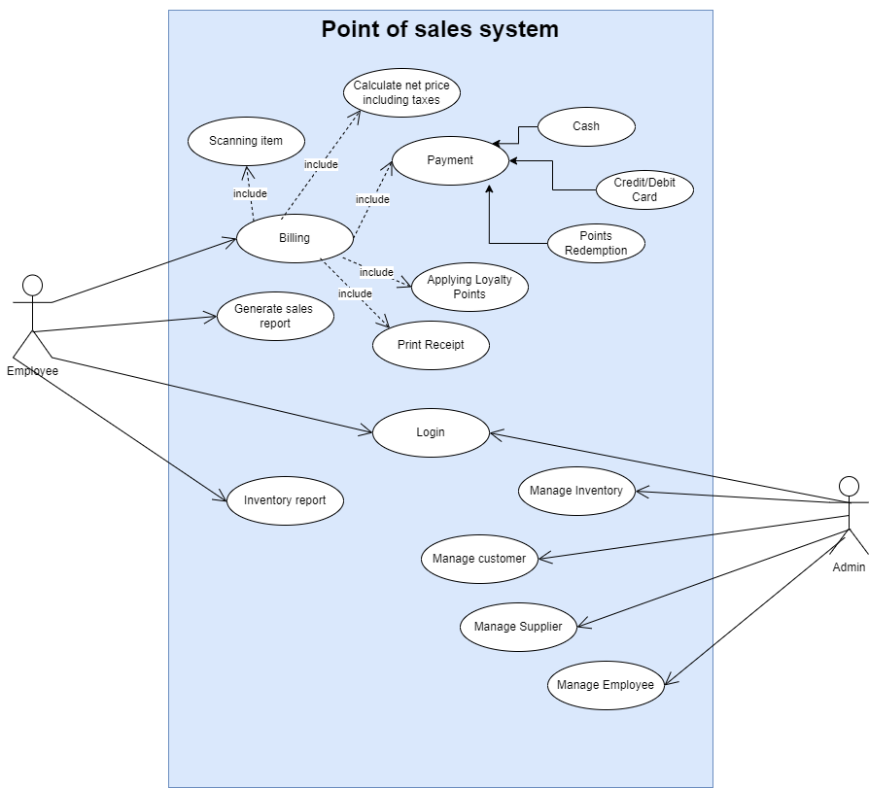
Use Case Diagram

Slide 9
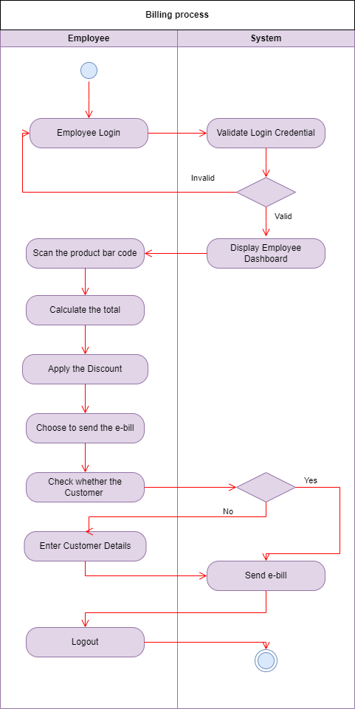
Activity Diagram

Slide 10
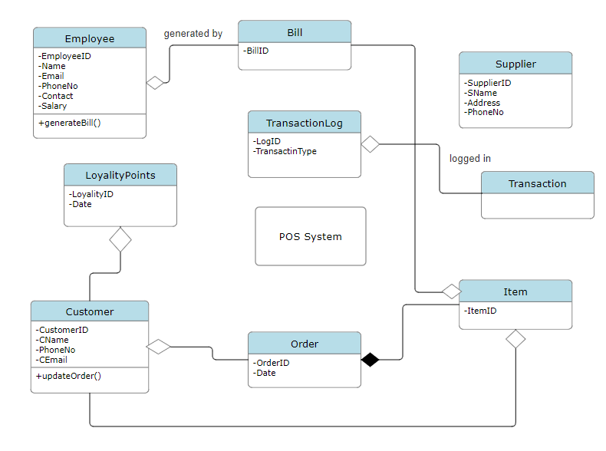
Class Diagram

Slide 11
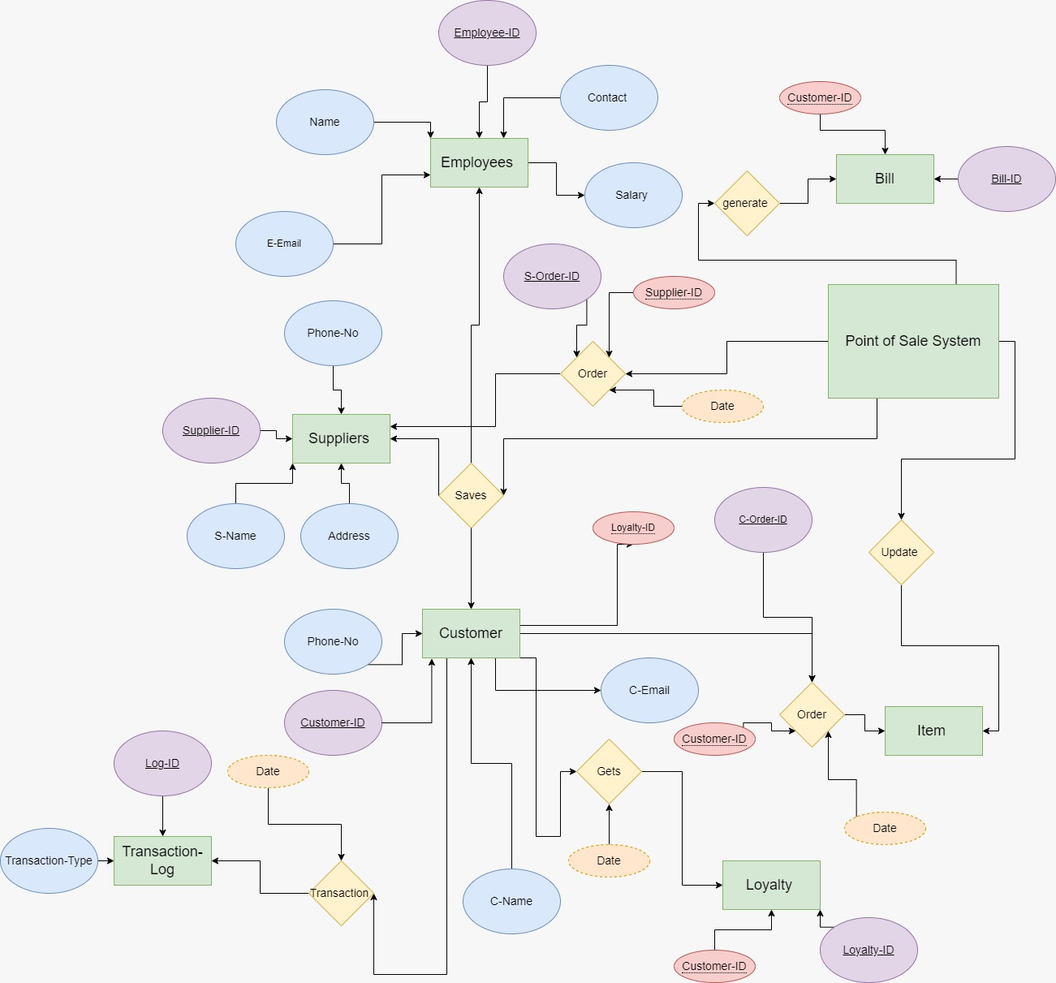
ER Diagram

Slide 12
Functional Requirements
User Authentication: Users must log in securely to access the system.
Inventory Management: Add, update, and delete products. Track quantities and set reorder thresholds.
Sales Processing: Cashiers process transactions, calculate totals, and generate receipts.
Customer Management: Register customers, update contact info, track purchase history.
Employee Management: Managers manage employee accounts, roles, and working hours.Reporting and Analytics: Generate sales reports and analyze inventory, supplier, and employee data.

Slide 13
Non Functional Requirements
Performance: Fast response times and minimal downtime.
Security: Secure authentication, data encryption, and protection against breaches.
Reliability: High system reliability and data integrity.
Scalability: Ability to handle growing transaction volumes and inventory.
Usability: Intuitive user interface requiring minimal training.
Compatibility: Support for various hardware and software configurations.

Slide 14



Technologies and Techniques

Slide 15
IntelliJ IDEA (Version X.X): The main Integrated Development Environment (IDE) for programming and debugging.
The PostgreSQL database can be seen and interacted with using PostgreSQL Compass (version X.X).
React is a JavaScript library used for building interactive user interfaces for the POS system.

Slide 16
Thank you !

