Slide 1

Collaborating with InsurTech Startups
May 29, 2020

Slide 2

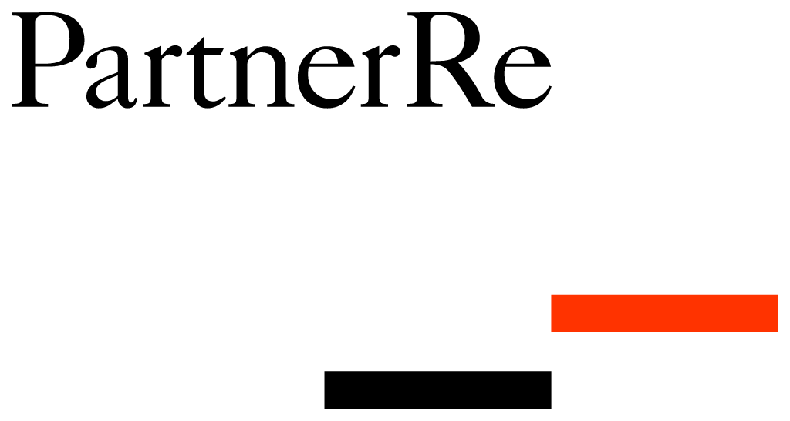


MEET the TEAM
Ed Swerhone
Wanda Richardson
Fred Beaudoin
Joy Angeles

Slide 3




MEET
the EXPERTS
Bill Genovese Vice President Huawei Technologies
Laura McKay Co-Founder PolicyMe
Rainer Takahashi Founder Jauntin’
Trevor Gary Founder and CEO Micruity

Slide 4
THE PROBLEM
How might we accelerate and increase competitiveness through collaboration with startups while learning from their agility and expertise?”
We are Fred et ED from Big Bad Wolfe Insurance

Slide 5
ADDITIONAL QUESTIONS
OUR JOURNEY
What are the advantages and what are the pitfalls to be avoided, as a corporation?
Are there proven ways to decrease the problems and issues that may arise from these collaboration attempts?
During the COVID lockdown…
We lock ourselves in for 4 afternoons…
With Cookhouse Labs to fix our problem!

Slide 6
WHAT WE DID
16 hours
25 ideas in 5 minutes
3 organizations
4 masterminds interviewed for testing
25 ideas in 5 minutes
4 masterminds interviewed
1 sketch of solution
1 Hi-fi level 2 prototype

Slide 7
DISCOVERY
Startups are fun
B2B(2B2B) relationships built as Ecosystems
Relationship types: New Distribution or New ability (SaaS, APIs)
Reasons: harness data > respond to untapped opportunities
Needs: mutual data security expectations
Reasons: Overcome challenge
Establish strong communication channels
NDAs, Transparency, Relationship Building, Trust Building
solving problems
Pilots: Solve for a Known problem
Attitudes
Define objectives
Establish strong communication channels
Should result in a win-win (share asset and strengths)
Align with internal departments
Common understanding of strong use cases
Reasons: Become faster - more nimble
Think small and educate
Since 2017 - more than 180 partnerships worldwide
Optimize biz structure - based on requirements (legislation)
Start-ups ability to pivot based on consumer insight or intuition
Startups focus on what traditional companies lack now
Internal initiatives
Startups are searching to improve insurance activities rather than replacing it
Start-ups projects aligned to pilot projects in gain traction and reduce internal change resistance
Innov. exists already in companies, how do we organize it
Research insights

Slide 8
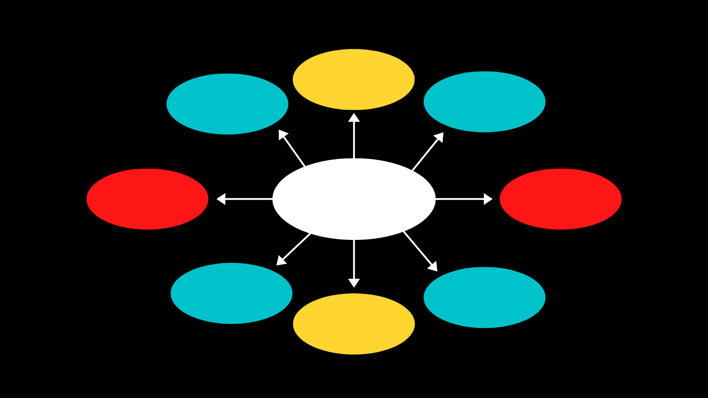

GAINS FOR STARTUPS
Improving client experience
Access to bigger network
Quicker GTM
GAINS FROM COLLABORATION
Autonomy for Innovation Teams
Scale up sustainably
New revenue stream
Improving client experience
More funding

Slide 9
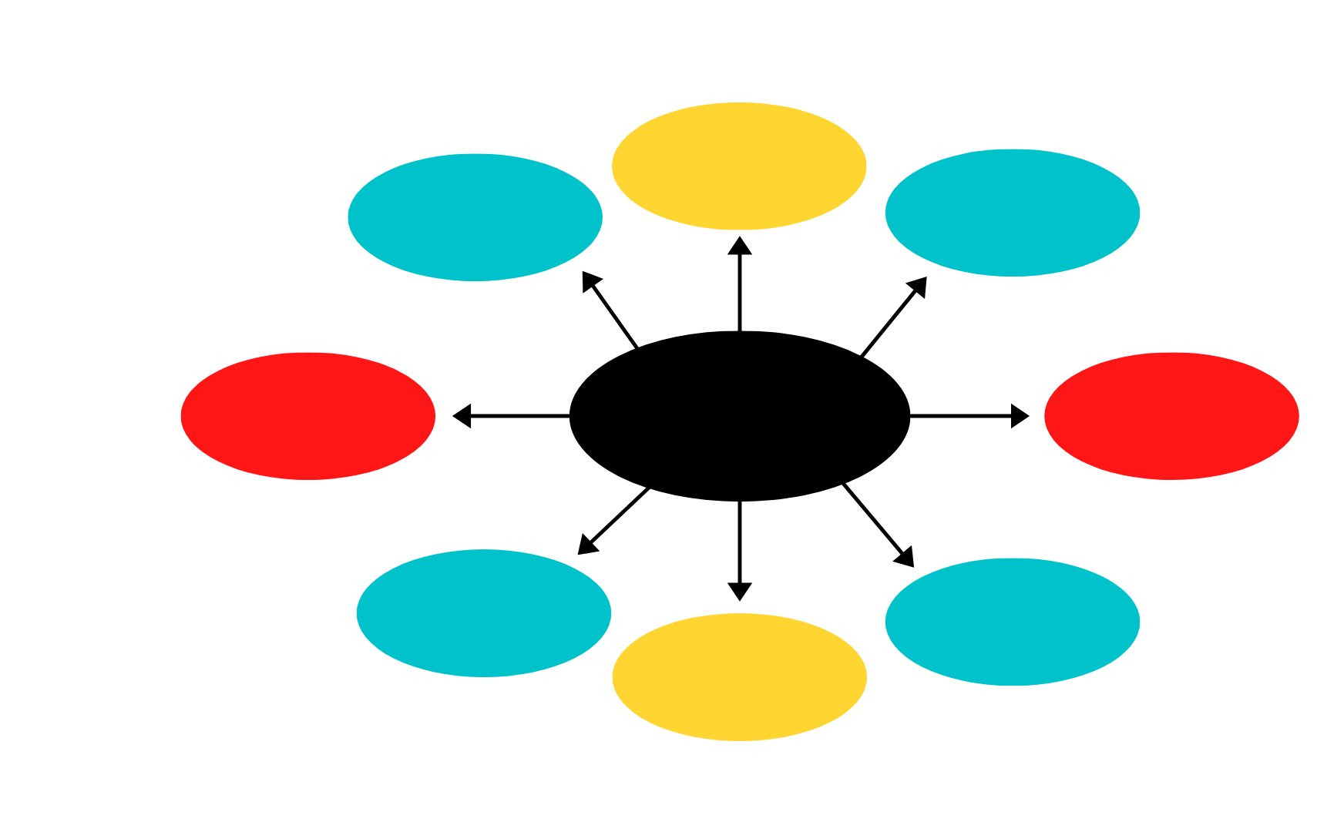
PAIN POINTS FOR STARTUPS
Corporate hesitation to test and fail
Bureaucratic process
Legacy mentality
Many security requirements
PAIN POINTS
Not included in early discussions
Solution may lack cultural fit
Time wasted arranging meetings
Close-minded approach
Notes:
Needs logo

Slide 10
"It can often take 1 month between the first email and the in-person meeting”

Slide 11
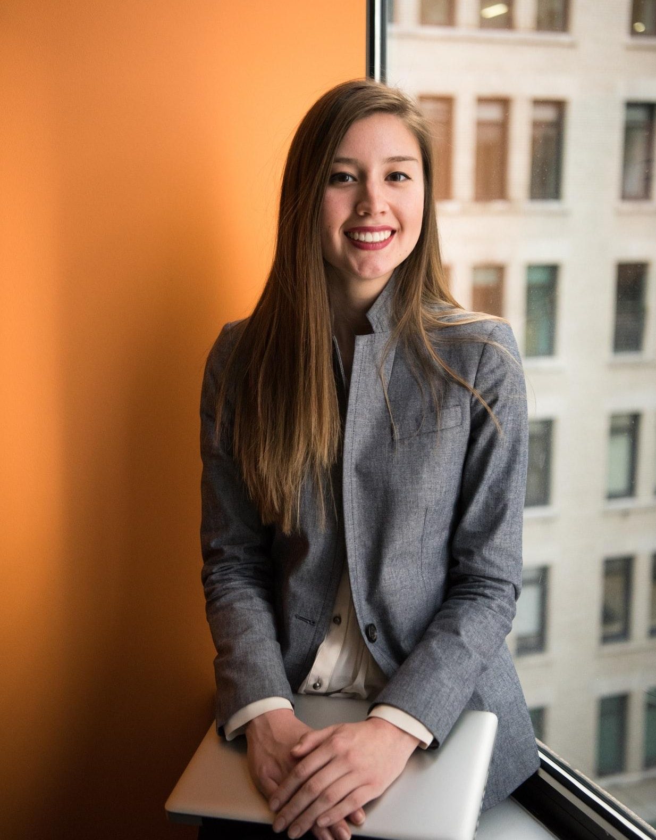
OUR FOCUS: WORKING WITH BETTY
INTERESTS
GOALS
Customer experience
Do things better
Ability to test
Ability to be creative
Programming
Website building
Making people’s lives better
Challenge status-quo
Professional organizations
Be leader in my area
Bring something else to table
500k GOAL!
VALUES
We’ll do it
FRUSTRATIONS
Financial freedom
Freedom/ Independence
Seeing others suffer
Everything takes long
Sometimes talking to wrong people
Caring
Sees solutions – but others don’t see it ☹
Solving problems
Being of service
NAME | AGE | GENDER
STATUS | CHILDREN | FOCUS
LOCATION | SAVINGS/SEED MONEY | GOAL INCOME
No access to decision makers/right resources
Impatience
No fear of failure
BETTY
29
FEMALE
Sees solutions – but it’s not there ☹
Industry and orgs too conservative
KEY CHARACTERISTICS
NEEDS
Optimistic
Motivated
DIRECT TO CONSUMER
Mutual respect
Partnerships!
RESULTS out of partnerships (progress, new business)
Visionaries
SINGLE
0
Being listened to
Open to change
Deeper relationships
Networking
Ambitious
Passionate
Validation
Appreciation for her innovative solution
Adaptable
TORONTO
250K
500K

Slide 12
PERSONA JOURNEY MAP
Discovery phase
Contractual phase
MAIN ACTIONS
EMOTIONS & TOUCHPOINTS
THOUGHTS
Research targets (network, linkedin)
Identify targets
Phone call to arrange a meeting for pitch meeting
Delay in the meeting
Discovery on the responsible decision-maker
Review requirements
Set-up pitch
Follow-up with e-mail/material before meeting
Pitch meeting
Stakeholder meeting
Contract negotiation
Linkedin
Cold calling
GOOD
Close network
Market research
Negotiations
Research about insurers
Follow-up emails asking for response
Check in with key stakeholders
BAD
Legal roadblocks
Bureaucratic
Organization has internal politics
Fear in making decisions
Stakeholder changed

Slide 13
HMW identify the right decision makers to speed up the process of collaboration, improving Betty’s experience?

Slide 14
OUR SOLUTION IDEAS
One week
One month
One Year
Three Years
Never/ Whenever
identify winners and losers on technology
inform all potential bodies
identify roadbloclks
Create new protocol for making decision
have some success to change attitudes
Create an organization body that can oversee and decide on any ongoing project
set up a culture that doesn't mind missing once in a while
identify winners and losers on technology
provide room and time for that person to act
Create and implement a new training program for current staff
set up a separate company or joint venture with competitor to bring in Betty
It's ok to fail - no more fear to it
Hire new decision-maker
Clearly defined requirements at all times based on org culture
Team of interns choose the decision-makers
No C - levels allowed to make decision on start-ups
Only starts up hire startups
Review who has had past experience with startups in the organization
Search LinkedIn for type of role
Decision workflow which has a warning of 5 minutes once the alert is received
Start a committee of decision makers
Hire a team of decision-makers for startup projects only
Quarterly meetings dedicated only to startup pitches
Internal accelerator program
Evolve to a more agile culture
Bring external experts (they've had experience w/start ups)
identify who is interested in project
Define process for bringing startups
Define the cycle
Train decision makers
Train committee
Create culture that is open to failure
Bring a coach to train decision makers on innovation
create a multi-function team surrounding project
KPIs for Inno managers (Rain)
Create an incentive program for DMs

Slide 15
OUR SOLUTION: A COMMITTEE OF DECISION MAKERS
A COMMITTEE WITH THE RIGHT PEOPLE
A COMMITTEE WITH BUSINESS OBJECTIVES AND INCENTIVES
TRAINING FROM INNOVATION COACH
REGULAR MEETINGS DEDICATED TO STARTUP PITCHES
AN AGILE AND FAIL FAST CULTURE
A WELL DEFINE PROJECT CYCLE TO COLLABORATE WITH STARTUPS
WE WANT YOUR FEEDBACK!!

Slide 16
What we learned!
Top learnings
Empathy is key to finding solution
Speed is important for working with startups
How many pain points there can be in the process
Gaining perspective (walking in their shoes)

Slide 17

THANK YOU
Collaborating with InsurTech Startups
May 29th, 2020

