Slide 1
FAKE NEWS DETECTION USING AUTOENCODERS
GOBALA KRISHNAN B
au21CB17
KGiSL INSTITUTE OF TECHNOLOGY
3/21/2024 Annual Review

Slide 2
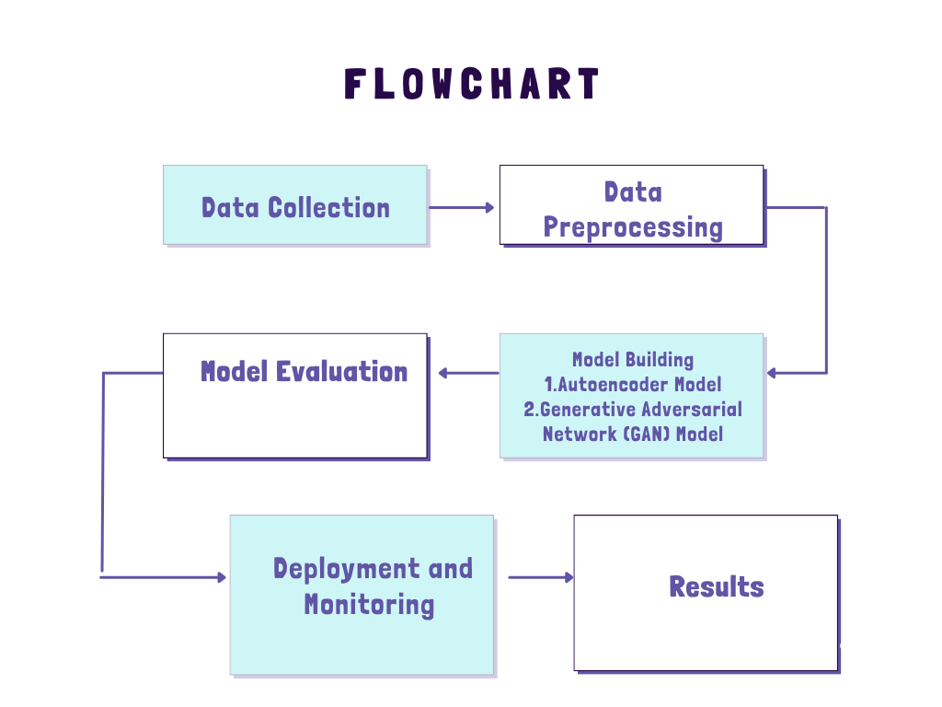
FAKE NEWS DETECTION USING AUTOENCODERS
3/21/2024 Annual Review

Slide 3


AGENDA
PROBLEM STATEMENT
PROJECT OVERVIEW
WHO ARE THE END USERS?
SOLUTION
WOW IN THE SOLUTION
MODEL
RESULT
3/21/2024 Annual Review

Slide 4

PROBLEM STATEMENT
The task involves developing a robust fake news detection system capable of accurately distinguishing between real and fake news articles. Given the proliferation of misinformation on social media and other online platforms, the goal is to create a solution that can automatically identify deceptive or misleading content, thereby helping to mitigate the spread of false information and preserve the integrity of online discourse.
3/21/2024 Annual Review

Slide 5

PROJECT OVERVIEW
In the field of machine learning, autoencoders and Generative Adversarial Networks (GANs) have different functions. By training a generator and discriminator simultaneously, GANs are adept at producing new data that closely resembles an existing dataset. Conversely, autoencoders are very good at taking input data and compressing it into a lower-dimensional representation, which they then reconstruct.
The most widely used approaches in the field of fake news detection systems mostly centre on Natural Language Processing (NLP) methods including sentiment analysis and text categorization. These systems frequently use deep learning models like Recurrent Neural Networks (RNNs) and Convolutional Neural Networks (CNNs), or supervised learning methods like Support Vector Machines (SVMs) and random forests. As a result, although GANs and autoencoders make a substantial contribution to data processing tasks, they are not the main techniques used to detect fake news.
3/21/2024 Annual Review

Slide 6

WHO ARE THE END USERS?
1. Social Media Platforms
2. News Organizations
3. Government Agencies
4. Educational Institutions
5. Fact-Checking Organizations
6. General Public
3/21/2024 Annual Review

Slide 7

SOLUTION AND PROPOSITION
Autoencoders for Feature Extraction: Utilizing autoencoders, meaningful features are extracted from the textual content present in news articles. By condensing the input data into a lower-dimensional representation, autoencoders capture the underlying patterns and semantics crucial for distinguishing between genuine and fake news.
Generative Adversarial Networks for Data Augmentation: The application of Generative Adversarial Networks (GANs) involves generating synthetic instances of both real and fake news articles. This augmentation process enriches the dataset, enabling the model to assimilate a broader range of features and enhance its resilience to various types of fake news.
Model Integration and Training: In this phase, the features extracted from autoencoders and the synthetic data generated by GANs are amalgamated to train a classification model. This model is trained to differentiate between authentic and deceptive news articles based on the learned representations. The training process revolves around optimizing the model parameters to minimize classification errors and enhance overall accuracy.
Evaluation and Validation: To gauge the performance of the fake news detection system, standard metrics such as accuracy, precision, recall, and F1-score are employed. The system undergoes validation using a distinct test dataset to evaluate its ability to generalize and effectively operate in real-world scenarios.
Deployment and Application: Following training and validation, the fake news detection system is ready for deployment across various platforms including social media networks, news websites, and online forums.
3/21/2024 Annual Review

Slide 8

THE WOW IN YOUR SOLUTION
1. Feature Extraction
2. Data Augmentation
3. Improved Performance
4. Enhanced Generalization
5. Reduced Overfitting
6. Adaptability
3/21/2024 Annual Review

Slide 9
MODELLING
In fake news detection, various models and techniques can be employed depending on the nature of the data and the specific requirements of the task. Here are some common models used in fake news detection:
1. Traditional Machine Learning Models:
- Logistic Regression
- Support Vector Machines (SVM)
- Random Forest
- Naive Bayes
2. Deep Learning Models:
- Recurrent Neural Networks (RNNs)
- Convolutional Neural Networks (CNNs)
- Long Short-Term Memory (LSTM) Networks
- Gated Recurrent Units (GRUs)
3. Ensemble Models:
- Voting Classifier
- Bagging and Boosting Techniques (e.g., AdaBoost, XGBoost)

Slide 10
MODELLING
4. Transformer-Based Models:
- BERT (Bidirectional Encoder Representations from Transformers)
- GPT (Generative Pre-trained Transformer)
6. Generative Adversarial Networks (GANs):
- GANs can be used to generate fake news articles for data augmentation or to detect patterns in fake news content.
7. Hybrid Models:
- Combining multiple models and techniques to improve overall performance and robustness.
3/21/2024 Annual Review

Slide 11
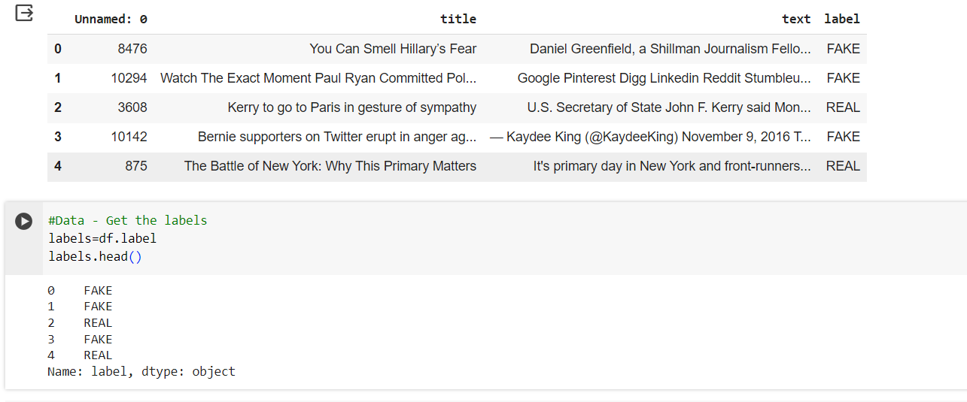
RESULTS
https://drive.google.com/drive/folders/1x2lWbIH6xn0KOQRvdQeYIX4aYeqd2ZBN?usp=drive_link
3/21/2024 Annual Review

