Slide 1
FAKE NEWS DETECTION USING AUTOENCODERS
GOBALA KRISHNAN B
au21CB17
KGiSL INSTITUTE OF TECHNOLOGY
3/21/2024 Annual Review

Slide 2
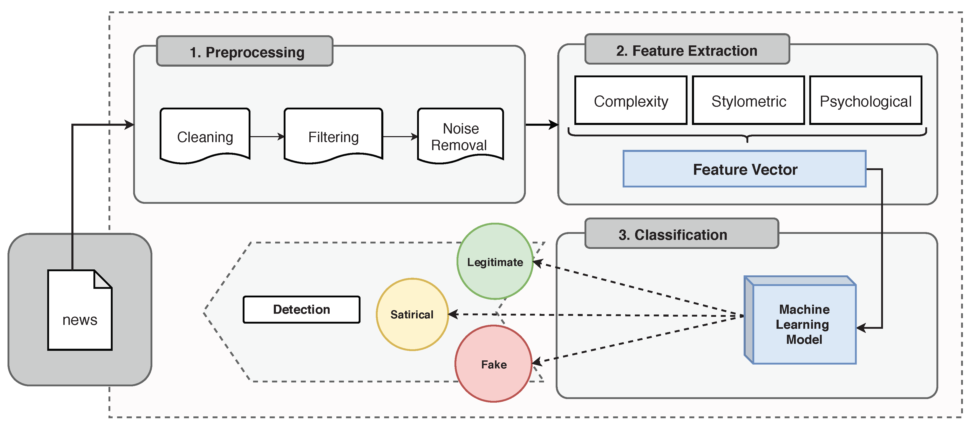
FAKE NEWS DETECTION USING AUTOENCODERS
3/21/2024 Annual Review

Slide 3


AGENDA
PROBLEM STATEMENT
PROJECT OVERVIEW
WHO ARE THE END USERS?
SOLUTION
WOW IN THE SOLUTION
MODEL
RESULT
3/21/2024 Annual Review

Slide 4

PROBLEM STATEMENT
Detecting fake news is a critical challenge in today's information landscape. Using autoencoders presents a promising avenue for discerning between genuine and fabricated content. However, this approach faces hurdles like acquiring high-quality labeled datasets, ensuring semantic understanding, achieving generalization, and maintaining computational efficiency. Overcoming these obstacles will require a concerted effort from experts in natural language processing and deep learning. Yet, successful implementation could significantly enhance our ability to combat the proliferation of misinformation, fostering a more informed society.
3/21/2024 Annual Review

Slide 5

PROJECT OVERVIEW
The project aims to develop a fake news detection system using autoencoders, a type of artificial neural network. This system addresses the pressing challenge of identifying fabricated or misleading information amidst the vast volume of digital content. By leveraging unsupervised learning techniques, the autoencoder learns to extract meaningful features from both genuine and fake news articles, creating compressed representations that capture essential characteristics while filtering out noise. The project focuses on overcoming key challenges such as acquiring high-quality labeled datasets, ensuring semantic understanding, achieving generalization, and maintaining computational efficiency. Successful implementation of this system could significantly enhance our ability to combat the proliferation of misinformation, benefiting end users ranging from the general public and social media platforms to news organizations, educational institutions, government agencies, and fact-checking organizations.
3/21/2024 Annual Review

Slide 6

WHO ARE THE END USERS?
1. General Public
2. Social Media Platforms
3. News Organization
4. Government Agencies
5. Fact-Checking Organizations
6. Educational Instituitions
3/21/2024 Annual Review

Slide 7

SOLUTION AND PROPOSITION
The proposed solution entails the development of a sophisticated fake news detection system leveraging autoencoder technology. By employing unsupervised learning techniques, this system autonomously learns to discern patterns between genuine and fabricated news articles, without relying on pre-labeled data.
The autoencoder architecture compresses the input articles into a latent space representation, capturing essential features while filtering out noise. This innovative approach not only enhances the accuracy of fake news detection but also enables real-time or near-real-time analysis, crucial for addressing the rapidly evolving landscape of misinformation.
The proposition lies in the system's ability to provide a scalable, efficient, and adaptable solution to the pervasive issue of fake news. By combining advanced machine learning techniques with interdisciplinary expertise, this solution aims to empower users across various domains, including social media platforms, news organizations, and fact-checking agencies, in combating the spread of misinformation and fostering a more informed society.
3/21/2024 Annual Review

Slide 8

THE WOW IN YOUR SOLUTION
1. Feature Extraction
2. Anamoly Detection
3. Improved Performance
4. Real-Time Detection
5. Unsupervised Learning
6. Adaptive Learning
3/21/2024 Annual Review

Slide 9
MODELLING
Autoencoder Architecture: The core of the system is the autoencoder, a type of artificial neural network consisting of an encoder and a decoder. The encoder compresses the input data (news articles) into a latent space representation, while the decoder reconstructs the original input from this representation.
Preprocessing: Data preprocessing techniques are applied to clean and prepare the input news articles for modeling. This may include tokenization, stemming or lemmatization, stop-word removal, and handling of special characters or formatting issues.
Training Strategy: The autoencoder is trained using a large corpus of labeled news articles, with genuine articles labeled as positive examples and fake articles labeled as negative examples.
Hyperparameter Tuning: Various hyperparameters of the autoencoder model, such as the number of layers, layer sizes, learning rate, dropout rate, and activation functions, are tuned to optimize model performance. Techniques like grid search or random search may be employed to efficiently explore the hyperparameter space and identify optimal configurations.

Slide 10
MODELLING
Evaluation Metrics: The performance of the fake news detection system is evaluated using appropriate metrics such as accuracy, precision, recall, F1-score, and area under the receiver operating characteristic curve (AUC-ROC). Cross-validation or holdout validation techniques may be used to assess the generalization performance of the model on unseen data.
Ensemble Methods: Ensemble methods, such as combining multiple autoencoder models or integrating other machine learning algorithms like logistic regression or support vector machines, may be explored to improve the robustness and generalization performance of the fake news detection system.
3/21/2024 Annual Review

Slide 11
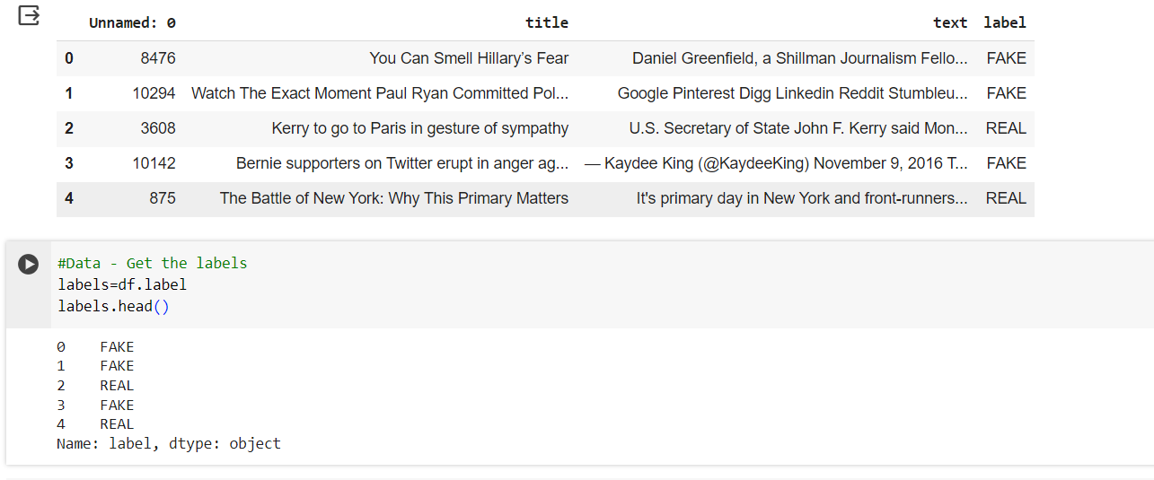
RESULTS
https://drive.google.com/file/d/1MbrFkdS_-FJqIaZHkPceFhf2SIplV_Xe/view?usp=drive_link
3/21/2024 Annual Review

