Slide 1

Virtual Assistant Healthcare

Slide 2
Team name
GitCtrl

Slide 3
MEMBERS
Aditya Arora
Ashi Verma
Harsha Yadav
Shivang Shah

Slide 4
INTRODUCTION
The main objective of the proposed assistant is to make the interaction between the user and the web service easier and less complicated. The assistant provides the facility to talk to you about your health problems and can tell you the what kind of problem you are suffering from.

Slide 5
IDENTIFICATION OF NEED
Virtual Assistant Healthcare is very convenient to implement and quite easy to understand. The most important thing is that it can be implemented by users in their daily life. The need of designing such a web service is to act as a centralized base for all health related problems so that anyone with an internet facility can have access to it regardless of their time and place.

Slide 6
ABOUT PROJECT
So basically we have used a technology called ARTIFICIAL INTELLIGENCE to create an AI Bot . We have created this Bot on AI playgrounds and we have trained this Bot from various data related to health problems so it can tell you from what kind of related issue you have.

Slide 7
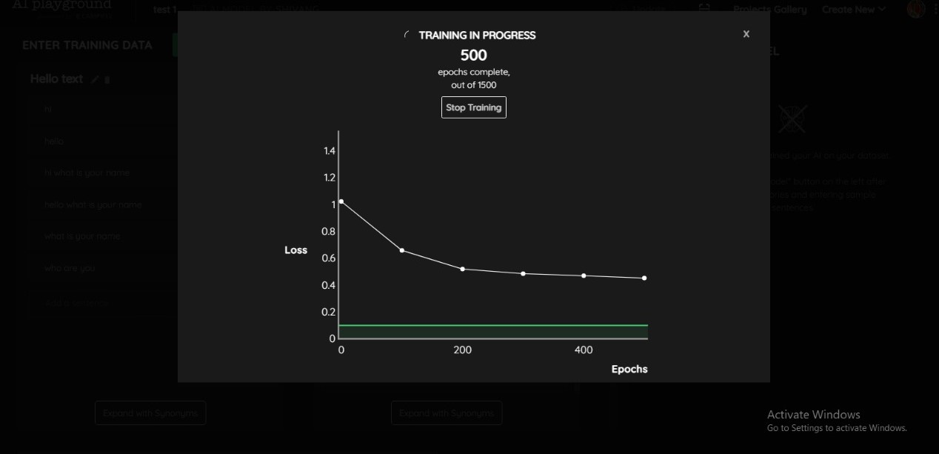
Here are some graphs showing the steps

Slide 8
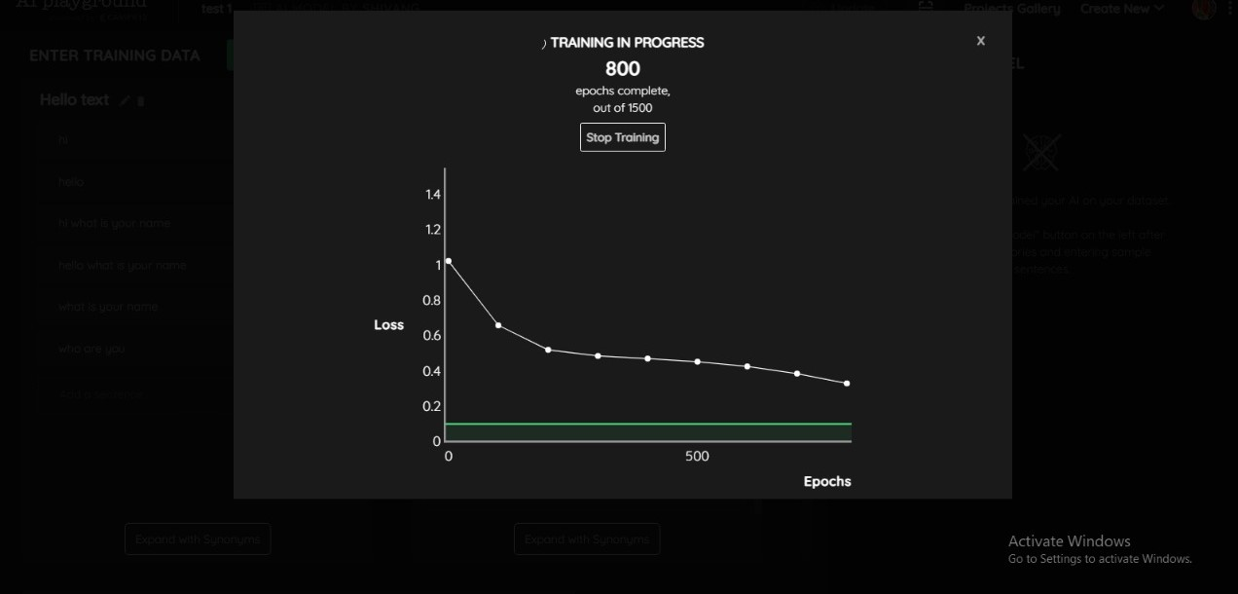

Slide 9
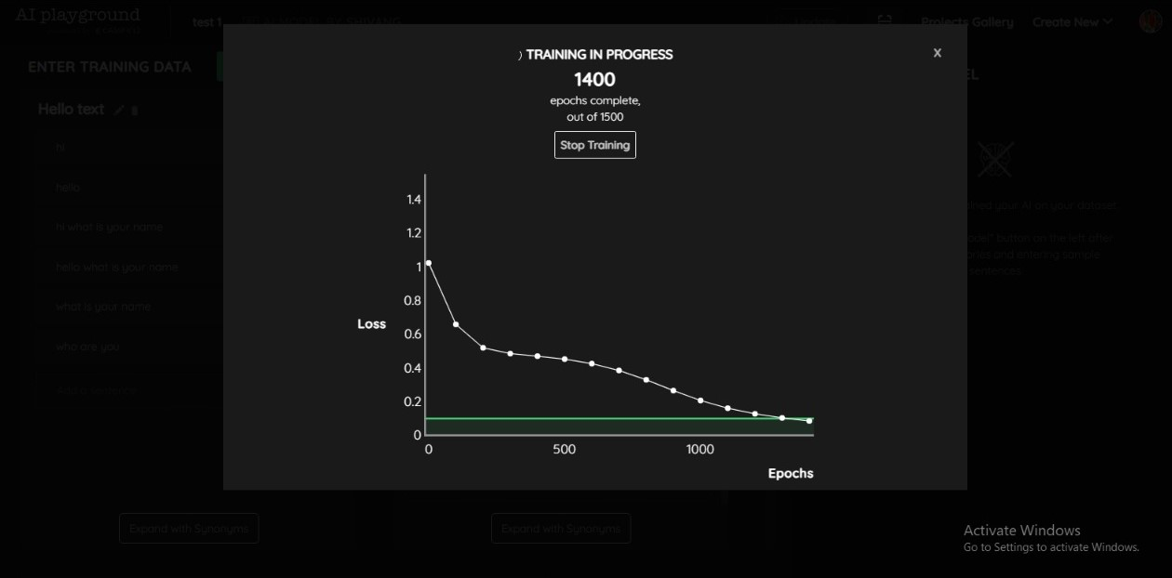

Slide 10
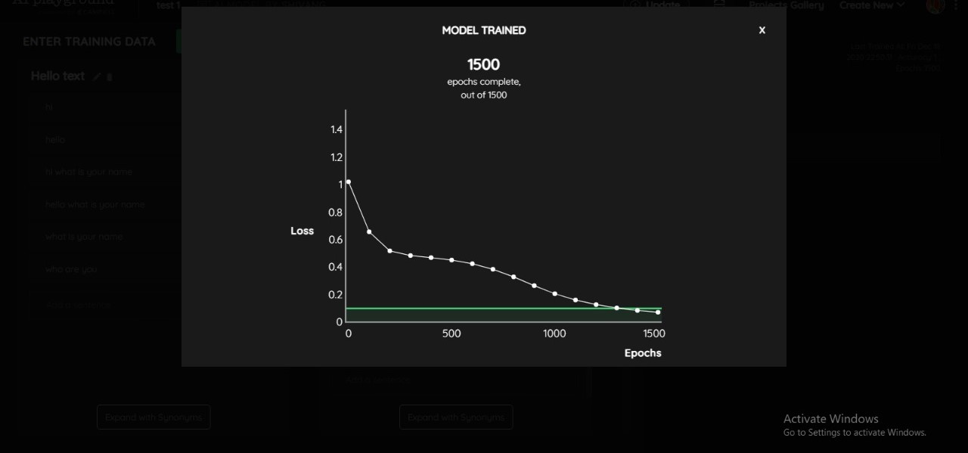

Slide 11
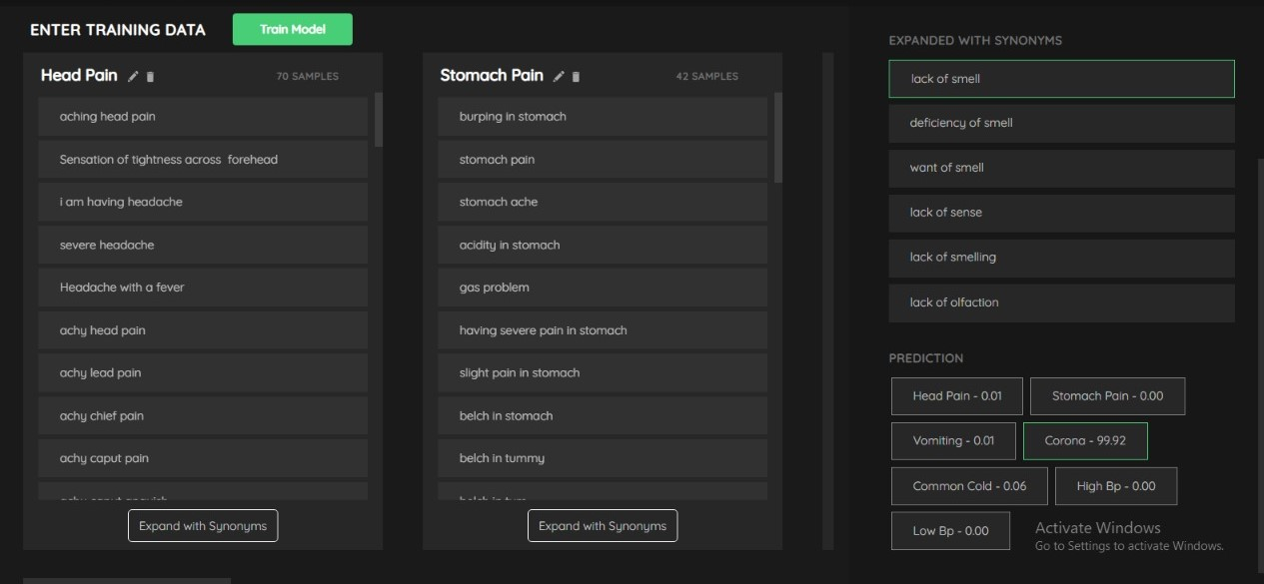
Training data that we have given to assistant

Slide 12
Link for the final prototype
https://theaiplayground.com/shivangshah42/bot/Virtual-Assistant-Final-prototype/view

Slide 13
BENEFITS
Save time
Save money
Super charge productivity
Specialized task assistance

Slide 14
THANK YOU!

