Slide 1

CODE-INNOVATION SERIES an initiative by GITHUB presented by team INFINITY⚡ THE FUTURE OF GAME DEVELOPMENT FOR PROGRAMMERS /HACKERS Team Members:- 1.Nikhil Goyal id: goyalnikhil743@gmail.com
COLLAGE NAME:-
G.L. Bajaj group of institutions
Mathura

Slide 2
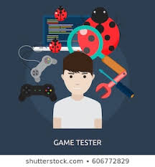
Realistic problems
Why customer / target segments may want this?
As many programmers/hackers didn't get the type of game from which they get a adventurous and a shocking experience.
Why is it important for us to address this need?
As we being a part of the customer segment also faces the above listed problems, so addressing these from a different perspective might lift some of the hidden treasures.
By participating in this contest, we get to express our ideas which we think might be helpful for our society.
Realistic experience
Provides of platform
Playing time
Testing environment
Causes of Excessive playing
issues of connectivity
Automation in testing

Slide 3
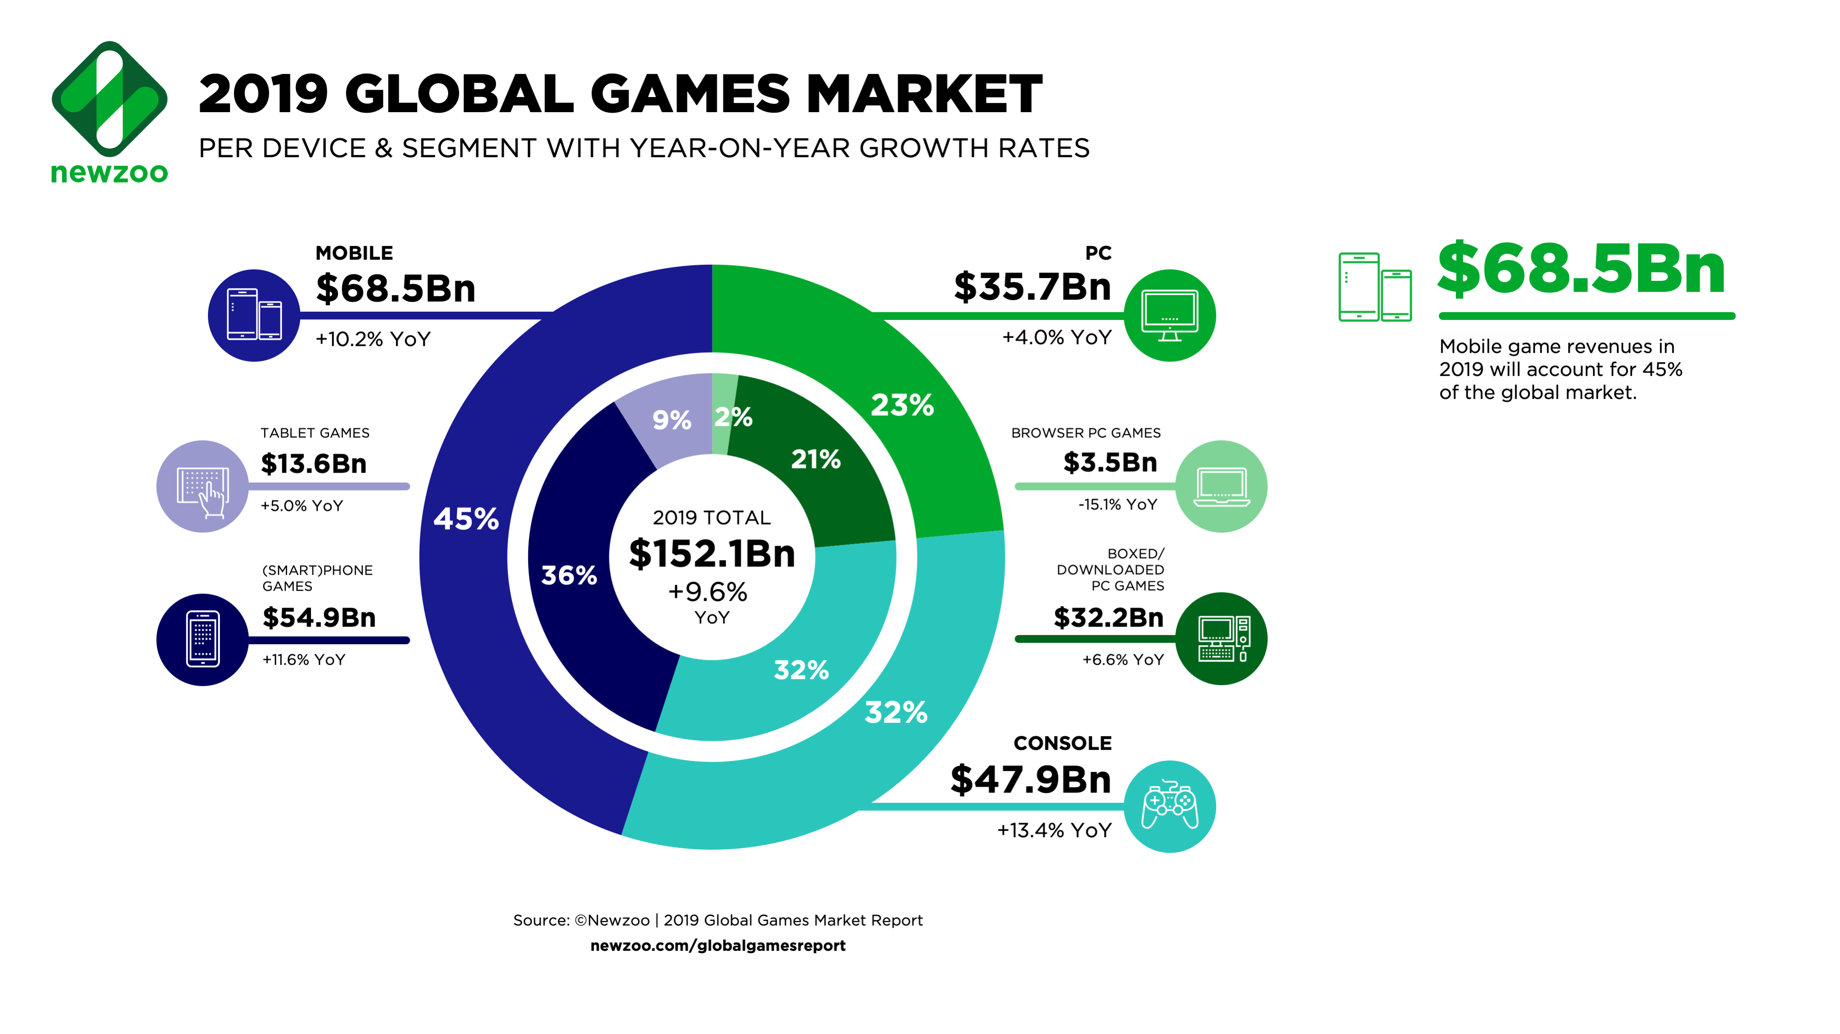
Intended customer/target segment 1.on an average 40 % of India's students related to the cs field and at least 35% are belongs to non-it fields but work in it sectors. 2.these are the public segments those demands these type of games. 3.it can easily hit the target segment not in India but in other countries too.
Market Growth
Growth hacking is a relatively new field in marketing focused on growth. ... The goal of growth hacking strategies is generally to acquire as many users or customers as possible while spending as little as possible.
The World's 2.7 Billion Gamers Will Spend $159.3 Billion on Games in 2020.
a healthy year-on-year growth of +9.3%.
Market size
The global video game market size was valued at USD 151.06 billion in 2019 and is expected to grow at a Compound Annual Growth Rate (CAGR) of 12.9% from 2020 to 2027.

Slide 4
Solution/idea
We have an idea of create a world’s first realistic experienced game in which the user used his skills for play the game:
Coding skills
Some basic hacking tools
Testing tools
Automation Techniques
COST:
The one can play this game by take subscription from the site at low cost.
SCALABILITY:
Depends as market increase it’s scalability get better.
TIME TO MARKET:
It really hits the market and as per the new features we provide it will long last in market.
FEATURES:
You have to use commands for hacking in the game.
When you log in to the website you get game id.
The game is play online only no downloads needed.
You will get three lives.
If u fail three times the your id get banned for 24 hours.
And after 1 day start from there only.

Slide 5
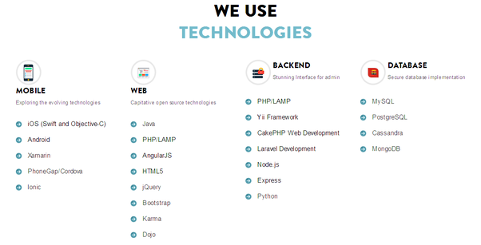
EXTRA FEATURES
TECHNOLOGY STACK:
Programming languages like java ,c++,etc.
Game engines
Different UI platforms
Blockchain technology for platform
More technologies according to the use cases..
We provide Online platform for the game
Other’s will contribute with us for sharing the platform
Testers will test the games on the platform only by using required tools/or they can use there tools.
Users can find bugs in the game.
Users will get the full documentation related
to the games on the site only.
EXPECTED RESULT/CUSTOMER BENEFIT:
The platform provide every feature that will attract any type of gamer ,programmer or any one else.
It just like the HACK THE BOX but different as it will for GAMING and TESTING.
The benefit for customer is that they can enhance their skill of programming related things and thinking skills.
They will get to know the a advanced real experience while playing the game as they are do the things in real.

