Slide 1
Predictive Modeling for
Direct Marketing Campaigns
Problem statement:
The goal is to create a model that will help a Portuguese banking institution to determine clients who will subscribe a long term deposit before contacting them in a direct marketing campaign, using data from previous campaigns.

Slide 2
Dataset
Source: https://archive.ics.uci.edu/ml/datasets/Bank+Marketing
Why choose bank over bank-additional
  The social economic indicators in bank-additional dataset are not available before predictions.
  The bank dataset has feature balance, which is likely to be a strong predictor

Slide 3
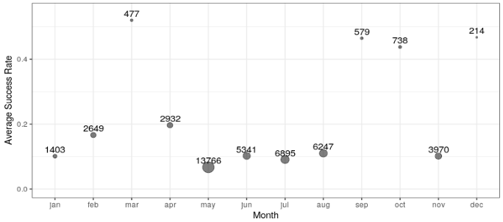
Removing features
Duration: not available before contact.
Month: outcome strongly depends on month in the dataset but no reason to believe so; may learn wrong relationship from the data.
Day: too many categorical values, weak dependence.

Slide 4
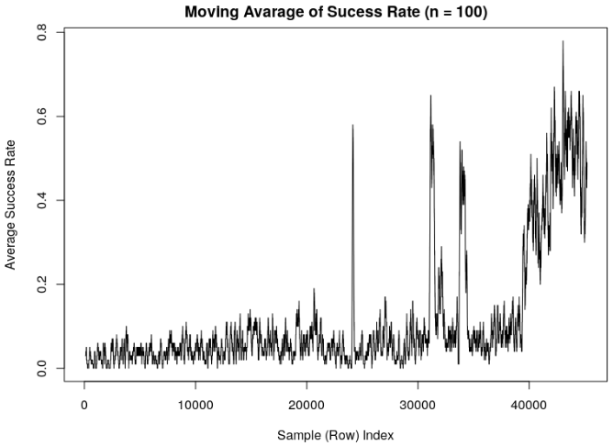
Train – test split
11.7%
success (“yes”)
Ideally, use newer
records as test. But the outcome is not uniform over time so use random split instead.
train
val
test
old
new
old
new

Slide 5
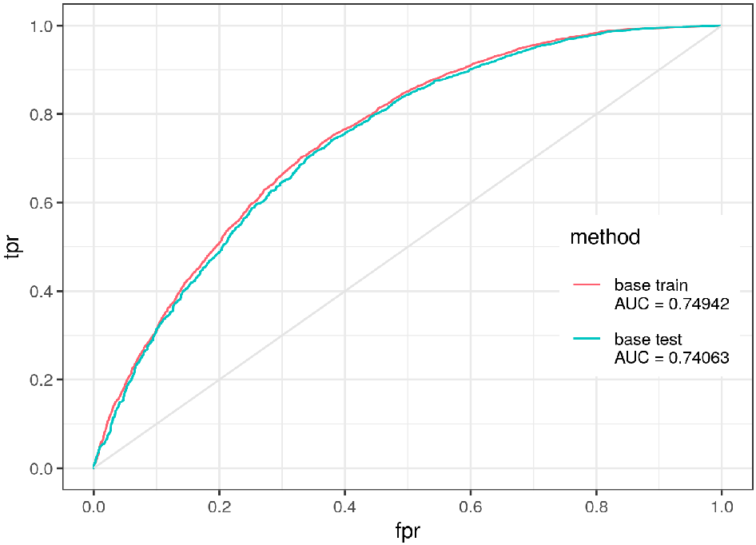
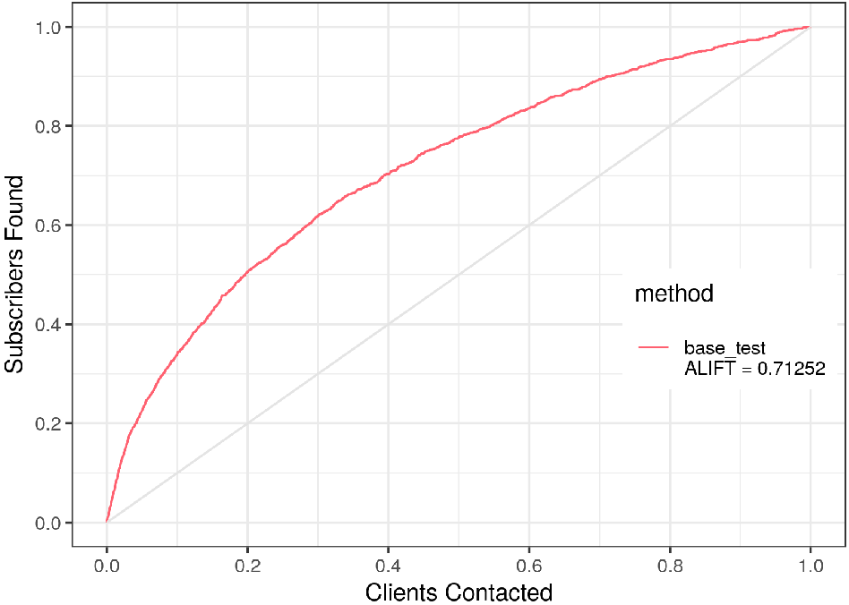
Baseline model
Task: binary classification problem
Baseline model: linear regression
Metrics: AUC and ALIFT
No data preprocessing
ROC
LIFT

Slide 6
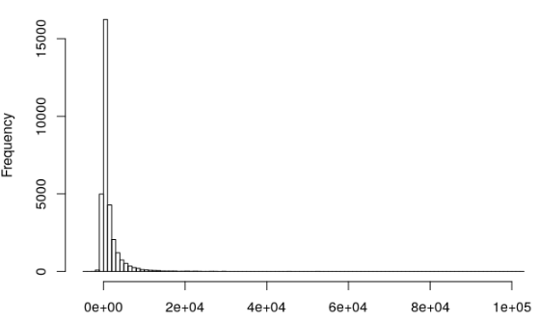
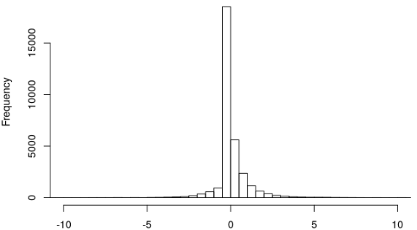
Data pre-processing
Missing (unknown) as its own category
Transform skewed data, for example balance
pdays and previous
  Create a new feature previous contact: “yes” or “no”
Under-sampling: sufficient records, fast in training.
before
after

Slide 7
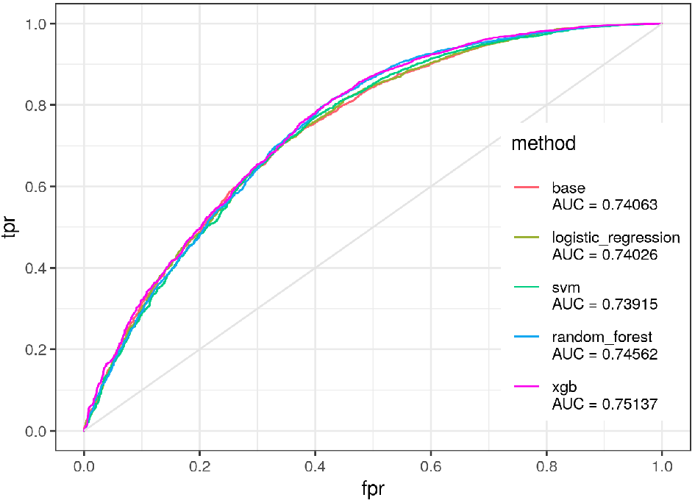
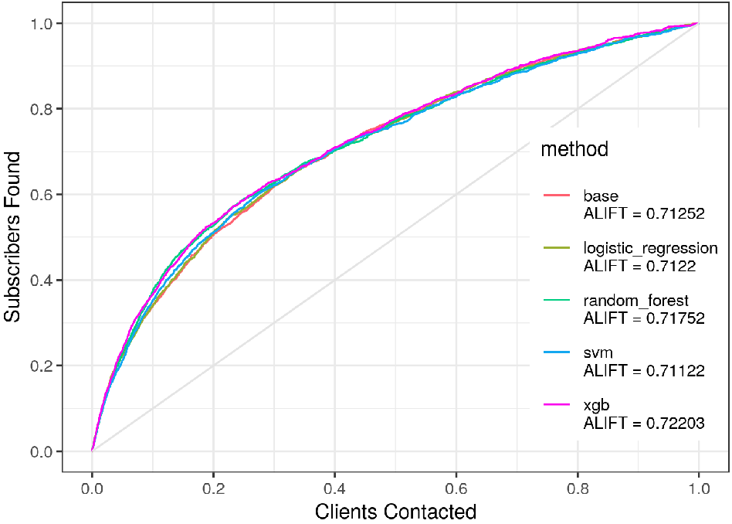
Try different algorithms
XGBoost performed better than logistic regression, svm, and random forest, using both AUC and ALIFT
ROC
LIFT

Slide 8
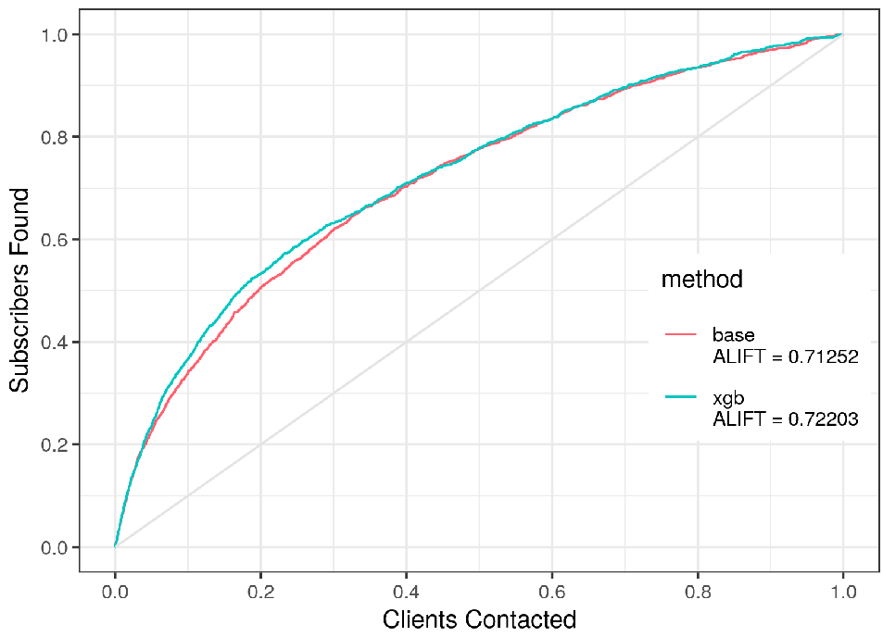
Final model: XGBoost
Contacted --- Found
1% --- 6.4%
5% --- 23.6%
10% --- 36.6%
20% --- 53.3%
50% --- 77.8%
What else to consider:
Profit from a subscriber
Cost of contact
Total number of subscribers

Slide 9
Further improvement
Understand the original data, especially how campaigns differed from each other
More time on feature engineering and hyper parameter tuning
Understand profit from subscribers and cost of contact.

