Slide 1
Growing Fraud Problem
Loss in 2017
£94958.12
£7913 each month

Slide 2
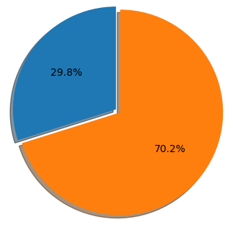
Preventing Fraud Loss
We built a machine learning model to identify top 400 transactions per month for review.
We are able to prevent up to 70% fraud loss.
lost
prevented
Model tested on January 2018 transactions

