Slide 1

DriverPass
System Analysis
Gabriel Romero
Notes:
[No speaker notes required for this slide.]

Slide 2

System Requirements
Allows User to Schedule Driving Lessons with Available Drivers
Users can register for classes and exams as needed
Provide Standardized exams and practice material in accordance with DMV requirements
System should provide reports within a day's time of requesting it
System needs to be able to handle multiple user logins simultaneously.
System needs to be responsive for scheduling purposes
Notes:
[In your speaker notes, include an explanation of the different requirements you determined for DriverPass’s system. What are the functional requirements you selected to describe? What are the nonfunctional requirements you selected to describe? Be sure to explain how these requirements meet DriverPass’s needs.]

Slide 3
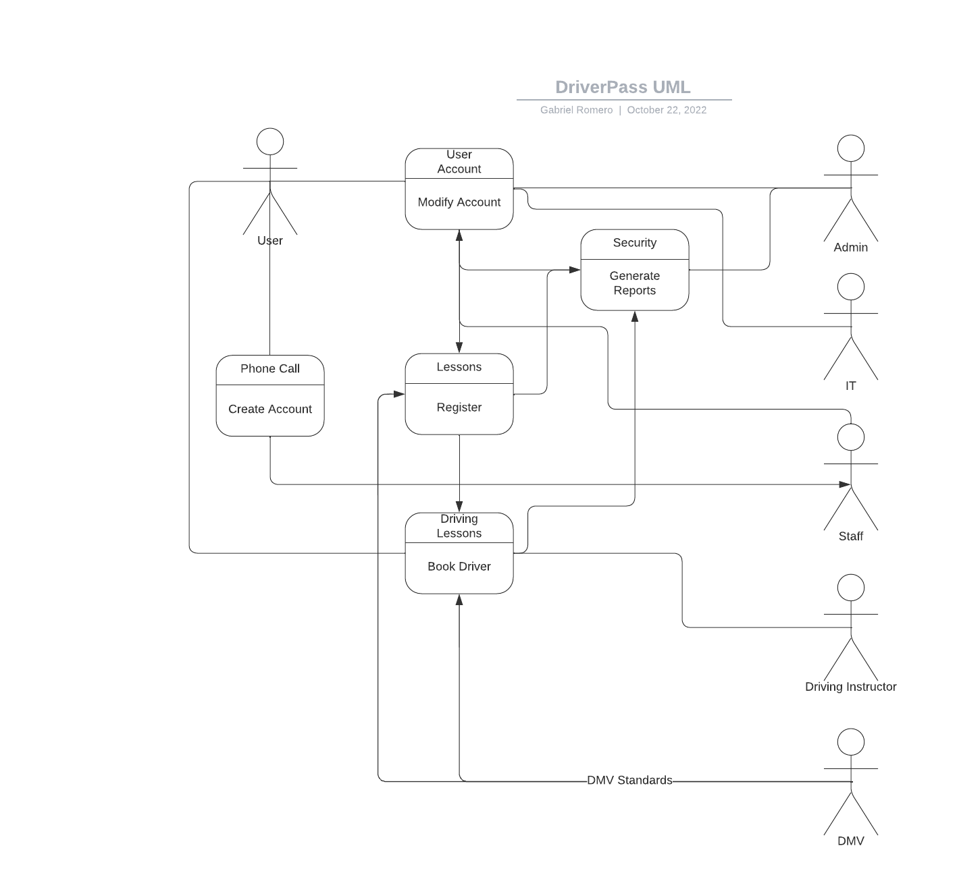
Use Case Diagram
Notes:
[Explain your diagram. Who are the different actors in the system? What are the different use cases? How did you account for DriverPass’s needs in your design? In your explanation, keep your audience in mind. Avoid the use of terms like “actors” and “use cases” in your explanation.]

Slide 4
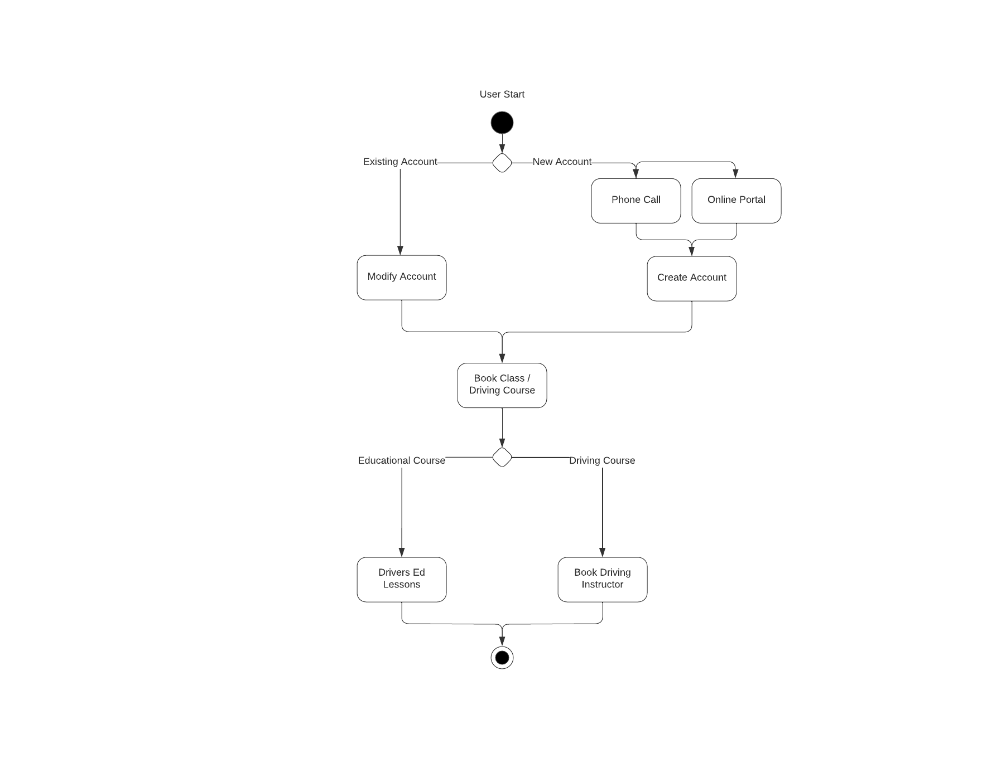
Activity
Diagram
Notes:
[Explain your diagram. Which use case are you breaking down? What are the steps for this use case? How did you account for DriverPass’s needs in your design? In your explanation, keep your audience in mind. Avoid the use of technical terms such as “nodes,” “control flows,” and so on.]

Slide 5
Security
With the use of group policies, we are able to divide the user access as needed.
Admins will have the ability to create reports and log all activity as needed.
Each account will have a unique Identifier that will be used to track their actions
Account authentication is a must, and each account shall have a unique email address associated with it.
There will be a separate class of IT users to assist users with their issues, but Admins will have access to the full suite of methods.
Notes:
[How did you consider security in your design? In your explanation, keep your audience in mind by avoiding the use of technical terms.]

Slide 6
System Limitations
The system will be limited by the hardware we are able to incorporate
There is still the human error issue where we have people calling in and making accounts/ registering for classes that can go amiss.
There needs to be a seamless connection between the calling and the online portal so that there isn’t anything that is conflicting.
This limits us in terms of hardware as we will need to make sure we are able to get our data updated quickly all depending on the volume of calls.
Standards will also be associated with the DMV so we will need to constantly keep up to date with their systems.
Our driving instructors will also need to be capable of controlling their appointments and giving notice if they cannot make them as well. This could lead to severe conflicts.
Notes:
[What are the limitations of your design? In your explanation, keep your audience in mind by avoiding the use of technical terms.]

