Slide 1
OTA Rx Test

Slide 2
OTA Test Para
仪表参数：
Density=-156.3
IQoffset=0.00002
Gain Imb=0.002
PhaseNoise=[100 -98.57 1e3 -107.56 1e4 -121.67]
ADC_Nbits=14
Imp 测试参数：
Power out=15dBm
Density=-156.3
IQoffset=0.002
Gain Imb=0.02
PhaseNoise=[100 -88.57 1e3 -97.56 1e4 -111.67]
ADC_Nbits=12
NoiseFigure=5
Length=1.1m
Pathloss=-46dBm

Slide 3
Intermodulation OTA Test
Intermodulation | Test_EVM(dB) | Sim_EVM(dB) | Delta(dB) | Test_Throughput(%) | Sim_Throughput(%)
Ideal | -7.911 | -7.961 | 0.05 | 100 | 100
RFImp | -2.264 | -2.133 | 0.131 | 100 | 100

Slide 4
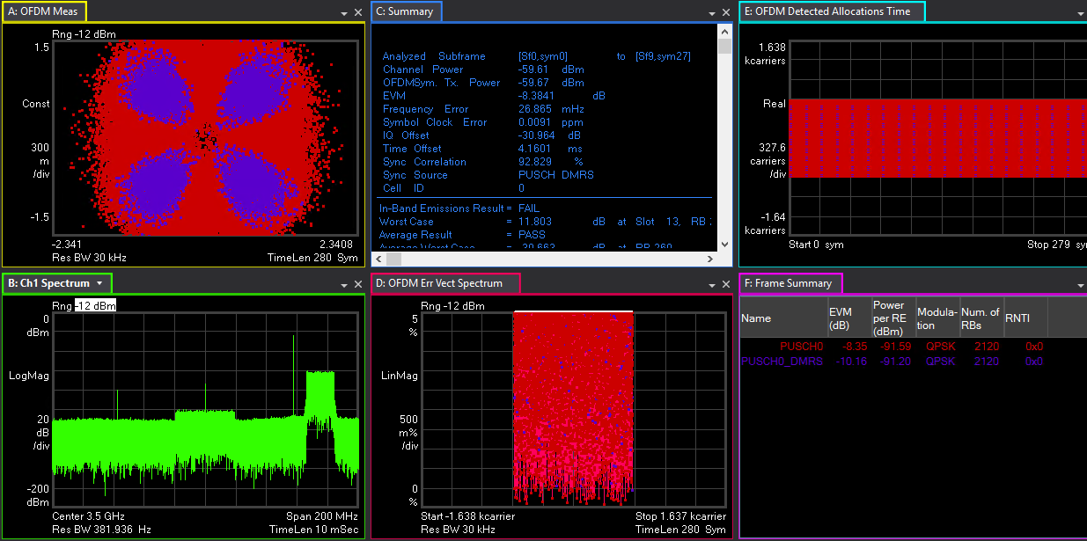
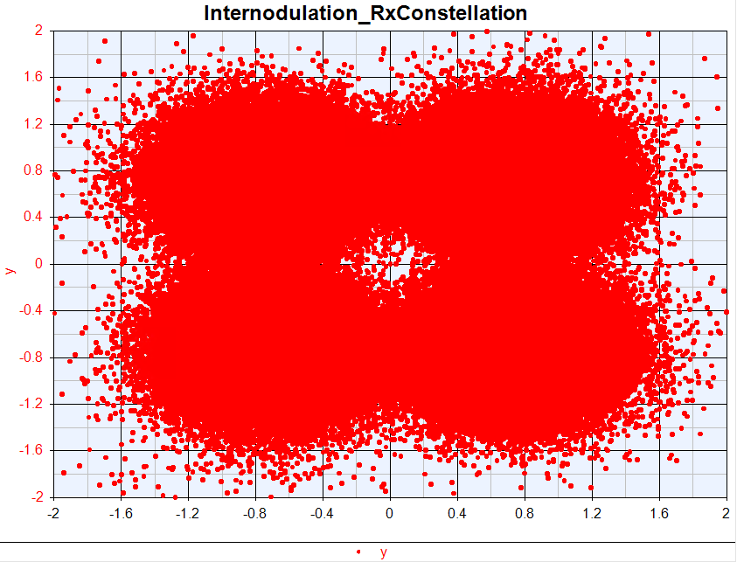

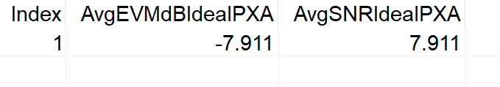

Ideal Intermodulation OTA Test

Slide 5
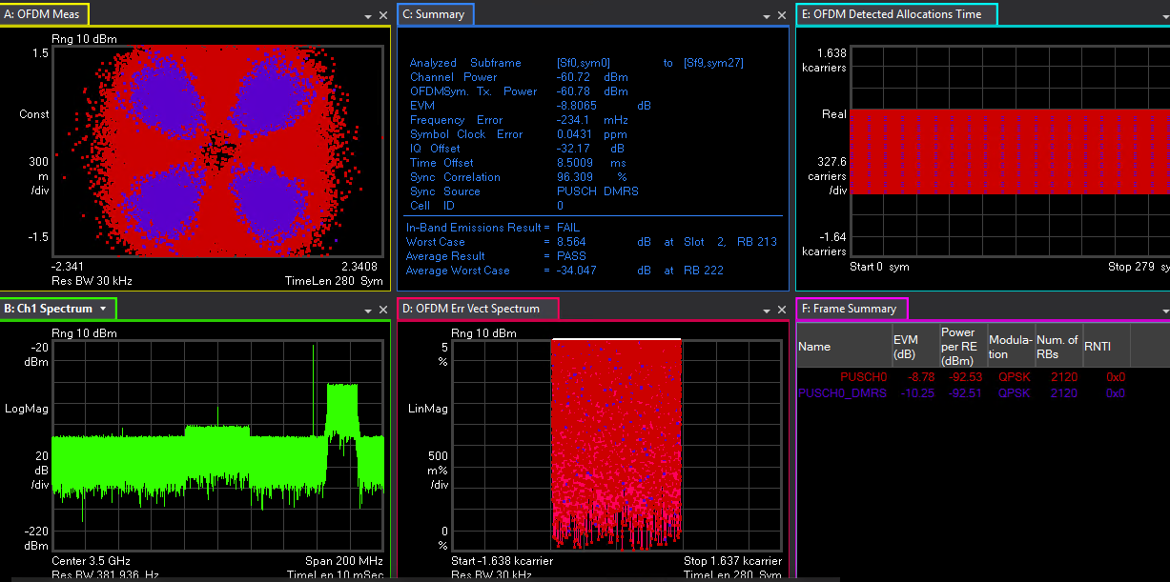
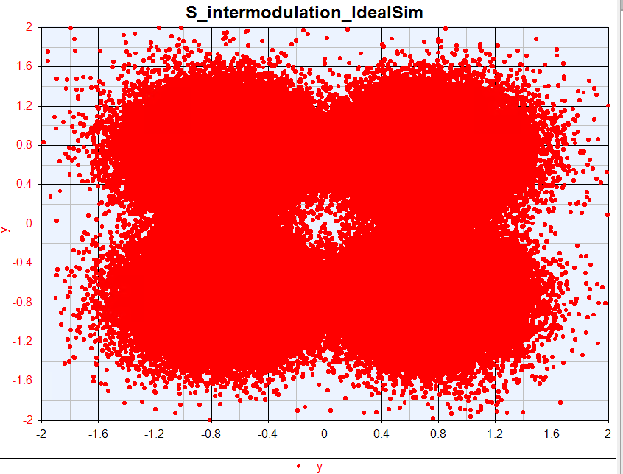
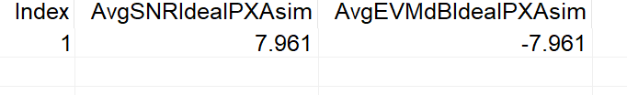


Sim OTA Ideal Intermodulation
Density=156.3
IQ offset=0.00002

Slide 6
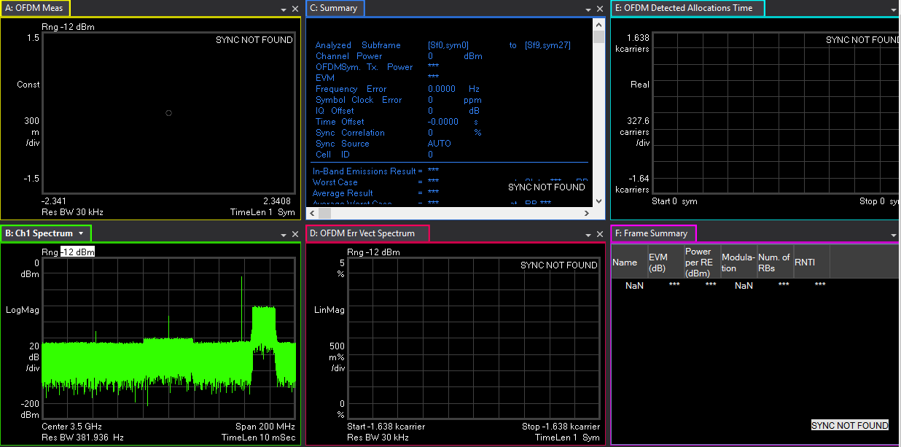
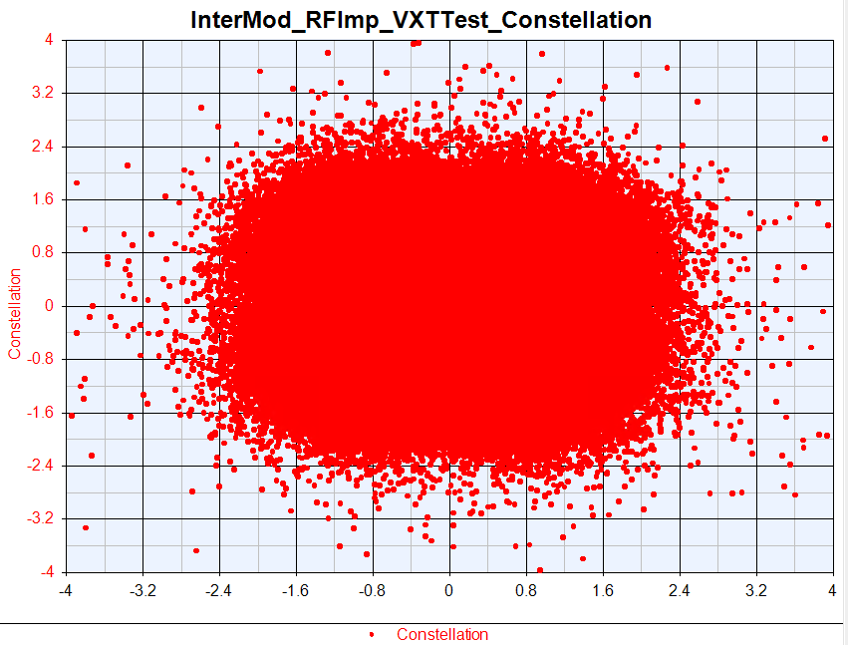



OTA RFImp Intermodulation Test

Slide 7
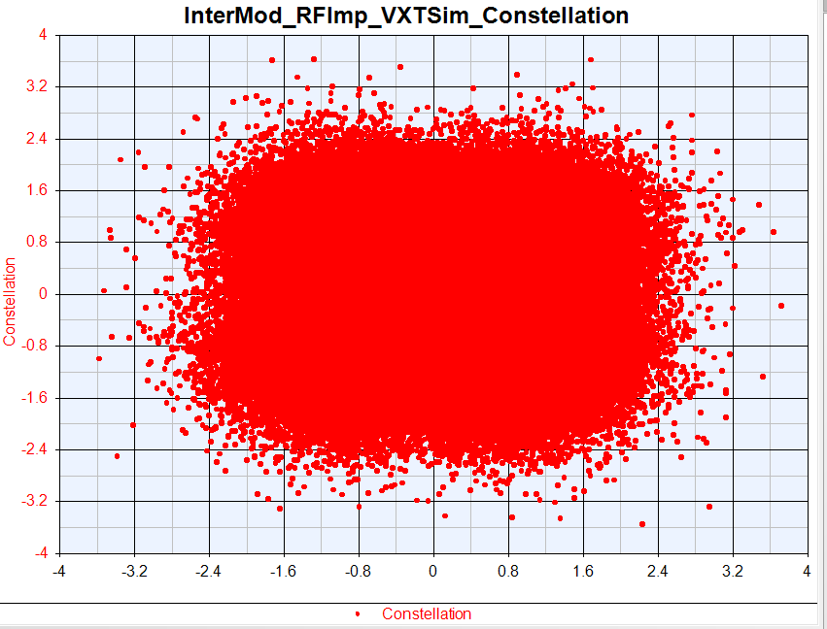
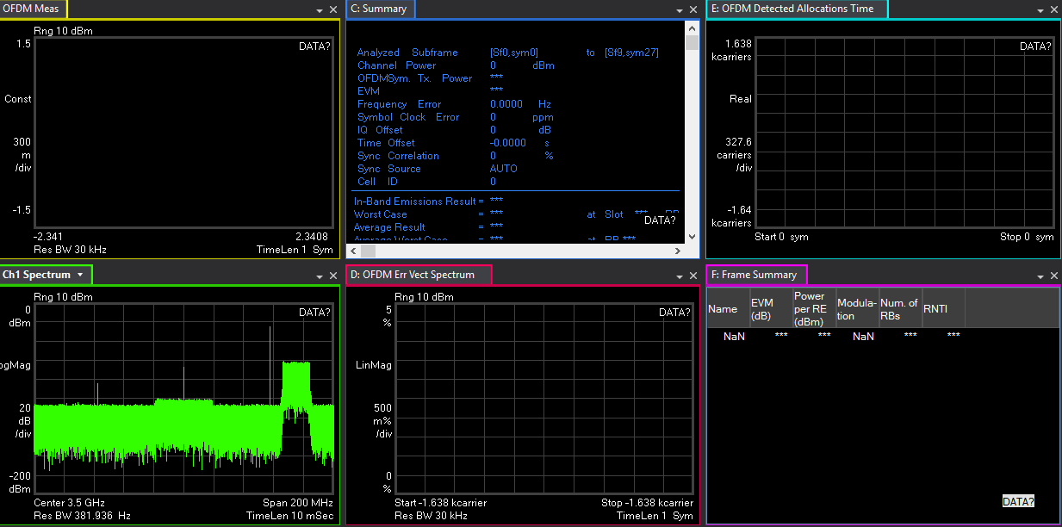
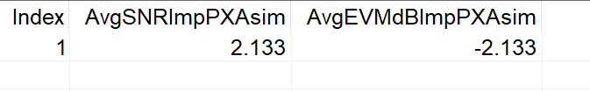


Sim OTA RFImp Intermodulation

Slide 8
Narrow Blocking OTA Test
Narrow Blocking | Test_EVM(dB) | Sim_EVM(dB) | Delta(dB) | Test_Throughput(%) | Sim_Throughput(%)
Ideal | -7.658 | -7.773 | 0.115 | 100 | 100
RFImp | -2.874 | -2.685 | 0.189 | 100 | 100

Slide 9
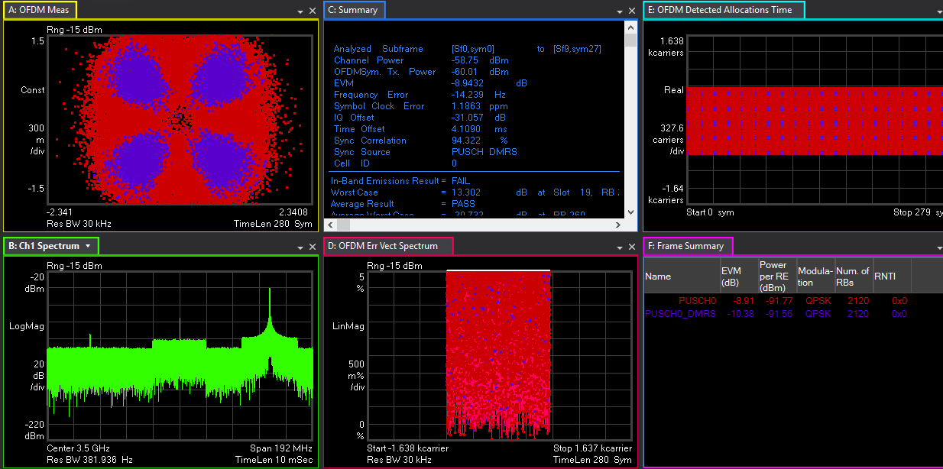
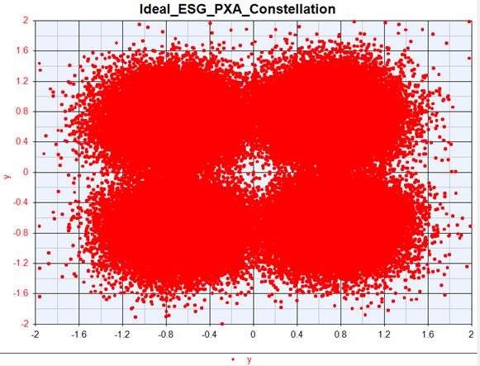
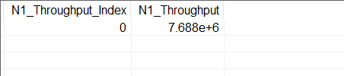


OTA Test Ideal Narrow Blocking

Slide 10
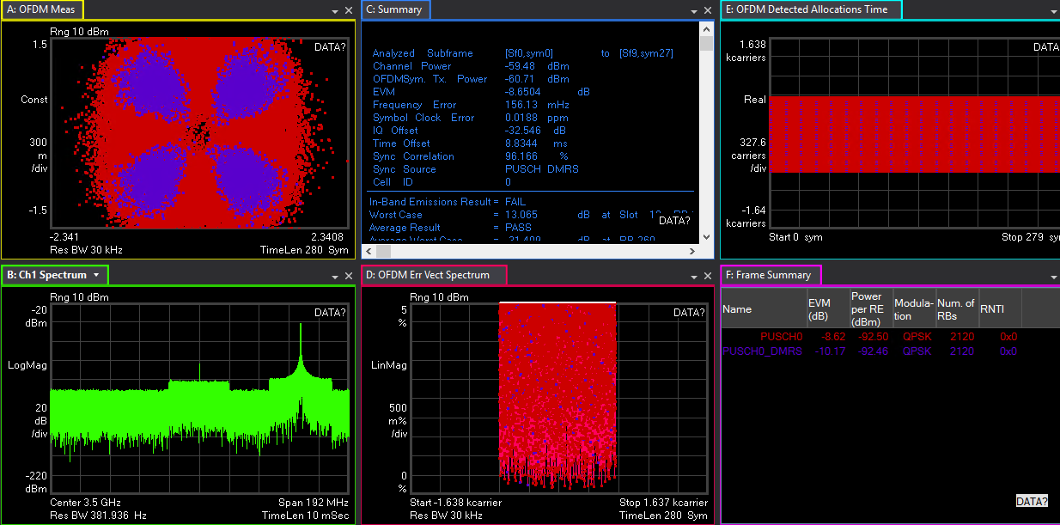
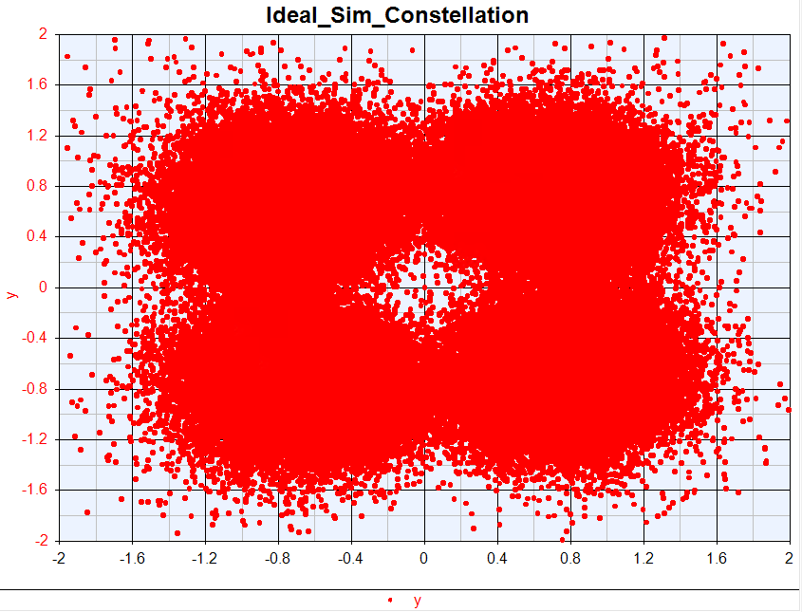
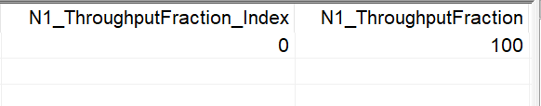


Sim OTA Ideal Narrow Blocking

Slide 11
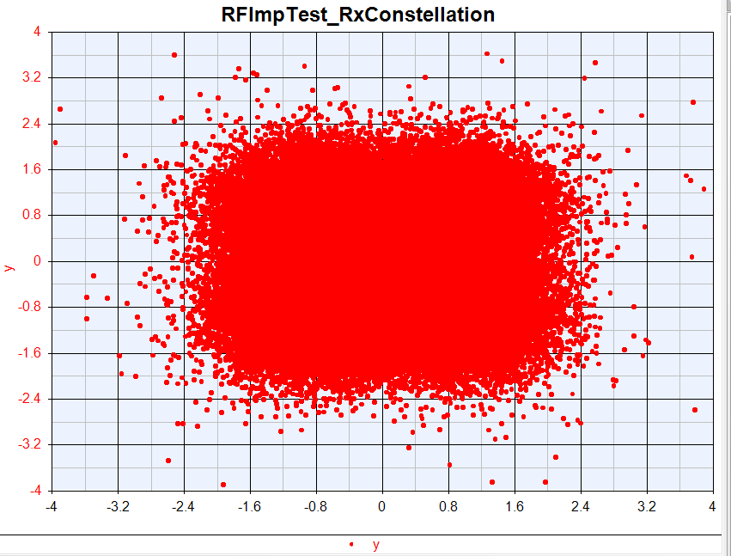
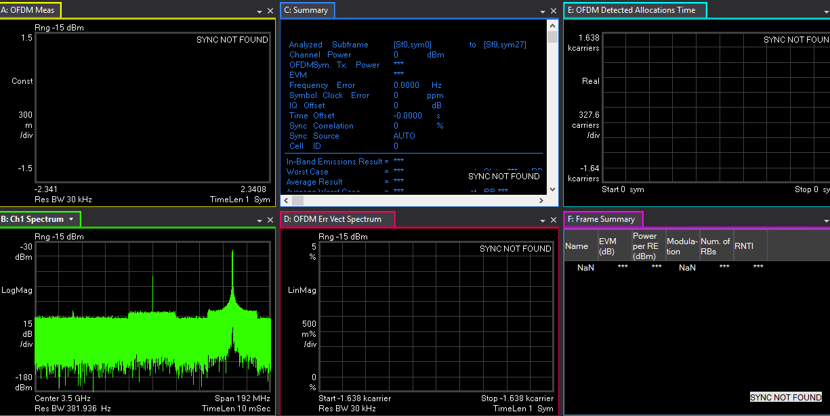



Test OTA RFImp Narrow Blocking

Slide 12
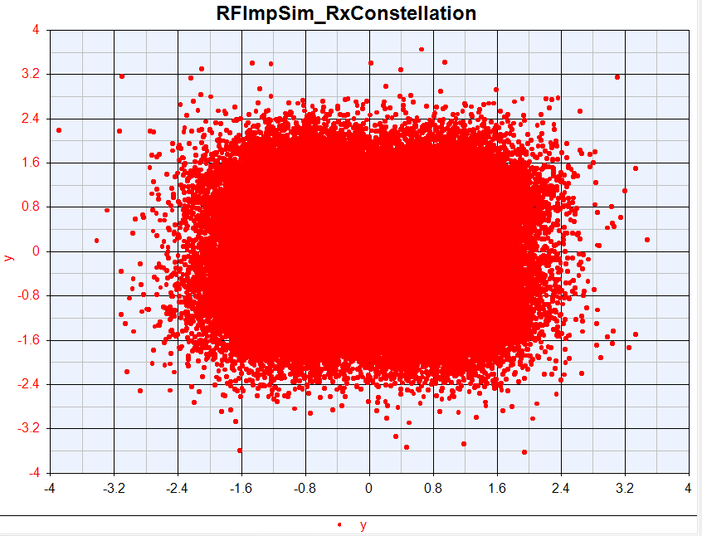
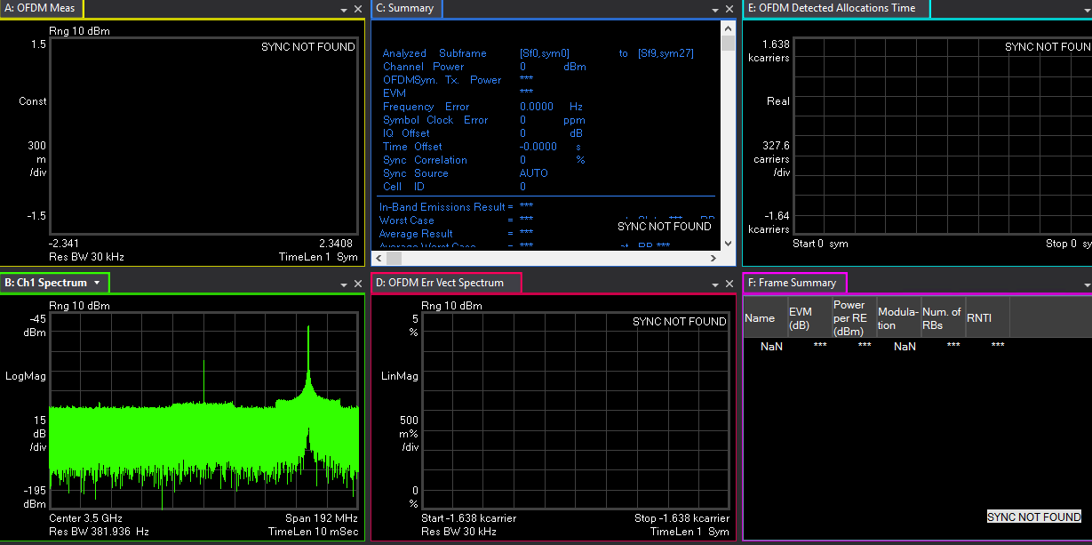
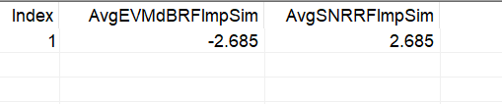


Sim OTA RFImp Narrow Blocking

Slide 13
General Blocking OTA Test
General Blocking | Test_EVM(dB) | Sim_EVM(dB) | Delta(dB) | Test_Throughput(%) | Sim_Throughput(%)
Ideal | -8.105 | -8.13 | 0.008 | 100 | 100
RFImp | -2.195 | -2.541 | 0.346 | 100 | 100
Blocking Signal Power=-43dBm-6dBm=-49dBm

Slide 14
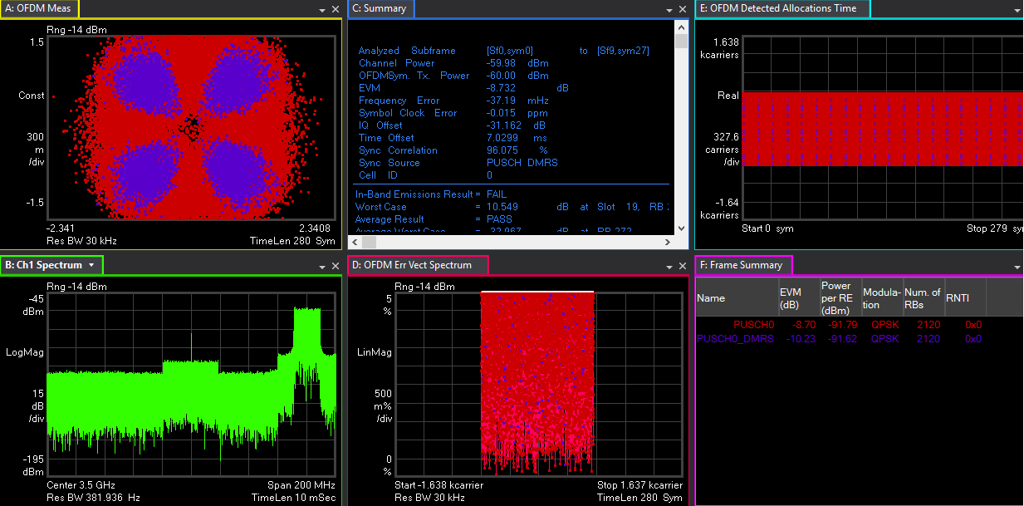
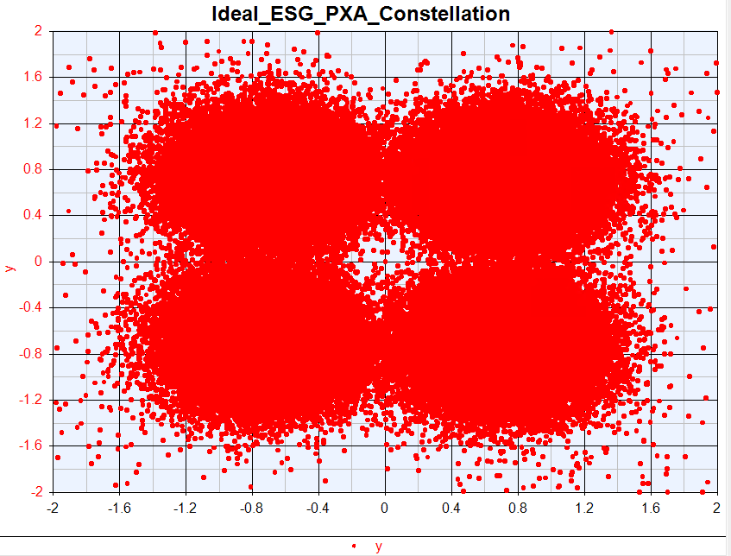



Test OTA Ideal General Blocking

Slide 15
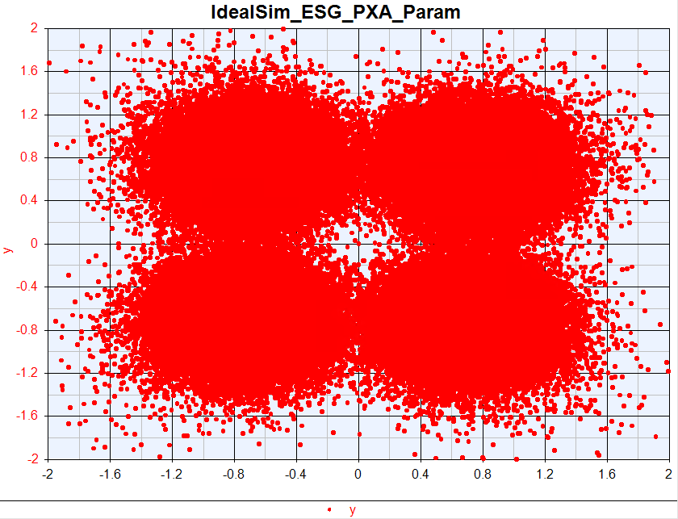
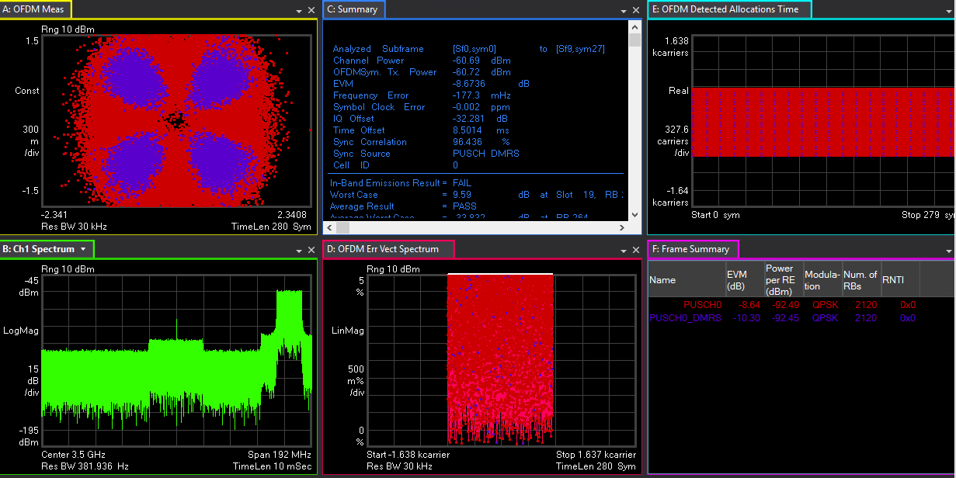



Sim OTA Ideal General Blocking

Slide 16
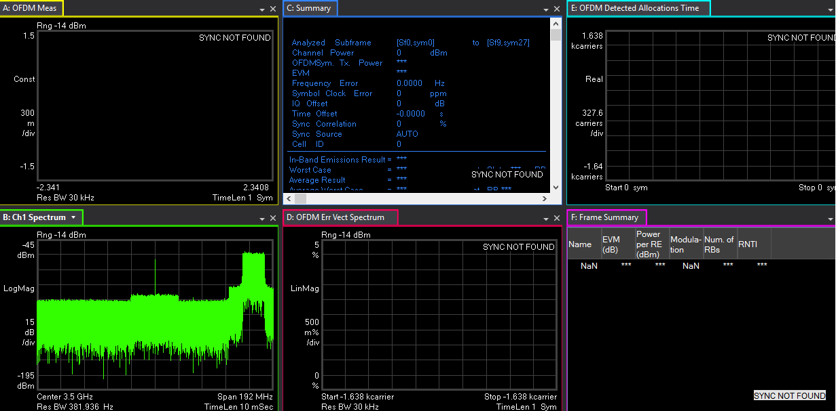
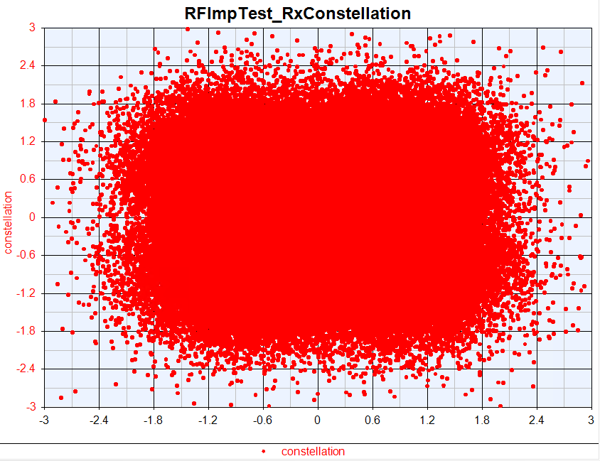



Test OTA RFImp General Blocking

Slide 17
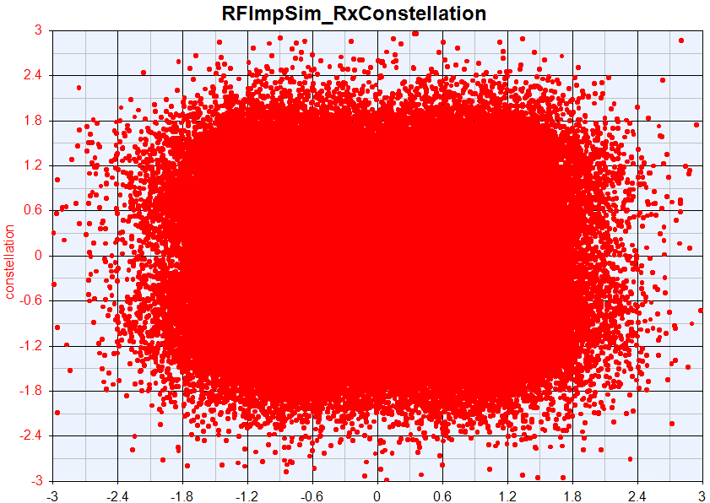
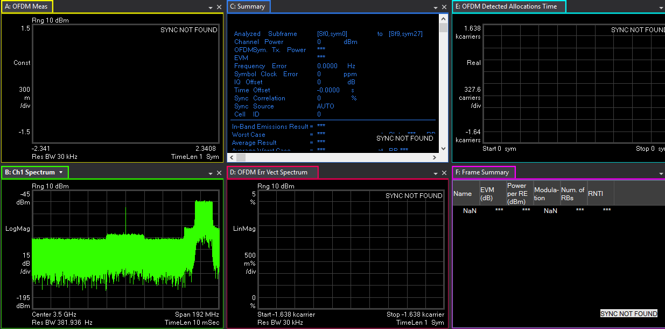



Sim OTA RFImp General Blocking

