Slide 1
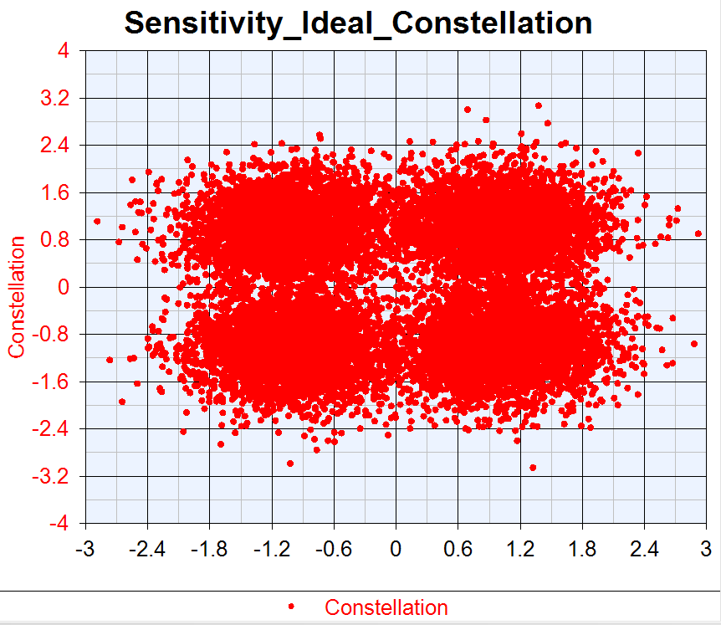
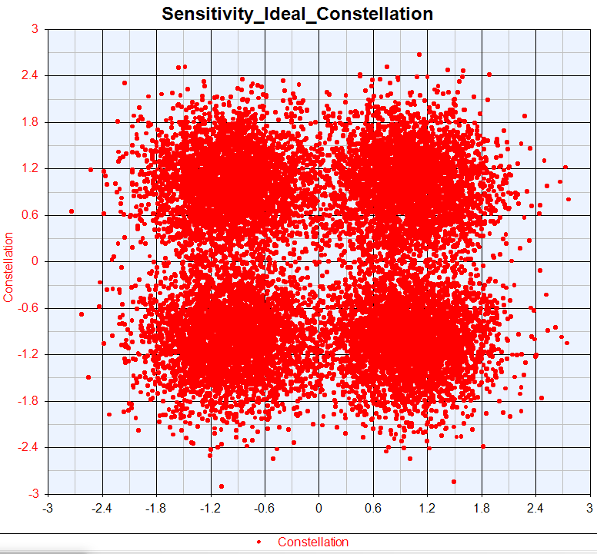
Ideal Constellation
50M
100M

Slide 2
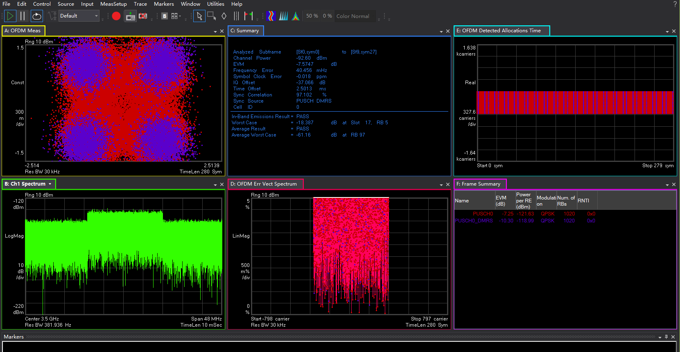
Ideal 50M
EVM:-7.5747dB

Slide 3
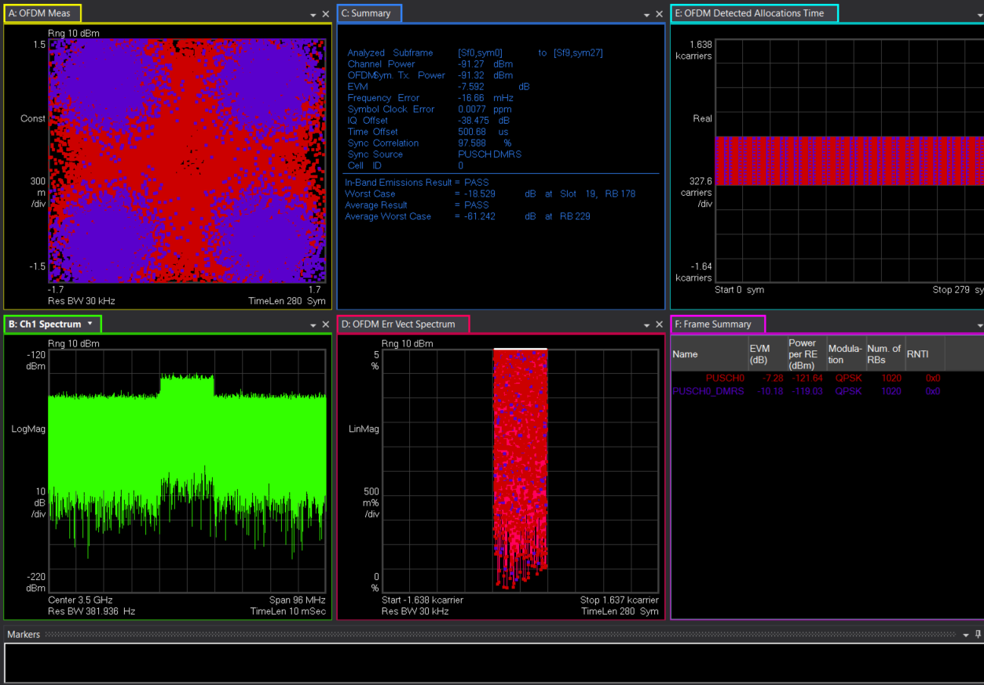
Ideal 100M
EVM:-7.592dB

Slide 4




Ideal ThroughPut
50M
100M

Slide 5


Ideal EVM
50M
100M

Slide 6
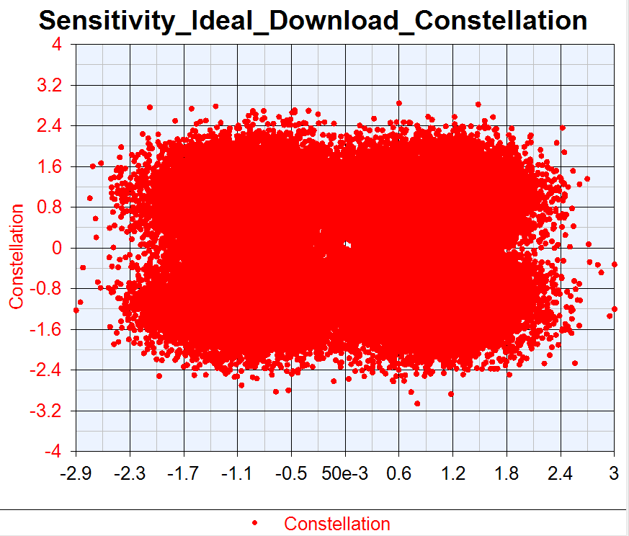
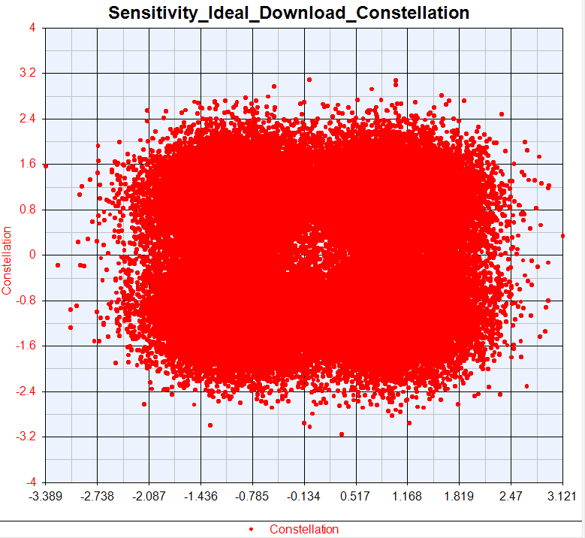
VXT Ideal Constellation
50M
100M

Slide 7
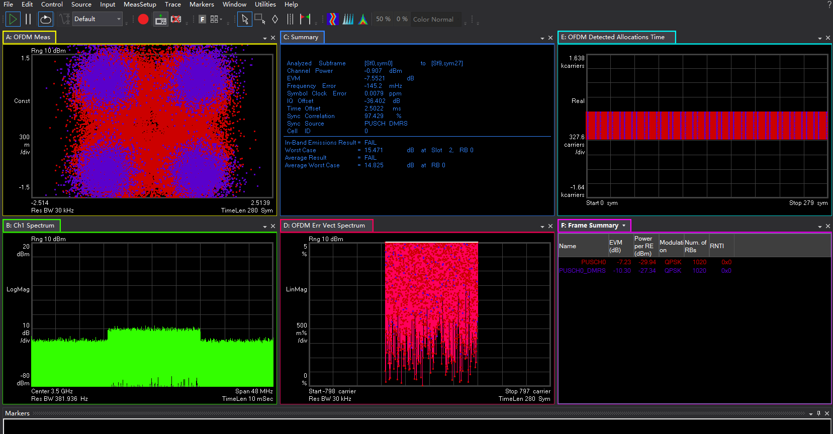
Ideal 50M VXT
EVM:-7.5521dB

Slide 8
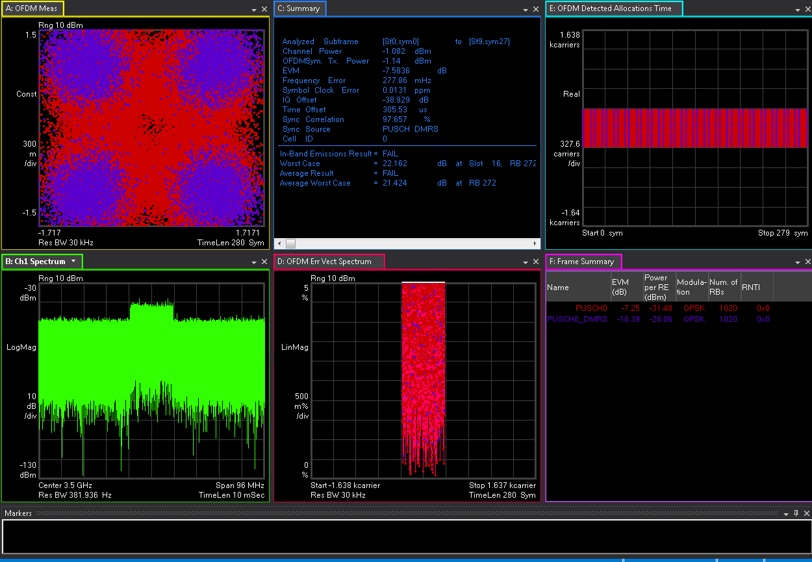
Ideal 100M VXT
EVM:-7.583dB

Slide 9

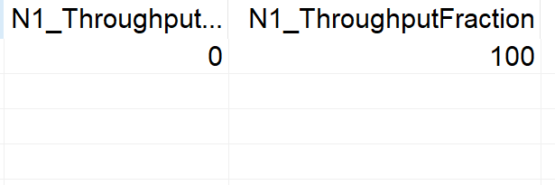
VXT Ideal ThroughPut
50M
100M

Slide 10


VXT Ideal EVM
50M
100M

