Slide 1
Mini Capstone Project (SQL & EXCEL)
Done by:
Gaddam Lakshmi Deepak
Student ID: S9648

Slide 2
Project Question: Analysis of Rental Patterns and Film Popularity in MavenMovies Database
Objective: To analyze rental trends, identify popular films, and assess store performance using the MavenMovies Sakila database.
Tools used – SQL, Excel & PowerPoint
Total Tables – 19
Used Tables - 9

Slide 3
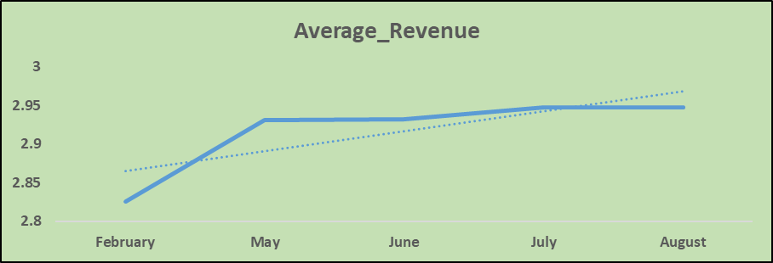
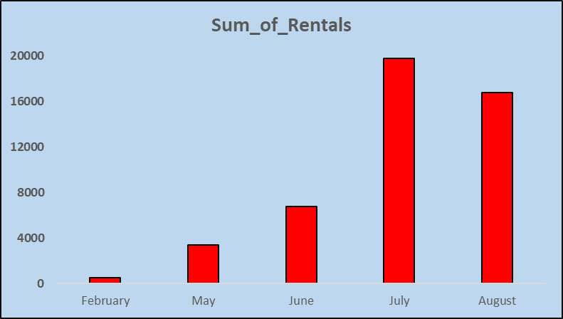
1. Rental Trends:
Analyze the monthly rental trends over the available data period.

Slide 4
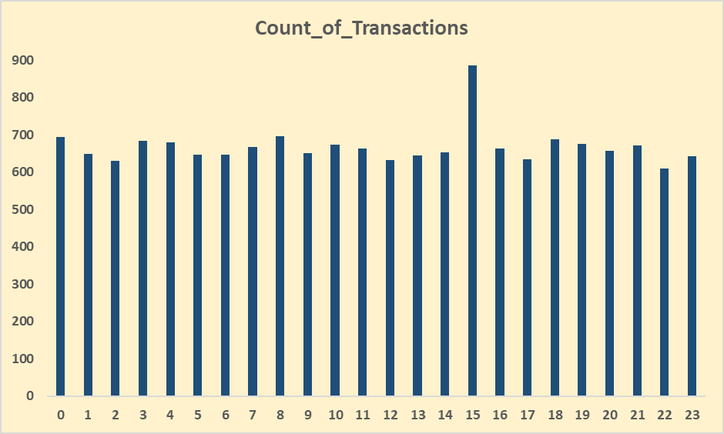
Determine the peak rental hours in a day based on rental transactions.

Slide 5
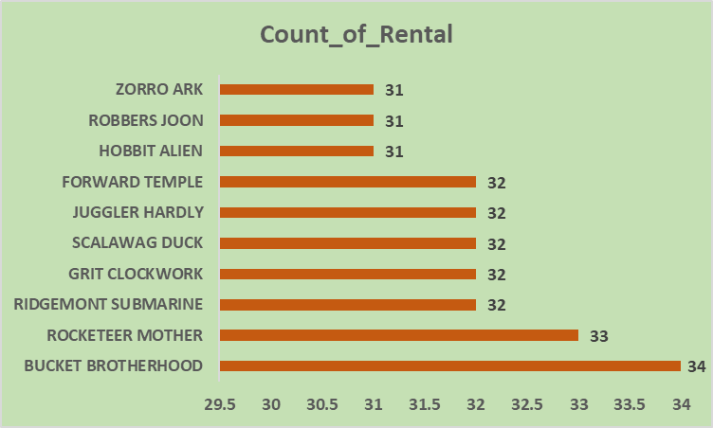
2. Film Popularity:
Identify the top 10 most rented films.

Slide 6
Determine which film categories have the highest number of rentals.

Slide 7
3. Store Performance:
Identify which store generates the highest rental revenue.
Determine the distribution of rentals by staff members to assess performance.

Slide 8
THANK YOU

