Slide 1


DATA SCIENCE MINOR PROJECT PRESENTATION Hotels on MakeMyTrip Data Analysis
Submitted By
NAME: Gaddam Lakshmi Deepak
REGISTRATION NO: 11807039

Slide 2
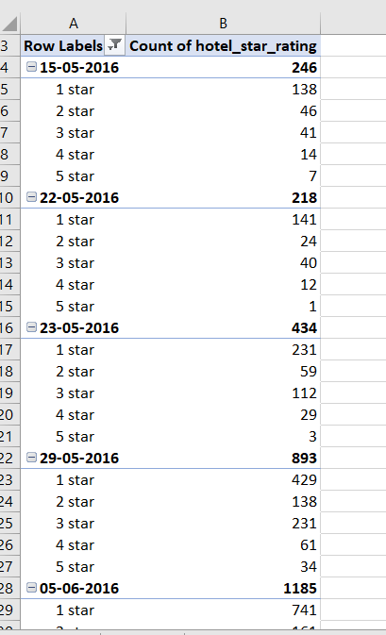
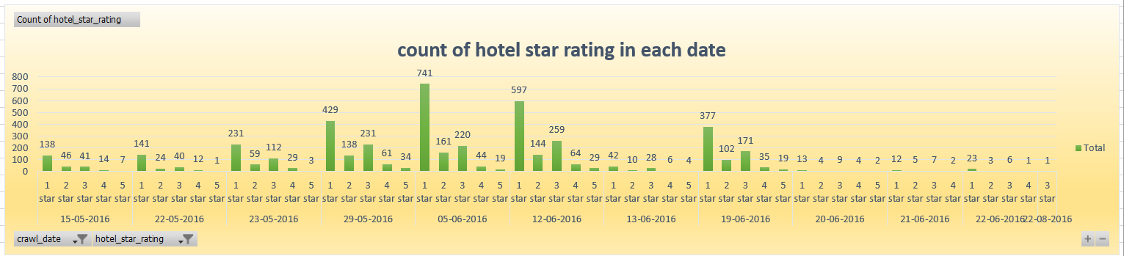
OBJECTIVES:-
Find the count of hotel star rating for each 1 star to 5 stars in each date from given dataset with the column chart?

Slide 3
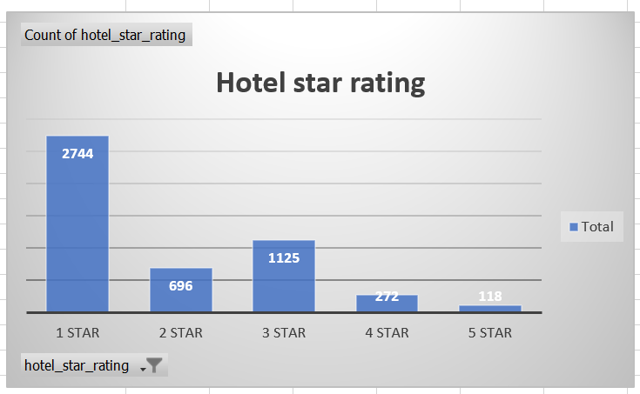
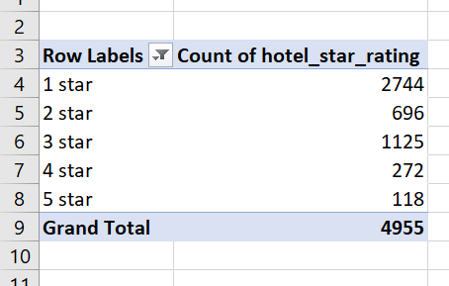
2. Find the total number of rating for each 1 star to 5 star and show what is maximum star is getting with column chart?

Slide 4
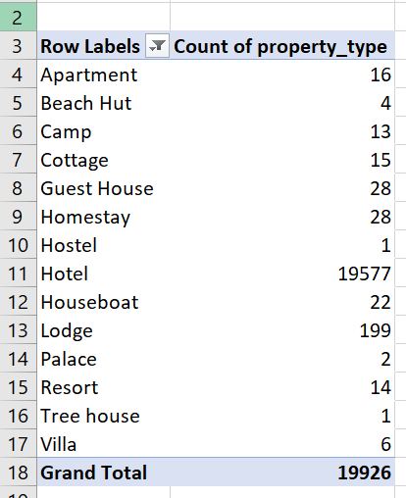
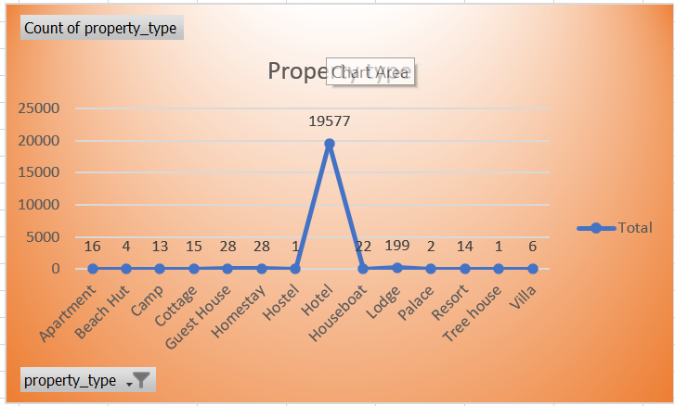
3.Find the number of property type having in each property type?

Slide 5
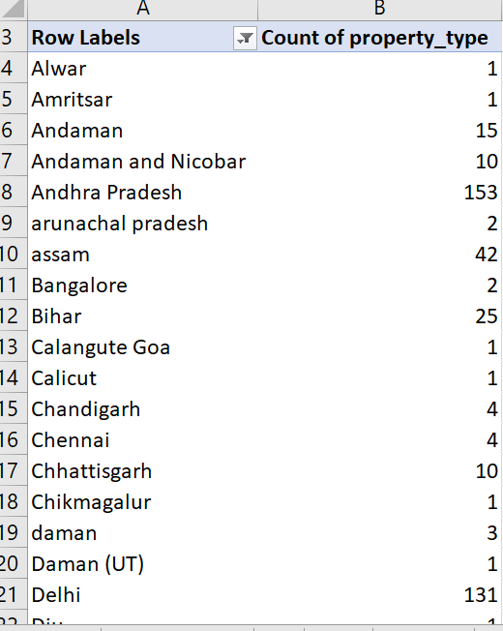
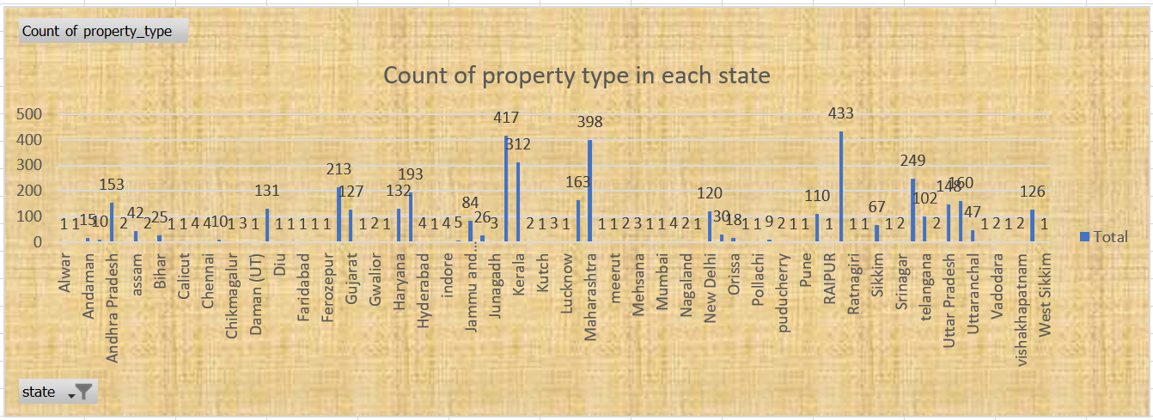
4.Find the count of property type in each state with Column chart?

Slide 6
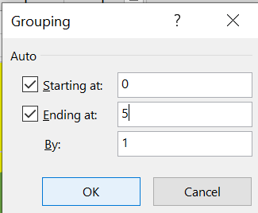
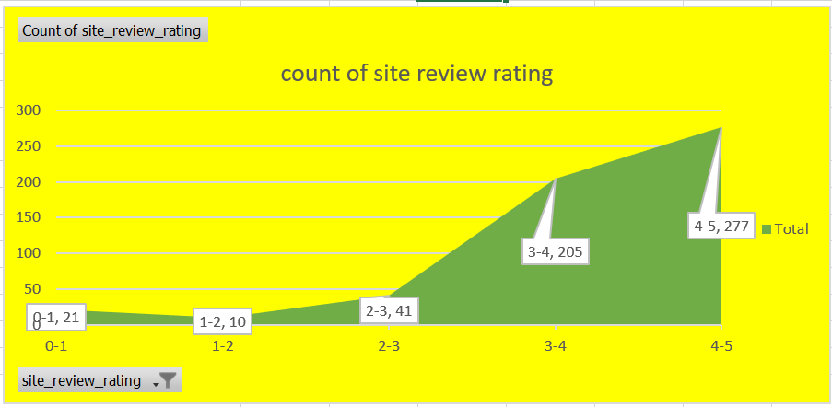
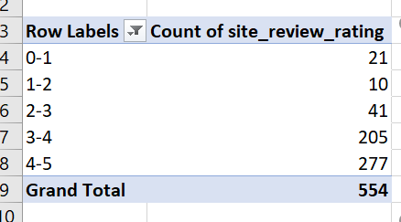
5.Find the count of site review rating which group labels and show Area chart?

Slide 7
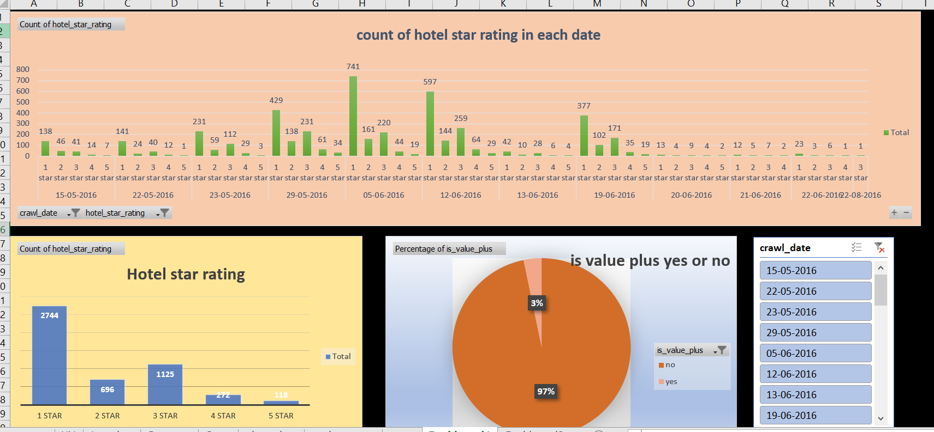
DASHBOARDS:- Dashboard 1

Slide 8
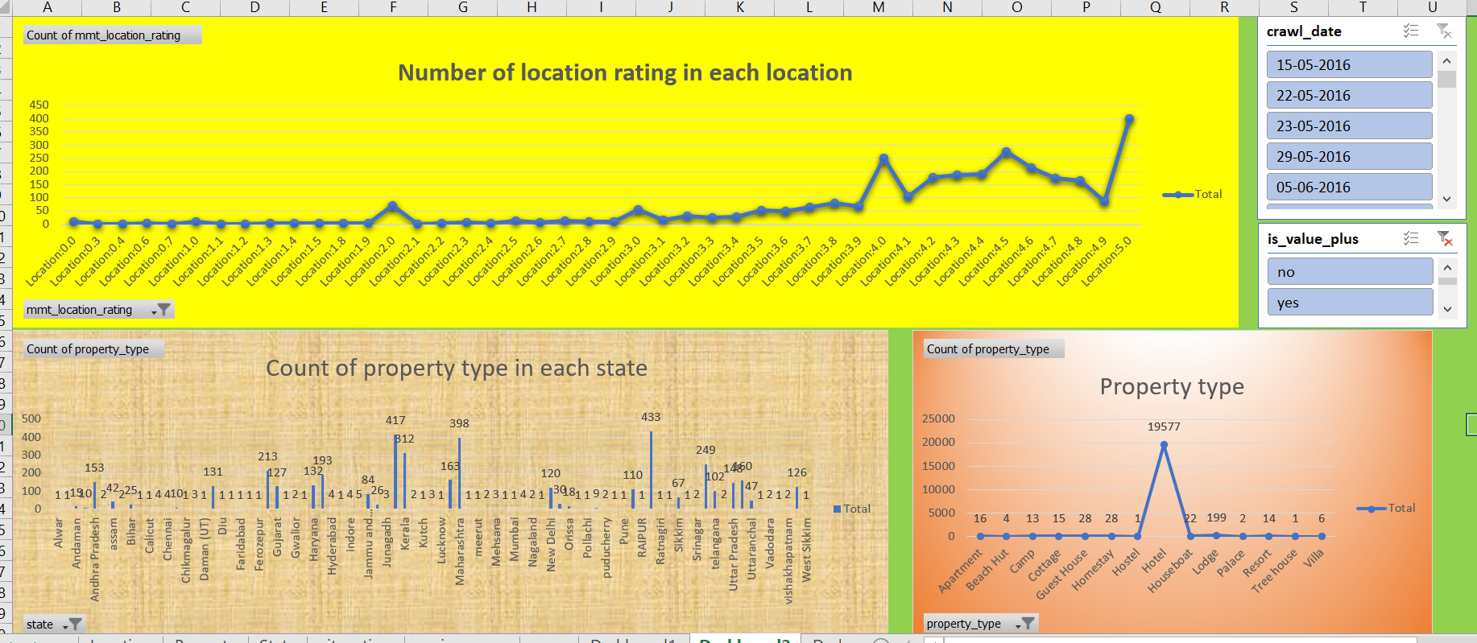
Dashboard 2

Slide 9
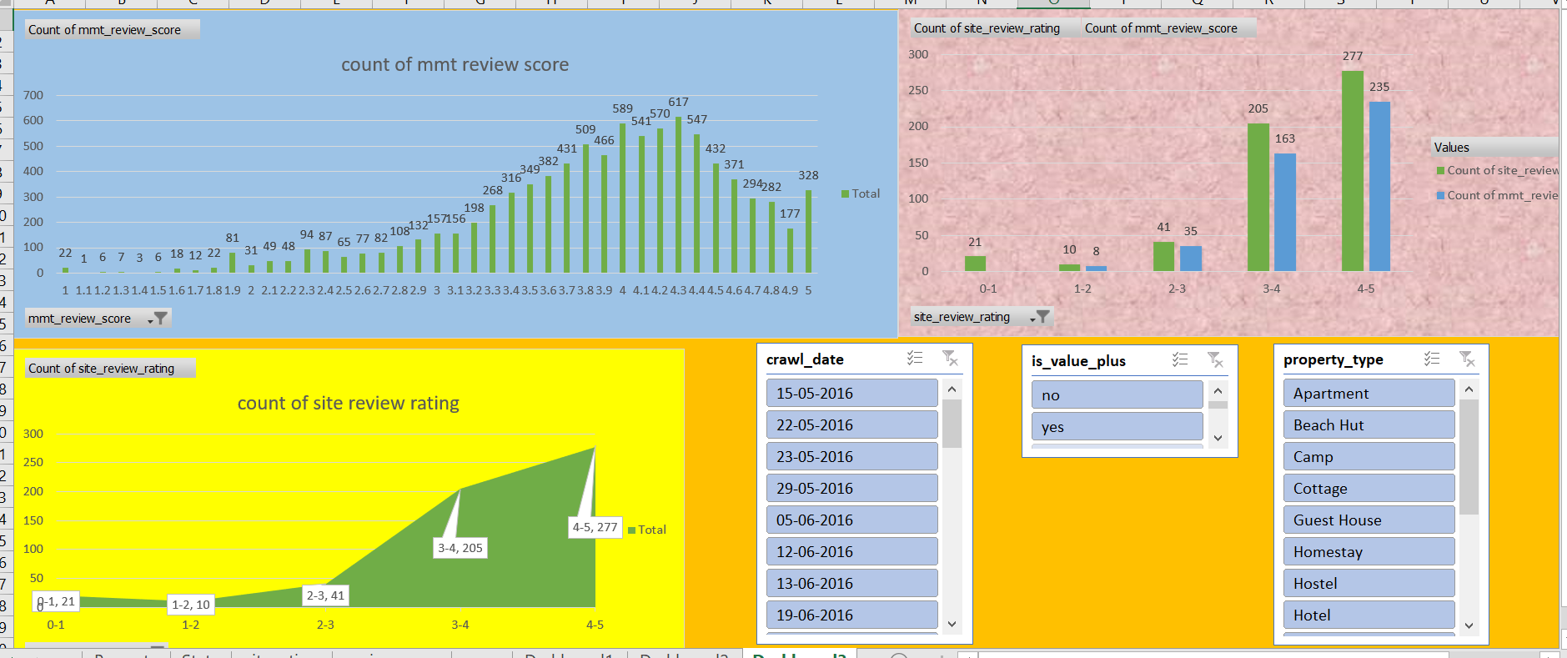
Dashboard 3

