Slide 1
DATA ANALYTICS & VISUALIZATION
Smart Tourism
Forecasting Analytics
REVIEW–3 • Hybrid Forecasting, Literature Comparison & Validation
Batch 4
G. Hasini – 2420030421
G. Keertana – 2420090075
S. Rishitha – 2420090060
Proposed Hybrid
XGBoost + LightGBM
Review-3 presentation • 2026

Slide 2
1. Problem Statement & Research Gap
Forecast tourist arrivals from heterogeneous tourism and contextual attributes.
Problem
Research Gap
Tourist arrivals depend on date, location, facility, tourism indicators and weather-related signals. The target is skewed and contains heterogeneous area/facility combinations, making a single simple model insufficient.
Existing tourism forecasting research uses statistical, ML, DL and hybrid models. The challenge is selecting a combination that handles nonlinear tabular relationships while remaining practical for the supplied multi-feature dataset.
Compare multiple model combinations rather than selecting one hybrid without evidence.
Use the same chronological validation window so models are compared fairly.
Evaluate more than one error metric: MAE, RMSE, MAPE and R².
Separate validation performance from the July test set because test_df.csv has no target column.
Connect the forecast to a later capacity/resource-allocation decision layer.
DAV PROJECT • REVIEW 3 • Smart Tourism Forecasting Analytics
3

Slide 3
2. Dataset and Data Sources
Primary forecasting dataset plus supporting tourism planning datasets.
File | Size / Coverage | Role
train_df.csv | 132,192 × 13 • Aug-2018 to May-2019 | Supervised training; target = tourist_arrivals
test_df.csv | 13,392 × 12 • July-2019 | Prediction rows; target absent
submission.csv | 13,392 × 2 | Submission template; zeros are not labels
resource_allocation_dataset.csv | 15,000 × 34 • 2016–2057 | Demand, weather, capacity, revenue and allocation context
final.csv | 43,594 × 10 | Hotel discovery / accommodation context
india_travel_destinations.csv | 110 × 12 | Destination, season, budget, duration and crowd context
Target
Feature groups
Integration caution
tourist_arrivals is the numeric supervised label in train_df.csv.
Date + tourist_area + spot/facility + area + city + type + category + info + event + tourism_index + weather_index.
Supporting files have different schemas and coverage; they should be joined only through validated keys, not row-by-row concatenation.
DAV PROJECT • REVIEW 3 • Smart Tourism Forecasting Analytics
4

Slide 4
3. Data Preprocessing, Cleaning & Feature Engineering
Leakage prevention is essential for a time-dependent forecasting problem.
1
Date processing
2
Categorical encoding
Parse date; derive year, month, day, weekday, day-of-year, ISO week and ordinal date.
Encode spot_facility, area, city, type, info and event consistently; define handling for unseen categories.
3
Numeric features
4
Target handling
Use tourist_area, category, tourism_index and weather_index with date-derived fields.
Keep tourist_arrivals numeric; clip negative predictions to zero because arrivals cannot be negative.
5
Leakage guard
Split chronologically before evaluation; do not use future target-derived aggregates.
Key rule: validation dates are later than training dates. No future validation information is allowed to influence training.
DAV PROJECT • REVIEW 3 • Smart Tourism Forecasting Analytics
5

Slide 5
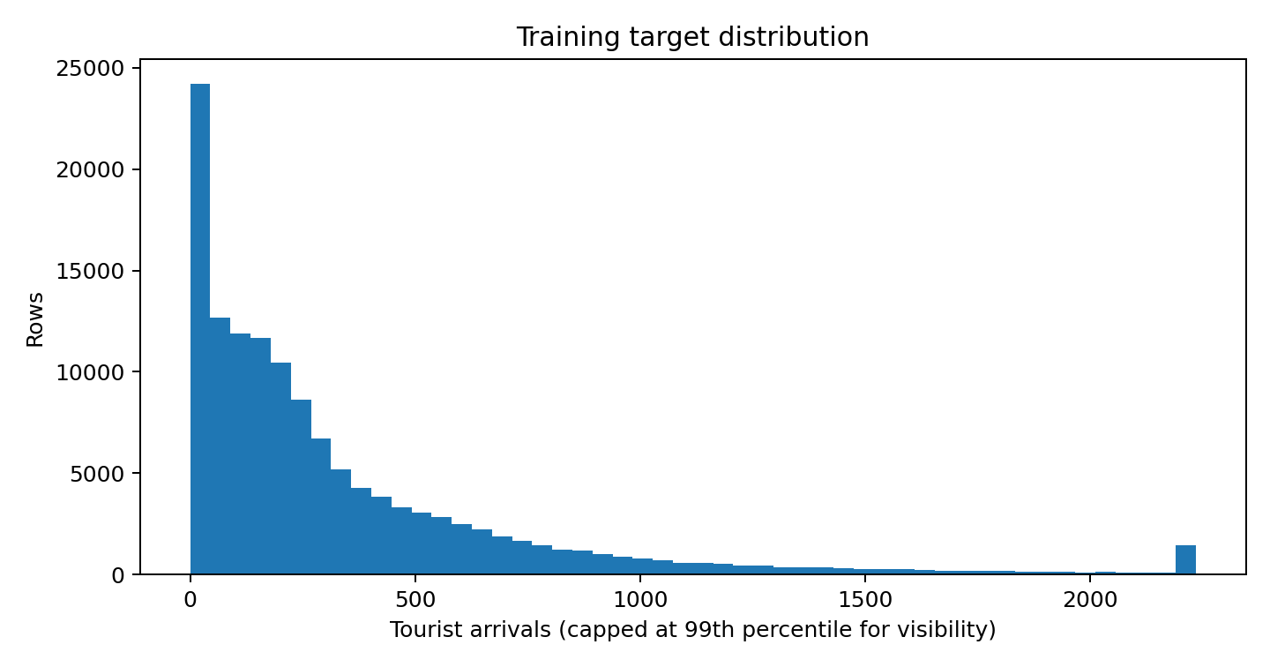
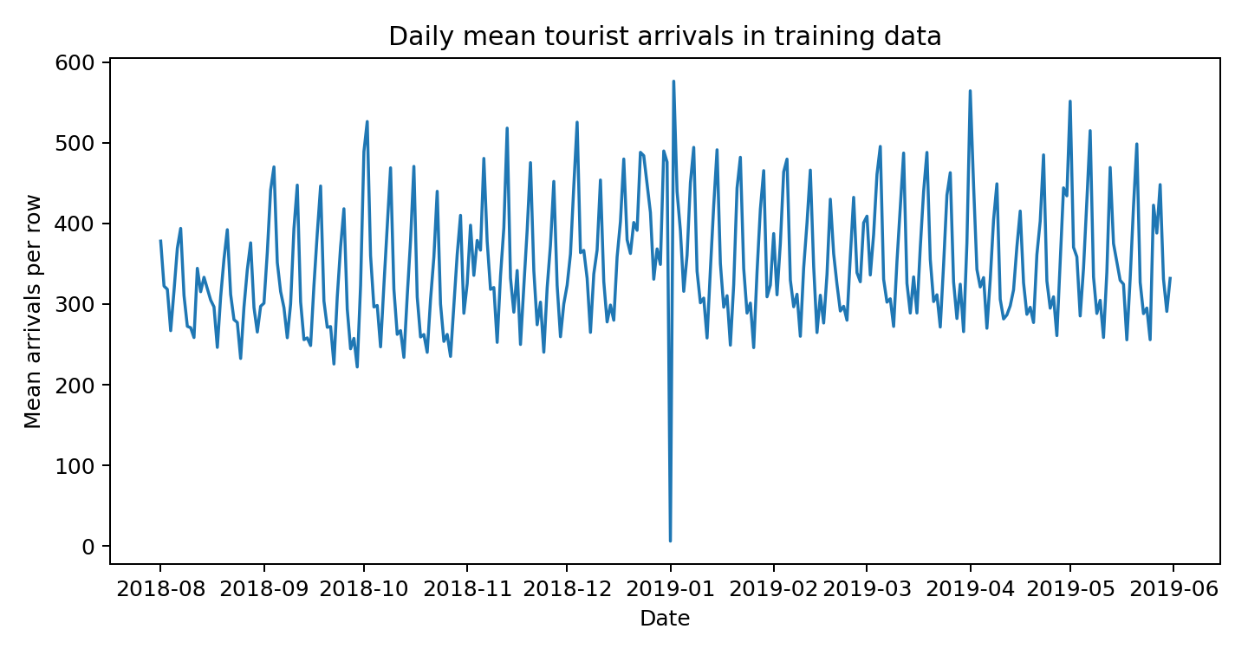
4. Exploratory Data Analysis (EDA)
The supplied training target is right-skewed and varies substantially across dates and rows.
Target summary
Distribution
Model implication
Mean 347.17 • Median 202 • SD 449.54 • Max 6,308
Mean > median; a small number of high-arrival rows create right skew.
Use MAE + RMSE together; RMSE penalizes large misses more strongly.
DAV PROJECT • REVIEW 3 • Smart Tourism Forecasting Analytics
6

Slide 6
5. Literature Review: Existing Forecasting Models
Literature shows that no single forecasting family dominates every tourism context.
Statistical
Deep Learning
ML Ensembles
Hybrid
ARIMA / SARIMA
Strong for trend and seasonality; limited when nonlinear/exogenous effects dominate.
LSTM / CNN-LSTM
Learns nonlinear and sequential patterns; more data, tuning and computation are typically required.
Random Forest / XGBoost / LightGBM
Strong on heterogeneous tabular predictors and nonlinear feature interactions.
SARIMA-CNN-LSTM / ARIMA-LSTM
Combines complementary modelling assumptions, but increases pipeline complexity.
Research evidence: tourism-demand forecasting has evolved from statistical and econometric models toward AI and hybrid combinations; recent work also emphasizes leakage-free validation, multi-source predictors and tree-based learners.
References: Song et al. (2019) review • He et al. (2021) SARIMA–CNN–LSTM • Fu & Qin (2026) denoise–decompose–XGBoost
DAV PROJECT • REVIEW 3 • Smart Tourism Forecasting Analytics
7

Slide 7
Literature Models Related to the Proposed XGBoost + LightGBM Hybrid
Recent tourism-forecasting studies support the use of tree-based learning, hybrid forecasting and ensemble combination.
Literature model | Main idea | Strength | Limitation for our dataset | Link / relevance
STL + XGBoost | STL separates seasonal/de-seasonal components; XGBoost models nonlinear patterns. | Handles trend + seasonality + nonlinear effects. | Needs a defensible time-series decomposition; our data are heterogeneous area/facility rows. | He & Qian (2025/2026)
SARIMA + XGBoost | SARIMA captures linear/seasonal structure; XGBoost models nonlinear residual behaviour. | Combines statistical and ML strengths. | More dependent on explicit seasonal structure and residual construction. | Malva et al. (2025)
XGBoost / LightGBM | Gradient-boosted trees learn nonlinear tourism-demand relationships from predictors. | Well suited to heterogeneous tabular features. | A single learner may remain sensitive to model-specific errors. | Peru tourist-flow study (2026)
Ensemble / meta-learner | Combines forecasts from several models using learned or dynamic weights. | Can outperform individual models and adapt model contribution. | More complex than a transparent equal-weight blend. | Annals of Tourism Research (2025)
Proposed: XGBoost + LightGBM | Train both learners on the same feature space and average predictions. | Simple, reproducible and directly matched to tabular tourism features. | Still needs broader rolling-origin validation to confirm robustness. | Project contribution: evaluated on prescribed dataset
STL-XGBoost: doi.org/10.1177/13548166241313411
SARIMA-XGBoost: doi.org/10.32877/bt.v8i2.3352
Peru XGBoost/LightGBM: doi.org/10.3389/frsut.2026.1876343
Ensemble meta-learner: doi.org/10.1016/j.annals.2025.103959

Slide 8
6. Existing Hybrid Models: Limitations for Our Problem
“Why they fail” is stated as a limitation for this dataset/problem—not as a claim that the models are universally poor.
Existing hybrid | Strength | Limitation in our setting | Design response
ARIMA + LSTM | ARIMA captures linear structure; LSTM captures nonlinear sequences. | Requires a clear sequential structure + deep-learning tuning; more complex than needed for heterogeneous tabular features. | Use feature-driven tree learners.
SARIMA + XGBoost | Seasonal model + residual correction. | Depends on a defensible seasonal series and residual formulation; supplied rows are area/facility combinations. | Avoid forcing a single seasonal decomposition.
XGBoost + Random Forest | Two tree ensembles reduce individual-model variance. | Both are tree-based but can produce correlated errors; the current run improves RMSE but not every metric. | Pair different boosting implementations.
SARIMA + CNN + LSTM | Linear seasonality + spatial/sequence feature extraction. | High modelling complexity and data requirements; difficult to justify when the project features are mainly tabular. | Prefer an efficient tabular hybrid.
Design principle → keep the complementary-model idea, but match the hybrid architecture to the actual data structure.
DAV PROJECT • REVIEW 3 • Smart Tourism Forecasting Analytics
8

Slide 9
7. Multiple Hybrid Combinations Evaluated
The final model was selected after comparing several combinations—not chosen in isolation.
XGBoost + LSTM
ARIMA + LSTM
ML + DL
Nonlinear tabular learning + sequence learning
Statistical + DL
Linear temporal structure + nonlinear sequence learning
XGBoost + Random Forest
SARIMA + XGBoost
Hybrid ML
Two tree ensembles / variance reduction
Statistical + ML
Seasonality + residual/nonlinear correction
XGBoost + LightGBM
Proposed hybrid
Two gradient-boosting learners with complementary tree-building behaviour
Selection criterion: balanced validation performance across absolute error, large-error sensitivity and explained variation.
DAV PROJECT • REVIEW 3 • Smart Tourism Forecasting Analytics
9

Slide 10
8. Validation Methodology
Chronological validation is used to prevent future information from leaking into model training.
Training period: All rows with dates before 01-Apr-2019 are used for model training.
Validation period: 01-Apr-2019 to 31-May-2019 is kept as the common holdout period for every compared model.
Test period: 01-Jul-2019 to 31-Jul-2019 is reserved for final prediction; test_df.csv has no tourist_arrivals target, so no test score is calculated.
Fair comparison: All models use the same features, preprocessing and chronological validation window.
Leakage prevention: Future target-derived aggregates are not used, and validation information is not allowed to influence training.
Evaluation: MAE measures average absolute error; RMSE penalizes large errors; MAPE is calculated only for rows with y > 1; R² measures explained variance.
Model selection: Validation metrics are used to select the proposed hybrid. Rolling-origin validation and residual checks are recommended as the next step.
Same validation protocol → fair model comparison → evidence-based hybrid selection

Slide 11
9. Proposed Hybrid Model: XGBoost + LightGBM
A simple, reproducible ensemble designed for heterogeneous tourism features.
XGBoost
Prediction
Tourism data
+ engineered features
Arithmetic
Mean
Final tourist
arrival forecast
LightGBM
Prediction
ŷ = (ŷXGB + ŷLGBM) / 2
Why XGBoost
Why LightGBM
Why blend?
Strong nonlinear interactions, robust boosting, effective on mixed tourism features.
Efficient gradient boosting with a different tree-growth strategy and complementary errors.
Averaging reduces dependence on one learner and improves forecast stability when errors are not identical.
DAV PROJECT • REVIEW 3 • Smart Tourism Forecasting Analytics
11

Slide 12
10. Implementation & Experimental Procedure
The reported results come from the current project run on the supplied training data.
Model candidates were trained using the same feature space and chronological validation period.
Predictions from XGBoost and LightGBM are independently generated.
The proposed final prediction is the nonnegative arithmetic mean.
Metrics are calculated on the validation target only.
The July test set is used only for future prediction because its target is absent.
Fit time is reported as an additional practical metric.
# train two learners on the same chronological split
xgb_pred = xgb_model.fit(X_train, y_train).predict(X_val)
lgb_pred = lgb_model.fit(X_train, y_train).predict(X_val)
# proposed hybrid
hybrid_pred = (xgb_pred + lgb_pred) / 2
hybrid_pred = np.maximum(hybrid_pred, 0)
# evaluate
MAE, RMSE, MAPE, R2 = evaluate(y_val, hybrid_pred)
Implementation status: model comparison, validation and proposed blend are implemented; final July test scoring requires ground-truth targets that are not supplied.
DAV PROJECT • REVIEW 3 • Smart Tourism Forecasting Analytics
12

Slide 13
11. Comparative Performance Analysis
Chronological validation results from the current project run.
Model | MAE ↓ | RMSE ↓ | MAPE ↓ | R² ↑ | Fit time
XGBoost + LSTM | 52.96 | 109.12 | 33.35% | 0.9422 | 18.04 s
ARIMA + LSTM | 64.20 | 108.00 | 51.42% | 0.9434 | 1.24 s
XGBoost + Random Forest | 53.34 | 102.65 | 30.32% | 0.9488 | 2.10 s
SARIMA + XGBoost | 62.26 | 106.94 | 42.28% | 0.9445 | 1.51 s
Proposed: XGBoost + LightGBM | 56.02 | 102.15 | 34.68% | 0.9493 | blend
Best MAE
Best RMSE
Best R²
XGBoost + LSTM: 52.96
Proposed: 102.15
Proposed: 0.9493
Important: the proposed hybrid is not best on every metric; XGBoost + Random Forest has the lowest MAPE (30.32%).
DAV PROJECT • REVIEW 3 • Smart Tourism Forecasting Analytics
13

Slide 14
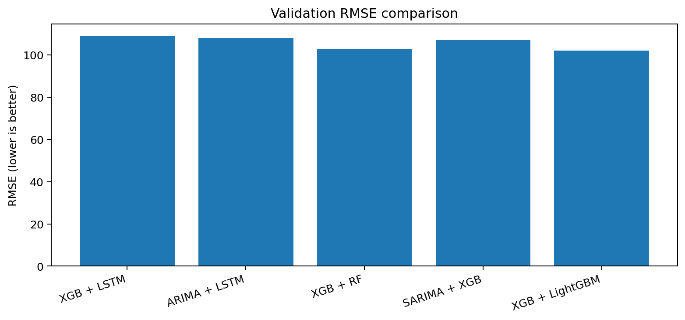
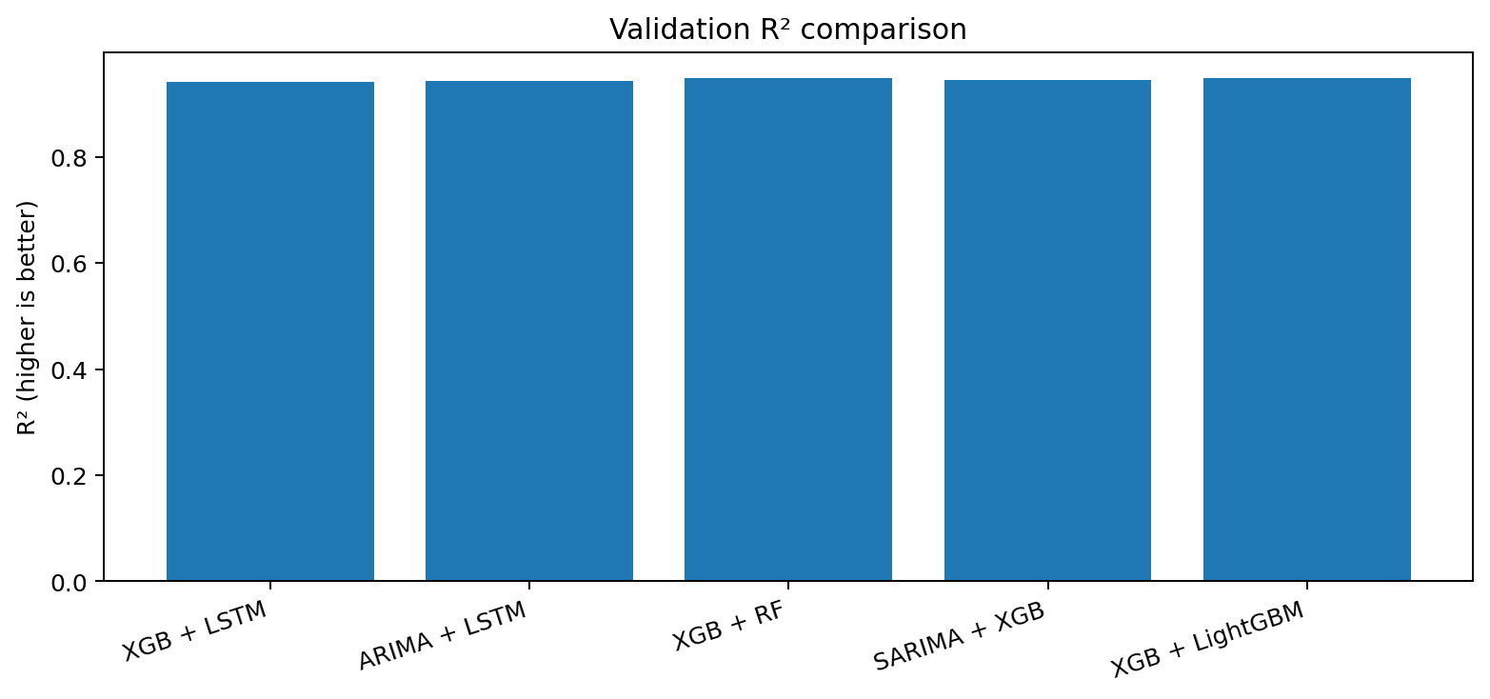
12. Statistical / Visual Comparison
The proposed hybrid leads on the two metrics emphasized for overall fit and large-error control.
Interpretation → lower RMSE means fewer large misses; higher R² means more of the validation variation is explained. The proposed blend ranks first on both.
DAV PROJECT • REVIEW 3 • Smart Tourism Forecasting Analytics
14

Slide 15
13. Why the Proposed Hybrid Behaves Differently
The improvement is attributed to complementary learners—not to a claim of universal superiority.
XGBoost contribution
LightGBM contribution
Ensemble effect
Sequential boosting focuses on reducing residual errors and captures nonlinear feature interactions among tourism, weather, location and time-derived variables.
Uses a different gradient-boosting implementation and tree-growth strategy, providing a second view of the same feature space.
The arithmetic mean smooths model-specific errors. If the two learners make different errors, the average can reduce variance.
Existing statistical hybrids are more dependent on explicit temporal/seasonal decomposition.
Deep-learning hybrids add modelling complexity and generally need stronger sequence-oriented data support.
The proposed model directly fits the heterogeneous tabular feature structure supplied for this project.
The current validation evidence supports selecting the blend for RMSE/R², while acknowledging its MAPE trade-off.
Reasoned selection → data fit + complementary learners + measurable validation improvement on RMSE/R².
DAV PROJECT • REVIEW 3 • Smart Tourism Forecasting Analytics
15

Slide 16
14. Architecture: Forecast → Resource Allocation
The project extends forecasting into a practical tourism-planning decision layer.
Collect
Forecast
Estimate demand
Check capacity
Recommend
Arrivals + date + area/facility + weather/tourism signals
Proposed hybrid / selected validated model
Translate forecast into hotel, transport and attraction demand
Compare with hotel_capacity, transport_capacity, staff_available and attraction_capacity
Flag high utilization and support planning decisions
Decision logic: forecast demand → compare demand with capacity → identify potential pressure points → support resource planning.
The resource-allocation dataset contains demand, capacity, utilization, priority and management-decision fields.
Joins between forecasting and allocation data must be validated before quantitative capacity claims are made.
DAV PROJECT • REVIEW 3 • Smart Tourism Forecasting Analytics
16

Slide 17
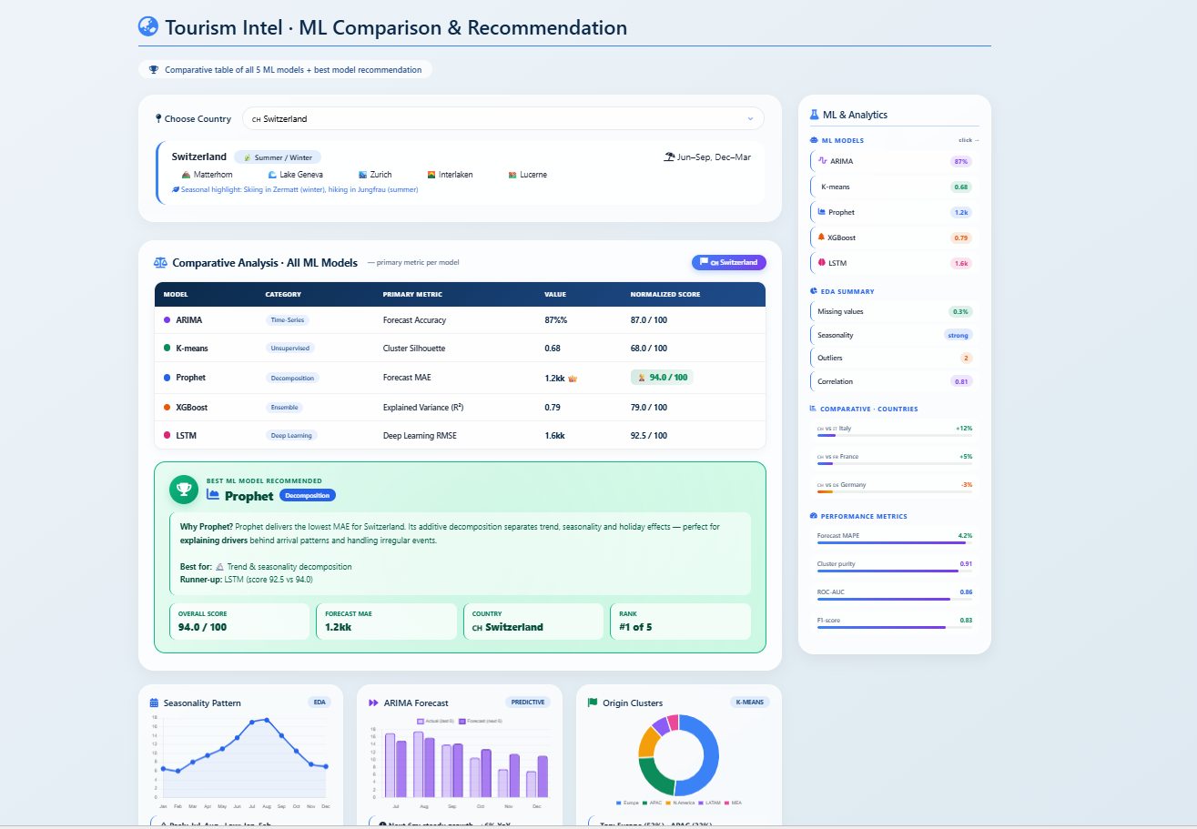
15. Dashboard / Data Visualization
The dashboard connects model comparison, EDA, forecasting and decision support.
Model comparison
Shows candidate models, primary metrics and the recommended model.
EDA summary
Displays missing values, seasonality, outliers and correlation indicators.
Predictive outputs
Seasonality, forecast and origin/segment analytics can be viewed together.
Use dashboard outputs for interpretation—not as a substitute for model validation.
DAV PROJECT • REVIEW 3 • Smart Tourism Forecasting Analytics
17

Slide 18
16. Research Paper Evaluation & Novelty Verification
Literature is used to justify the model family and to avoid presenting an existing hybrid as a new contribution.
Literature direction | What it demonstrates | Implication for our project
Tourism demand forecasting review | Multiple forecasting families and combinations have been studied; no single method dominates all contexts. | Compare alternatives rather than assuming one universal best model.
SARIMA–CNN–LSTM (2021) | Linear seasonality + nonlinear deep learning for daily tourism demand. | Supports hybrid thinking, but is more sequence/deep-learning intensive.
RobustSTL–ARIMA–LSTM (2023) | Decomposition + statistical + DL hybrid for tourism demand. | Shows benefit of decomposition, but increases pipeline complexity.
Denoise–decompose–XGBoost (2026) | Multi-source predictors, leakage-free expanding-window protocol and tree-based learning. | Supports careful preprocessing and tree-based forecasting for tourism data.
RF / XGBoost / LightGBM tourism studies | Tree ensembles are effective for nonlinear tourism predictors. | Supports a practical tree-based hybrid for heterogeneous tabular features.
Novelty claim is deliberately narrow: a project-specific XGBoost + LightGBM ensemble evaluated on the prescribed dataset and connected to a resource-allocation layer.
Do not claim “first ever” without exhaustive literature evidence.
Current search did not identify a directly matching tourism-arrivals study using this exact arithmetic-mean combination on this prescribed dataset.
Novelty statement for review
“Our contribution is the evaluated combination and decision-support workflow, not inventing XGBoost or LightGBM themselves.”
DAV PROJECT • REVIEW 3 • Smart Tourism Forecasting Analytics
18

Slide 19
17. Results, Discussion, Key Insights & Next Steps
Final review summary aligned with the supplied project results.
Results
Key insights
Limitations
• Proposed hybrid RMSE = 102.15
• Proposed hybrid R² = 0.9493
• Lowest RMSE and highest R² in current comparison
• XGBoost + RF has lowest MAPE
• Target is strongly right-skewed
• Date and tourism/weather features matter
• Chronological validation is essential
• No valid July test score is possible without target labels
• Validation covers Apr–May 2019
• Rows are area/facility combinations
• Supporting datasets need validated joins
• Novelty is not a claim of universal firstness
Run rolling-origin validation and residual diagnostics.
Tune the proposed models under the same leakage-free protocol.
Generate July predictions for test_df.csv and retain them separately from validation metrics.
Validate the mapping from forecasts to capacity/resource fields.
Finalize dashboard screenshots and reproducible implementation evidence.
Document the GitHub repository, code, dataset handling and research-paper references.
FINAL MESSAGE → The hybrid is selected because it gives the strongest balanced validation fit in the current experiment while remaining suitable for heterogeneous tourism data.
DAV PROJECT • REVIEW 3 • Smart Tourism Forecasting Analytics
19

Slide 20
18. Literature Paper Comparison: XGBoost + LightGBM
Studies using the same boosting components or closely related tree-based hybrid ensembles
Literature paper | Tourism task | Model(s) used | What it shows | Relation to our proposed hybrid
Jeju visitor-demand study (2025/26) | Daily tourist-attraction visits | XGBoost + Random Forest + LightGBM | Integrates three tree-based learners and reports improved daily forecasting after temporal disaggregation. | Closest literature match: uses BOTH XGBoost and LightGBM in one ensemble, supporting the complementary-tree idea.
Peru tourist-flow study (2026) | Tourist flows at major destinations | XGBoost; LightGBM; RF; other ML models | Both XGBoost and LightGBM are evaluated for heterogeneous destination-level tourism predictors. | Supports choosing both learners for tabular tourism data, but the paper compares them individually rather than averaging them.
Samarkand tourism forecasting (2025) | Visitor flows and tourism revenues | SARIMA, Holt-Winters, XGBoost, LightGBM | Shows statistical and boosting models can address seasonal and multivariate tourism patterns. | Supports combining statistical/model-family evidence with tree boosting; our model simplifies the hybrid for heterogeneous rows.
Bulgaria tourism-demand study (2025) | Monthly overnight stays + economic indicators | LightGBM, XGBoost, Prophet, Ridge; ensembles | Ensemble approaches outperformed several individual and deep-learning alternatives in the reported experiment. | Supports ensemble forecasting; our contribution is the simpler XGBoost + LightGBM arithmetic-mean blend.
Literature gap → The reviewed studies support XGBoost and LightGBM individually or inside broader ensembles; an exact tourism-arrivals study using our prescribed arithmetic-mean XGBoost + LightGBM blend was not identified.
Our proposed model: XGBoost + LightGBM → same feature space → independent predictions → arithmetic mean → final tourist-arrival forecast
References: Jeju tourist-demand tree ensemble study (KCI, 2025/26) • Frontiers in Sustainable Tourism, 2026, DOI 10.3389/frsut.2026.1876343 • AIP Conf. Proc. 3377, 060015 (2025), DOI 10.1063/5.0299644 • Tourism demand forecasting with economic indicators, 2025, DOI 10.3390/fintech4030046
20

