Slide 1
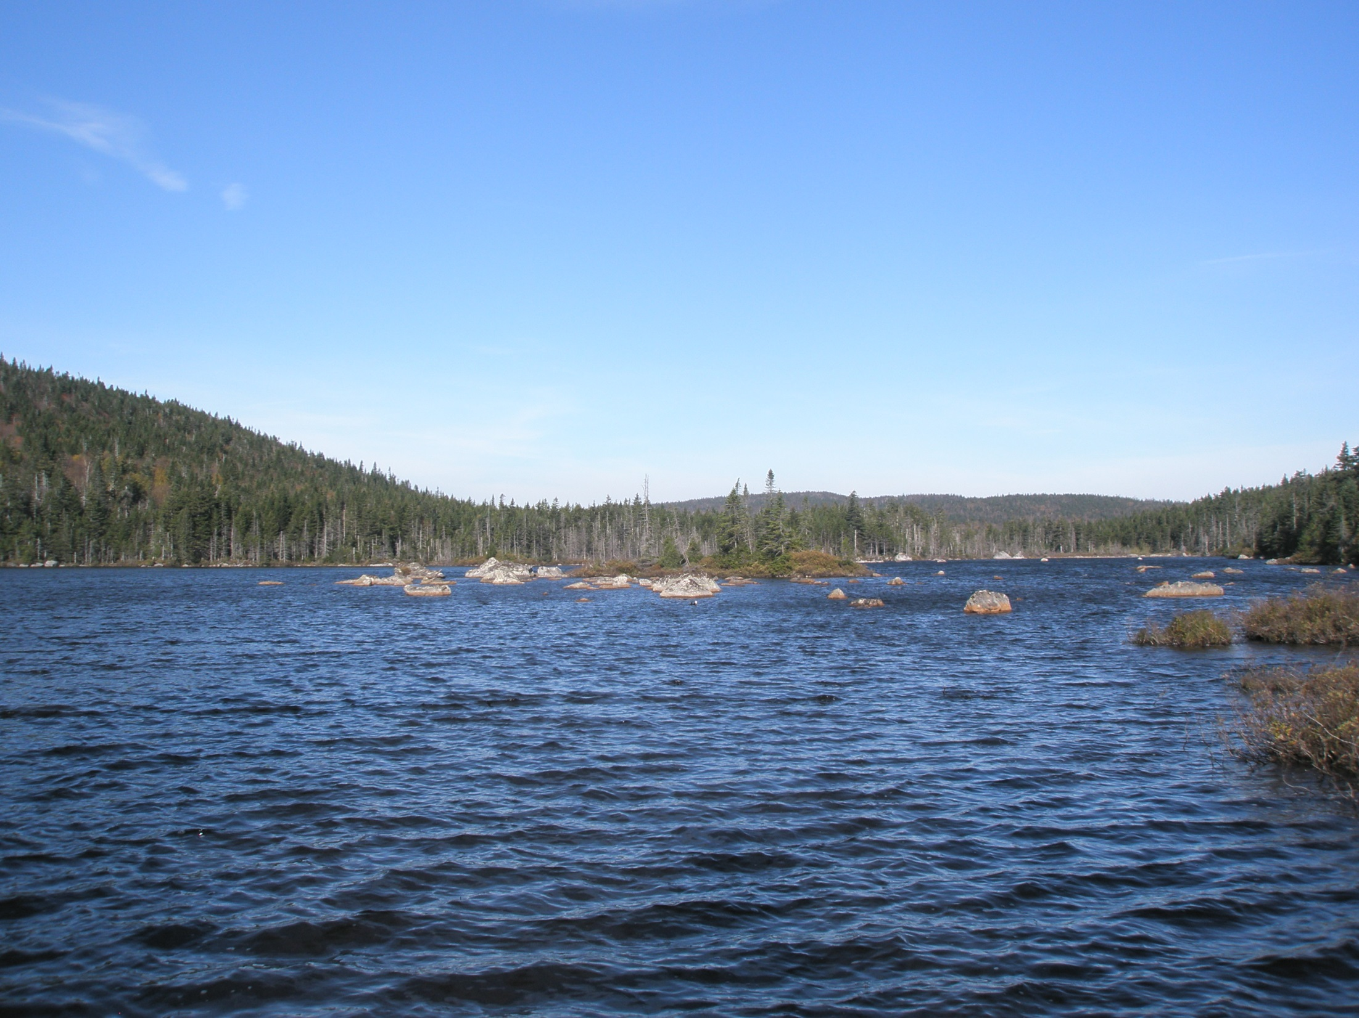
Modeling Lake DOC
Kait Farrel, Ian McCullough
June 24, 2015

Slide 2
Recap
Tried relating adjacent wetland area to lake DOC
Defined adjacency based on different lake buffer widths
Didn’t work #groanzone
Tried non-linear model between Secchi depth and DOC
Worked OK #groanzone
Log-transformed Secchi and DOC for linear model
Very close!

Slide 3
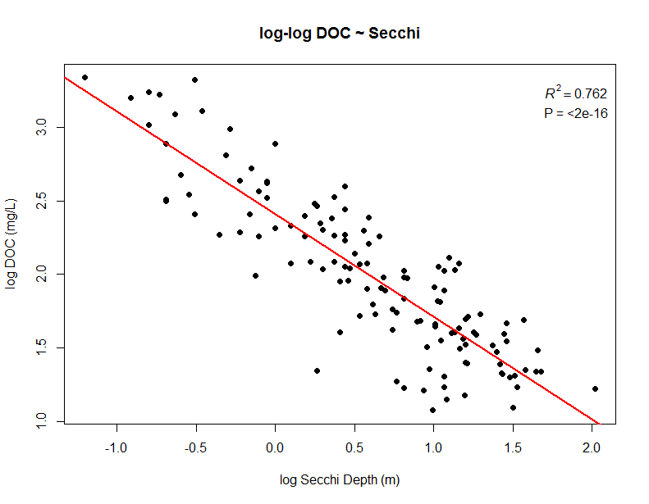

Slide 4
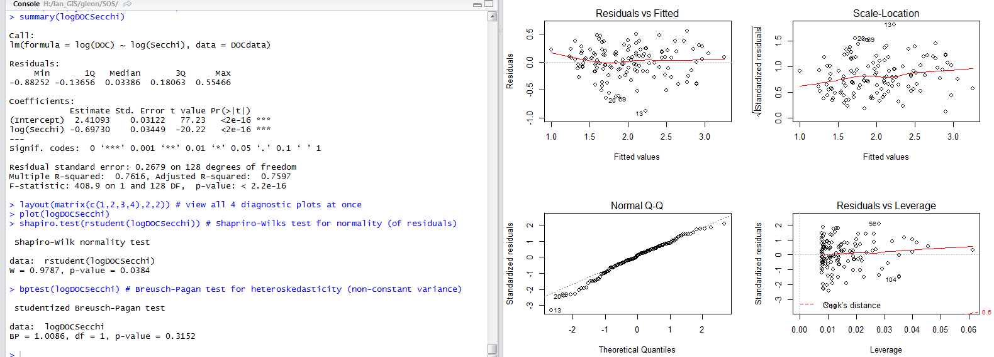
Notes:
Residuals vs. leverage: leverage=importance of each observation
Cook’s distance: smaller distances mean that removal of that observation has little impact. Larger than 1 is red flag. High residuals and leverage increase Cook’s distance

Slide 5
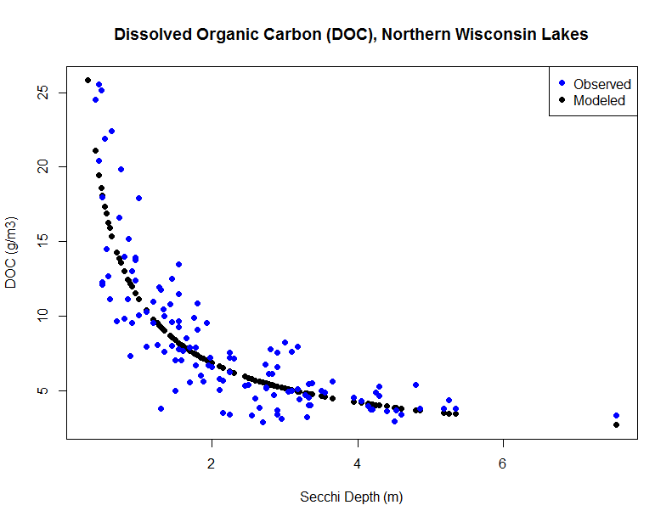

Slide 6
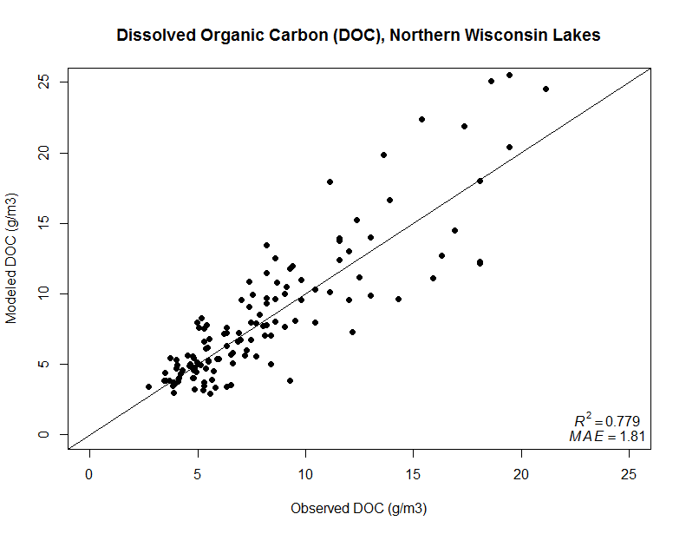
MAE = mean absolute error

