Slide 1


GlIKcH

Slide 2




AbouT
g
K

Slide 3
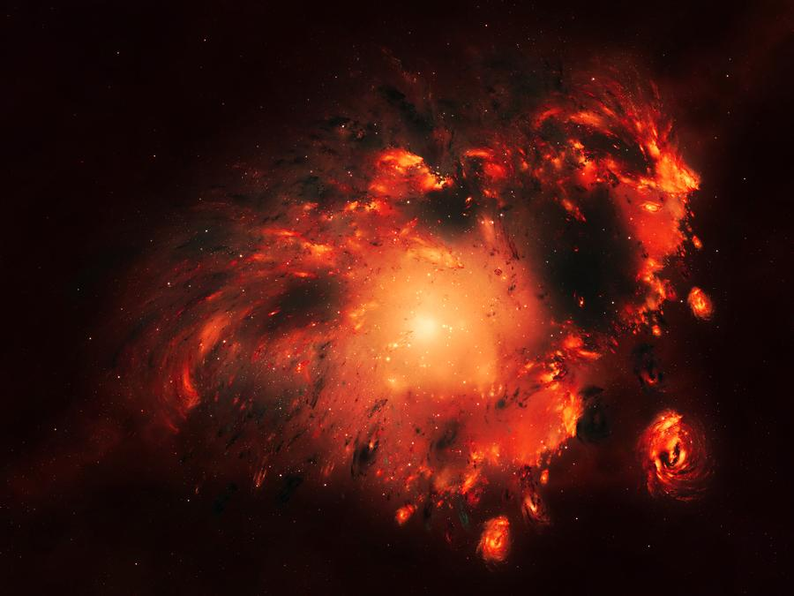
G L I K C H
G l I K C H
GL
G L I K C H

Slide 4


Slide 5






