Slide 1
Earth

Slide 2
Tropopause ~10km

Slide 3
Tropopause ~10km
Balloon Height ~35km

Slide 4
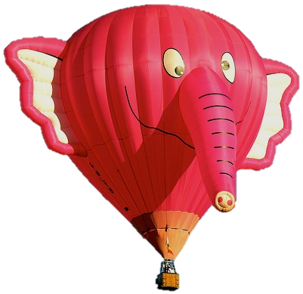
Tropopause ~10km
Balloon Height ~35km

Slide 5
GLO Line of Sight
Tropopause ~10km
Balloon Height ~35km

Slide 6
GLO Line of Sight
need this distance
Tropopause ~10km
Balloon Height ~35km

Slide 7
Y
GLOspheric circle eqn:
y_{glo}=(h_{glo}+R_{E})*sin(θ)
x_{glo} =(h_{glo}+R_{E})*cos(θ)
(0,y_{trop})
h_{glo}
(x_{glo} ,y_{glo})
θ
X

Slide 8
Y
GLOspheric circle eqn:
y_{glo}=(h_{glo}+R_{E})*sin(θ)
x_{glo} =(h_{glo}+R_{E})*cos(θ)
(0,y_{trop})
at tangent point (0,y_{trop}) we know
y_{trop} = h_{trop}+R_{E}= y_{glo}≈ 10km + 6371km
h_{glo}
(x_{glo} ,y_{glo})
θ
X

Slide 9
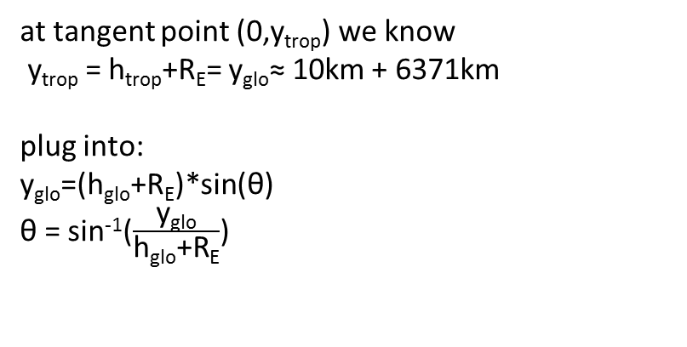
Y
GLOspheric circle eqn:
y_{glo}=(h_{glo}+R_{E})*sin(θ)
x_{glo} =(h_{glo}+R_{E})*cos(θ)
(0,y_{trop})
at tangent point (0,y_{trop}) we know
y_{trop} = h_{trop}+R_{E}= y_{glo}≈ 10km + 6371km
plug into:
y_{glo}=(h_{glo}+R_{E})*sin(θ)
θ = sin⁻¹($\frac{\text{y}\text{glo}}{\text{h}\text{glo}\text{+}\text{RE}}$)
h_{glo}
(x_{glo} ,y_{glo})
θ
X

Slide 10
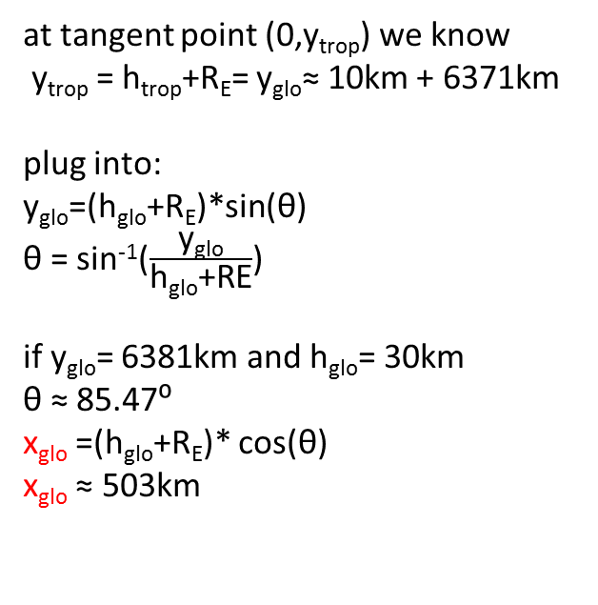
Y
GLOspheric circle eqn:
y_{glo}=(h_{glo}+R_{E})*sin(θ)
x_{glo} =(h_{glo}+R_{E})*cos(θ)
(0,y_{trop})
503 km
at tangent point (0,y_{trop}) we know
y_{trop} = h_{trop}+R_{E}= y_{glo}≈ 10km + 6371km
plug into:
y_{glo}=(h_{glo}+R_{E})*sin(θ)
θ = sin⁻¹($\frac{\text{y}\text{glo}}{\text{h}\text{glo}\text{+}\text{RE}}$)
if y_{glo}= 6381km and h_{glo}= 30km
θ ≈ 85.47⁰
x_{glo} =(h_{glo}+R_{E})* cos(θ)
x_{glo} ≈ 503km
h_{glo}
(x_{glo} ,y_{glo})
θ
X

Slide 11
(x_{glo} ,y_{glo})

Slide 12

Solar Disc subtends ~0.5 ⁰
Solar Disc ~211 pixels on GLO FPA
(x_{glo} ,y_{glo})

Slide 13
Solar Disc subtends ~0.5 ⁰
Solar Disc ~211 pixels on GLO FPA
(x_{glo} ,y_{glo})

Slide 14
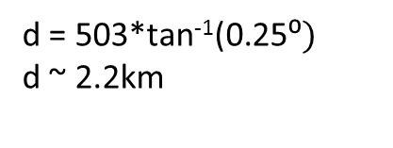
Solar Disc subtends ~0.5 ⁰:
Solar Disc ~211 pixels on GLO FPA
(x_{glo} ,y_{glo})
d
0.25⁰
d = 503*tan⁻¹(0.25⁰$)$
d ~ 2.2km
503km

Slide 15
Solar Disc subtends ~0.5 ⁰:
Solar Disc ~211 pixels on GLO FPA
At tropopause, 211 pixels ~ 4.4km
or 20.8m/pixel
2*d
(x_{glo} ,y_{glo})
d
0.25⁰
d = 503*tan⁻¹(0.25⁰$)$
d ~ 2.2km
503km

Slide 16
Comparison of different viewing heights
Balloon height 30km
At tropopause, 211 pixels ~ 4.4km
or 20.8m/pixel

Slide 17
Solar Disc subtends ~0.5 ⁰:
Solar Disc ~211 pixels on GLO FPA
(x_{glo} ,y_{glo})
d
0.25⁰
d = 503*tan⁻¹(0.25⁰$)$
d ~ 2.2km
503km

Slide 18
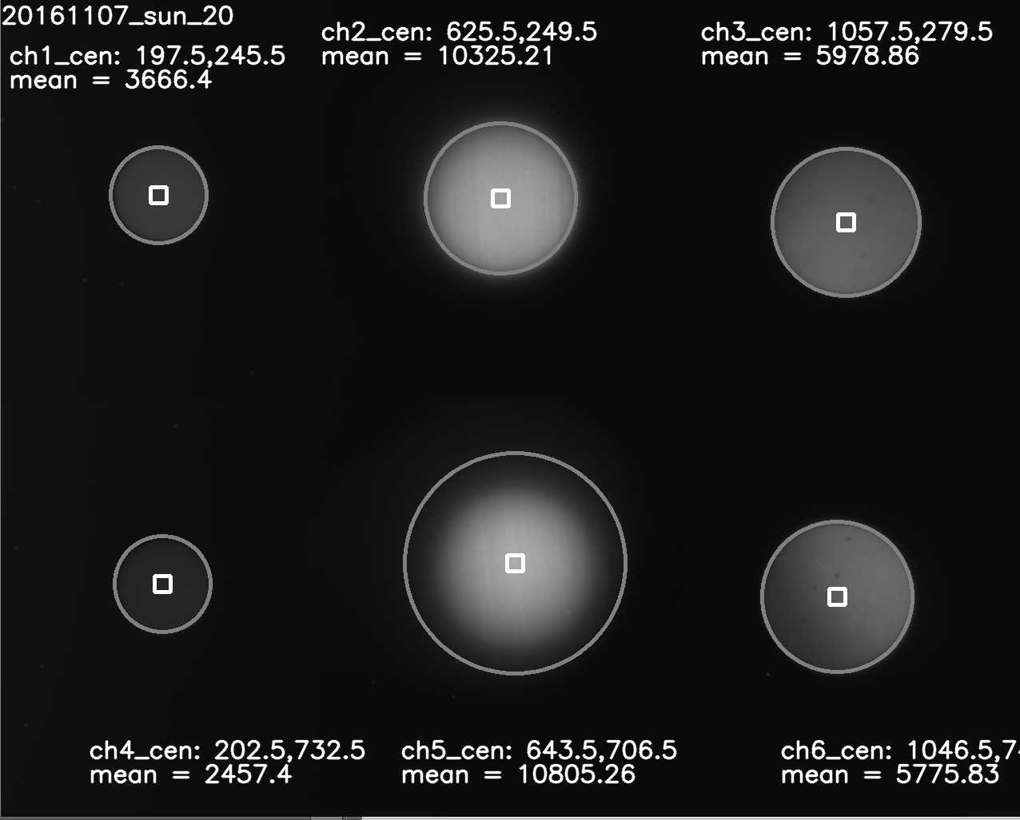
Solar Disc subtends ~0.5 ⁰:
Solar Disc ~211 pixels on GLO FPA
At tropopause, 211 pixels ~ 292m
or 1.38m/pixel

Slide 19
Solar Disc subtends ~0.5 ⁰:
Solar Disc ~211 pixels on GLO FPA
At tropopause, 211 pixels ~ 292m
or 1.38m/pixel
-Location of solar discs on the FPA is variable.

Slide 20
Solar Disc subtends ~0.5 ⁰:
Solar Disc ~211 pixels on GLO FPA
At tropopause, 211 pixels ~ 292m
or 1.38m/pixel
-Location of solar discs on the FPA is variable.
-Amount of variation depends on tracking performance

Slide 21
Solar Disc subtends ~0.5 ⁰:
Solar Disc ~211 pixels on GLO FPA
At tropopause, 211 pixels ~ 292m
or 1.38m/pixel
-Location of solar discs on the FPA is variable.
-Amount of variation depends on tracking performance
-Pixel distance between two channels on the FPA should be constant

Slide 22
Solar Disc subtends ~0.5 ⁰:
Solar Disc ~211 pixels on GLO FPA
At tropopause, 211 pixels ~ 292m
or 1.38m/pixel
-Location of solar discs on the FPA is variable.
-Amount of variation depends on tracking performance
-Pixel distance between two channels on the FPA should be constant
-Looking at all days of data, standard deviation of pixel distance between HF proxy channel pair is ~3.2 pixels
std ~3.2 pixels ~4.42m

Slide 23
Extra

Slide 24

Calculate Diameter of Sun
Assume know distance to sun is d_{sun}= 146x10⁶ km
d
0.25⁰
146*10⁶ km
sun radius = 146*10⁶ *tan⁻¹(0.25⁰$)$
sun radius ~ 0.637*10⁶km
sun diameter ~ 1.274*10⁶km (almost one million miles!)
earth diameter ~ 8,000 miles

