Slide 1
PRINCIPLE COMPONENT ANALYSIS

Slide 2
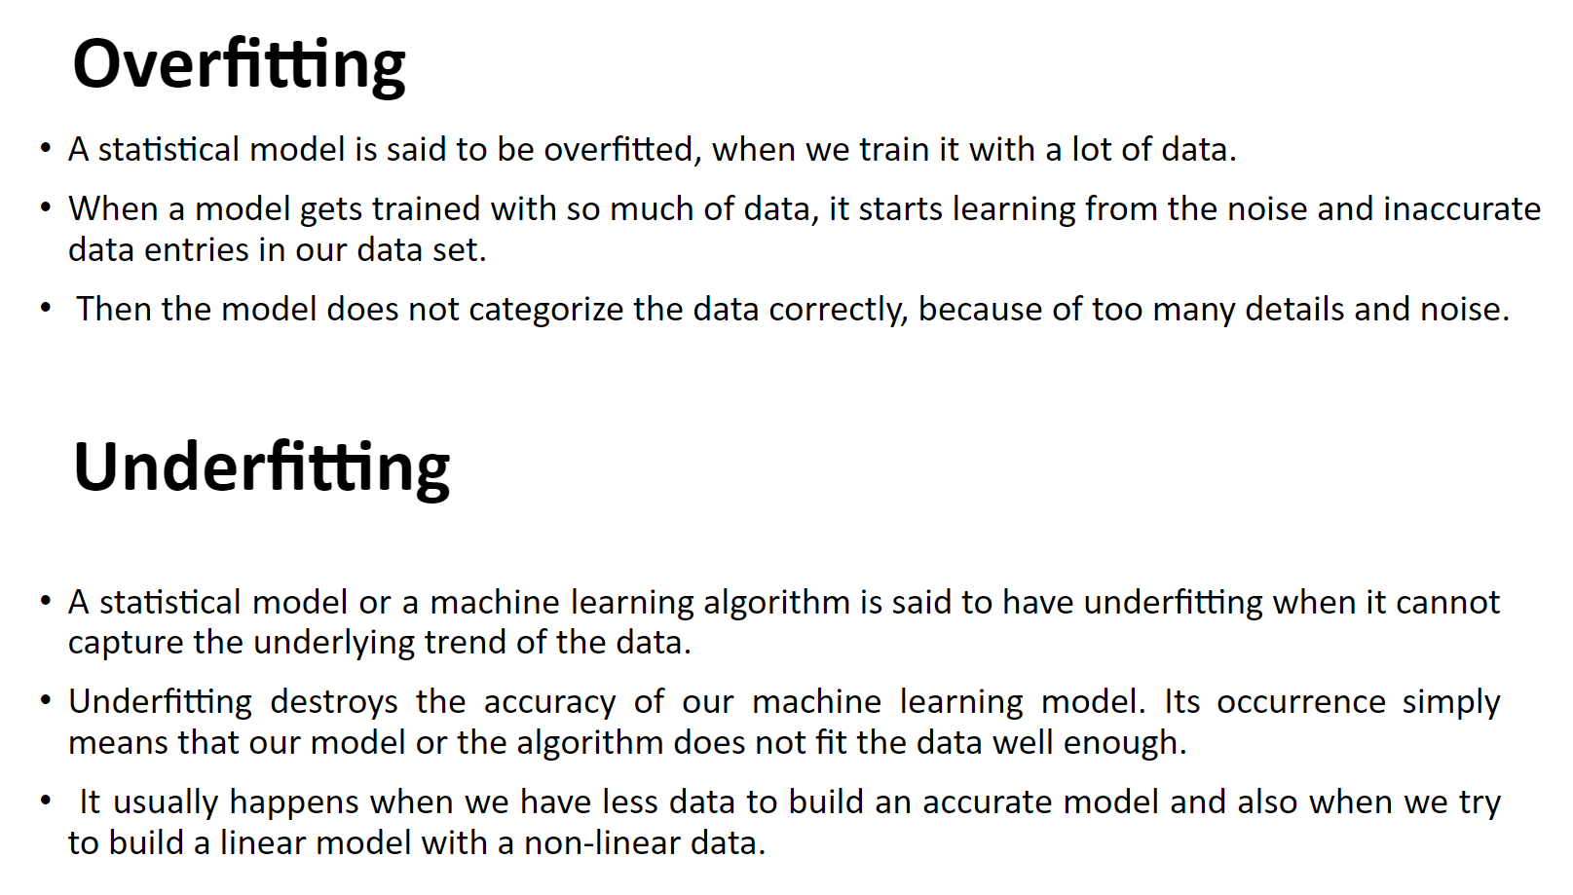

Slide 3
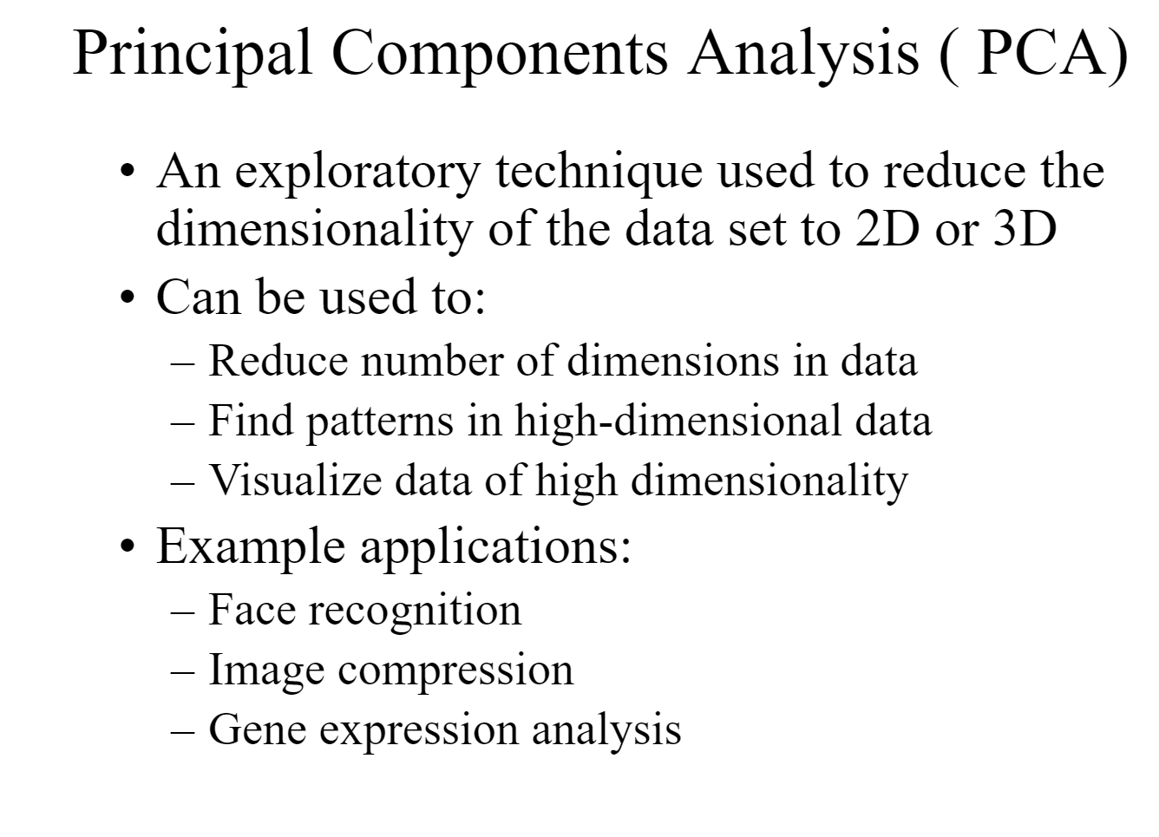

Slide 4
