Slide 1
GPP Exam: Zombie AI

Slide 2
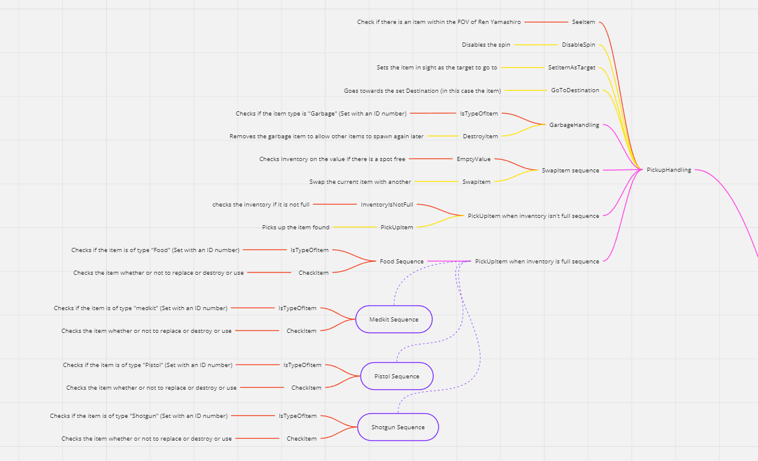
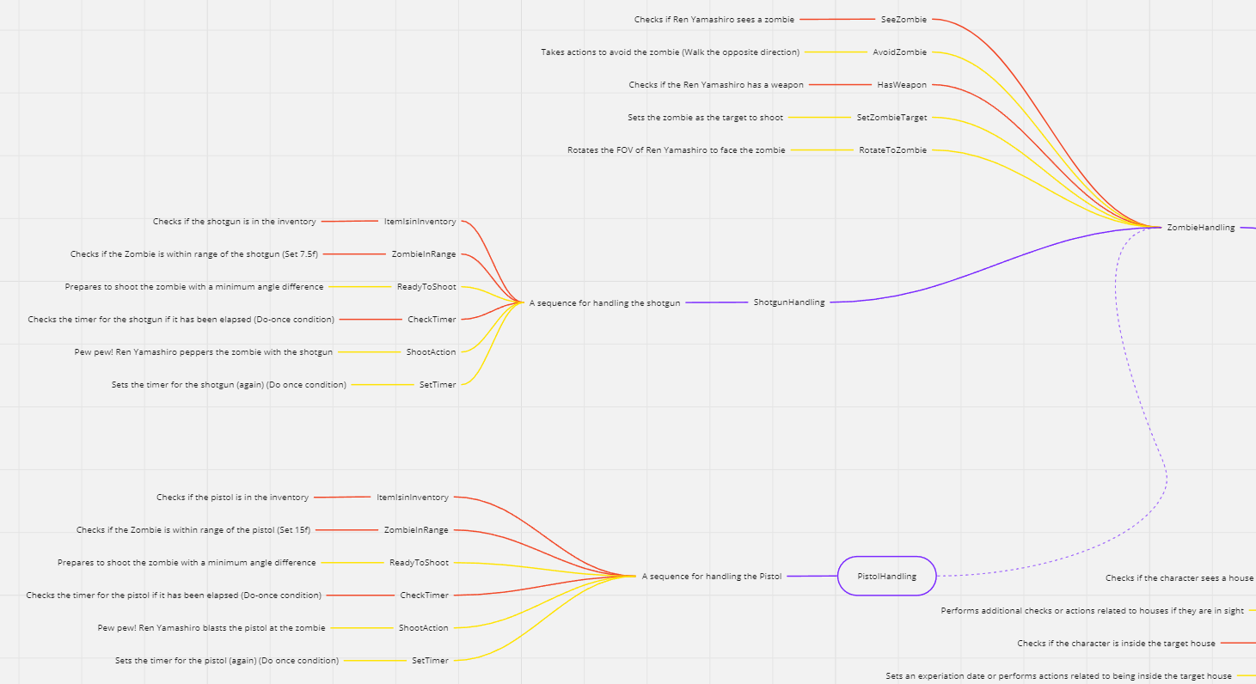
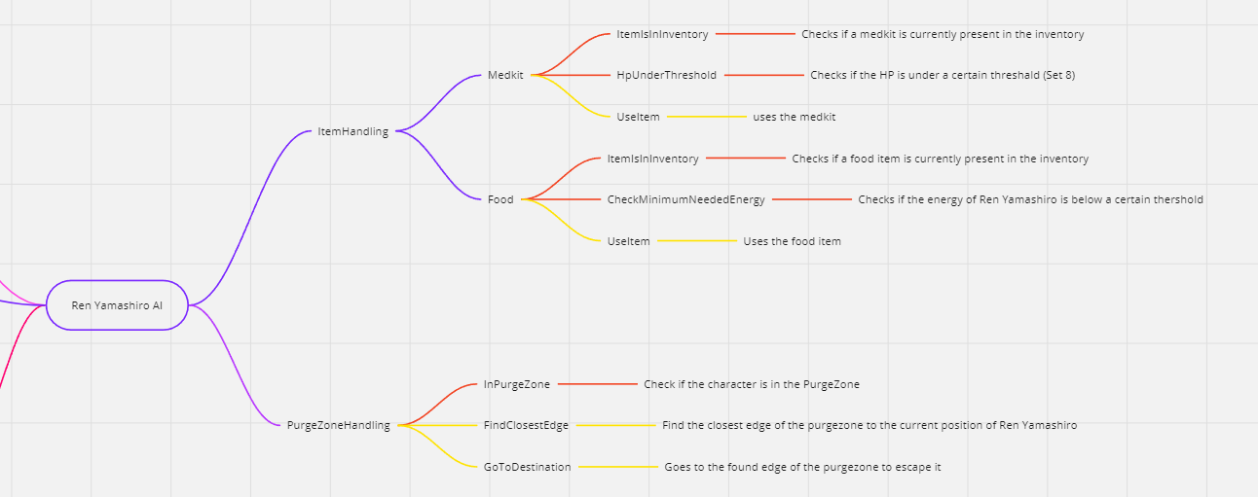
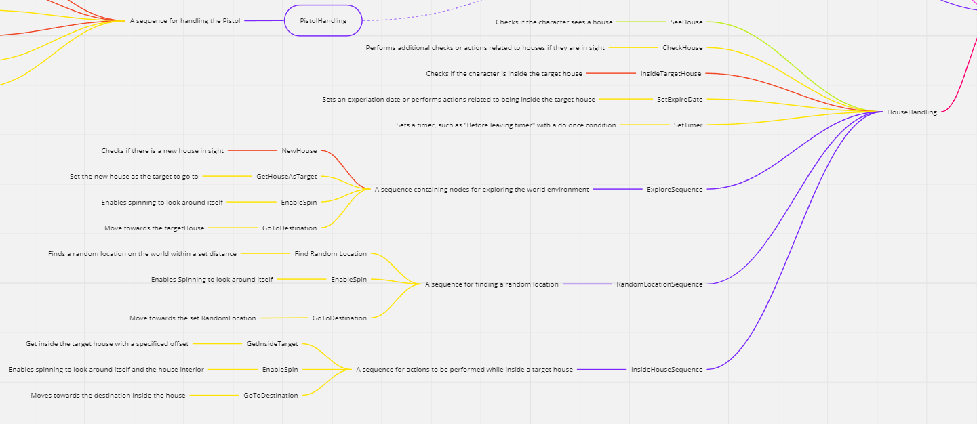
Decision Making (https://miro.com/app/board/uXjVN48AfMo=/?share_link_id=334617668742)

Slide 3
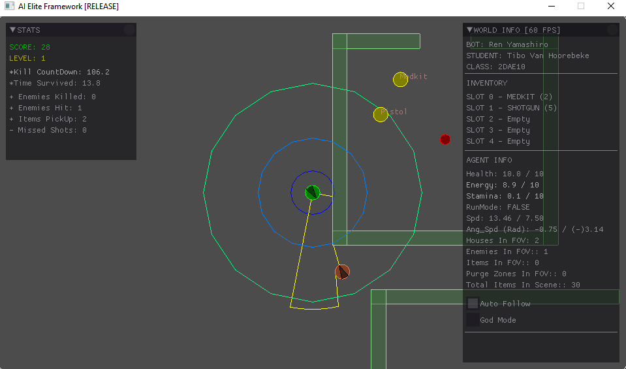
Enemy handling
Checks for zombies in FOV, if none state -> failure
If there’s one or more, picks the closest zombie based on square distance -> TargetZombie -> State success
Iterating through the zombies within FOV and calculate a vector pointing away from each zombie
Sums up all the calculated vectors to get a final “EvadeDirection” indicating the direction to move away from the walkers!
Calculates a target angle based off on the direction to the “TargetZombie”
Compares the absolute value of the angle difference with the minimum set anglediffference if condition met -> State success, otherwise fail
Shoot the zombie!
Note: Weapon usage depends on the range of each (Pistol is set to 15f, Shotgun 7.5f)
Reason: To avoid missed shots, for example shotgun is way more inaccurate the longer range it is
Timer is to avoid spamming bullets causing unnecessary bullet usage and potential misses afterwards because of enemy dying

Slide 4
Inventory
When exploring in house, looks around house until it finds an item within FOV, upon nearing this item
Checks the Type of item (Set by ID), and checks inventory status (If it’s full or not)
If the item in question: garbage -> destroy in order to let other items spawn in again
If any other type, checks the inventory if there’s a spot free if yes, swap it with the item
If it’s full, it destroys the item (Unless a item inside inventory has a value of equal or less then 0)
Usage: Such as medkits and food -> checks if item present, then checks if threshold is reached, if so, use item
Usage: Pistol and shotgun (Mentioned before in previous slide)

Slide 5
Movement - Steering
I don’t use Blended steering
The only behaviours used are as follows:
- AvoidZombie (Evadebehaviour)
- GoToDestination (SeekBehaviour)

Slide 6
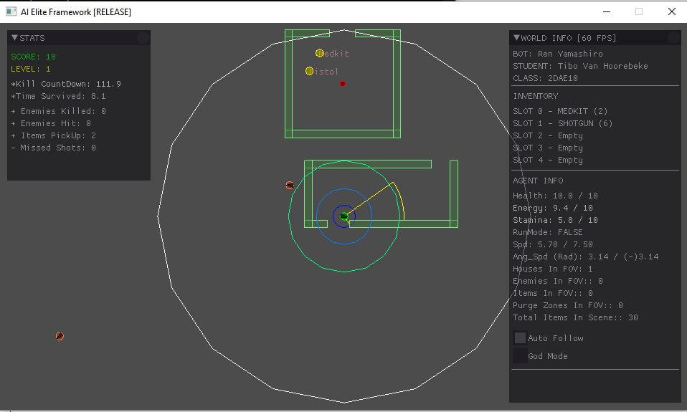
Movement - Exploration
Exploration Mechanism: Uses a BT structure to make decisions and control its actions, “HouseHandling” Manages this part “Exploration”
Traversal of the world: Uses GoToDestination to traverse the world (SeekBehaviour)
If there’s nothing in sight in FOV (no item, no house, no PurgeZone, …) then it executes the “FindRandomLocation” method to set a new destination to go to
When the agent does find a house within FOV, it checks whether or not this house has been explored already, it stores the found houses in a container.
In the container of found houses, it saves the location + a timer of Invalidity (To mark the house as recently explored), upon the timer has reached 0, the house will become valid to explore again
it sets a new destination in that house’s center to explore and tries to explore every corner of the house
A set experiation timer (3 seconds after entering house) to explore before leaving the house.
I won’t go into detail of the EvadeZombie as I already mentioned it before
PurgeZone -> if the player is In such zone, it find the nearest edge to escape to and sets it’s destination there
Occasional sprints
Spins the FOV

Slide 7
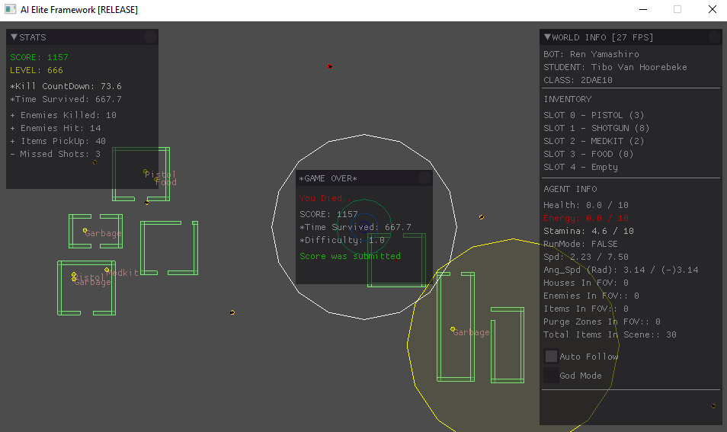
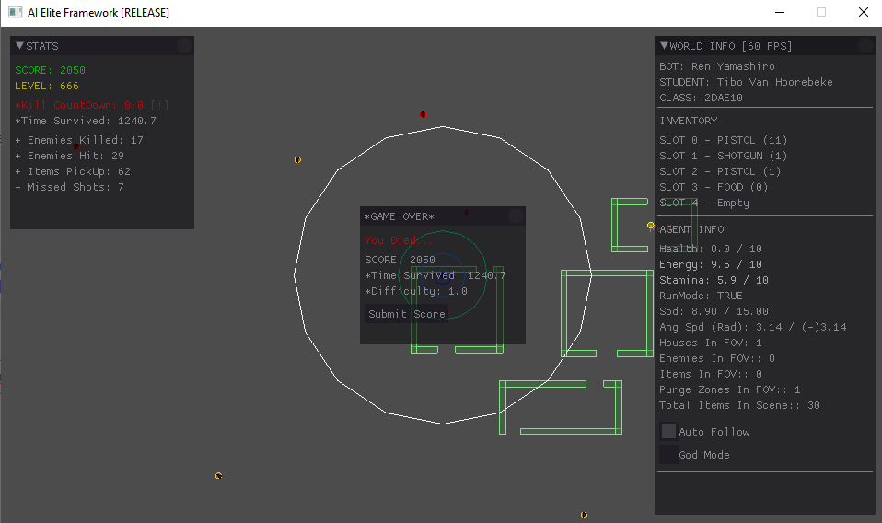
High Score
Screen shot or list of highest scores

