Slide 1
EECS498-008 Formal Verification of Systems Software
Material and slides created by
Jon Howell and Manos Kapritsos

Slide 2
A distributed system is composed of multiple hosts, a network and clocks
Distributed system: attempt #3
module DistributedSystem {
datatype Variables =
Variables(hosts:seq<Host.Variables>,
network: Network.Variables,
time: Time.Variables)
predicate Next(v, v’, hostid, msgOps: MessageOps, clk:Time) {
|| (&& HostAction(v, v’, hostid, msgOps)
&& Network.Next(v, v’, msgOps)
&& Time.Read(v.time, clk))
|| (&& Time.Advance(v.time, v’.time)
&& v’.hosts == v.hosts
&& v’.network == v.network)
}
}
Distributed system
Host
Host
Network
Time
Host
Host

Slide 3
A “distributed” system
module DistributedSystem {
datatype Variables =
Variables(fs: FileSystem.Variables,
disk: Disk.Variables)
predicate Next(v, v’) {
|| (exists io ::
&& FileSystem.Next(v.fs, v’.fs, io)
&& Disk.Next(v.disk, v’.disk, io)
|| ( // Crash!
&& FileSystem.Init(v’.fs)
&& v’.disk == v.disk
)
}
}
Distributed system
File system
(in-memory state
Disk
Binding variable

Slide 4
Trusted vs proven
Hosts cannot communicate except through the network
Time can advance between any host steps
File system (kernel)
can crash
Distributed system
Distributed system
Disk won’t forget writes it acknowledged
Network won’t make up packets
Host
Host
Network
File system
(in-memory state
Disk
Network might reorder packets
Time
Host
Host
Disk might reorder concurrent writes
Time only moves forward

Slide 5

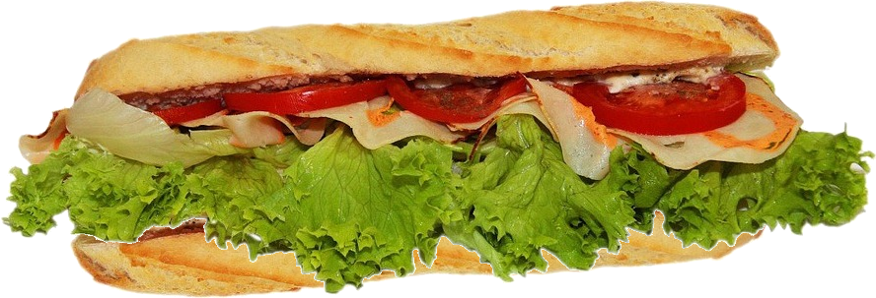
: the systems specification sandwich
trusted application spec
proof
protocol
proof
code
trusted environment assumptions
image: pixabay

Slide 6
Administrivia
Midterm went great, congratulations!
Problem set 3 due on Friday
Project 1 will be released on Monday
Let me know if you can’t find teammates
Midterm evaluations due today!
They are really, really important
If we reach 66%, I’ll design custom course stickers
I’m giving another lecture right after this one, so I have to skip IOH

Slide 7
Chapter 6: Refinement

Slide 8
State machines: a versatile tool
State machines can be used to
Model the program
Model environment components
Model how the system (program+environment) fits together
Specify the system behavior

Slide 9
Different ways to specify behavior
Spec
C-style assertions
Postconditions
Properties/invariants
Refinement to a state machine
Distributed system
Host
Network
Host
Host

Slide 10
Example: hashtable
module HashTable {
datatype Variables = Variables(tbl:seq<Pair<int, string>>)
predicate Insert(v:Variables, v’:Variables, key:int, val:string) {
var free := Probe(v.tbl, key);
&& free.Some?
&& v’.tbl == v.tbl[free.value := Pair(key, val)]
}
}
-
-
-
13￫C
13￫C
-
-
-
-
-
-
23￫A
23￫A
23￫A
23￫A
-
-
-
-
47￫D
-
-
71￫B
71￫B
71￫B

Slide 11
The spec: a simple map
(empty)
23￫A
23￫A
71￫B
13￫C
23￫A
71￫B
13￫C
23￫A
47￫D
71￫B
module MapSpec {
datatype Variables = Variables(mapp:map<Key, Value>)
predicate InsertOp(v:Variables, v':Variables, key:Key, value:Value) {
&& v'.mapp == v.mapp[key := value]
}
}

Slide 12
Refinement
(empty)
23￫A
23￫A
71￫B
13￫C
23￫A
71￫B
13￫C
23￫A
47￫D
71￫B
-
-
-
13￫C
13￫C
-
-
-
-
-
-
23￫A
23￫A
23￫A
23￫A
-
-
-
-
47￫D
-
-
71￫B
71￫B
71￫B

Slide 13
The benefits of refinement
Refinement allows for good specs
Abstract: elide implementation details
Concise: simple state machine
Complete: better than a “bag of properties”
But if you want, you can prove properties about the spec
Refinement is very powerful
Can specify systems that are hard to specify otherwise
E.g. linearizability

Slide 14
A sharded key-value store
Logically centralized, physically distributed
(empty)
23￫A
23￫A
71￫B
13￫C
23￫A
71￫B
13￫C
23￫A
47￫D
71￫B
Host 1
Host 1
Host 1
Host 1
Host 1
-
-
-
13￫C
13￫C
-
-
-
-
-
-
-
-
-
-
Host 2
Host 2
Host 2
Host 2
Host 2
-
23￫A
23￫A
23￫A
23￫A
-
-
-
-
47￫D
-
-
71￫B
71￫B
71￫B

Slide 15
Stutter steps
(empty)
23￫A
23￫A
71￫B
23￫A
71￫B
One “stutter”
step for the spec
Host 1
Host 1
Host 1
Host 1
-
-
-
23￫A
-
-
-
-
One normal step for the implementation
-
-
-
-
Host 2
Host 2
Host 2
Host 2
-
23￫A
23￫A
-
-
-
-
-
-
-
71￫B
71￫B

Slide 16

A primary-backup protocol
Clients
Primary
Primary
Backup
Backup

Slide 17
A primary-backup protocol
Primary
Primary
Primary
Primary
Primary
Primary
Backup
Backup
Backup
Backup
Backup
Backup

Slide 18
The interpretation (Abstraction) function
(empty)
23￫A
23￫A
71￫B
13￫C
23￫A
71￫B
13￫C
23￫A
47￫D
71￫B
function Abstraction(lv:HashTblState) : (hv:MapSpec.Variables)
{
...
}
-
-
-
13￫C
13￫C
-
-
-
-
-
-
23￫A
23￫A
23￫A
23￫A
-
-
-
-
47￫D
-
-
71￫B
71￫B
71￫B

Slide 19
A refinement proof
function Abstraction(v:Variables) : MapSpec.Variables
predicate Inv(v:Variables)
lemma RefinementInit(v:Variables)
requires Init(v)
ensures Inv(v) // Inv base case
ensures MapSpec.Init(Abstraction(v)) // Refinement base case
lemma RefinementNext(v:Variables, v':Variables)
requires Next(v, v')
requires Inv(v)
ensures Inv(v') // Inv inductive step
ensures MapSpec.Next(Abstraction(v), Abstraction(v')) // Refinement inductive step
|| Abstraction(v) == Abstraction(v') // OR stutter step

