Slide 1
EECS498-003 Formal Verification of Systems Software
Material and slides created by
Jon Howell and Manos Kapritsos

Slide 2

Leader election
-1
id
23
-1
-1
id
35
id
40
id
11
id
86
-1
-1
VSCode transition

Slide 3

Leader election
40
-1
id
23
23
35
40
-1
-1
id
35
id
40
id
11
id
86
86
86
-1
-1

Slide 4
Leader election
35
-1
id
23
23
35
-1
-1
id
35
id
40
id
11
id
86
86
40
-1
-1

Slide 5
Administrivia
Midterm exam on Thursday, 10/17
6-8pm
No lecture that day
Sample exams coming soon™
Closed books
Allowed one double-sided cheat-sheet, 10pt minimum
Covers everything up to Chapter 4 (i.e. excluding distributed systems)
Problem set 2 (Chapters 3 and 4) due today!
Problem set 3 (Chapter 5) will be released tomorrow

Slide 6
Introduction to distributed systems
What is a distributed system?
A collection of distinct processes that:
are spatially separated
communicate with one another by exchanging messages
have non-negligible communication delay
do not share fate
have separate, imperfect, unsynchronized physical clocks

Slide 7
Leader election
...as a distributed, asynchronous system
-1
id
23
-1
id
40

Slide 8


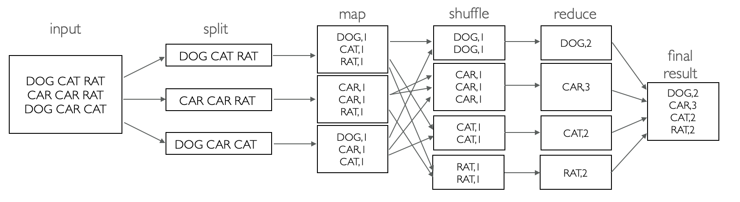
Other examples of distributed systems
Web server

Slide 9
A distributed system
Network

Slide 10
Modeling distributed systems
A distributed system is composed of multiple hosts
Distributed system
Distributed System: attempt #1
module DistributedSystem {
datatype Variables =
Variables(hosts:seq<Host.Variables>)
predicate Next (v:Variables, v’:Variables, hostid: nat) {
&& Host.Next(v.hosts[hostid],v'.hosts[hostid]))
&& forall otherHost:nat | otherHost != hostid ::
v’.hosts[otherHost] == v.hosts[otherHost]
}
}
Host
Host
Host
Host

Slide 11
New Dafny syntax: modules
Modules allow us to break up our code into multiple parts
module A {
predicate MyPredicate() { ... }
}
module B {
import A
predicate MySecondPredicate() { A.MyPredicate() }
}

Slide 12
Defining the network
datatype Option<T> = Some(value:T) | None
datatype MessageOps = MessageOps(
recv:Option<Message>, send:Option<Message>)
Network module
module Network {
datatype Variables =
Variables(sentMsgs: set<Message>)
predicate Next(v, v’, msgOps:MessageOps) {
// can only receive messages that have been sent
&& (msgOps.recv.Some? ==> msgOps.recv.value in v.sentMsgs)
// Record the sent message, if there was one
&& v'.sentMsgs ==
v.sentMsgs + if msgOps.send.None? then {}
else {msgOps.send.value}
}
}
Distributed system
Host
Host
Network
Host
Host

Slide 13
A distributed system is composed of multiple hosts and a network
Distributed system: attempt #2
module DistributedSystem {
datatype Variables =
Variables(hosts:seq<Host.Variables>,
network: Network.Variables)
predicate HostAction(v, v’, hostid, msgOps) {
&& Host.Next(v.hosts[hostid],v'.hosts[hostid],msgOps))
&& forall otherHost:nat | otherHost != hostid ::
v’.hosts[otherHost] == v.hosts[otherHost]
}
predicate Next(v, v’, hostid, msgOps: MessageOps) {
&& HostAction(v, v’, hostid, msgOps)
&& Network.Next(v, v’, msgOps)
}
}
Distributed system
Host
Host
Network
Host
Host
Binding variable

Slide 14
A distributed system is composed of multiple hosts, a network and clocks
Distributed system: attempt #3
module DistributedSystem {
datatype Variables =
Variables(hosts:seq<Host.Variables>,
network: Network.Variables,
time: Time.Variables)
predicate Next(v, v’, hostid, msgOps: MessageOps, clk:Time) {
|| (&& HostAction(v, v’, hostid, msgOps, clk)
&& Network.Next(v, v’, msgOps)
&& Time.Read(v.time, clk))
|| (&& Time.Advance(v.time, v’.time)
&& v’.hosts == v.hosts
&& v’.network == v.network)
}
}
Distributed system
Host
Host
Network
Time
Binding variable
Host
Host

Slide 15
Administrivia
Problem set 3 (Chapter 5) will be released later today
Start looking for partners for Project 1 (released after PS3)
Midterm evaluations are up
Please provide feedback!
Note the additional questions

Slide 16
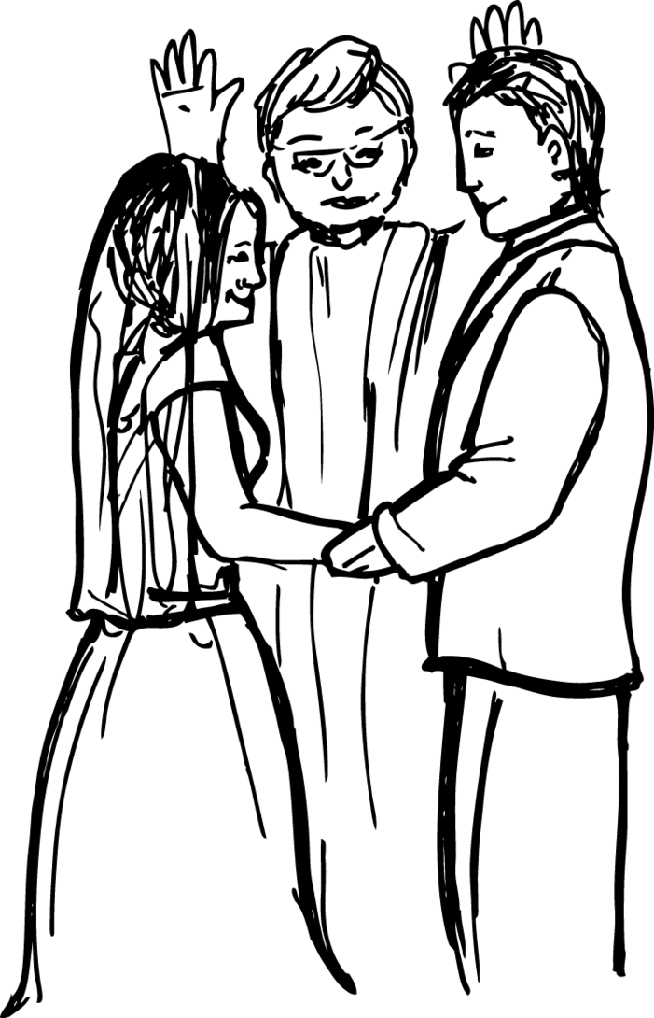
Atomic Commit (Problem Set 3)
-Do you take each other?
-I do.
-I do.
-I now pronounce you atomically committed.

Slide 17
Atomic Commit: the objective
Preserve data consistency for distributed transactions
Example: book a hotel and flight on Expedia

Slide 18

Atomic Commit: the setup
One coordinator
A set of participants
Allowed to be empty in our model
Every participant has an “input” value, called vote/preference
Every participant/coordinator has an “output” value, called decision
We are ignoring the possibility of failures

Slide 19
Atomic Commit: the spec (simplified to ignore failures)
AC-1: All processes that reach a decision reach the same one
AC-3: The Commit decision can only be reached if all processes vote Yes
AC-4: If there are no failures and all processes vote Yes, then the decision must be Commit
AC-2 and AC-5 ignored

Slide 20



Two Phase Commit (2PC)
1. sends VOTE-REQ message to all participants
2. sends to coordinator
if == No
then := Abort
3. Wait for all votes to come in
If all votes are Yes then
:= Commit
Send Commit message to all
else
:= Abort
Send Abort message to all who voted Yes
4. If received Commit then
:= Commit
else
:= Abort

Slide 21
A “distributed” system
module DistributedSystem {
datatype Variables =
Variables(fs: FileSystem.Variables,
disk: Disk.Variables)
predicate Next(v, v’) {
|| (exists io ::
&& FileSystem.Next(v.fs, v’.fs, io)
&& Disk.Next(v.disk, v’.disk, io)
|| ( // Crash!
&& FileSystem.Init(v’.fs)
&& v’.disk == v.disk
)
}
}
Distributed system
File system
(in-memory state
Disk
Binding variable

Slide 22
Trusted vs proven
Hosts cannot communicate except through the network
Time can advance between any host steps
File system (kernel)
can crash
Distributed system
Distributed system
Disk won’t forget writes it acknowledged
Network won’t make up packets
Host
Host
Network
File system
(in-memory state
Disk
Network might reorder packets
Time
Host
Host
Disk might reorder concurrent writes
Time only moves forward

Slide 23

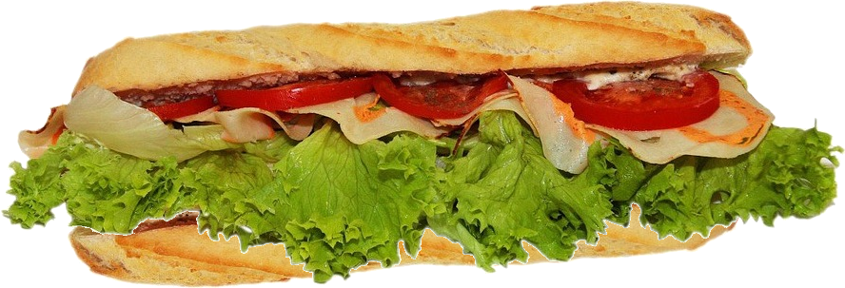
: the systems specification sandwich
trusted application spec
proof
protocol
proof
code
trusted environment assumptions
image: pixabay

Slide 24
Recap of Chapters 1-4
Chapter 1: Dafny mechanics
Primitive types, quantifiers, assertions, recursion, loop invariants, datatypes
Chapter 2: Specification
Formally define how a system should behave
Chapter 3: State machines
Express the behavior of a system using Init() and Next() predicates, JNF
Chapter 4: Inductive invariants
A strengthening of the safety property to become inductive

Slide 25
Invariants vs Inductive invariants
All states
Reachable
states
Inductive
invariant
Safe states
(property P holds)

