Slide 1
EECS498-003 Formal Verification of Systems Software
Material and slides created by
Jon Howell and Manos Kapritsos

Slide 2
New Dafny syntax: modules
Modules allow us to break up our code into multiple parts/namespaces
module Host {
predicate Next() { ... }
}
module DistributedSystem {
import Host
predicate Next() { Host.Next() }
}

Slide 3
Introduction to distributed systems
Animation removed
What is a distributed system?
A collection of distinct processes that:
are spatially separated
communicate with one another by exchanging messages
have non-negligible communication delay
do not share fate
have separate, imperfect, unsynchronized physical clocks

Slide 4


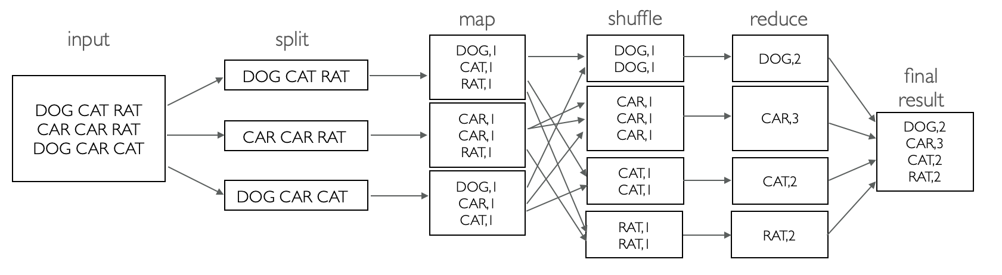
Other examples of distributed systems
Animation removed
Web server

Slide 5
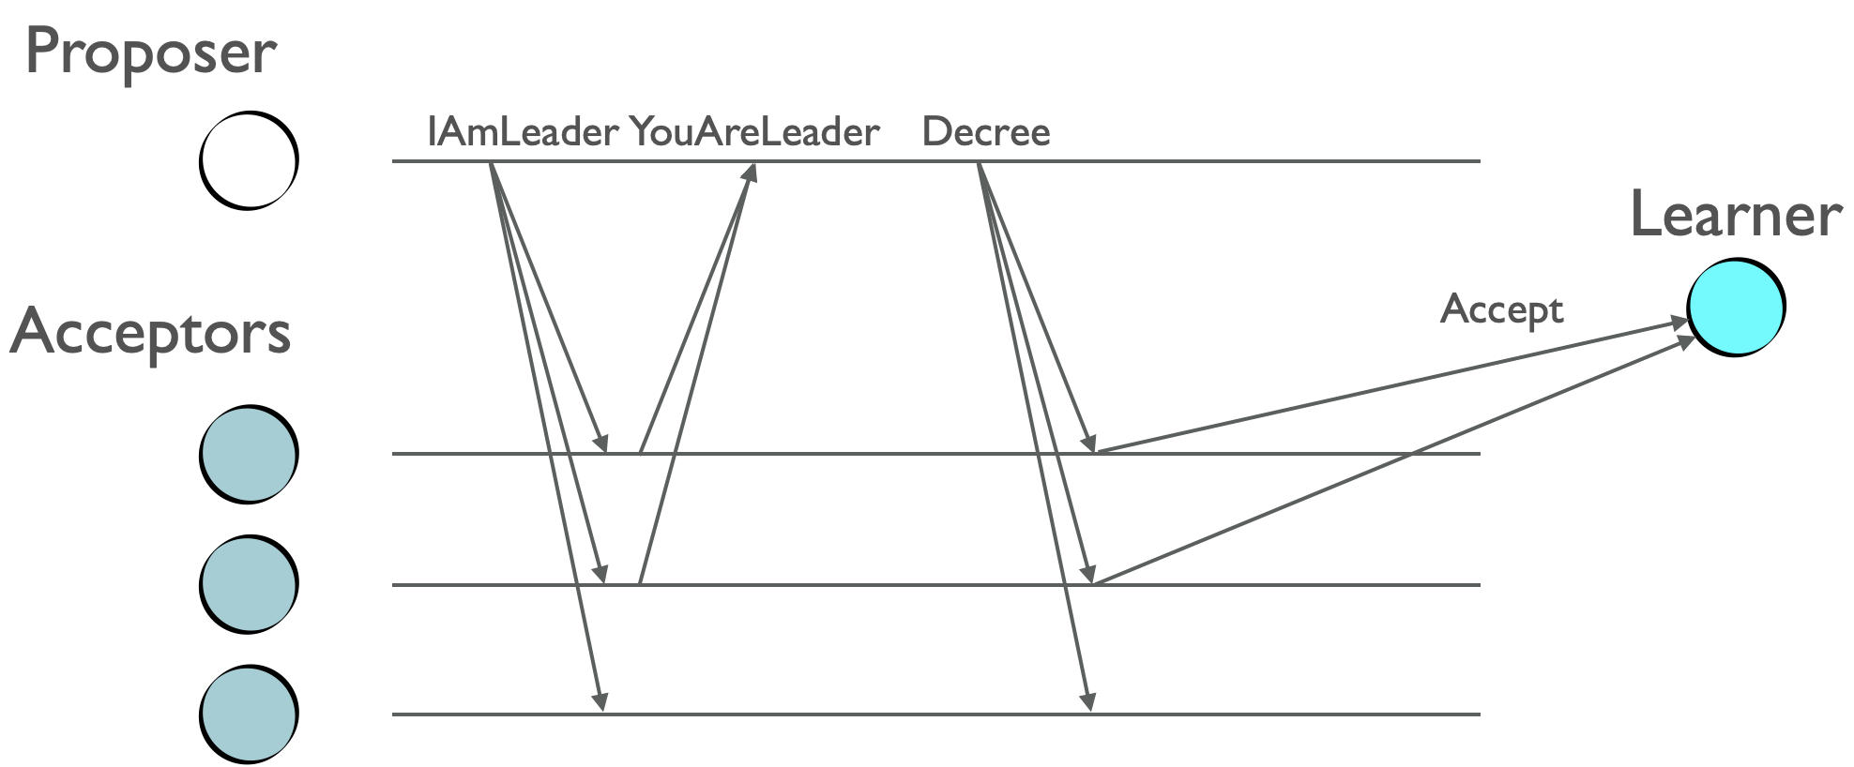
Other examples of distributed systems
The Paxos protocol

Slide 6
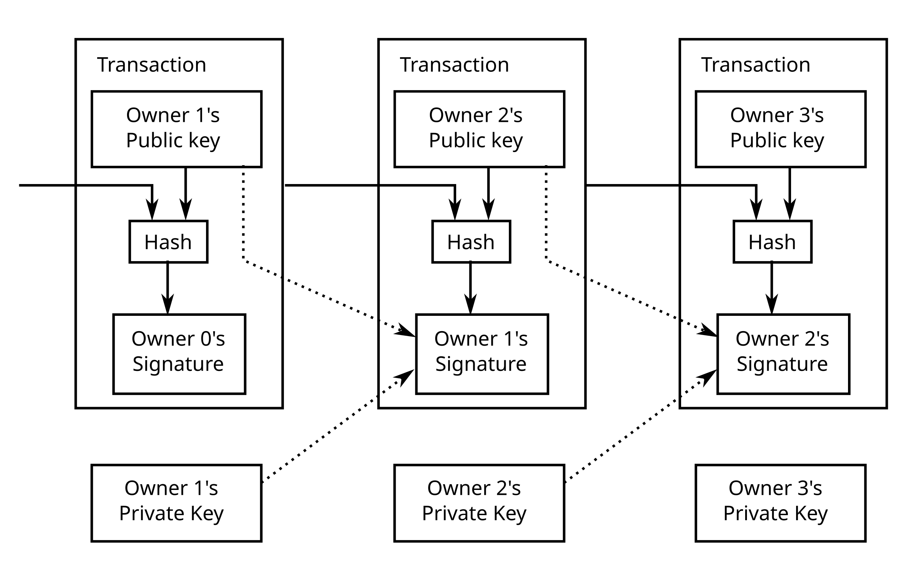
Other examples of distributed systems
The Bitcoin blockchain

Slide 7
A distributed system
Network

Slide 8
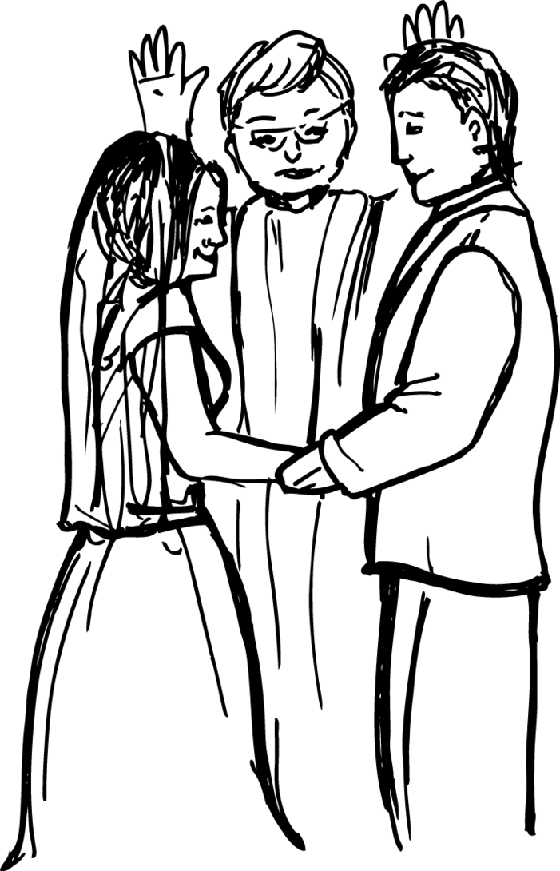
Atomic Commit (Problem Set 3)
-Do you take each other?
-I do.
-I do.
-I now pronounce you atomically committed.

Slide 9
Atomic Commit: the objective
Preserve data consistency for distributed transactions
Example: book a hotel and flight on Expedia

Slide 10

Atomic Commit: the setup
One coordinator
A set of participants
Allowed to be empty in our model
Every participant has an “input” value, called vote/preference
Every participant/coordinator has an “output” value, called decision
We are ignoring the possibility of failures

Slide 11
Atomic Commit: the spec (simplified to ignore failures)
AC-1: All processes that reach a decision reach the same one
AC-3: The Commit decision can only be reached if all processes vote Yes
AC-4: If there are no failures and all processes vote Yes, then the decision must be Commit
AC-2 and AC-5 ignored

Slide 12



Two Phase Commit (2PC)
1. sends VOTE-REQ message to all participants
2. sends to coordinator
if == No
then := Abort
3. Wait for all votes to come in
If all votes are Yes then
:= Commit
Send Commit message to all
else
:= Abort
Send Abort message to all who voted Yes
4. If received Commit then
:= Commit
else
:= Abort

Slide 13
Administrivia
Problem set 3 (Chapter 5) has been released and is due Oct 24
Start looking for partners for Project 1 (released after PS3)
Midterm evaluations are up
Please provide feedback! (Currently 2 out of 28)
Note the additional questions
Midterm exam on October 17
Time: 6-8pm
Location: BBB1670
Will contact you for time/location if you have accommodations
We will release practice exams tonight

Slide 14


A distributed system
Network

Slide 15
Modeling distributed systems
A distributed system is composed of multiple hosts
Distributed system
Distributed System: attempt #1
module DistributedSystem {
datatype Variables =
Variables(hosts:seq<Host.Variables>)
predicate Next (v:Variables, v’:Variables, hostid: nat) {
&& Host.Next(v.hosts[hostid],v'.hosts[hostid]))
&& forall otherHost:nat | otherHost != hostid ::
v’.hosts[otherHost] == v.hosts[otherHost]
}
}
Host
Host
Host
Host

Slide 16
Defining the network
datatype Option<T> = Some(value:T) | None
datatype MessageOps = MessageOps(
recv:Option<Message>, send:Option<Message>)
Network module
module Network {
datatype Variables =
Variables(sentMsgs: set<Message>)
predicate Next(v, v’, msgOps:MessageOps) {
// can only receive messages that have been sent
&& (msgOps.recv.Some? ==> msgOps.recv.value in v.sentMsgs)
// Record the sent message, if there was one
&& v'.sentMsgs ==
v.sentMsgs + if msgOps.send.None? then {}
else {msgOps.send.value}
}
}
Distributed system
Host
Host
Network
Host
Host

Slide 17
A distributed system is composed of multiple hosts and a network
Distributed system: attempt #2
module DistributedSystem {
datatype Variables =
Variables(hosts:seq<Host.Variables>,
network: Network.Variables)
predicate HostAction(v, v’, hostid, msgOps) {
&& Host.Next(v.hosts[hostid],v'.hosts[hostid],msgOps))
&& forall otherHost:nat | otherHost != hostid ::
v’.hosts[otherHost] == v.hosts[otherHost]
}
predicate Next(v, v’, hostid, msgOps: MessageOps) {
&& HostAction(v, v’, hostid, msgOps)
&& Network.Next(v, v’, msgOps)
}
}
Distributed system
Host
Host
Network
Host
Host
Binding variable

Slide 18
A distributed system is composed of multiple hosts, a network and clocks
Distributed system: attempt #3
module DistributedSystem {
datatype Variables =
Variables(hosts:seq<Host.Variables>,
network: Network.Variables,
time: Time.Variables)
predicate Next(v, v’, hostid, msgOps: MessageOps, clk:Time) {
|| (&& HostAction(v, v’, hostid, msgOps)
&& Network.Next(v, v’, msgOps)
&& Time.Read(v.time, clk))
|| (&& Time.Advance(v.time, v’.time)
&& v’.hosts == v.hosts
&& v’.network == v.network)
}
}
Distributed system
Host
Host
Network
Time
Host
Host

Slide 19
This modeling applies to all asynchronous systems
module DistributedSystem {
datatype Variables =
Variables(fs: FileSystem.Variables,
disk: Disk.Variables)
predicate Next(v, v’) {
|| (exists io ::
&& FileSystem.Next(v.fs, v’.fs, io)
&& Disk.Next(v.disk, v’.disk, io)
|| ( // Crash!
&& FileSystem.Init(v’.fs)
&& v’.disk == v.disk
)
}
}
”Distributed” system
File system
(in-memory state
Disk
Binding variable

Slide 20
Trusted vs proven
Hosts cannot communicate except through the network
Time can advance between any host steps
File system (kernel)
can crash
Distributed system
Distributed system
Disk won’t forget writes it acknowledged
Network won’t make up packets
Host
Host
Network
File system
(in-memory state
Disk
Network might reorder packets
Time
Host
Host
Disk might reorder concurrent writes
Time only moves forward

Slide 21

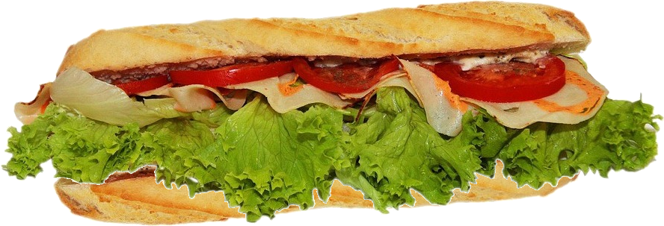
: the systems specification sandwich
trusted application spec
proof
protocol
proof
code
trusted environment assumptions
image: pixabay

Slide 22
Triggers
Q: Does Dafny verify this code?
predicate P(x:int)
predicate Q(x:int)
method test()
requires forall x :: P(x) && Q(x)
ensures Q(0)
{
}
A: Only if it’s smart enough to pick the right trigger

Slide 23
Imagine you are the solver
requires forall x :: P(x) && Q(x)
I wonder if P(0) is a useful fact...
I wonder if P(1) is a useful fact...
I wonder if P(2) is a useful fact... I wonder if Q(2) is a useful fact...
I wonder if P(3) is a useful fact... I wonder if Q(3) is a useful fact...
I wonder if P(4) is a useful fact... I wonder if Q(4) is a useful fact...
I wonder if P(5) is a useful fact... I wonder if Q(5) is a useful fact...
I wonder if P(6) is a useful fact... I wonder if Q(6) is a useful fact...
I wonder if P(7) is a useful fact... I wonder if Q(7) is a useful fact...
I wonder if P(8) is a useful fact... I wonder if Q(8) is a useful fact...
I wonder if Q(0) is a useful fact...
I wonder if Q(1) is a useful fact...
I wonder if P(9) is a useful fact... I wonder if Q(9) is a useful fact...
I wonder if P(10) is a useful fact... I wonder if Q(10) is a useful fact...
I wonder if P(11) is a useful fact... I wonder if Q(11) is a useful fact...
I wonder if P(12) is a useful fact... I wonder if Q(12) is a useful fact...
I wonder if P(13) is a useful fact... I wonder if Q(13) is a useful fact...
I wonder if P(14) is a useful fact... I wonder if Q(14) is a useful fact...
I wonder if P(15) is a useful fact... I wonder if Q(15) is a useful fact...
I wonder if P(16) is a useful fact... I wonder if Q(16) is a useful fact...
I wonder if P(17) is a useful fact... I wonder if Q(17) is a useful fact...
I wonder if P(9) is a useful fact... I wonder if Q(9) is a useful fact...
I wonder if P(10) is a useful fact... I wonder if Q(10) is a useful fact...
I wonder if P(11) is a useful fact... I wonder if Q(11) is a useful fact...
I wonder if P(12) is a useful fact... I wonder if Q(12) is a useful fact...
I wonder if P(13) is a useful fact... I wonder if Q(13) is a useful fact...
I wonder if P(14) is a useful fact... I wonder if Q(14) is a useful fact...
I wonder if P(15) is a useful fact... I wonder if Q(15) is a useful fact...
I wonder if P(16) is a useful fact... I wonder if Q(16) is a useful fact...
I wonder if P(17) is a useful fact... I wonder if Q(17) is a useful fact...
I wonder if P(9) is a useful fact... I wonder if Q(9) is a useful fact...
I wonder if P(10) is a useful fact... I wonder if Q(10) is a useful fact...
I wonder if P(11) is a useful fact... I wonder if Q(11) is a useful fact...
I wonder if P(12) is a useful fact... I wonder if Q(12) is a useful fact...
I wonder if P(13) is a useful fact... I wonder if Q(13) is a useful fact...
I wonder if P(14) is a useful fact... I wonder if Q(14) is a useful fact...
I wonder if P(15) is a useful fact... I wonder if Q(15) is a useful fact...
I wonder if P(16) is a useful fact... I wonder if Q(16) is a useful fact...
I wonder if P(17) is a useful fact... I wonder if Q(17) is a useful fact...
I wonder if P(9) is a useful fact... I wonder if Q(9) is a useful fact...
I wonder if P(10) is a useful fact... I wonder if Q(10) is a useful fact...
I wonder if P(11) is a useful fact... I wonder if Q(11) is a useful fact...
I wonder if P(12) is a useful fact... I wonder if Q(12) is a useful fact...
I wonder if P(13) is a useful fact... I wonder if Q(13) is a useful fact...
I wonder if P(14) is a useful fact... I wonder if Q(14) is a useful fact...
I wonder if P(15) is a useful fact... I wonder if Q(15) is a useful fact...
I wonder if P(16) is a useful fact... I wonder if Q(16) is a useful fact...
I wonder if P(17) is a useful fact... I wonder if Q(17) is a useful fact...

Slide 24


Completeness vs Soundness
Proving a program correct is undecidable
i.e. it is impossible to design a program that always correctly answers the question: is this program correct
Side note:
Logicomix
Veritasium
Provers embrace incompleteness while guarding soundness
Incompleteness: the prover will say “no” to some correct programs
Soundness: the prover will never say “yes” to an incorrect program

Slide 25
Triggers
What is a trigger?
A syntactic pattern involving quantified variables
A heuristic to let the solver know when to instantiate the quantifier

Slide 26
Triggers
Q: Does Dafny verify this code?
predicate P(x:int)
predicate Q(x:int)
method test()
requires forall x {:trigger P(x)} :: P(x) && Q(x)
ensures Q(0)
{
}

Slide 27
Chapter 6: Refinement

Slide 28
State machines: a versatile tool
State machines can be used to
Model the program
Model environment components
Model how the system (program+environment) fits together
Specify the system behavior

Slide 29
Different ways to specify behavior
Spec
C-style assertions
Postconditions
Properties/invariants
Refinement to a state machine
Distributed system
Host
Network
Host
Host

Slide 30
Example: hashtable
module HashTable {
datatype Variables = Variables(tbl:seq<Pair<int, string>>)
predicate Insert(v:Variables, v’:Variables, key:int, val:string) {
var free := Probe(v.tbl, key);
&& free.Some?
&& v’.tbl == v.tbl[free.value := Pair(key, val)]
}
}
-
-
-
13￫C
13￫C
-
-
-
-
-
-
23￫A
23￫A
23￫A
23￫A
-
-
-
-
47￫D
-
-
71￫B
71￫B
71￫B

Slide 31
The spec: a simple map
(empty)
23￫A
23￫A
71￫B
13￫C
23￫A
71￫B
13￫C
23￫A
47￫D
71￫B
module MapSpec {
datatype Variables = Variables(mapp:map<Key, Value>)
predicate InsertOp(v:Variables, v':Variables, key:Key, value:Value) {
&& v'.mapp == v.mapp[key := value]
}
}

Slide 32
Refinement
(empty)
23￫A
23￫A
71￫B
13￫C
23￫A
71￫B
13￫C
23￫A
47￫D
71￫B
-
-
-
13￫C
13￫C
-
-
-
-
-
-
23￫A
23￫A
23￫A
23￫A
-
-
-
-
47￫D
-
-
71￫B
71￫B
71￫B

Slide 33
The benefits of refinement
Refinement allows for good specs
Abstract: elide implementation details
Concise: simple state machine
Complete: better than a “bag of properties”
But if you want, you can prove properties about the spec
Refinement is very powerful
Can specify systems that are hard to specify otherwise
E.g. linearizability

Slide 34
A sharded key-value store
Logically centralized, physically distributed
(empty)
23￫A
23￫A
71￫B
13￫C
23￫A
71￫B
13￫C
23￫A
47￫D
71￫B
Host 1
Host 1
Host 1
Host 1
Host 1
-
-
-
13￫C
13￫C
-
-
-
-
-
-
-
-
-
-
Host 2
Host 2
Host 2
Host 2
Host 2
-
23￫A
23￫A
23￫A
23￫A
-
-
-
-
47￫D
-
-
71￫B
71￫B
71￫B

Slide 35
Stutter steps
(empty)
23￫A
23￫A
71￫B
23￫A
71￫B
One “stutter”
step for the spec
Host 1
Host 1
Host 1
Host 1
-
-
-
23￫A
-
-
-
-
One normal step for the implementation
-
-
-
-
Host 2
Host 2
Host 2
Host 2
-
23￫A
23￫A
-
-
-
-
-
-
-
71￫B
71￫B

Slide 36

A primary-backup protocol
Clients
Primary
Primary
Backup
Backup

Slide 37
A primary-backup protocol
Primary
Primary
Primary
Primary
Primary
Primary
Backup
Backup
Backup
Backup
Backup
Backup

Slide 38
The interpretation (Abstraction) function
(empty)
23￫A
23￫A
71￫B
13￫C
23￫A
71￫B
13￫C
23￫A
47￫D
71￫B
function Abstraction(lv:HashTblState) : (hv:MapSpec.Variables)
{
...
}
-
-
-
13￫C
13￫C
-
-
-
-
-
-
23￫A
23￫A
23￫A
23￫A
-
-
-
-
47￫D
-
-
71￫B
71￫B
71￫B

Slide 39
A refinement proof
function Abstraction(v:Variables) : MapSpec.Variables
predicate Inv(v:Variables)
lemma RefinementInit(v:Variables)
requires Init(v)
ensures Inv(v) // Inv base case
ensures MapSpec.Init(Abstraction(v)) // Refinement base case
lemma RefinementNext(v:Variables, v':Variables)
requires Next(v, v')
requires Inv(v)
ensures Inv(v') // Inv inductive step
ensures MapSpec.Next(Abstraction(v), Abstraction(v')) // Refinement inductive step
|| Abstraction(v) == Abstraction(v') // OR stutter step

