Slide 1
EECS498-003 Formal Verification of Systems Software
Material and slides created by
Jon Howell and Manos Kapritsos

Slide 2



Slide 3

Recursion: exporting ensures
function Evens(count:int) : (outseq:seq<int>)
ensures forall idx :: 0<=idx<|outseq| ==> outseq[idx] == 2 * idx
{
if count==0 then [] else Evens(count) + [2 * (count-1)]
}
VSCode transition

Slide 4


Chapter 2: Specification
Specification
Karma is a word. Another way of saying “What I am here to do”

Slide 5
How to specify our programs
Attempt #1: Just tell your programmers what you want them to code
Writing is nature's way of letting you know how sloppy your thinking is
-Dick Guindon

Slide 6
How to specify our programs
Attempt #2: Write down an English description (aka a design doc)
Mathematics is nature's way of letting you know how sloppy your writing is
-Leslie Lamport
Formal mathematics is nature's way of letting you know how sloppy your mathematics is
-Leslie Lamport

Slide 7
Formal specification
A way to define formally (i.e. precisely) what your program should do
Before you start writing code, make sure you know what code is supposed to be doing
Before you start writing a proof, make sure you know what you are proving

Slide 8


Specification
A specification defines which executions are allowable
lemma Double(x:int) returns (y:int)
ensures y == 2*x
{
...
}
(x=1, y=2)
(x=2, y=4)
(x=2, y=2)
(x=-3, y=-6)
(x=-2, y=4)

Slide 9
Ways to specify what the program should do
C-style assertions
Postconditions
Properties/invariants
Refinement
y = 2*x; assert(y==2*x)
lemma Double(x:int) returns (y:int)
ensures y == 2*x
{
y := 2*x;
}
“At most one node holds the lock at any time”
Linearizability
Equivalence to logically centralized service

Slide 10
Specification is trusted
Formal verification: proving that your protocol or implementation meets the spec
You cannot prove that the spec is correct
You have to trust your spec
Your proof is as good as your spec
A wrong spec is one of the few ways to introduce bugs into formally verified code

Slide 11
Check your spec
Check your spec!
Check your spec!
Check your spec!
Check your spec!
Check your spec!
Now that should be your 1st, 2nd, 3rd, 4th and 5th concern!

Slide 12
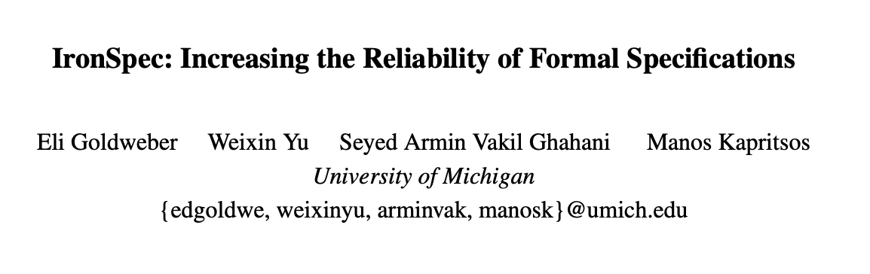
Research detour: IronSpec (OSDI ‘24)
A methodology and tool to find bugs in formal specifications
Found multiple spec bugs in real-world Dafny codebases

Slide 13
The benefit of specification
The spec is typically much smaller than the code
So we have to inspect a few lines of code only
Dijkstra’s algorithm spec
IsShortestPath(g, p) { && IsPath(g, p) && forall p2 :: IsPath(g, p2) ==> |p| <= |p2|
}

Slide 14
A good spec
A good spec is correct/complete
It precludes all undesirable behaviors
Example: IsMaxIndex
predicate IsMaxIndex(a:seq<int>, x:int) {
&& 0 < x < |a|
&& (forall i | 0 < i < |a| :: a[i] <= a[x])
}

Slide 15
A good spec (cont.)
A good spec is concise
It elides every irrelevant concept
Is simple and easy to read
predicate IsMaxIndex(a:seq<int>, x:int) {
&& 0 <= x < |a|
&& (forall i | 0 <= i < |a| :: a[i] <= a[x])
}

Slide 16
A good spec (cont.)
A good spec is abstract
It doesn’t constrain the implementation
Dijkstra’s algorithm spec
IsShortestPath(g:Graph, p:Path) { && IsPath(g, p) && forall p2 :: IsPath(g, p2) ==> |p| <= |p2|
}

Slide 17
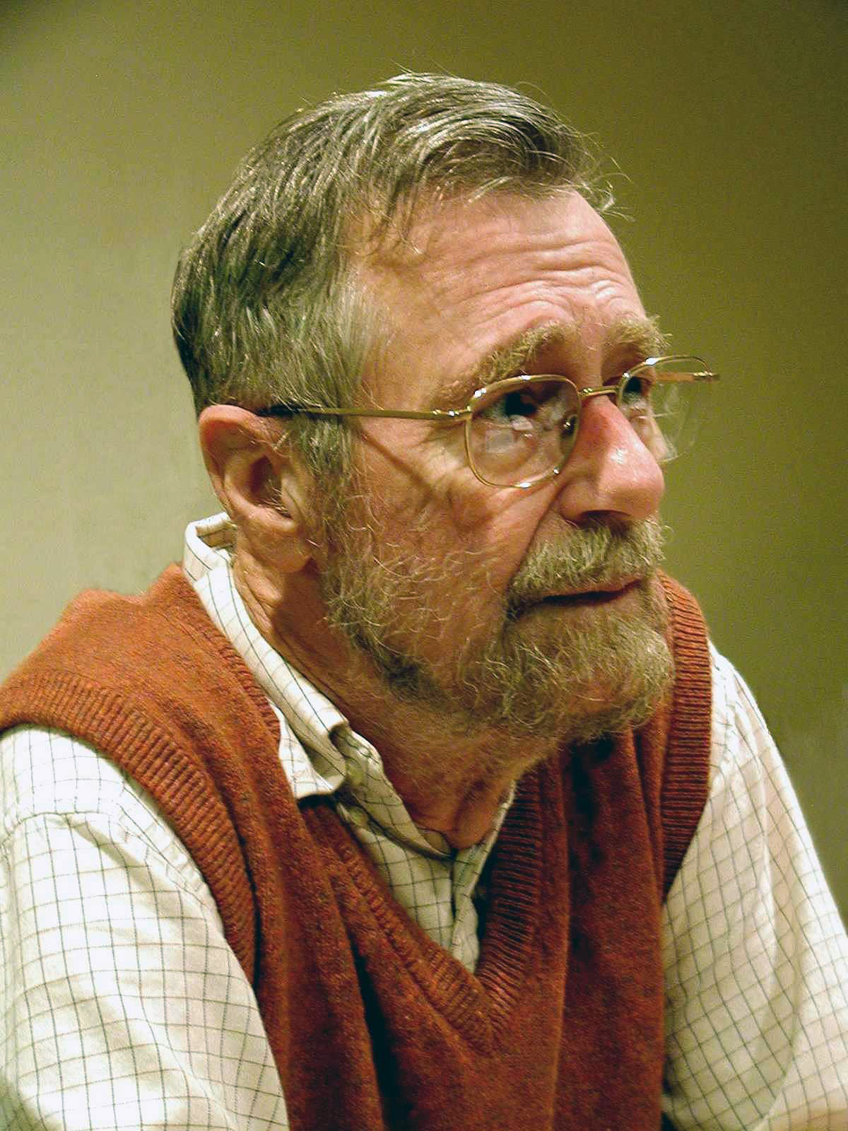
Edsger W. Dijkstra
1972 Turing Award winner
Inventor of:
Dijkstra’s shortest path algorithm
Semaphores
The THE operating system
Banker’s algorithm
“Progress is possible only if we train ourselves to think about programs without thinking of them as pieces of executable code.”

Slide 18
Verification and the “eradication” of bugs
Frequent quote from verification experts
“We prove that there are no bugs at all…”
Frequent quote from verification skeptics
“Nonsense! You can still have bugs in your spec”
The truth is somewhere in the middle
Yes, your spec may have bugs
But do you prefer inspecting 30 lines for bugs or 30000?

Slide 19
Autograder submissions
Reminder: PS1 deadline is September 19
Dafny timeouts/out of resource
dafny /trace
dafny /rlimit:32700000
Remember to pull the code repo for the starter code of examples presented in class

Slide 20
Some new Dafny syntax
Datatype member functions
datatype Pet = Dog | Cat | Ant | Spider {
function CountLegs() : int {
match this
case Dog => 4
case Cat => 4
case Ant => 6
case Spider => 8
}
}
function ShoesForTwo(pet: Pet) : int {
2 * pet.CountLegs()
}

Slide 21
Some new Dafny syntax
Calc statements
assert a == b;
assert b == c;
assert c == d;
calc {
a;
b;
c;
d;
}

Slide 22
Some new Dafny syntax
Calc statements
assert a == b;
assert b == c;
assert c == d;
calc {
a;
{ MyUsefulLemma(a,b); }
b;
c;
d;
}

Slide 23
Some new Dafny syntax
Calc statements
assert a == b;
assert b == c;
assert c == d;
calc ==> {
a;
{ MyUsefulLemma(a,b); }
b;
c;
d;
}

Slide 24
Some new Dafny syntax
Choose operator
assert 1 % 7 == 1;
assert exists x :: x % 7 == 1;
var x :| x % 7 == 1;
Choose x such that...

