Slide 1
EECS498-003 Formal Verification of Systems Software
Material and slides created by
Jon Howell and Manos Kapritsos

Slide 2
Chapter 3: State Machines

Slide 3
Building state machines
A state is an assignment of values to variables
An action is a transition from one state to another
An execution is a sequence of states
We will capture executions with state machines
x=1
y=1
x=1
y=2

Slide 4
Building state machines
A state is an assignment of values to variables
An action is a transition from one state to another
An execution is a sequence of states
We will capture executions with state machines
A
B
A
B
C
D

Slide 5
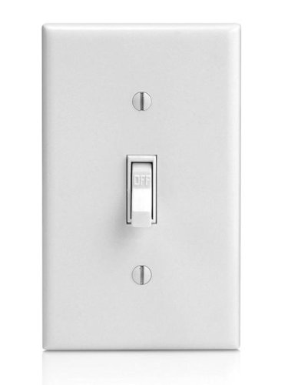
The Switch state machine
Activate, Toggle
Activate
off
on
Deactivate
Deactivate, Toggle
Activate
Activate
Toggle
Toggle
off
on
on
off
on

Slide 6
The Switch state machine
Activate, Toggle
predicate Activate(v:Variables, v':Variables) {
v'.switch == On
}
predicate Deactivate(v:Variables, v':Variables) {
v'.switch == Off
}
predicate Toggle(v:Variables, v':Variables) {
v'.switch != v.switch
}
predicate Next(v:Variables, v':Variables) {
|| Activate(v, v')
|| Deactivate(v, v')
|| Toggle(v, v')
}
Activate
off
on
Deactivate
Deactivate, Toggle
datatype SwitchState = On | Off
datatype Variables =
Variables(switch:SwitchState)
predicate Init(v:Variables) {
v.switch == Off
}

Slide 7
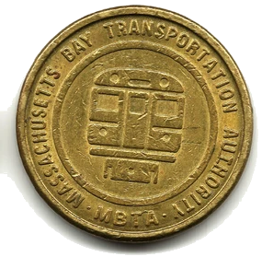
The Game of Nim
Play(1)
Play(3)
Play(2)
Play(4)
11
10
7
5
1

Slide 8
The Nim state machine
datatype Variables = Variables(tokens:nat)
predicate Init(v:Variables) {
v.tokens > 0
}
predicate Play(v:Variables, v':Variables, take:nat) {
&& 1 <= take <= 4
&& v'.tokens == v.tokens - take
}
predicate Next(v:Variables, v':Variables)
{
exists take :: Play(v, v', take)
}
enabling condition
“update”

Slide 9
Play(1)
Play(3)
Play(2)
Play(4)
11
10
7
5
1
11
10
9
8
7
0
!Init()
11
10
11
8
7
!Next()

Slide 10
Administrivia
Remember that Problem Set 1 is due next Thursday, September 19
My office hours today were moved to 5-6pm

Slide 11
A simple library app
datatype Card = Shelf | Patron(name: string) datatype Book = Book(title: string) type Variables = map<Book, Card>
Small-library rule: each patron can have at most one book checked out

Slide 12
A state is an assignment of values to variables
datatype Card = Shelf | Patron(name: string) datatype Book = Book(title: string) type Variables = map<Book, Card>
The state space is the set of possible assignments.
The Martian: Shelf White Fang: Shelf
The Martian: Jon White Fang: Jon
The Martian: Shelf White Fang: Jon
The Martian: Manos White Fang: Jon
Notes:
A state space is a type (think C struct).
A state is an assignment of values to variables in the type (think C struct literal).
For many practical state definitions, many states might be nonsense.

Slide 13
An execution is an infinite sequence of states
check out
check out
check in
check out
The Martian: Shelf White Fang: Shelf
The Martian: Shelf White Fang: Jon
The Martian: Manos White Fang: Jon
The Martian: Shelf White Fang: Jon
The Martian: Rob White Fang: Jon
check out
check in
check out
check in
The Martian: Shelf White Fang: Shelf
The Martian: Jon White Fang: Shelf
The Martian: Shelf White Fang: Shelf
The Martian: Rob White Fang: Shelf
The Martian: Shelf White Fang: Shelf
check out
???
The Martian: Shelf White Fang: Shelf
The Martian: Shelf White Fang: Jon
The Martian: Shelf White Fang: Rob
Notes:
A behavior is an infinite sequence of states.
A given state space (struct) implies a set of all possible behaviors: all infinite sequences of states in any order.
Intuitively, almost all of those behaviors are useless. A specification is a subset of behaviors that we care about.
A safety violation happens at a single state.
A liveness violation requires the infinite behavior. We’re not going to say anything more about liveness this week.

Slide 14
A behavior is the set of all possible executions
check out
check out
check in
check out
The Martian: Shelf White Fang: Shelf
The Martian: Shelf White Fang: Jon
The Martian: Manos White Fang: Jon
The Martian: Shelf White Fang: Jon
The Martian: Rob White Fang: Jon
check out
check in
check out
check in
The Martian: Shelf White Fang: Shelf
The Martian: Jon White Fang: Shelf
The Martian: Shelf White Fang: Shelf
The Martian: Rob White Fang: Shelf
The Martian: Shelf White Fang: Shelf
check out
???
The Martian: Shelf White Fang: Shelf
The Martian: Shelf White Fang: Jon
The Martian: Shelf White Fang: Rob
Notes:
A behavior is an infinite sequence of states.
A given state space (struct) implies a set of all possible behaviors: all infinite sequences of states in any order.
Intuitively, almost all of those behaviors are useless. A specification is a subset of behaviors that we care about.
A safety violation happens at a single state.
A liveness violation requires the infinite behavior. We’re not going to say anything more about liveness this week.

Slide 15
A state machine definition
datatype Card = Shelf | Patron(name: string) datatype Book = Book(title: string) type Variables = map<Book, Card>
predicate Init(v: Variables) {
forall book | book in v :: v[book] == Shelf
}
predicate CheckOut(v : Variables, v’ : Variables, book: Book, name: string) {
&& book in v
&& v[book] == Shelf
&& (forall book | book in v :: v[book] != Patron(name))
&& v’ == v[book := Patron(name)]
}
predicate CheckIn(v : Variables, v’ : Variables, book: Book, name: string) {
&& book in v
&& v[book] == Patron(name)
&& v’ == v[book := Shelf]
}
predicate Next(v: Variables, v’: Variables) {
|| (exists book, name :: CheckOut(v, v’, book, name))
|| (exists book, name :: CheckIn(v, v’, book, name))
}
enabling condition
“update”
Nondeterministic
definition

Slide 16
A behavior is the set of all possible executions
predicate CheckOut(v, v’, book, name) {
&& book in v
&& v[book] == Shelf
&& (forall book | book in v :: v[book] != Patron(name))
&& v’ == v[book := Patron(name)]
}
predicate CheckIn(v, v’, book, name) {
&& book in v
&& v[book] == Patron(name)
&& v’ == v[book := Shelf]
}
check out
???
The Martian: Shelf White Fang: Shelf
The Martian: Shelf White Fang: Jon
The Martian: Shelf White Fang: Rob
Notes:
A behavior is an infinite sequence of states.
A given state space (struct) implies a set of all possible behaviors: all infinite sequences of states in any order.
Intuitively, almost all of those behaviors are useless. A specification is a subset of behaviors that we care about.
A safety violation happens at a single state.
A liveness violation requires the infinite behavior. We’re not going to say anything more about liveness this week.

Slide 17
How should we define a behavior?
With a program?
Its variables define its state space
Its executions define its behavior
Weaknesses:
concreteness
nondeterminism
asynchrony
environment

Slide 18
How should we define a behavior?
With a state machine
Its type defines its state space
Its initial states and transitions define its behavior

Slide 19
State machine strengths
Abstraction
States can be abstract
Model an infinite map instead of an efficient pivot table
Next predicate is nondeterministic:
Implementation may only select some of the choices
Can model Murphy’s law (e.g. crash tolerance) or an adversary

Slide 20
State machine strengths
Abstraction
Asynchrony
Each step of a state machine is conceptually atomic
Interleaved steps capture asynchrony: threads, host processes, adversaries
Designer decides how precisely to model interleaving; can refine/reduce

Slide 21
State machine strengths
Abstraction
Asynchrony
Environment
Model a proposed program with one state machine (verified)
Model (adversarial) environment with another (trusted)
Compound state machine models their interactions (trusted)
System (environment assumption)
Distributed System (environment assumption)
Filesystem
(program to verify)
Disk
(environment assumption)
Host
(program to verify)
Network
(environment assumption)

