Slide 1
EECS498-008 Formal Verification of Systems Software
Material and slides created by
Jon Howell and Manos Kapritsos

Slide 2
About me
Manos Kapritsos (manosk@umich.edu)
Areas of research: Formal Verification, Distributed Systems
28 years old (well, maybe not in decimal)
Disclaimer
Any resemblance to purple-looking super
villains, living or dead, is purely coincidental

Slide 3

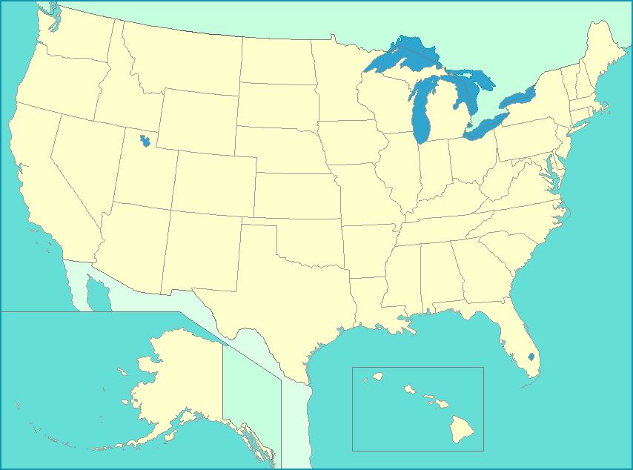

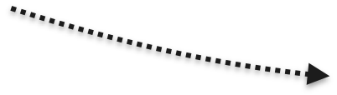
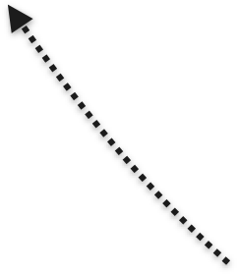


About me

Slide 4
About you and me
I love teaching and interacting with my students
I want to get to know you all by name
Send me your picture by email (manosk@umich.edu)
Use subject ”EECS498-008 picture”
I’m here to help. Come to me with any question!
course-related: office hours (Tuesday, 11am-12pm, BBB 4824)
Life, The Universe, and Everything: any time

Slide 5
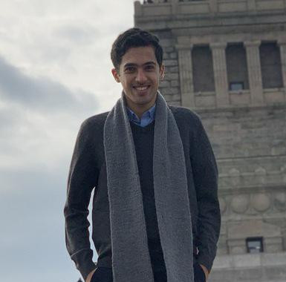

If you need more help...
Our TA, Armin Vakil, is here to help
A Jedi Master in Formal Verification
Office hours: 2-3pm Thursday, Learning Center, Table 2

Slide 6
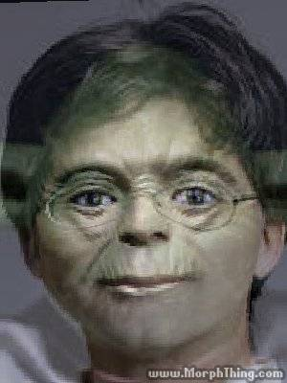
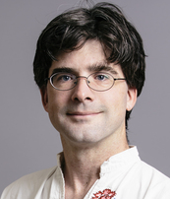
The unseen hero
Jon Howell, VMWare Research
Co-designer of the material in this course
“Bugs, unit tests, gdb. The dark side are they.”
“Testing not make one great.”

Slide 7
Agenda for Today
Why learn formal verification?
Course syllabus and logistics
What is formal verification?
(and other, similar approaches)
Getting started with Dafny

Slide 8
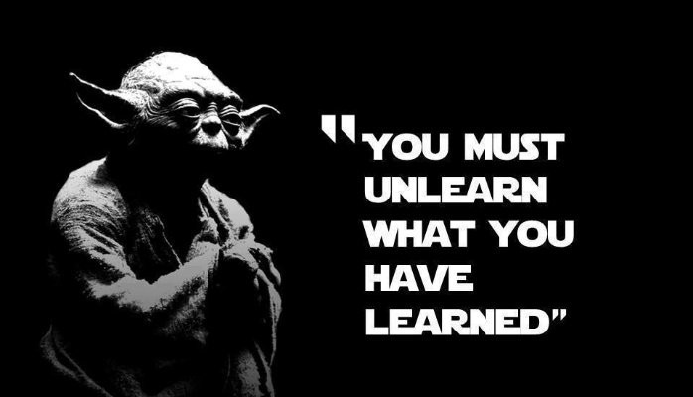
Why learn formal verification?
My research interests
EECS280/281
High-level programming
EECS482
OS-level programming
EECS491
Distributed programming
Scalability
Dependability
We have taught you how to write and test programs

Slide 9
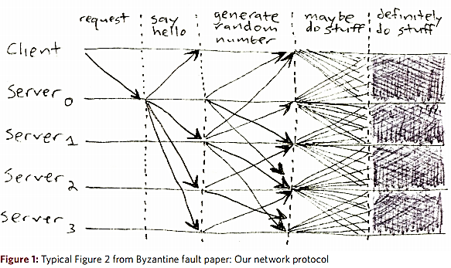
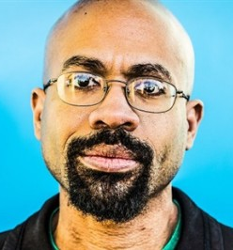
Real-world systems are too complex to test
My research interests
Scalability
Dependability
[Mickens 2013]

Slide 10
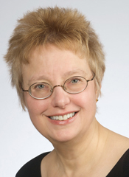
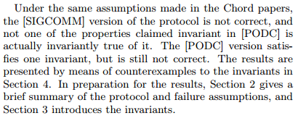
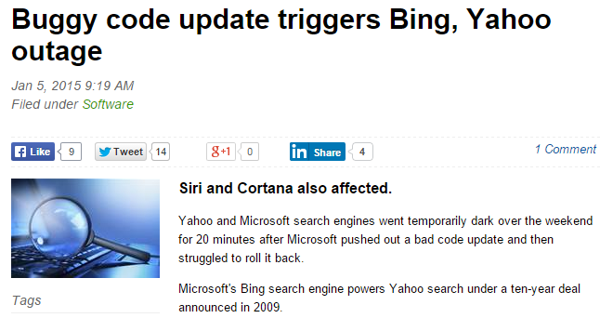
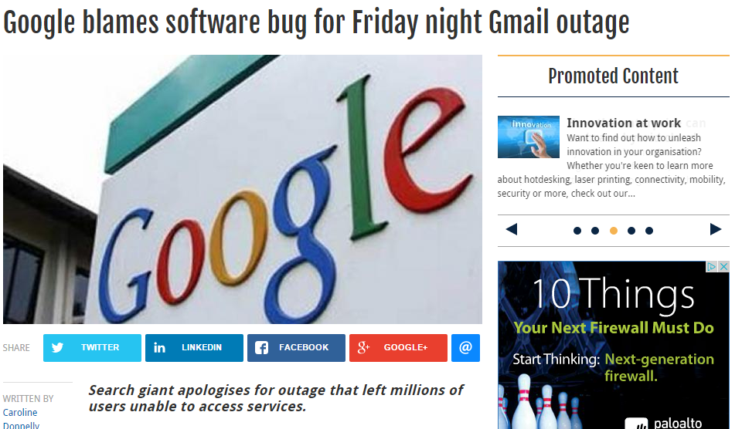
Despite tremendous effort...
My research interests
“not one of the properties claimed invariant in [PODC] is actually invariantly true of it.”
BUGS
Scalability
Dependability
[Zave 2015]

Slide 11
Is it possible to write code that is completely bug-free?
Formal verification is as close as we can get

Slide 12
March 25, 2015
(or how I became a believer)
One day before the deadline of SOSP’15, we had not yet run our code
...and yet our code ran correctly the first time we ran it!
(and every time afterwards)

Slide 13
How will you benefit from this class?
It will make you a better programmer
Whether you end up writing verified code or not
You will learn to specify your code
To express your intent clearly and unambiguously
Just like design docs, but better
You will learn important concepts
E.g. inductive invariants, refinement
Get ahead of the curve
Learn an emerging skill

Slide 14
Objectives of this class
Understand the fundamentals of formal verification
Learn how they apply in a (distributed) systems context
Get hands-on experience with proving systems correct
Become familiar with a practical verification language

Slide 15
Prerequisites
Experience with distributed or asynchronous systems
i.e. EECS482
I will explain the mechanics of any distributed systems in the class for those of you that haven’t taken EECS491
No verification experience required
If anything is unclear, do not hesitate to ask

Slide 16

About this class
Disclaimer: this class is not formally verified!
This is the first time I am teaching this class
...or rather, anyone is teaching this class
...or rather, anyone is teaching a class on this material
There is no textbook (anywhere!)
Jon and I will write one based on the experience from this class

Slide 17
Class material
Class webpage
https://verification.eecs.umich.edu
Syllabus, lecture slides, problem sets and projects will be posted on the class webpage
Subscribe yourself to Piazza
Announcements and class discussion

Slide 18
Enrollment
Current cap at 40 with a few people on the waitlist
I’m working to increase the cap (and perhaps add a second lab)

Slide 19
Lectures
Lectures will be held in person in DOW 1017
Recordings will be posted at: http://leccap.engin.umich.edu/leccap/site/p3kt6ubmxl1hk61vfm0 (link is also on course web page and Piazza)
I will be posting slides of each lecture (shortly) before the lecture, in case you want to keep notes directly on the slides

Slide 20
Lectures schedule
Material is divided into eight chapters
Chapters 1-5 (before midterm) cover the basic concepts of verification
Basic verification and Dafny mechanics
Specification
Centralized state machines
Proving properties and inductive invariants
Distributed state machines
Chapters 6-8 (after midterm) cover refinement proofs and advanced topics
Refinement
Asynchronous clients
Application correspondence

Slide 21
Problem sets and projects
There are four (programming) problem sets and two projects
Problem sets will be done individually
Projects will be done in groups of 1-2 students
All deliverables will be submitted via the autograder.io website
They use a combination of auto-grading and hand-grading
(this is where I warn you about how hard the projects are, but...)

Slide 22
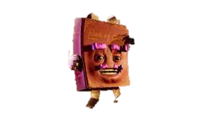
Policies
Submission
Three submissions per day to the autograder
Due at midnight on deadline
Three late days throughout the semester
Collaboration
Okay to clarify problem or discuss Dafny syntax
Not okay to discuss solutions

Slide 23
Exams
Midterm: October 12, 6-8pm
Final: December 12, 10:30am-12:30pm
No makeup exams
Except in dire circumstances
Make sure you schedule your interviews appropriately

Slide 24
Grading breakdown
Problem sets: 30%
PS1: 8%
PS2: 8%
PS3: 8%
PS4: 6%
Projects: 30%
Project 1: 15%
Project 2: 15%
Midterm exam: 20%
Final exam: 20%

Slide 25
What is formal verification?
Step 1: Specify the correctness of the system formally
Step 2: Prove that the implementation conforms to the spec
If the spec expresses your correctness property, then your system is correct, subject to any assumptions you have made during your proof

Slide 26
Other approaches
Testing: run the system with a large and/or representative set of inputs to determine if it behaves correctly
Quality depends on acumen of test designer
Infeasible to achieve complete coverage for complex systems
Model checking: Model the system and ensure all possible states are safe
Correctness depends on how accurate the model is
Does not scale well to complex systems, especially those with infinite state spaces, like distributed systems

Slide 27
Statically checking for correctness
What we want is a “static correctness check”, akin to a static type check
You write your code normally, but if you introduce bugs the checker will tell you
When the checker complains, you have to spend some time to convince it that your code is right---if indeed it is

Slide 28
Using a Theorem Prover
Express the execution of the system and its correctness as a mathematical formula (done automatically by the language)
Give the formula to a theorem prover, effectively asking:
”If the system behaves this way, is it possible for its correctness to be violated?”
A negative answer means the system is proven to be correct
A positive answer means there is still work to do, either:
the system is indeed incorrect
the proof is incomplete

Slide 29

Using Dafny
We will be using Dafny as our verification language
Dafny is an imperative language designed with formal verification in mind
...and plenty of functional language features
Dafny uses an SMT solver (Z3) to automate verification to a large degree
...but it needs our help sometimes
Most of the high-level skills are transferrable...
...but some are specific to Dafny and/or automation

Slide 30

Dafny in Docker
We provide you with a Docker container that has Dafny pre-installed
Makes it easy to get started
Ensures everyone is using the same Dafny version as the autograder
Download and run it like this:
docker pull ekaprits/eecs498-008
docker container run --mount src=$PWD,target=/home/autograder/working_dir,type=bind,readonly -t -i ekaprits/eecs498-008
CAEN machines don’t support Docker, yet
If you don’t have access to a machine that can run Docker, contact me ASAP

Slide 31
Things to do
Browse the course web page
Subscribe to Piazza
Install Docker, pull image, run image

