Slide 1
EECS498-008 Formal Verification of Systems Software
Material and slides created by
Jon Howell and Manos Kapritsos

Slide 2
Some new Dafny syntax
Datatype member functions
datatype Pet = Dog | Cat | Ant | Spider {
function CountLegs() : int {
match this
case Dog => 4
case Cat => 4
case Ant => 6
case Spider => 8
}
}
function ShoesForTwo(pet: Pet) : int {
2 * pet.CountLegs()
}

Slide 3
Some new Dafny syntax
Calc statements
assert a == b;
assert b == c;
assert c == d;
calc {
a;
b;
c;
d;
}

Slide 4
Some new Dafny syntax
Calc statements
assert a == b;
assert b == c;
assert c == d;
calc {
a;
{ MyUsefulLemma(a,b); }
b;
c;
d;
}

Slide 5
Some new Dafny syntax
Calc statements
assert a == b;
assert b == c;
assert c == d;
calc ==> {
a;
{ MyUsefulLemma(a,b); }
b;
c;
d;
}

Slide 6
Some new Dafny syntax
Choose operator
assert 1 % 7 == 1;
assert exists x :: x % 7 == 1;
var x :| x % 7 == 1;
Choose x such that...

Slide 7
Administrivia
Remember that Problem Set 1 is due this Friday
I’m still missing some of your pictures. Please send me your picture (manosk@umich.edu) with the Subject “EECS498-008 picture”

Slide 8
Chapter 3: Building state machines
A state is an assignment of values to variables
An action is a transition from one state to another
An execution is a sequence of states
We will capture executions with state machines
x=1
y=1
x=1
y=2

Slide 9
Building state machines
A state is an assignment of values to variables
An action is a transition from one state to another
An execution is a sequence of states
We will capture executions with state machines
A
B
A
B
C
D

Slide 10
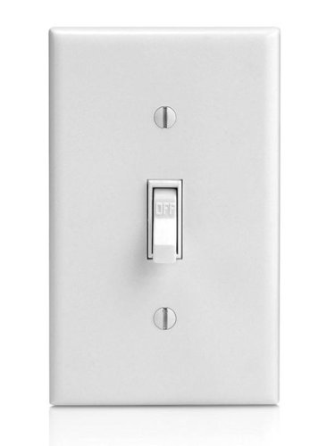
The Switch state machine
Activate, Toggle
Activate
off
on
Deactivate
Deactivate, Toggle
Activate
Activate
Toggle
Toggle
off
on
on
off
on

Slide 11
The Switch state machine
Activate, Toggle
predicate Activate(v:Variables, v':Variables) {
v'.switch == On
}
predicate Deactivate(v:Variables, v':Variables) {
v'.switch == Off
}
predicate Toggle(v:Variables, v':Variables) {
v'.switch == if v.switch.On? then Off else On
}
predicate Next(v:Variables, v':Variables) {
|| Activate(v, v')
|| Deactivate(v, v')
|| Toggle(v, v')
}
Activate
off
on
Deactivate
Deactivate, Toggle
datatype SwitchState = On | Off
datatype Variables =
Variables(switch:SwitchState)
predicate Init(v:Variables) {
v.switch == Off
}

Slide 12
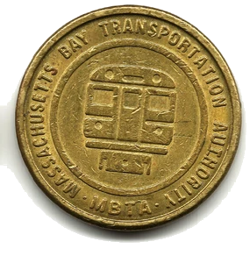
The Game of Nim
Play(1)
Play(3)
Play(2)
Play(4)
11
10
7
5
1

Slide 13
The Nim state machine
datatype Variables = Variables(tokens:nat)
predicate Init(v:Variables) {
v.tokens > 0
}
predicate Play(v:Variables, v':Variables, take:nat) {
&& 1 <= take <= 4
&& take <= v.tokens
&& v'.tokens == v.tokens - take
}
predicate Next(v:Variables, v':Variables)
{
exists take :: Play(v, v', take)
}
enabling condition
“update”

Slide 14
Play(1)
Play(3)
Play(2)
Play(4)
11
10
7
5
1
11
10
9
8
7
0
!Init()
11
10
11
8
7
!Next()

Slide 15
A state is an assignment of values to variables
datatype Card = Shelf | Patron(name: string) datatype Book = Book(title: string) type Library = map<Book, Card>
The state space is the set of possible assignments.
The Martian: Shelf Snow Crash: Shelf
The Martian: Jon Snow Crash: Jon
The Martian: Shelf Snow Crash: Jon
The Martian: Manos Snow Crash: Jon
Notes:
A state space is a type (think C struct).
A state is an assignment of values to variables in the type (think C struct literal).
For many practical state definitions, many states might be nonsense.

Slide 16
An execution is an infinite sequence of states
check out
check out
check in
check out
The Martian: Shelf Snow Crash: Shelf
The Martian: Shelf Snow Crash: Jon
The Martian: Manos Snow Crash: Jon
The Martian: Shelf Snow Crash: Jon
The Martian: Rob Snow Crash: Jon
check out
check in
check out
check in
The Martian: Shelf Snow Crash: Shelf
The Martian: Jon Snow Crash: Shelf
The Martian: Shelf Snow Crash: Shelf
The Martian: Rob Snow Crash: Shelf
The Martian: Shelf Snow Crash: Shelf
check out
???
The Martian: Shelf Snow Crash: Shelf
The Martian: Shelf Snow Crash: Jon
The Martian: Shelf Snow Crash: Rob
Notes:
A behavior is an infinite sequence of states.
A given state space (struct) implies a set of all possible behaviors: all infinite sequences of states in any order.
Intuitively, almost all of those behaviors are useless. A specification is a subset of behaviors that we care about.
A safety violation happens at a single state.
A liveness violation requires the infinite behavior. We’re not going to say anything more about liveness this week.

Slide 17
A behavior is the set of all possible executions
check out
check out
check in
check out
The Martian: Shelf Snow Crash: Shelf
The Martian: Shelf Snow Crash: Jon
The Martian: Manos Snow Crash: Jon
The Martian: Shelf Snow Crash: Jon
The Martian: Rob Snow Crash: Jon
check out
check in
check out
check in
The Martian: Shelf Snow Crash: Shelf
The Martian: Jon Snow Crash: Shelf
The Martian: Shelf Snow Crash: Shelf
The Martian: Rob Snow Crash: Shelf
The Martian: Shelf Snow Crash: Shelf
check out
???
The Martian: Shelf Snow Crash: Shelf
The Martian: Shelf Snow Crash: Jon
The Martian: Shelf Snow Crash: Rob
Notes:
A behavior is an infinite sequence of states.
A given state space (struct) implies a set of all possible behaviors: all infinite sequences of states in any order.
Intuitively, almost all of those behaviors are useless. A specification is a subset of behaviors that we care about.
A safety violation happens at a single state.
A liveness violation requires the infinite behavior. We’re not going to say anything more about liveness this week.

Slide 18
How should we define a behavior?
With a program?
Its variables define its state space
Its executions define its behavior
Weaknesses:
concreteness
nondeterminism
asynchrony
environment

Slide 19
How should we define a behavior?
With a state machine
Its type defines its state space
Its initial states and transitions define its behavior

Slide 20
A state machine definition
datatype Card = Shelf | Patron(name: string) datatype Book = Book(title: string) type Library = map<Book, Card>
predicate Init(v: Library) {
forall book | book in v :: v[book] == Shelf
}
predicate CheckOut(v : Library, v’ : Library, book: Book, name: string) {
&& book in v
&& v[book] == Shelf
&& (forall book | book in v :: v[book] != Patron(name))
&& v’ == v[book := Patron(name)]
}
predicate CheckIn(v : Library, v’ : Library, book: Book, name: string) {
&& book in v
&& v[book] == Patron(name)
&& v’ == v[book := Shelf]
}
predicate Next(v: Library, v’: Library) {
|| (exists book, name :: CheckOut(v, v’, book, name))
|| (exists book, name :: CheckIn(v, v’, book, name))
}
enabling condition
“update”
Nondeterministic
definition

Slide 21
A behavior is the set of all possible executions
predicate CheckOut(v, v’, book, name) {
&& book in v
&& v[book] == Shelf
&& (forall book | book in v :: v[book] != Patron(name))
&& v’ == v[book := Patron(name)]
}
predicate CheckIn(v, v’, book, name) {
&& book in v
&& v[book] == Patron(name)
&& v’ == v[book := Shelf]
}
check out
???
The Martian: Shelf Snow Crash: Shelf
The Martian: Shelf Snow Crash: Jon
The Martian: Shelf Snow Crash: Rob
Notes:
A behavior is an infinite sequence of states.
A given state space (struct) implies a set of all possible behaviors: all infinite sequences of states in any order.
Intuitively, almost all of those behaviors are useless. A specification is a subset of behaviors that we care about.
A safety violation happens at a single state.
A liveness violation requires the infinite behavior. We’re not going to say anything more about liveness this week.

Slide 22
State machine limitations
Note that neither programs nor state machines can define every possible behavior (think uncomputable functions).
But they’re plenty powerful for our practical goals of modeling
programs
adversarial components of the environment
distributed systems
desired application behavior

Slide 23
State machine strengths
Abstraction
States can be abstract
Model an infinite map instead of an efficient pivot table
Next predicate is nondeterministic:
Implementation may only select some of the choices
Can model Murphy’s law (e.g. crash tolerance) or an adversary

Slide 24
State machine strengths
Abstraction
Asynchrony
Each step of a state machine is conceptually atomic
Interleaved steps capture asynchrony: threads, host processes, adversaries
Designer decides how precisely to model interleaving; can refine/reduce

Slide 25
State machine strengths
Abstraction
Asynchrony
Environment
Model a proposed program with one state machine (verified)
Model adversarial environment with another (trusted)
Compound state machine models their interactions (trusted)
System (environment assumption)
Filesystem
(program to verify)
Disk
(environment assumption)

Slide 26
State machine strengths
Abstraction
Asynchrony
Environment
Model a proposed program with one state machine (verified)
Model adversarial environment with another (trusted)
Compound state machine models their interactions (trusted)
System (environment assumption)
Filesystem
(program to verify)
Disk
(environment assumption)

Slide 27
Chapter 4: Proving properties
Expressing a system as a state machine allows us to prove that it has certain properties
We will focus on safety properties
Basic tool: induction
Show that the property holds on state 0
Show that if the property holds on state k, it must hold on state k+1
0
1
2
…
k
k+1
3

Slide 28
Let’s prove a safety invariant!
predicate Safety(v:Library) {
true // TBD
}
lemma SafetyProof()
ensures forall v :: Init(v) ==> Safety(v)
ensures forall v, v' :: Safety(v) && Next(v, v') ==> Safety(v')
{
}
Base case
Inductive Step

Slide 29
Let’s prove a safety invariant!
Interactive proof development in editor
Bisection debugging,
case analysis,
existential instantiation

Slide 30
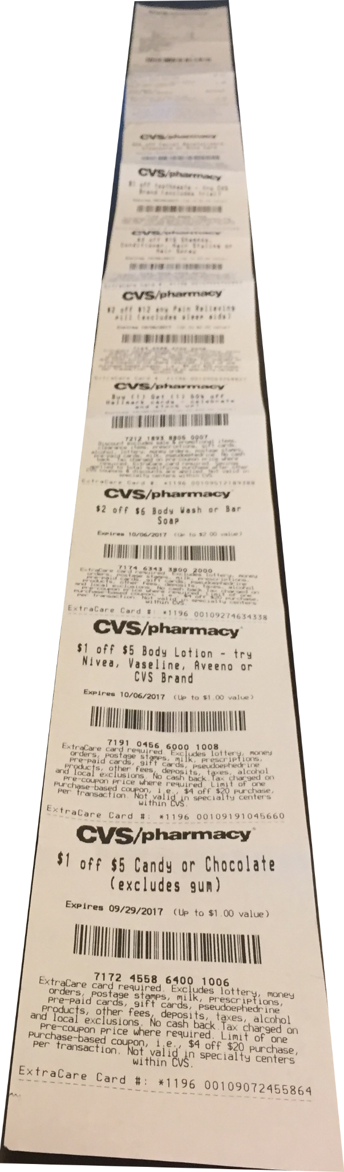
Jay Normal Form
As you begin writing more interesting specs proofs will be nontrivial.
Pull all the nondeterminism into one place, and get a receipt.
image: flickr/afagen CC-by-nc-sa

