Slide 1
Reading Report & LAB
Wei Gao

Slide 2
Papers
Hyperkernel: Push-Button Verification of an OS Kernel
The Scalable Commutativity Rule Designing Scalable Software for Multicore Processors
GPUvm: Why Not Virtualizing GPUs at the Hypervisor
Locating Cache Performance Bottlenecks Using Data Profiling
My VM is Lighter (and Safer) than your Container
RID Finding Reference Count Bugs with Inconsistent Path Pair Checking

Slide 3
Papers
GPUvm: Why Not Virtualizing GPUs at the Hypervisor
Locating Cache Performance Bottlenecks Using Data Profiling

Slide 4
GPUvm: Why Not Virtualizing GPUs at the Hypervisor (USENIX ATC 2014)
Yusuke Suzuki , Shinpei Kato, Hiroshi Yamada , Kenji Kono
Yusuke SUZUKI
Web Browsers , System Software, Accelerators: GPU, FPGA, Intel Xeon Phi
Kenji Kono
Operating systems , Internet security, distributed and parallel systems, programming language systems

Slide 5
Background
GPU is not the first-class citizen of cloud computing environment and enterprise servers
Can not multiplex GPGPU among virtual machines
Can not consolidate VMs that run GPGPU applications
GPU virtualization

Slide 6
Relative Works
I/O Pass-through
minimize overhead of virtualization
Para-virtualization
Expose an ideal GPU device model to VMs
Guest device driver must be modified or rewriten

Slide 7
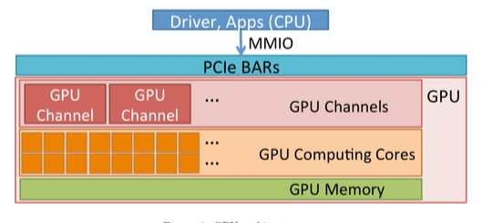
GPU

Slide 8
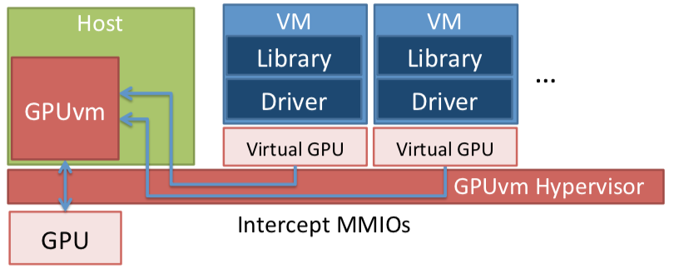
GPUvm

Slide 9
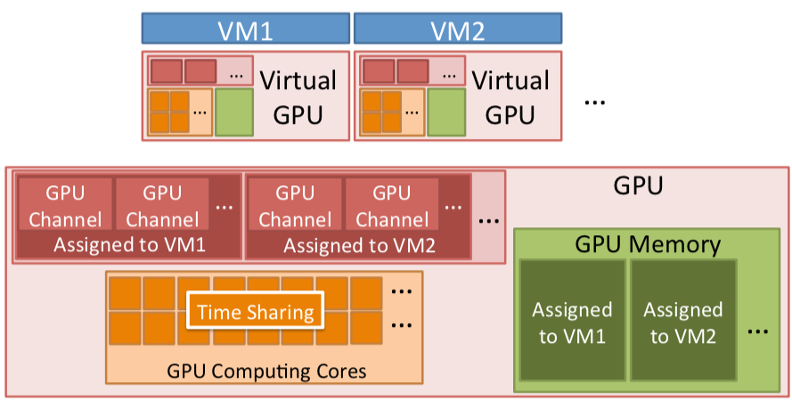
GPUvm

Slide 10
GPUvm
GPU shadow pagetable
Isolate GPU memory
GPU shadow channel
Isolate GPU channels
CPU fair-share scheduler
Isolate GPU Bme using GPU compuBng cores

Slide 11
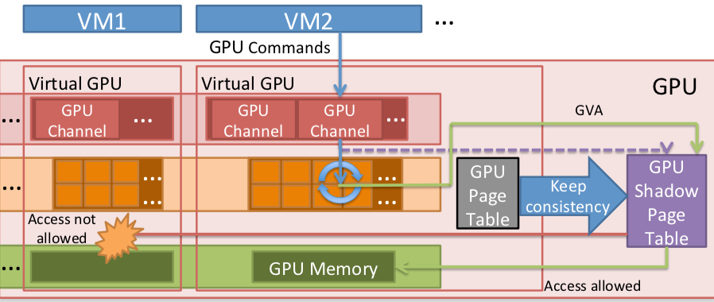
GPU Shadow Page Table

Slide 12
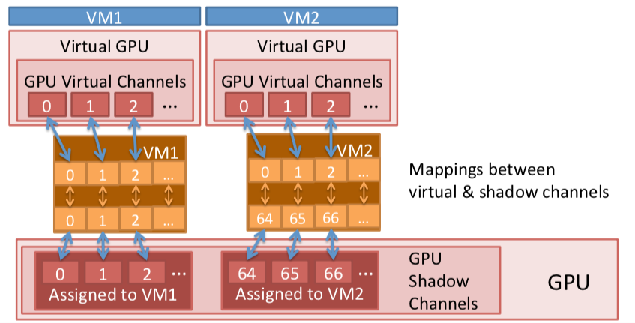
GPU Shadow Channel

Slide 13
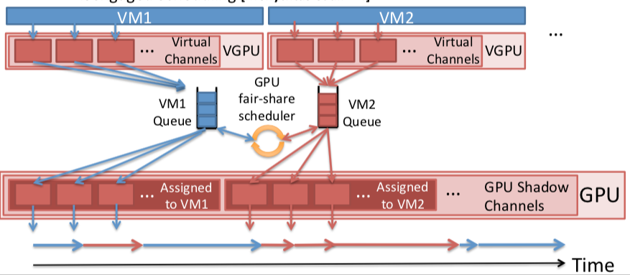
GPU Fair-Share Scheduler

Slide 14
Limitation
Full-virtualization
40X slower
Para-virtualization
2~3X slower
Scale performance
Large overhead in 4- and 8- VM case

Slide 15
Locating Cache Performance Bottlenecks Using Data Profiling (EuroSys 2010)
Aleksey Pesterev , Nickolai Zeldovich , Robert T. Morris
MIT Parallel & Distributed Operating Systems Group
Nickolai Zeldovich
building practical secure systems
Robert T. Morris
Linux kernel scalability on multicore machines

Slide 16
Background
Typical profilers attribute costs to specific code locations
cache miss spread over instructions easily appear insignificant

Slide 17
DProf
Understand cache miss costs by attributing misses to data types
Views of cache miss data, including a Data Profile

Slide 18
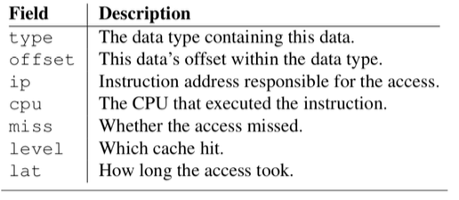
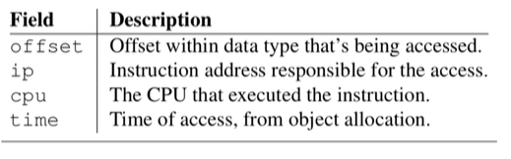
Collect
Path Traces and Address Sets
Access samples
AMD Instruction Based Sampling (IBS)
Object access histories
recording all instruction pointers that access a given object during that object’s lifetime
debug registers in Intel & AMD

Slide 19
Path Traces
Cache simulation
Address to Type Resolution
statically-allocated memory
dynamically- allocated
Path Trace Generation

Slide 20
DProf Views
Data profile
a list of data type names, “bounce” between cores
Miss classification
what types of misses are most common for each data type
Working Set
Active data types， cache associativity sets
Data flow

Slide 21
Experiments
memcached
dev queue xmit & dev hard start xmit
Bounce between cores
Improvement 57%
Notes:
核跳变

Slide 22
Limitation
Only AMD Processor
Limitation of debug registers

Slide 23
Lab of HyperKernel And Commuter
Install and bugs
run

Slide 24
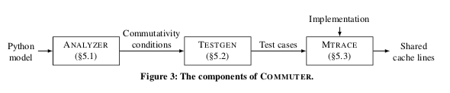
Commuter

Slide 25
Commuter
Install & bugs
17.10 pic bug
Z3
--z3-commit add8d26
mtrace
Pkg-config
linux -mtrace
Gcc 5.4
Sv6
Fellow Tan

Slide 26
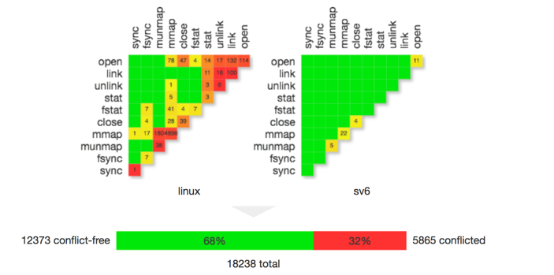
Test 10 syscalls

Slide 27
HyperKernel
Theorem 1 (Refinement). The kernel implementation is a refinement of the state-machine specification.
Theorem 2 (Crosscutting). The state-machine specifica- tion satisfies the declarative specification
Z3 Solver, LLVM IR

Slide 28
HyperKernel
Install & bugs
qemu
llvm
apt-get install llvm-5.0 llvm-5.0-dev
clang
apt-get install clang-5.0 clang-5.0-dev
Z3
python scripts/mk_make.py --prefix=/home/zhenyanjie/gaowei_zhenbao/os/z3install2 --python --pypkgdir=/home/zhenyanjie/gaowei_zhenbao/os/z3install2/lib/python-2.7/site-packages

Slide 29
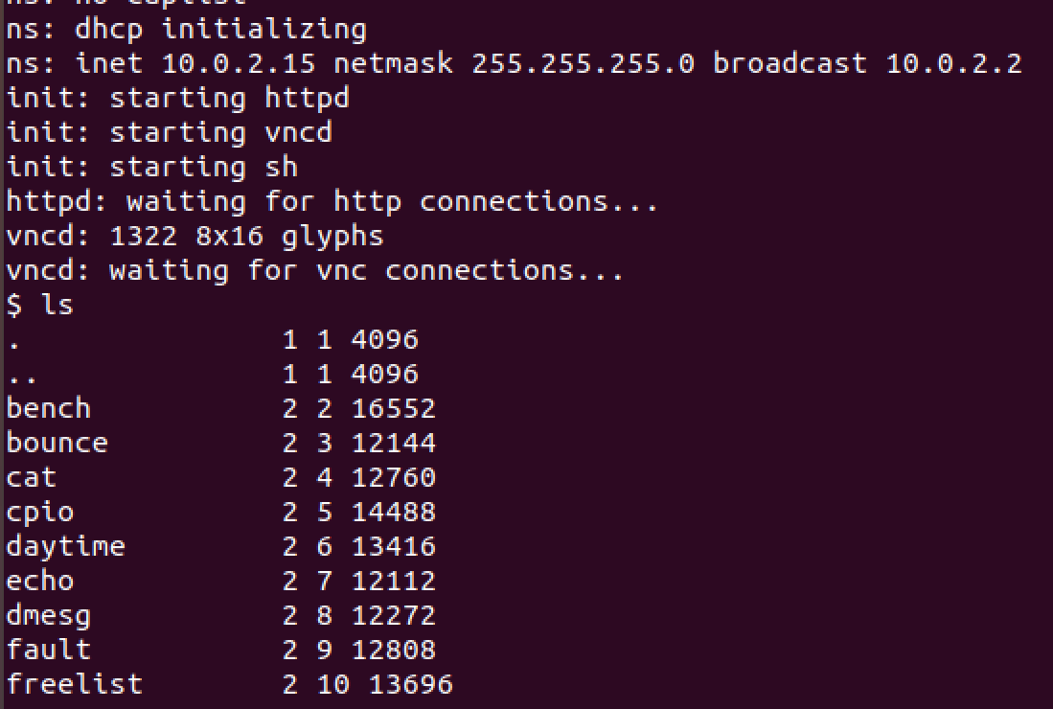
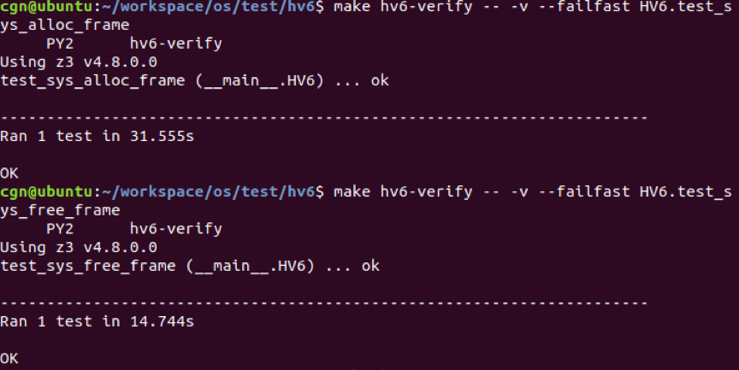
HyperKernel

Slide 30
THANKS

