Slide 1
Infosys Springboard AI-Driven Supply Chain Disruption Predictor & Inventory Optimization
Dhakshaya

Slide 2
Why Chocolate SCM
The chocolate industry is heavily dependent on cocoa production, which gets affected by climate change, price fluctuations, and supply chain issues. The raw materials over here, cocoa, are affected by droughts, the diseases and the political instability in the major producing areas (Ghana and Ivory Coast, etc.). In this regard, traditional supply chain systems are not aided with predictive analytics, thus leading to poor inventory management and loss of revenues.
Goal: Enabling AI to predict disruptions and optimize inventory decisions in the chocolate supply chain.

Slide 3
Issues Researched
Climate Change
Rising temperatures, droughts, and crop diseases affect cocoa production.
Price Fluctuations
Global cocoa prices are unstable due to economic and political instability.
Supply Chain Delay
Shipping disruptions, port congestion, and transportation failures lead to stock shortages.
Lack of Real-Time Monitoring
Traditional inventory systems are often slow to respond to market risks.

Slide 4
Solution Approach
1
2
3
4
Step 4: Notification
System
Step 1: Data Collection
Step 2: Sentiment & Risk Analysis
Step 3: Inventory Optimization
Fetch real-time news data using NewsAPI & OpenAI API
Analyze news sentiment
using Transformers to classify risks
AI-based decisions: BUY,
SELL, MONITOR
Slack API sends real-time
alerts via Slack app

Slide 5

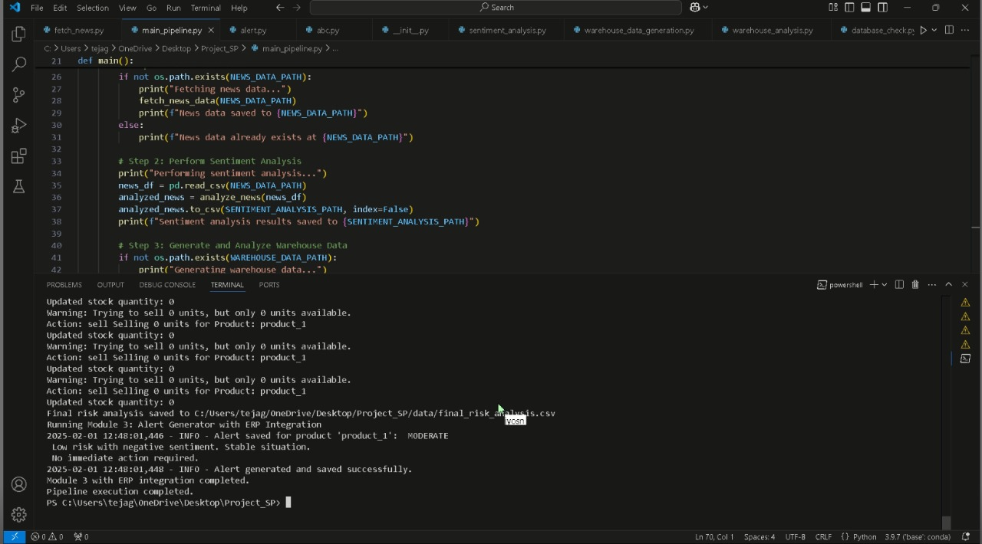

Slide 6
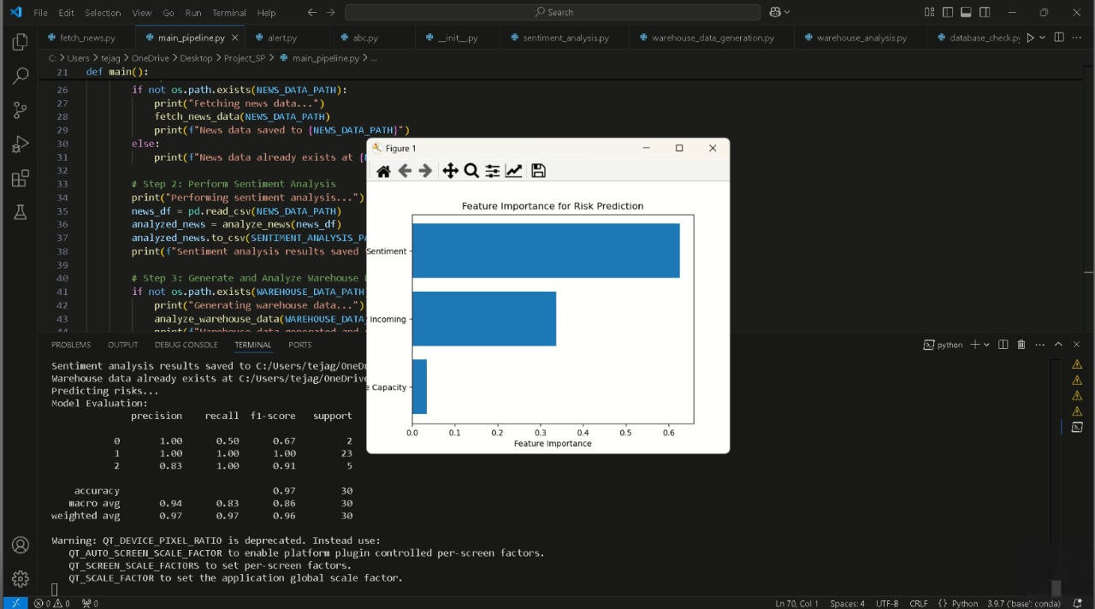

Slide 7
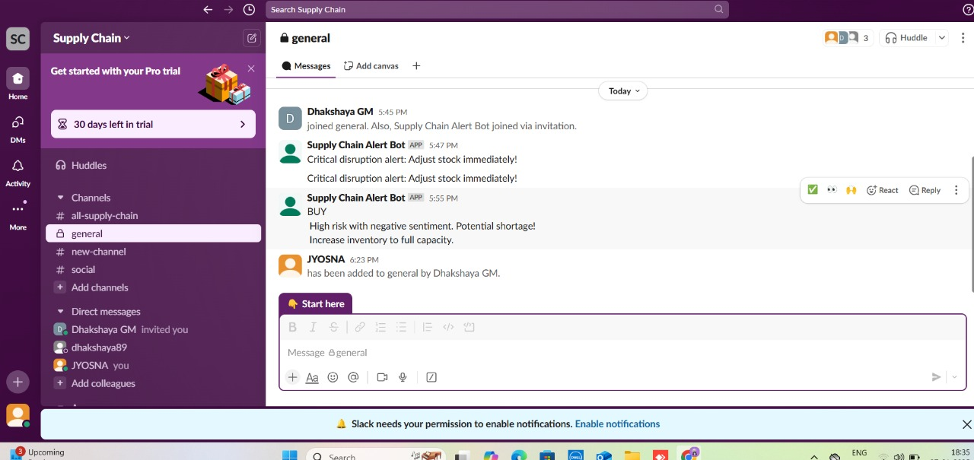

Slide 8
Future Improvements
Full ERP Integration
Advanced AI Forecasting
Geospatial Analysis
Supplier Network Expansion

Slide 9
Conclusion
Improved Resilience
Reduced Stock Fluctuations
Proactive Decision-Making
Scalability & Adaptability

Slide 10
Thank You

