Slide 1
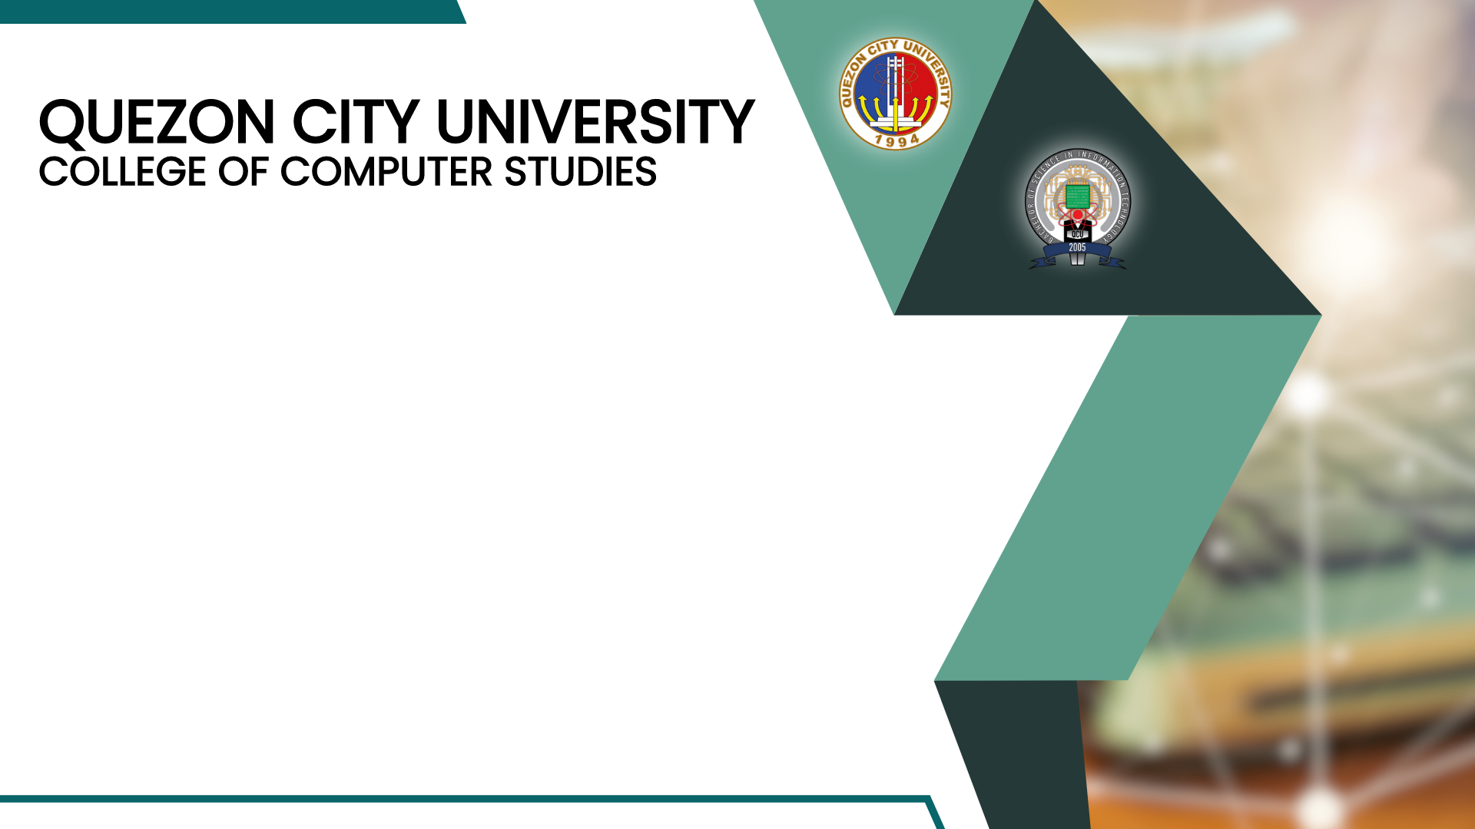
WEEK 2
SYSTEM ADMINISTRATION
OPERATING SYSTEM
SAM101 – SYSTEM ADMINISTRATION AND MAINTENANCE

Slide 2
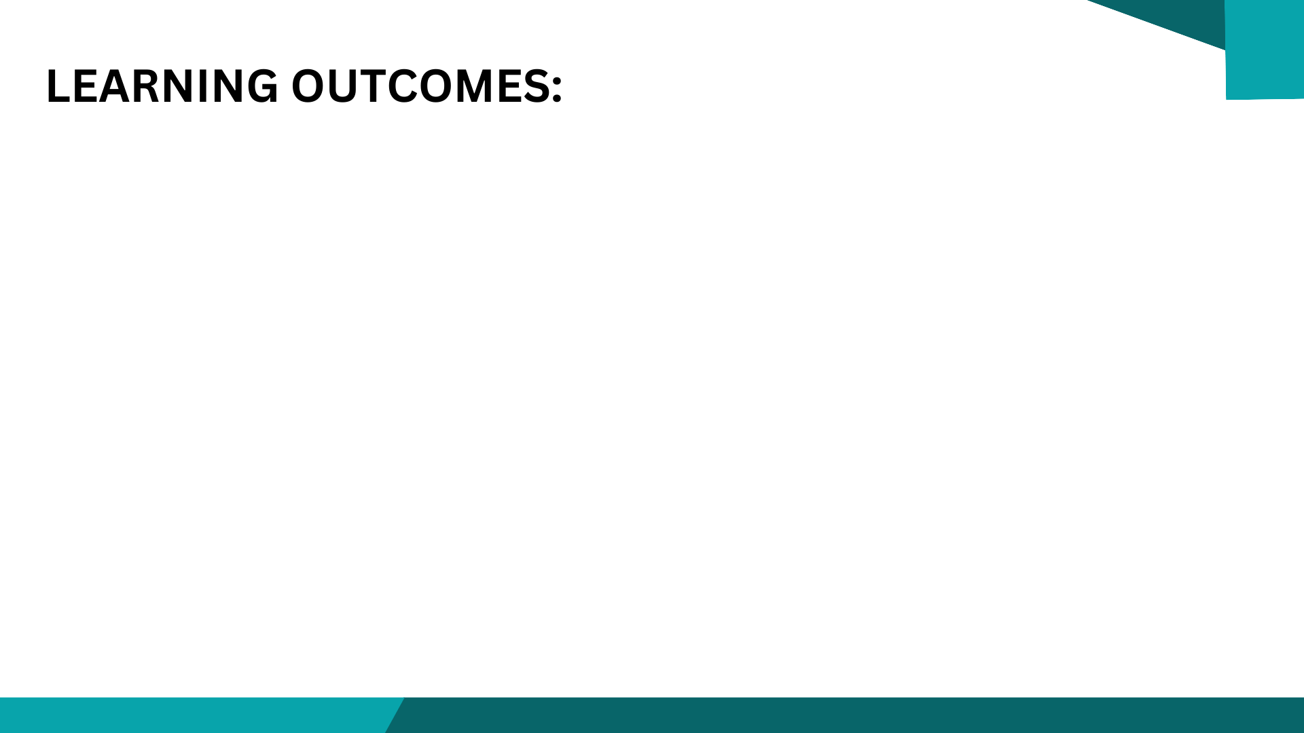
WEEK 2
At the end of this lesson, you will be able to:
Discuss the Operating System and show how to Install At least One (1) current Operating System.
Identify major Server Hardware Components.
Examine the physical specifications needed to install servers.

Slide 3

WEEK 2
SYSTEM ADMINISTRATION OPERATING SYSTEM
KEY TERMS
BIOS
clean installation
disk cloning
drives
firmware
motherboard
network connections
ports
power supply
processor
RAM
SAM101
SYSTEM ADMINISTRATION AND MAINTENANCE

Slide 4
WEEK 2
SYSTEM ADMINISTRATION OPERATING SYSTEM
KEY TERMS
server
Server Core
server features
server role
system preparation tool
unattended installation
upgrade installation
virtual server
Windows activation
Windows Deployment Services (WDS)
Windows updates
SAM101
SYSTEM ADMINISTRATION AND MAINTENANCE

Slide 5
WEEK 2
SYSTEM ADMINISTRATION OPERATING SYSTEM
UNDERSTANDING WHAT A SERVER DOES
It is a computer that is meant to be a dedicated service provider, and a client is a computer that requests services. A network that is made up of dedicated servers and clients is known as a client/server network.
A server-based network is the best network for sharing resources and data, while providing centralized network security for those resources and data. Networks with Windows Server 2003 and Windows Server 2008 are usually client/server networks.
SAM101
SYSTEM ADMINISTRATION AND MAINTENANCE

Slide 6
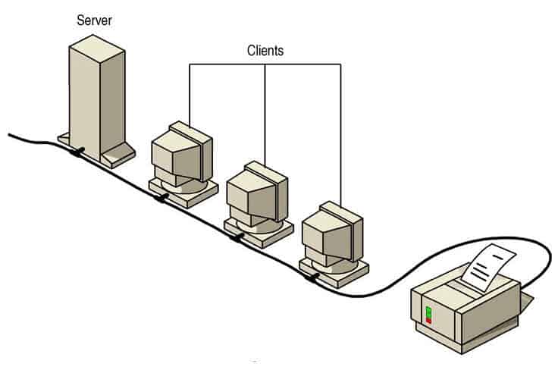
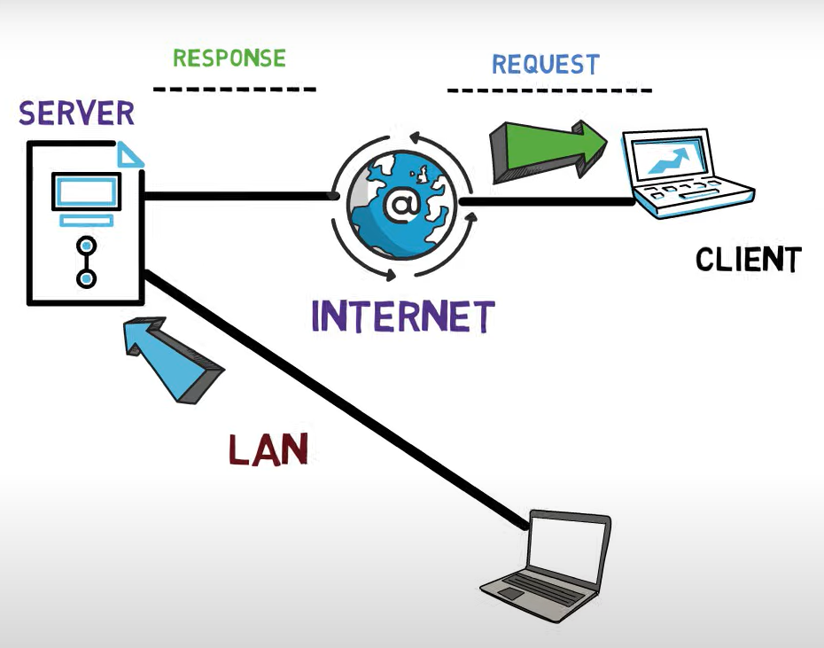
WEEK 2
SYSTEM ADMINISTRATION OPERATING SYSTEM
SAM101
SYSTEM ADMINISTRATION AND MAINTENANCE

Slide 7
WEEK 2
SYSTEM ADMINISTRATION OPERATING SYSTEM
Reminder:
Don’t forget to plan your server for growth. Most servers should be designed for three to five years of service. Be sure to envision what your landscape may look like three to five years from deployment of the server. This will help you avoid purchasing and reinstalling the server several months later.
It should also be noted that the bare basic server leaves little room for growth.
SAM101
SYSTEM ADMINISTRATION AND MAINTENANCE

Slide 8
WEEK 2
SYSTEM ADMINISTRATION OPERATING SYSTEM
SERVER ROLES
It is a primary duty that a server performs. You should note that a server could have multiple roles. Some of the more common server roles include:
File Services
Print services
Web services
Remote access
Application servers
Email server
Database server
Monitoring servers
Threat management servers
SAM101
SYSTEM ADMINISTRATION AND MAINTENANCE

Slide 9
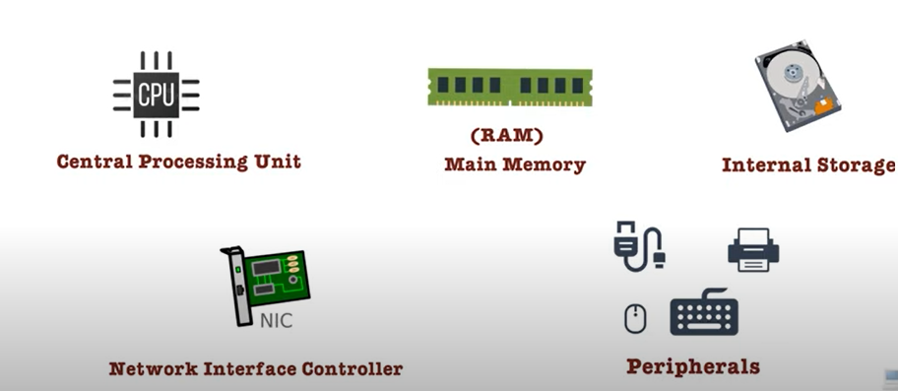
WEEK 2
SYSTEM ADMINISTRATION OPERATING SYSTEM
PRIMARY SUBSYSTEMS THAT MAKE UP A SERVER
Processor
• Memory
• Storage
• Network
If any of these fails, the entire system can fail. In addition, if any one of these is asked to do more than what it was designed for, it can cause a bottleneck that may affect performance of the entire system.
SAM101
SYSTEM ADMINISTRATION AND MAINTENANCE

Slide 10
WEEK 2
SYSTEM ADMINISTRATION OPERATING SYSTEM
PROCESSOR
The computer, including servers, is built around one or more integrated chips called the processor. It is considered the brain of the computer since all of the instructions it performs are mathematical calculations and logical comparisons.
Intel and AMD produce most of today’s processors.
SAM101
SYSTEM ADMINISTRATION AND MAINTENANCE

Slide 11
WEEK 2
SYSTEM ADMINISTRATION OPERATING SYSTEM
RAM
RAM, which stands for random access memory, is the computer’s short-term or temporary memory. It stores instructions and data that the processor accesses directly. If you have more RAM, you can load more instructions and data from the disks.
RAM can be one of the main factors in your computer’s overall performance. Unfortunately, when power is cut to the RAM, like when you shut off your PC, the contents of the RAM disappear. This is the reason you use disks rather than RAM for long-term storage.
SAM101
SYSTEM ADMINISTRATION AND MAINTENANCE

Slide 12
WEEK 2
SYSTEM ADMINISTRATION OPERATING SYSTEM
STORAGE
Traditionally, hard drives are half electronic/half mechanical devices that store magnetic fields on rotating platters.
Today, some hard drives, known as solid-state drives, are electronic devices with no mechanical components.
SAM101
SYSTEM ADMINISTRATION AND MAINTENANCE

Slide 13
WEEK 2
SYSTEM ADMINISTRATION OPERATING SYSTEM
NETWORK CONNECTIONS
The last primary component that makes up a server is the network connection. Without a network connection, the server is not able to communicate with other servers or the clients.
Most servers include one or more network interface cards or NICs. Because servers are designed to support many network connections, you must have the available bandwidth from the server. The minimum speed of today’s network cards is 100 Mbit/second, while the minimum speed for servers is 1Gbit/second or faster.
SAM101
SYSTEM ADMINISTRATION AND MAINTENANCE

Slide 14
WEEK 2
SYSTEM ADMINISTRATION OPERATING SYSTEM
SELECTING THE SOFTWARE
Software contains the instructions that the hardware follows, which make the computer do what it does. It also provides us with an interface that we can use to configure and manage the computer. With a server, you would first choose the operating system, choose the roles that the operating system provides, and then install any additional software to make the server do what you want.
SAM101
SYSTEM ADMINISTRATION AND MAINTENANCE

Slide 15
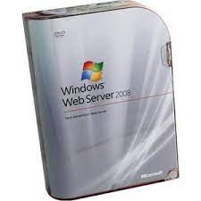
WEEK 2
SYSTEM ADMINISTRATION OPERATING SYSTEM
WINDOWS SERVER 2008 R2 FOUNDATION
It is an entry-level cost-effective technology foundation for your business designed for small business owners with less than 15 users.
SAM101
SYSTEM ADMINISTRATION AND MAINTENANCE

Slide 16
WEEK 2
SYSTEM ADMINISTRATION OPERATING SYSTEM
WINDOWS SERVER 2008 R2 STANDARD
It is an advanced server platform that provides more cost-effective and reliable support for business workloads. It offers innovative features for virtualization, power savings, and manageability and helps make it easier for mobile workers to access company resources.
SAM101
SYSTEM ADMINISTRATION AND MAINTENANCE

Slide 17
WEEK 2
SYSTEM ADMINISTRATION OPERATING SYSTEM
WINDOWS SERVER 2008 R2 ENTERPRISE
It is an advanced server platform that provides more cost-effective and reliable support for mission-critical workloads by offering an increased amount of RAM and number of processors supported and failover clustering.
SAM101
SYSTEM ADMINISTRATION AND MAINTENANCE

Slide 18
WEEK 2
SYSTEM ADMINISTRATION OPERATING SYSTEM
WINDOWS SERVER 2008 R2 DATACENTER
It delivers an enterprise-class platform for deploying business-critical applications and large-scale virtualization on small and large servers.
SAM101
SYSTEM ADMINISTRATION AND MAINTENANCE

Slide 19
WEEK 2
SYSTEM ADMINISTRATION OPERATING SYSTEM
WINDOWS WEB SERVER 2008 R2
It is a powerful web application and services platform. Featuring Internet Information Services (IIS) 7.5 and designed exclusively as an Internet facing server.
SAM101
SYSTEM ADMINISTRATION AND MAINTENANCE

Slide 20
WEEK 2
SYSTEM ADMINISTRATION OPERATING SYSTEM
PERFORMING CLEAN INSTALLATIONS
A clean installation is installing the software from scratch on a new drive or on a newly reformatted drive. Many people find that doing a clean install of an operating system is the best way to go because you are starting fresh. The disadvantage is that the system and all of its software needs to be reinstalled, patched, and configured and data copied over, something that may take hours or even days.
SAM101
SYSTEM ADMINISTRATION AND MAINTENANCE

Slide 21
WEEK 2
SYSTEM ADMINISTRATION OPERATING SYSTEM
PERFORMING AN UPGRADE
In some instances, you will want to take a current system and upgrade from an older version of Windows to Windows Server 2008 R2. You can upgrade (using an upgrade installation) from the previous versions of Windows to Windows Server 2008 R2
Unfortunately, you cannot perform an in-place upgrade from 32-bit
to 64-bit architecture since all editions of Windows Server 2008 R2 are 64-bit only. You also cannot upgrade from one language to another.
SAM101
SYSTEM ADMINISTRATION AND MAINTENANCE

Slide 22
WEEK 2
SYSTEM ADMINISTRATION OPERATING SYSTEM
OVERVIEW OF DISK CLONING AND SYSTEM PREPARATION TOOL
One way to install Windows Server 2008 R2 is to use disk cloning software such as Norton Ghost to create an image file, which is a sector-by-sector copy stored in a large file. To use the disk cloning software, you use the installation disk to install Windows onto a master computer (also called reference computer), update and patch the computer, customize Windows, and install any additional software. You then use the cloning software to copy the contents of a hard drive to a file. You use the disk cloning software to copy the contents of the image to a target computer.
SAM101
SYSTEM ADMINISTRATION AND MAINTENANCE

Slide 23
WEEK 2
SYSTEM ADMINISTRATION OPERATING SYSTEM
PERFORMING AN UNATTENDED INSTALLATION
An unattended installation is an installation that requires little interaction to install. To perform an unattended installation of Windows, you would use an answer file. An answer file is an XML file that stores the answers for a series of graphical user interface (GUI) dialog boxes. The answer file for Windows Setup is commonly called autounattend. xml. Since the answer file is an XML file, you can use any text editor such as notepad to create and modify the answer file.
SAM101
SYSTEM ADMINISTRATION AND MAINTENANCE

Slide 24
WEEK 2
SYSTEM ADMINISTRATION OPERATING SYSTEM
USING WINDOWS DEPLOYMENT SERVICES
Windows Deployment Services (WDS) is a technology from Microsoft for network-based installation of Windows operating system including Windows XP, Windows Vista, Windows Server 2003, and Windows Server 2008. The deployment of Windows can be fully automated and customized through the use of unattended installation scripting files.
SAM101
SYSTEM ADMINISTRATION AND MAINTENANCE

Slide 25
WEEK 2
SYSTEM ADMINISTRATION OPERATING SYSTEM
UNDERSTANDING WINDOWS LICENSING
One of the biggest costs to any IT department is the cost of software. When you add the client copies of Windows and Office, the cost of the server operating system, and the cost of additional enterprise software such as Exchange or SQL, it can easily add up to thousands of dollars. Therefore, you need to look at your available options to get the best price for what you need to do.
SAM101
SYSTEM ADMINISTRATION AND MAINTENANCE

Slide 26
WEEK 2
SYSTEM ADMINISTRATION OPERATING SYSTEM
UNDERSTANDING WINDOWS UPDATES
After installing Windows, check whether Microsoft has any Windows updates including fixes, patches, service packs, and device drivers, and apply them to the Windows system.
By adding fixes and patches, you will keep Windows stable and secure. If there are many fixes or patches, Microsoft releases them together as a service pack or a cumulative package.
SAM101
SYSTEM ADMINISTRATION AND MAINTENANCE

Slide 27
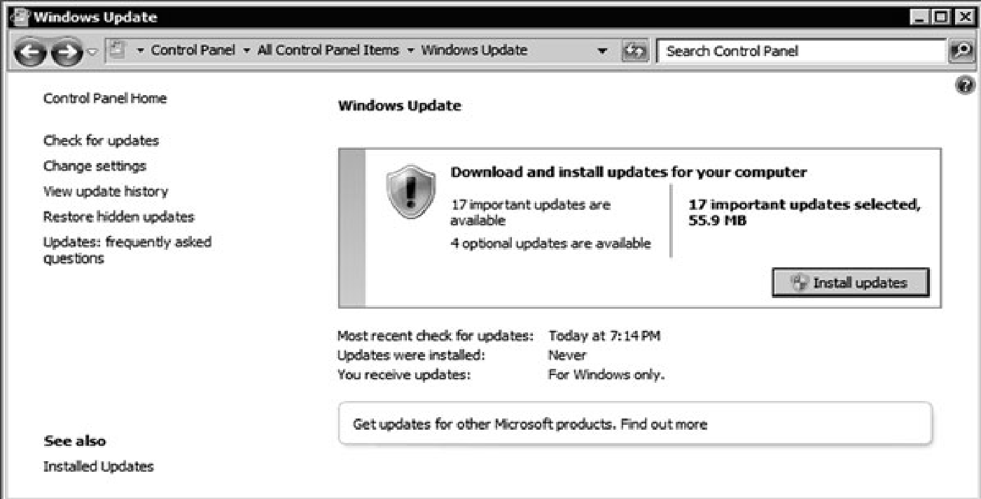
WEEK 2
SYSTEM ADMINISTRATION OPERATING SYSTEM
UNDERSTANDING WINDOWS UPDATES
SAM101
SYSTEM ADMINISTRATION AND MAINTENANCE

Slide 28
