Slide 1
VOLT MIZE × INFORMATION RETRIEVAL
01
INFORMATION RETRIEVAL • FYP-BASED IMPLEMENTATION
Finding the right energy evidence
Applying 7 retrieval models to VoltMize
QUESTION
When a factory user describes a problem, which past incident or diagnostic record should appear first?
Course presentation • 12–13 October 2026

Slide 2
VOLT MIZE × INFORMATION RETRIEVAL
02
01 • FYP PROBLEM
VoltMize turns meter streams into actionable evidence
01
02
03
04
INGEST
DETECT
EXPLAIN
ACT
Factory meter readings
Abnormal consumption
Likely cause + context
Recommended response
IR retrieval problem
Retrieve the most relevant historical evidence for a natural-language factory-energy query.

Slide 3
VOLT MIZE × INFORMATION RETRIEVAL
03
02 • RETRIEVAL REQUIREMENT
One project question, two kinds of evidence
Element | Unstructured text | Structured text
Query | “compressor abnormal high energy night shift” | “weekend no production shutdown consumption”
Document / item | Technician incident report | Diagnostic JSON record
Result | Ranked reports | Ranked records / regions
Success | Relevant incidents in top 3 | Correct diagnosis and action in top 3
Why two datasets?
The models make different assumptions about document structure, so a fair demo gives each family the data shape it was designed for.

Slide 4
VOLT MIZE × INFORMATION RETRIEVAL
04
03 • MODEL MAP
From course concepts to VoltMize datasets
UNSTRUCTURED INCIDENT REPORTS
STRUCTURED DIAGNOSTIC RECORDS
• Boolean — exact presence
• Vector Space — TF‑IDF similarity
• BIM — probability from binary evidence
• BM25 — term frequency + rarity + length
• Overlapped Lists — terms together in one region
• Non‑Overlapped Lists — terms across regions
• Proximal Nodes — nearby fields / nodes
Not treated as retrieval models: clustering and classification are supporting organization tasks.

Slide 5
VOLT MIZE × INFORMATION RETRIEVAL
05
04 • EVALUATION
Five judged queries per data type • Top‑3 evaluation
Ground truth was written before scoring: each query has an explicit relevant-document list.
PRECISION@3
RECALL@3
F1@3
MRR
nDCG@3
hits ÷ 3
hits ÷ all
P + R
first-hit rank
rank score
How clean are the first 3?
How much did we recover?
Precision + recall together
How soon is first good hit?
Rewards good ordering
Test discipline
Same tokenization • same queries • same relevance judgments • deterministic runs
This is a small classroom benchmark, so the scores demonstrate behavior—not production readiness.

Slide 6
VOLT MIZE × INFORMATION RETRIEVAL
06
DATA TYPE A
Unstructured text: 15 technician incident reports
Fictional but traceable to VoltMize events: energy anomalies, context, diagnosis, and maintenance action.
U01 • Compressor‑1 night shift anomaly
WHY IT FITS
“During the night shift Compressor‑1 drew unusually high energy. Power stayed above 92 kW while production was idle. Inspect unload valve leakage and the pressure setpoint.”
• Technicians naturally write prose
• Term frequency and rarity matter
• No reliable fields are required
• Search supports incident triage
Document = title + free-text note
5 queries • 15 documents • qrels included

Slide 7
UNSTRUCTURED TEXT
07
QUERY → EVIDENCE → SCORE → RANK
Boolean Retrieval
OR selects a document when any query term is present; every selected document ties.
QUERY
compressor abnormal high energy night shift
ANY MATCH → score 1
U01
✓ compressor ✓ high ✓ energy ✓ night ✓ shift
5 matches—but Boolean ignores count
1.000
TOP 3
1
U01
1.000
U02
✓ shift
1 match receives same score
1.000
2
U02
1.000
✓ shift
1 match receives same score
3
U03
1.000
U03
1.000
Tie shown in document-ID order.
WHY
Boolean answers MATCH / NO MATCH; it does not know that five matches are stronger than one.

Slide 8
UNSTRUCTURED TEXT
08
QUERY → EVIDENCE → SCORE → RANK
Vector Space Model
TF‑IDF turns the query and reports into vectors; cosine similarity ranks their direction.
QUERY
compressor abnormal high energy night shift
TF‑IDF → COSINE
U01
5 terms • compressor×2 • night×2 • shift×2
strong shared weighted direction
0.4365
TOP 3
1
U01
0.4365
U06
abnormal + compressor + shift
rare ‘abnormal’ adds high IDF
0.2413
2
U06
0.2413
compressor×2 + night
fewer terms, still similar
3
U11
0.2093
U11
0.2093
Largest cosine appears first.
WHY
Frequency and rarity shape the vectors; cosine compares the complete term-weight pattern.

Slide 9
UNSTRUCTURED TEXT
09
QUERY → EVIDENCE → SCORE → RANK
Binary Independence Model (BIM)
Each term is binary evidence; present rare terms contribute larger RSJ weights.
QUERY
compressor abnormal high energy night shift
PRESENT? × RARITY → SUM
U01
1 0 1 1 1 1 → five present terms
sum RSJ weights
4.7107
TOP 3
1
U01
4.7107
U06
1 1 0 0 0 1 → includes rare ‘abnormal’
rare evidence lifts score
4.4799
2
U06
4.4799
1 0 0 0 1 0 → two present terms
repetition is ignored
3
U11
2.9594
U11
2.9594
Binary vector order follows query terms.
WHY
BIM ranks by the strength of present evidence, not by how many times a word repeats.

Slide 10
UNSTRUCTURED TEXT
10
QUERY → EVIDENCE → SCORE → RANK
BM25
For every matching term: rarity × saturated frequency × length normalization.
QUERY
compressor abnormal high energy night shift
IDF × TF SATURATION × LENGTH
U01
5 terms • compressor×2 • night×2 • shift×2
rarity + repeat boost + length
7.9923
TOP 3
1
U01
7.9923
U06
abnormal + compressor + shift
rare terms; each occurs once
5.2178
2
U06
5.2178
compressor×2 + night
repeat boost, lower coverage
3
U11
4.0005
U11
4.0005
Scores use k1=1.5 and b=0.75.
WHY
BM25 rewards useful repetition but limits spam, then corrects for document length.

Slide 11
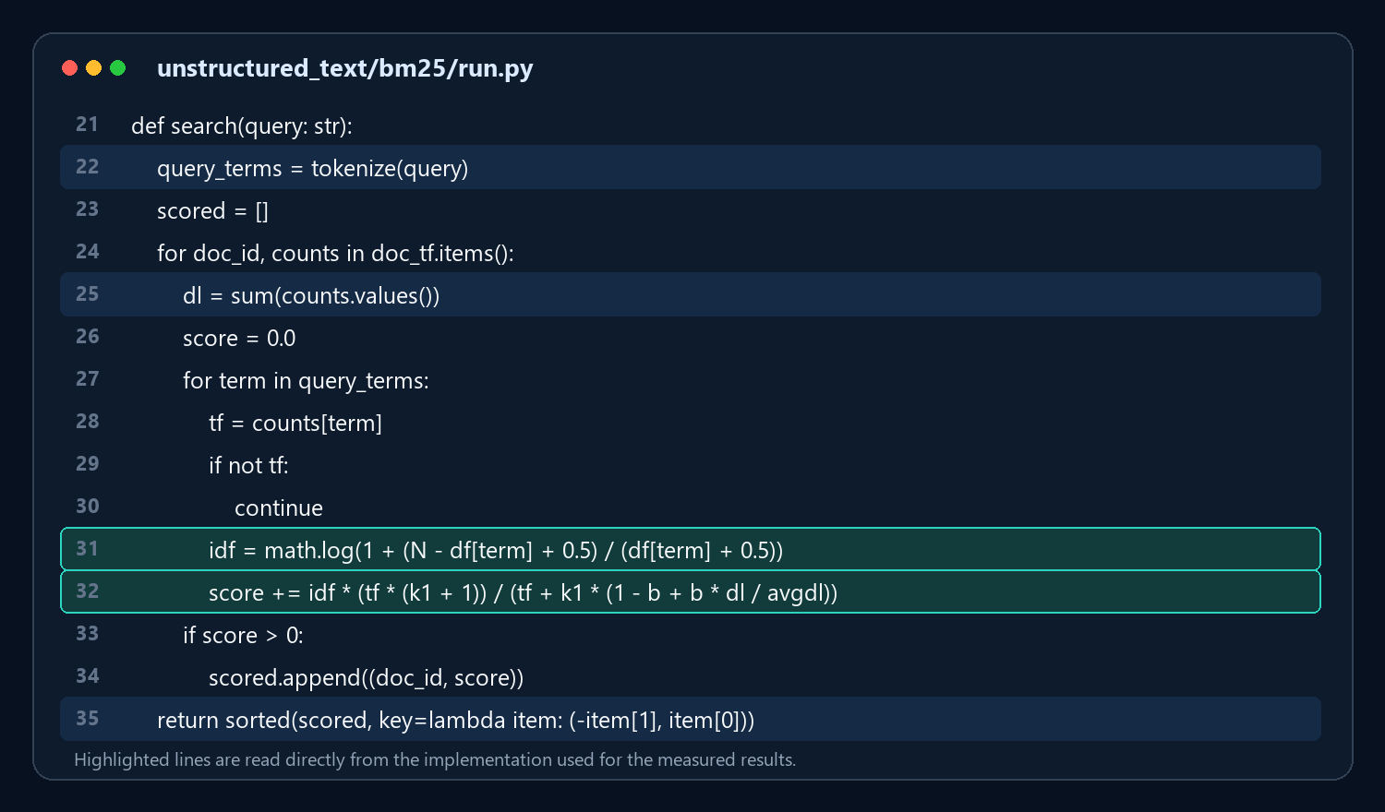
UNSTRUCTURED TEXT • IMPLEMENTATION
11
CODE → FORMULA → RANK
Where BM25 scoring happens in the real code
The highlighted lines are the implementation that generated the scores on the previous slide.
① TOKENIZE
Line 22 turns the query into terms.
② NORMALIZE
Line 25 measures document length.
③ SCORE
Lines 31–32 compute IDF and add each BM25 term score.
④ RANK
Line 35 sorts highest score first.
Same code → same scores → same top 3

Slide 12
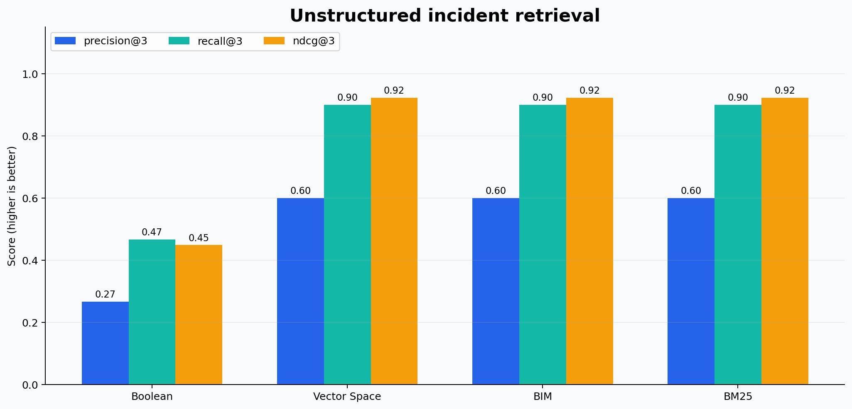
VOLT MIZE × INFORMATION RETRIEVAL
12
UNSTRUCTURED COMPARISON
Ranking changes everything
Averages across UQ1–UQ5; higher is better.
RESULT
0.923
nDCG@3 for VSM, BIM & BM25
Selection
BM25
Tie broken by practical robustness: frequency saturation and length normalization.

Slide 13
VOLT MIZE × INFORMATION RETRIEVAL
13
DATA TYPE B
Structured text: 12 diagnostic JSON records
Each record preserves the stages VoltMize needs to explain an anomaly.
equipment
Compressor‑1
WHY STRUCTURE MATTERS
summary
High energy during night shift
• The same term can occur in different fields
• Cause and action may be separated
• Region co‑occurrence changes meaning
• Tree distance can express closeness
symptoms
94 kW • idle • cycling
meter_context
night • 488 kWh
probable_cause
unload valve leakage
action
inspect valve; reduce setpoint

Slide 14
STRUCTURED TEXT
14
QUERY → EVIDENCE → SCORE → RANK
Overlapped Lists
Count query terms inside each field; only the best single field becomes the score basis.
QUERY
night shift compressor high energy cause action
MAX MATCHES IN ONE FIELD
S01
summary: night + shift + high + energy
best field = 4 → 4 + 4/7
4.5714
TOP 3
1
S01
4.5714
S03
meter_context: energy + shift
best field = 2 → 2 + 2/7
2.2857
2
S03
2.2857
meter_context: energy + night
best field = 2 → 2 + 2/7
3
S06
2.2857
S06
2.2857
S02 is relevant, but its terms are split across fields.
WHY
This model rewards co-occurrence inside one region and ignores evidence scattered elsewhere.

Slide 15
STRUCTURED TEXT
15
QUERY → EVIDENCE → SCORE → RANK
Non‑Overlapped Lists
Merge unique matches from every field, then divide matched query terms by query length.
QUERY
night shift compressor high energy cause action
UNION ACROSS FIELDS ÷ 7
S01
equipment: compressor • summary: night shift high energy
5 unique terms ÷ 7
0.7143
TOP 3
1
S01
0.7143
S03
symptoms: high • context: energy shift
3 unique terms ÷ 7
0.4286
2
S03
0.4286
equipment: compressor • symptoms/context: shift
2 unique terms ÷ 7
3
S02
0.2857
S02
0.2857
Distributed evidence lets S02 enter the top 3.
WHY
Unlike overlap, a match can be assembled from equipment, symptoms, context, cause, and action.

Slide 16
STRUCTURED TEXT
16
QUERY → EVIDENCE → SCORE → RANK
Proximal Nodes
Coverage finds the terms; node distance rewards matches that occur in the same or nearby fields.
QUERY
night shift compressor high energy cause action
2×COVERAGE + Σ 1/(1+DISTANCE)
S01
equipment[0] ↔ summary[1] ↔ context[3]
5/7 coverage + many close pairs
9.4286
TOP 3
1
S01
9.4286
S03
high[2] ↔ energy,shift[3]
3/7 coverage + 1+.5+.5
2.8571
2
S03
2.8571
energy[1,3] + night[3]
2/7 coverage + same-node pair
3
S06
1.5714
S06
1.5714
Node numbers follow the six-field record order.
WHY
Same node gives bonus 1; adjacent nodes .5; farther evidence contributes progressively less.

Slide 17
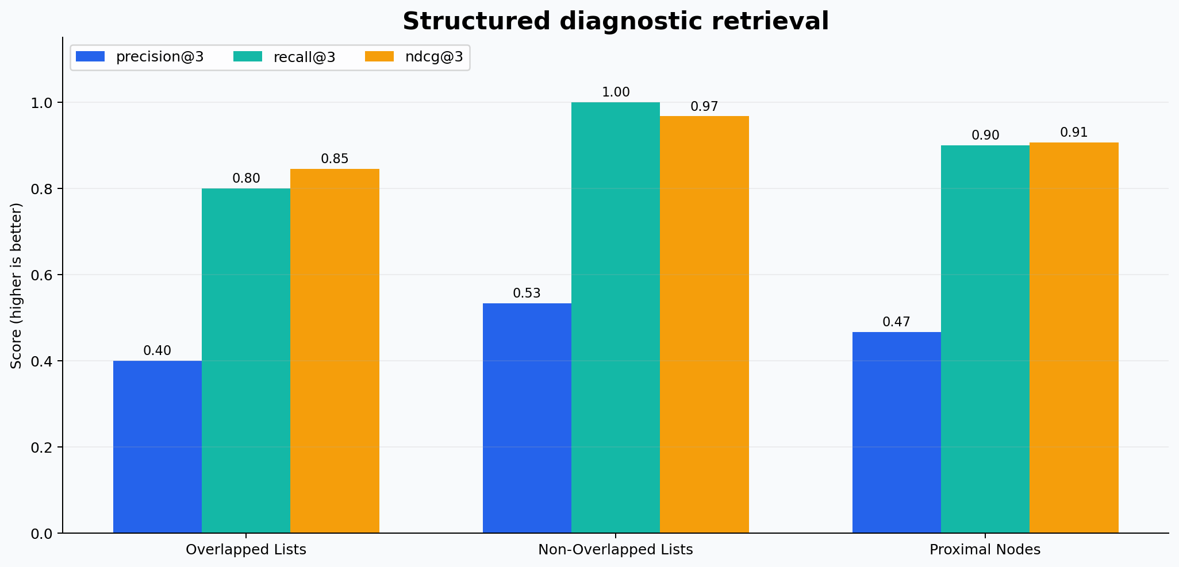
VOLT MIZE × INFORMATION RETRIEVAL
17
STRUCTURED COMPARISON
Distributed evidence favors Non‑Overlapped Lists
Averages across SQ1–SQ5; higher is better.
BEST nDCG@3
0.968
Non‑Overlapped Lists
Why?
VoltMize queries mix equipment + symptom + context + action. Those clues live in different fields.

Slide 18
VOLT MIZE × INFORMATION RETRIEVAL
18
MODEL DECISION
There is no honest single winner across different data types
We select one model per evidence shape, then choose the measured overall leader for the final demo.
FREE-TEXT REPORTS
STRUCTURED RECORDS • OVERALL LEADER
BM25
Non‑Overlapped Lists
• Tied best measured nDCG@3: 0.923
• Most robust ranking assumptions
• Recommended incident-search baseline
• Highest measured nDCG@3: 0.968
• Recall@3: 1.000
• Matches distributed diagnostic evidence

Slide 19
VOLT MIZE × INFORMATION RETRIEVAL
19
WHAT WE LEARNED
The model’s assumptions explain the results
Model behavior | Helps when… | Hurts when…
Exact presence | filters are strict | users describe problems loosely
Similarity / probability | documents are free text | field structure carries meaning
Same-region overlap | terms must co-occur | evidence spans fields
Across-region evidence | diagnosis is distributed | a phrase must stay together
Structural proximity | nearby nodes are meaningful | field order is only conventional
Core lesson
Choose a retrieval model because its assumptions match the document—not because its name sounds advanced.

Slide 20
VOLT MIZE × INFORMATION RETRIEVAL
20
APPENDIX • QUERY BANK
Ten VoltMize questions used for evaluation
UNSTRUCTURED
STRUCTURED
• UQ1 compressor abnormal high energy night shift
• UQ2 low power factor motor reactive energy
• UQ3 weekend idle consumption no production
• UQ4 temperature cooling chiller excess energy
• UQ5 missing meter readings communication
• SQ1 night shift compressor high energy cause action
• SQ2 low power factor reactive motor capacitor
• SQ3 weekend no production shutdown consumption
• SQ4 temperature chiller excess energy cause
• SQ5 missing meter readings communication action

Slide 21
VOLT MIZE × INFORMATION RETRIEVAL
21
CONCLUSION
From meter data to the right evidence
We connected course theory to a working, measured retrieval component for VoltMize.
FINAL TAKEAWAY
BM25 for incident prose. Non‑Overlapped Lists for structured diagnosis.
Retrieve → rank → evaluate → explain
Questions?

