Slide 1

Pro.io
Project for the laboratory of advanced programming course

Slide 2
The pro team
Nobile Gian Marco 1836319
D’Addetta Antonio Marco 2088804
Buracci Giovanni 2097143
Quinti Lorenzo 1869011
Lipari Alfredo 2084986

Slide 3
Project Description
The project consists of a web based game platform, where users can select one of the multiple games we will eventually propose and play with each other.
The idea came out because we wanted to create an online experience between users so they can interact and have fun!

Slide 4
Project Description (cont)
We developed the game by following the SCRUM methodology.
Starting from the requirements we created the users stories and then, by collecting them, we created different sprints for the main features, as well as introducing Quality of Life improvement.
In total we have implemented four sprints. In the next slides we will cover:
User stories
Sprint
Burndown Chart
Function Points | Cocomo II
ER Diagram
Architecture Design
Services
Screens

Slide 5
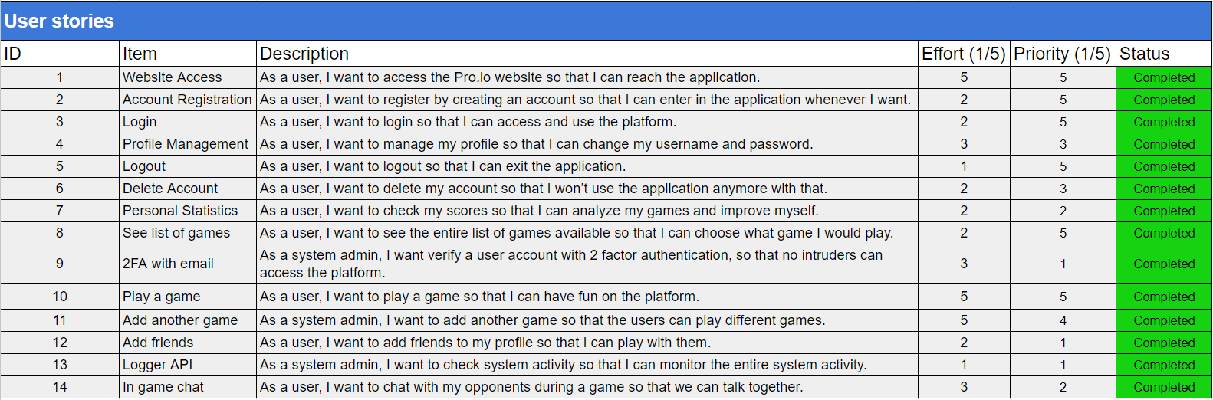
User Stories

Slide 6
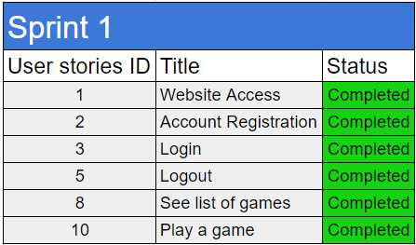
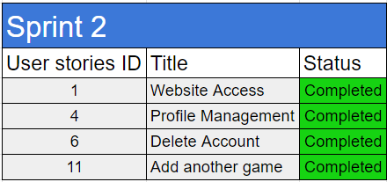
Sprints

Slide 7
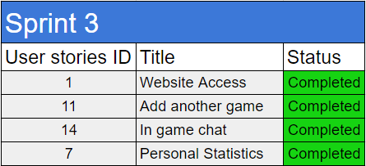
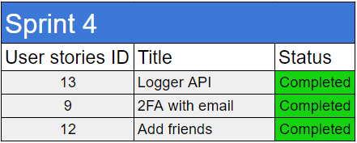
Sprints (cont)

Slide 8
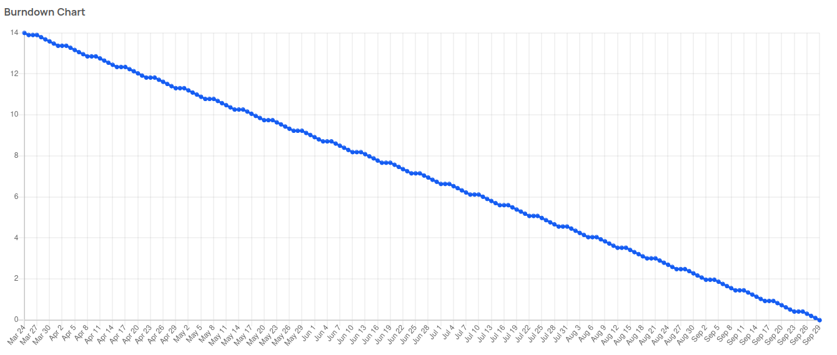
Burndown Charts

Slide 9
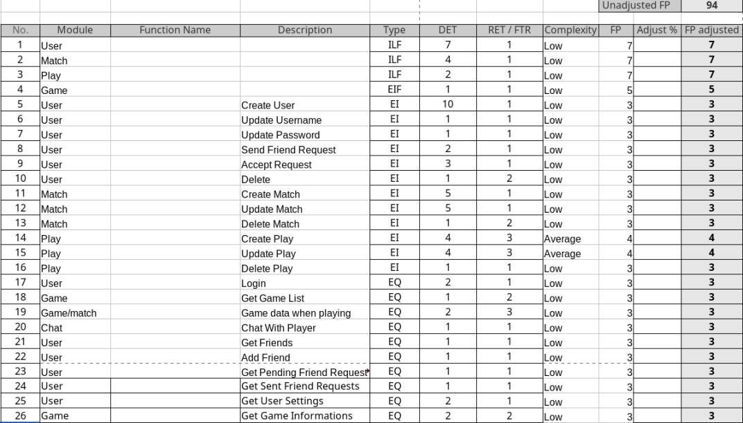
Function Points

Slide 10
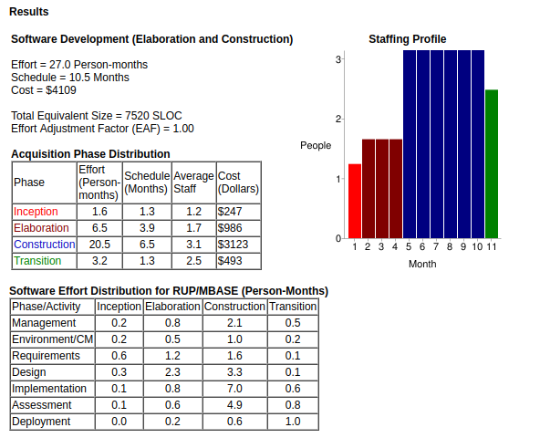
COCOMO II

Slide 11
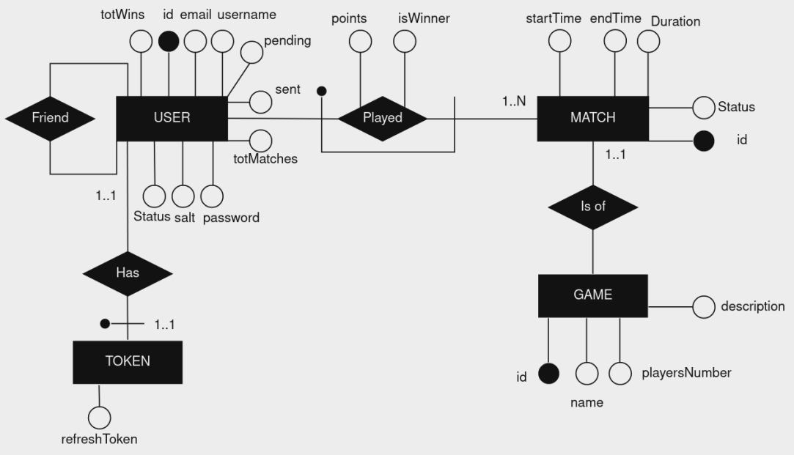
ER Diagram

Slide 12
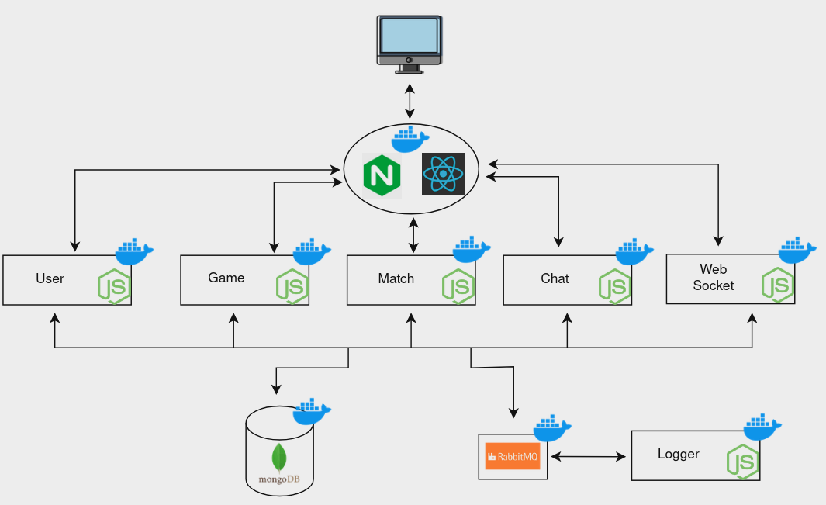
Architecture Design

Slide 13
Services
The users service is responsible of managing users informations, providing statistics and for the authentication procedures.
The game service is responsible of providing all games informations and configs.
The match service is responsible of managing the matchmaking and tracking specific information of the match, like the winner, scores, duration, ecc.
The logger is responsible of logging every event of the system and also to provide these data to system administrators.
The chat service provides users with an in-game chat during their matches.
The Web Socket services manage the multiplayer communication between clients for each game and host the game logic.
Pro.IO has 6 main services:
The users service
The game service
The match service
The logger service
The chat service
The Web Socket services

Slide 14
Technologies Employed
Backend Tools:
Node.js
Express.js
Socket.io
RabbitMQ
Nginx
MongoDB
Frontend Tools:
React
Vite
Chakra UI
Redux Toolkit
Devops/Infrastructure Tools:
Docker
GitHub
AWS(EC2)
Figma

Slide 15
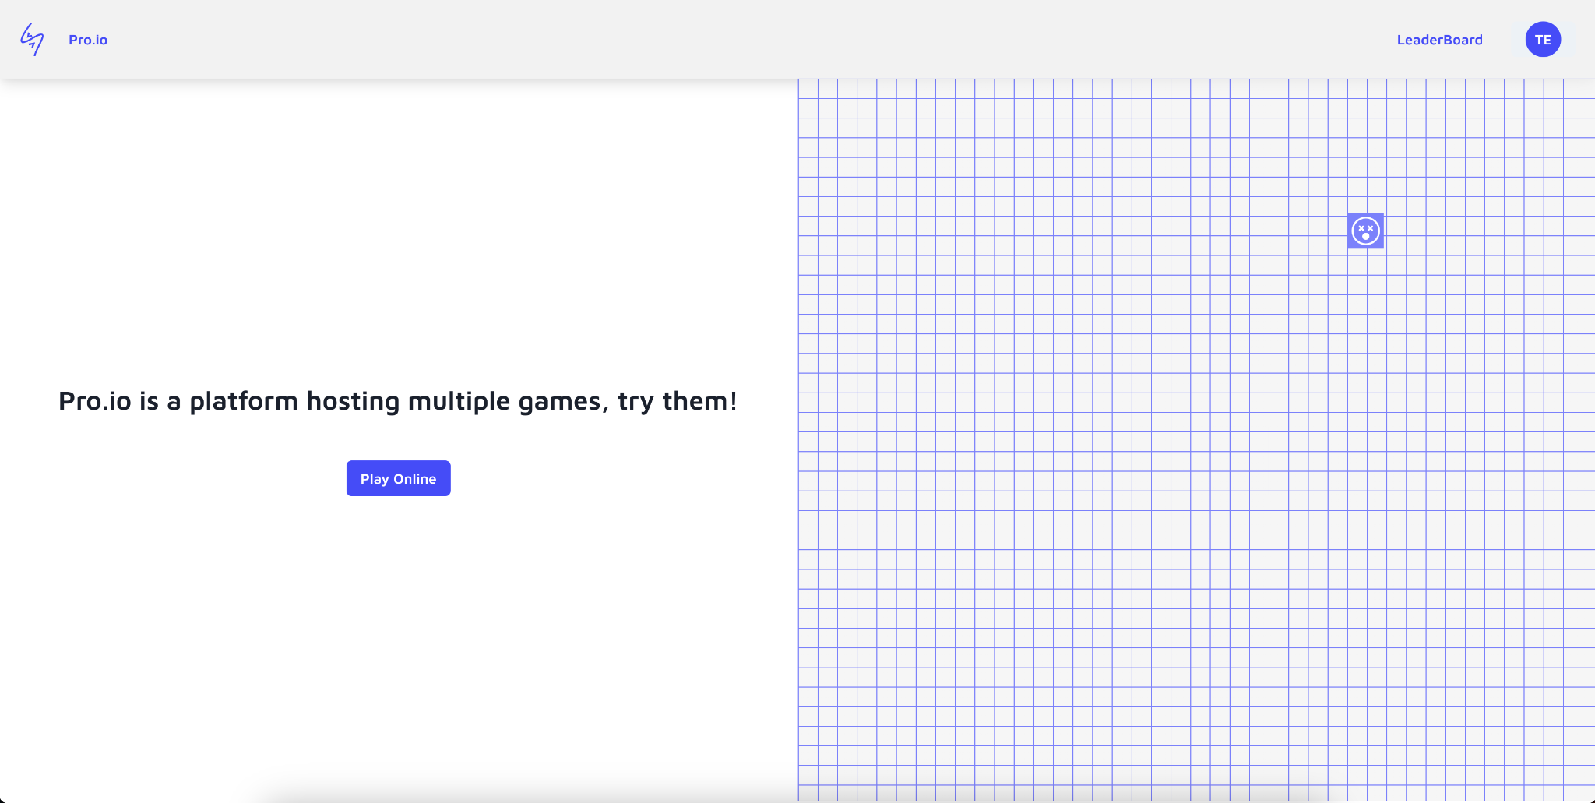
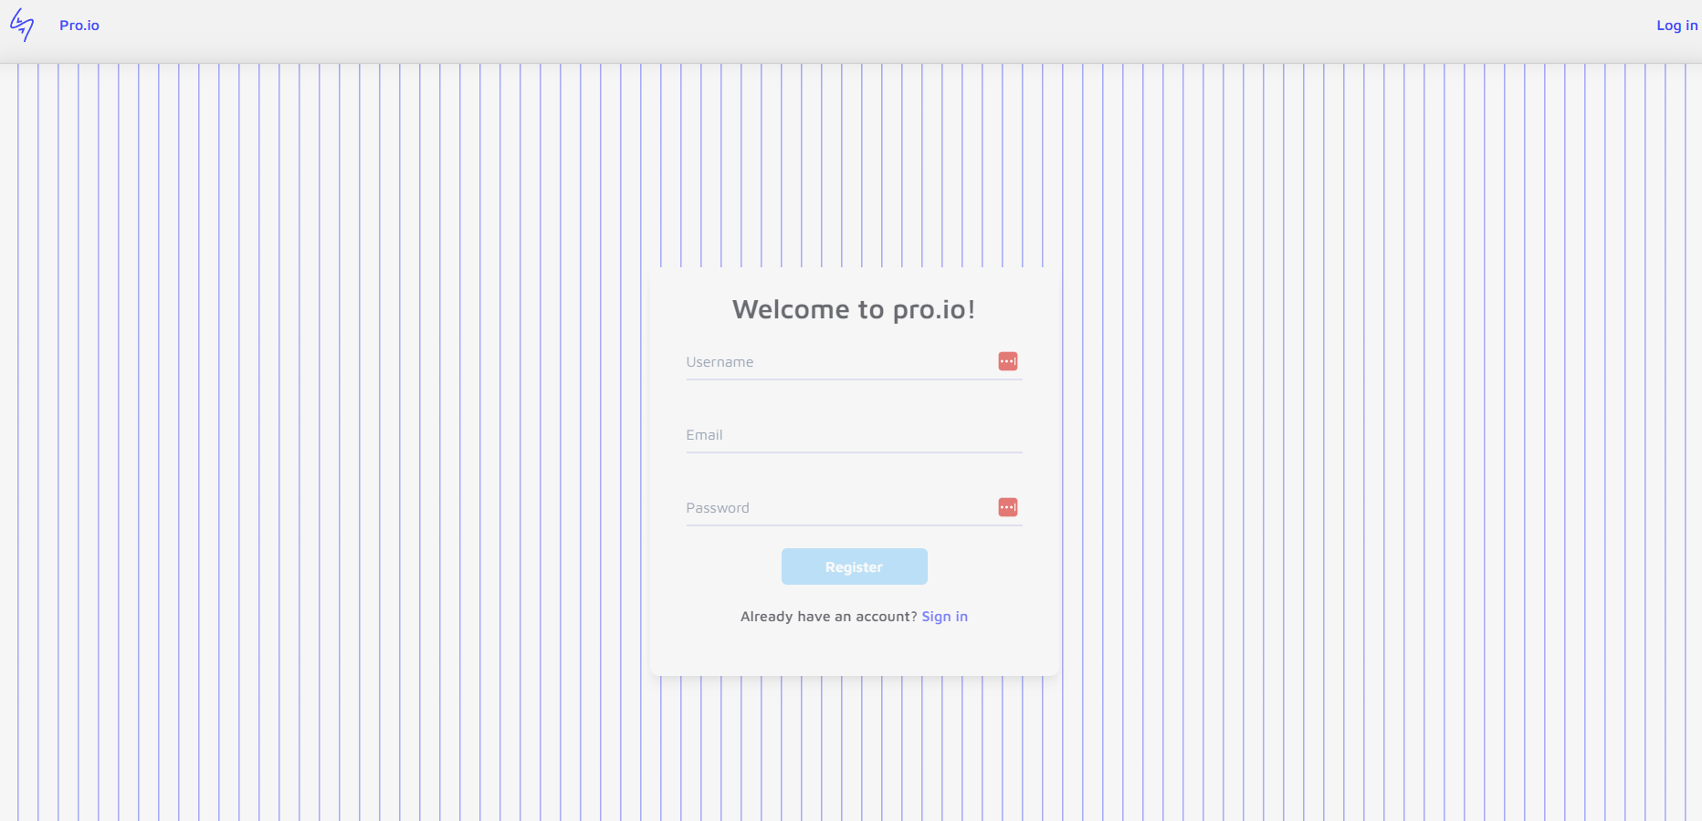
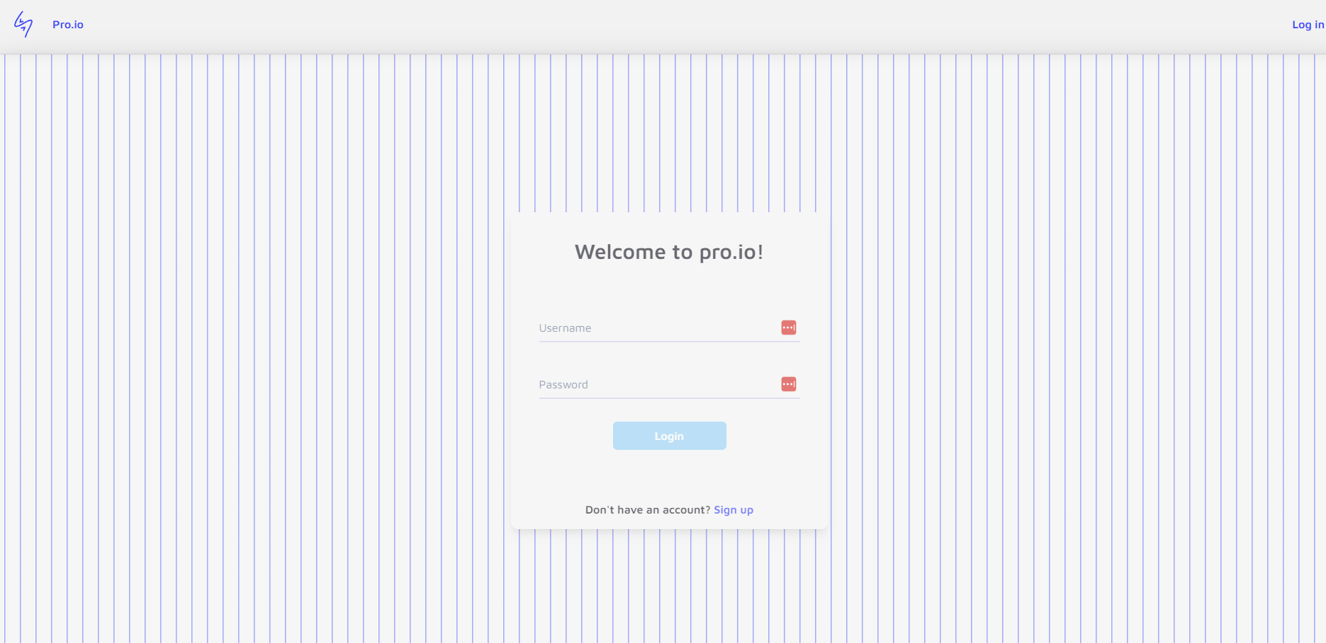
Screens - Homepage
Fig. 1 - Home Page
Fig. 3 - SignUp Page
Fig. 2 - Login Page

Slide 16
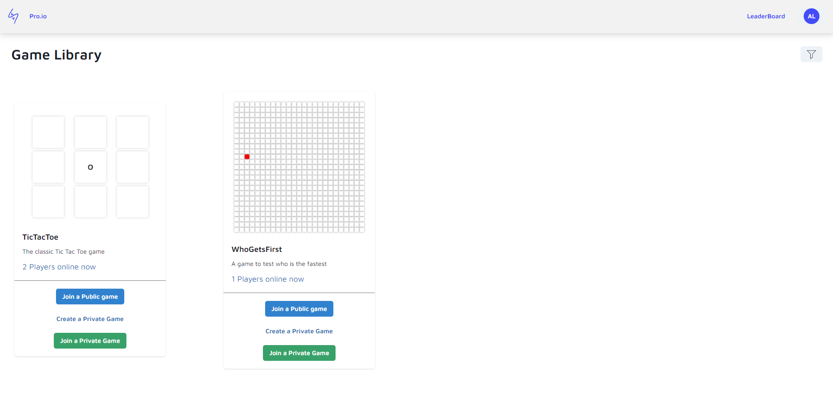
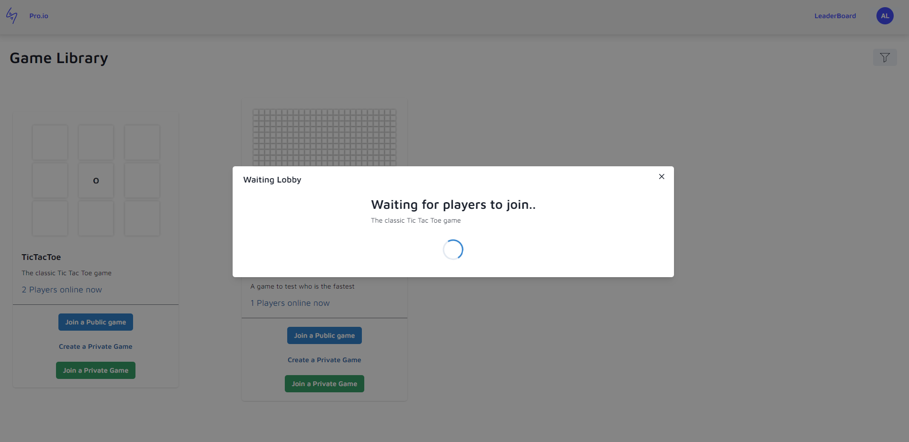
Screens 2 - Game Library
Fig. 4 - Game Library
Fig. 5 - Lobby Public Game
Here are listed all the available games with a brief description. There are the options to join a private game with a code or join a public game.

Slide 17
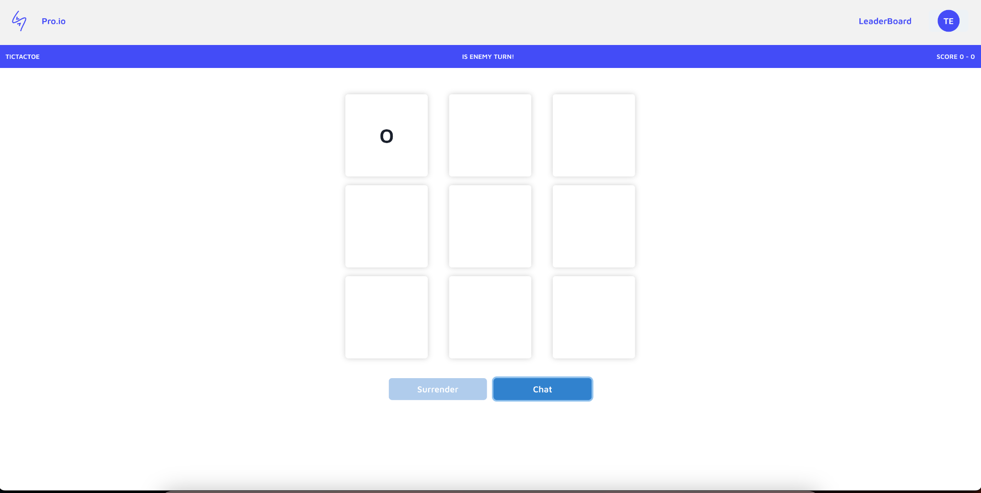
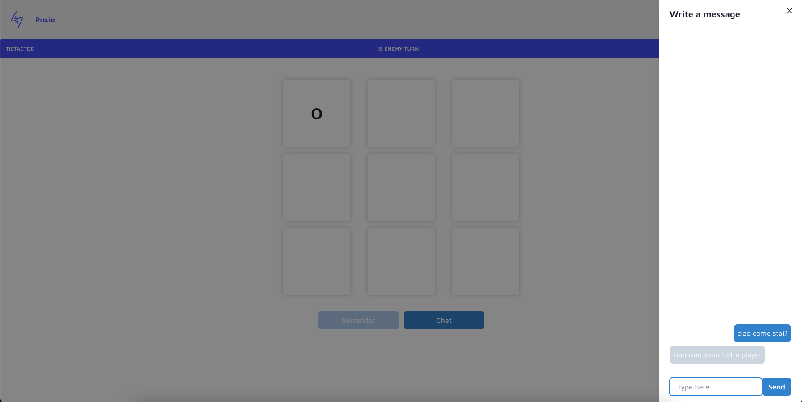
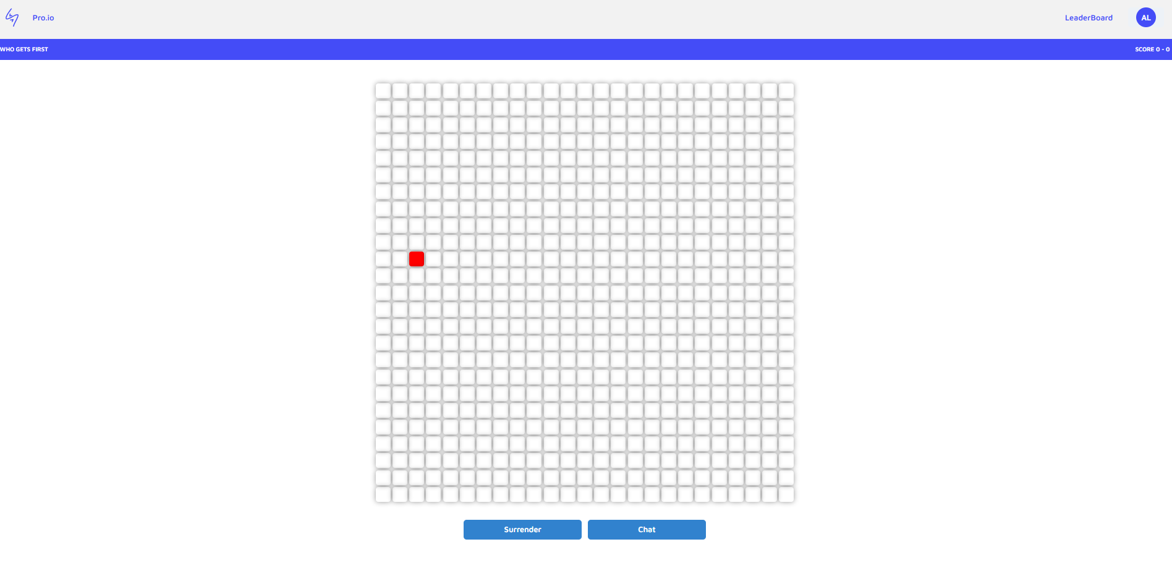
Screen 3 - In game
Fig. 6 - Game Page - Tic Tac Toe
Fig. 8 - Game Page - open chat
Fig. 7 - Game Page - Who Gets First?

Slide 18
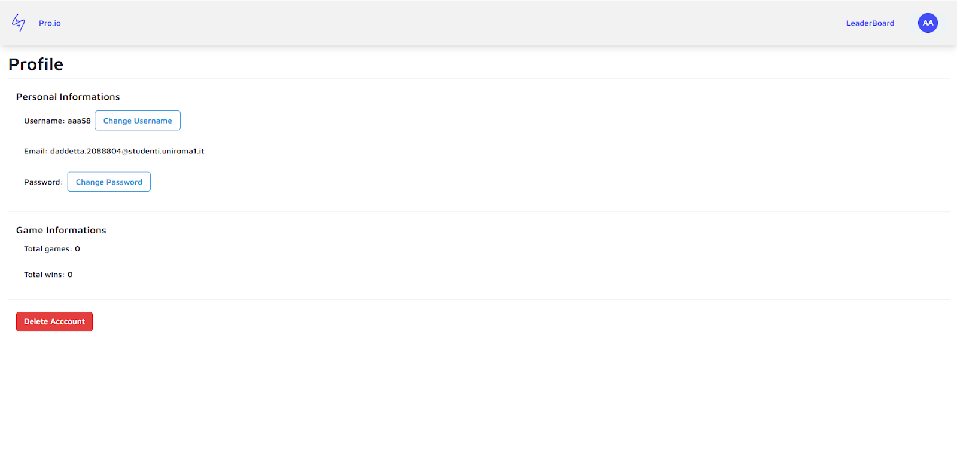
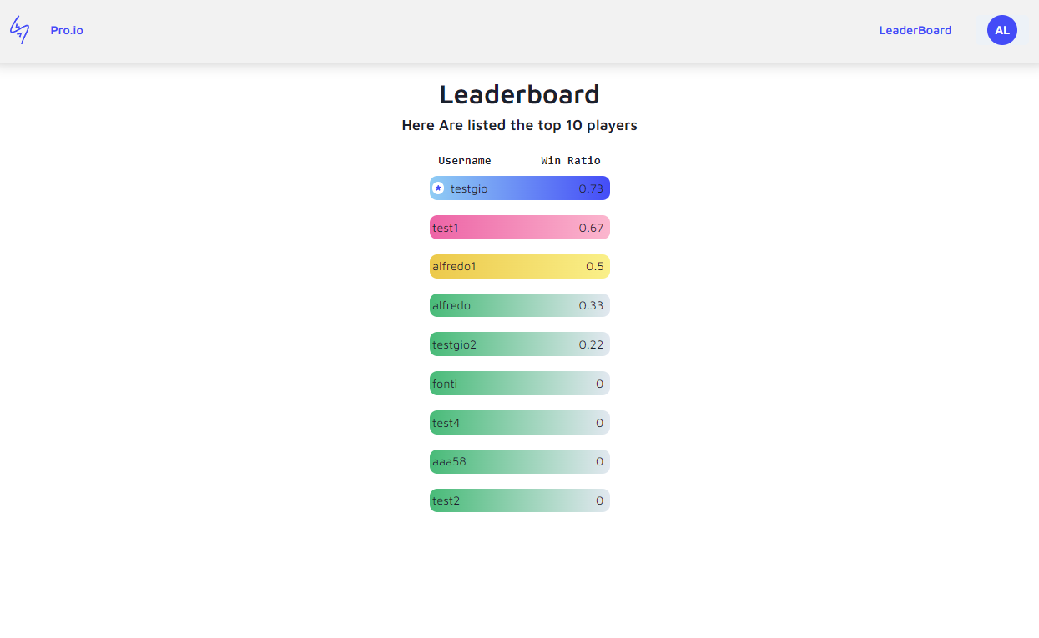
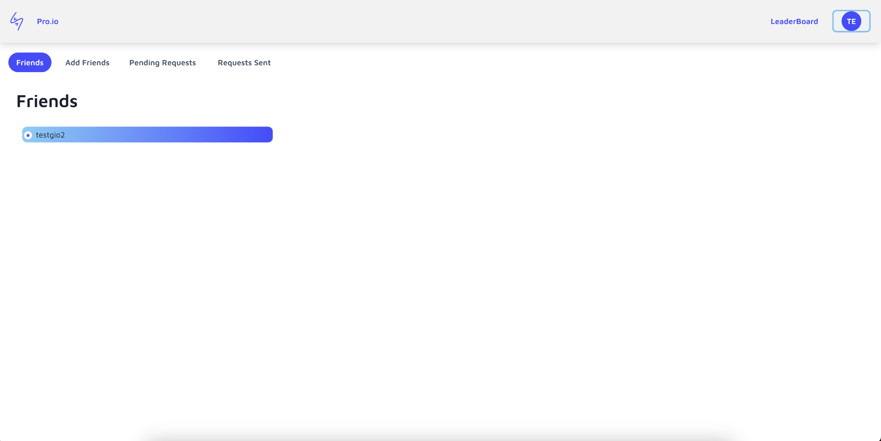
Screens 4 - UX
Fig. 9 - Profile Page
Fig. 13 - Leaderboard Page
Fig. 10 - Friends Page

Slide 19
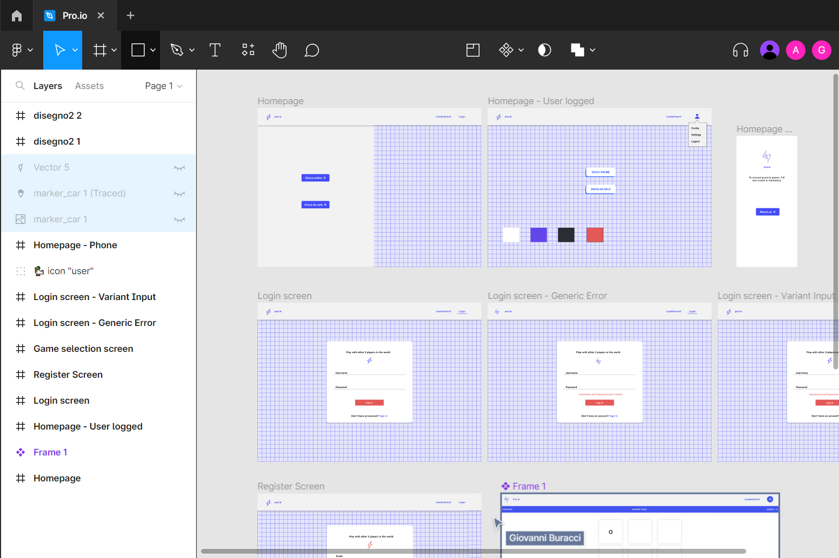
Mockup
We used Figma to create a collaborative workspace to build the mockup of the webapp
Fig. 12 - Figma UI

Slide 20
Thank you!
We hope you will have some fun now.

