Slide 1
Tripal in the Legume Genomics Community
January 11th, 2015
Tripal Workshop
Ethy Cannon
Iowa State University

Slide 2
A case study of Tripal/Chado
A description of two Tripal modules our groups are developing

Slide 3
A case study of Tripal/Chado
A description of two Tripal modules our groups are developing

Slide 4

A case study with PeanutBase and LegumeInfo
PeanutBase is a new resource funded by the Peanut Foundation. Most personnel are at Iowa State University.
LegumeInfo is the new implementation of the Legume Information System and is funded by the USDA-ARS. Most personnel are at the National Center for Genomic Resources
Both teams share some members.

Slide 5
A case study with PeanutBase and LegumeInfo
How can we share development and curation efforts across both websites and both locations?

Slide 6
A case study with PeanutBase and LegumeInfo
How can we share development and curation efforts across both websites and both locations?
Ruby on Rails?

Slide 7
Development objectives
Enable sharing of tool development, curation, and data between our two similar data portals.

Slide 8
Development objectives
Enable sharing of tool development, curation, and data between our two similar data portals.
Avoid redeveloping existing tools.

Slide 9
Development objectives
Enable sharing of tool development, curation, and data between our two similar data portals.
Avoid redeveloping existing tools.
Address the challenges of genomic/breeding data portals for small communities.

Slide 10
Development objectives
Enable sharing of tool development, curation, and data between our two similar data portals.
Avoid redeveloping existing tools.
Address the challenges of genomic/breeding data portals for small communities.
Support efforts toward standard data collection, metadata standards, schema, structures with sharable loaders and viewers.

Slide 11
An overview of our Tripal/Chado experience
☺ Created (mostly empty) websites very quickly.

Slide 12
An overview of our Tripal/Chado experience
☺ Created (mostly empty) websites very quickly.
☹ Difficult for even experienced developers to learn how to customize Drupal/Tripal, more difficult to write new modules.

Slide 13
An overview of our Tripal/Chado experience
☺ Created (mostly empty) websites very quickly.
☹ Difficult for even experienced developers to learn how to customize Drupal/Tripal, more difficult to write new modules.
☹ Chado’s flexibility makes it difficult to work with.
There are multiple ways to load the same data.
It is difficult to write custom loaders that are compatible with Tripal.
Controlled vocabularies for describing the data structures are essential but difficult to develop.

Slide 14
An overview of our Tripal/Chado experience
☺ Created (mostly empty) websites very quickly.
☹ Difficult for even experienced developers to learn how to customize Drupal/Tripal, more difficult to write new modules.
☹ Chado’s flexibility makes it difficult to work with.
There are multiple ways to load the same data.
It is difficult to write custom loaders that are compatible with Tripal.
Controlled vocabularies for describing the data structures are essential but difficult to develop.
☺ Once we got over the high hill(s), we rather suddenly found that we had useful loaders and viewers that tapped into underlying Tripal functionality and modules that were easy to share between the two websites.

Slide 15
Wish list
Chado: standards for loading common types of data (gene models, QTL, et cetera).
Tripal/Chado: improved loaders with error checking to help debug data errors.
Tripal: improved error reporting for both content management and module development.

Slide 16
Lessons learned
Deciding to use Chado does not mean your data will look like other data in Chado.

Slide 17
Lessons learned
Deciding to use Chado does not mean your data will look like other data in Chado.
It is worthwhile to take the time to do things right; it makes your data and tools more sharable and puts you in a better position to use other people’s data and tools.

Slide 18
Lessons learned
Deciding to use Chado does not mean your data will look like other data in Chado.
It is worthwhile to take the time to do things right; it makes your data and tools more sharable and puts you in a better position to use other people’s data and tools.
Don’t waste resources solving problems that have already been solved even if you don’t completely agree with the solution.

Slide 19
Lessons learned
Deciding to use Chado does not mean your data will look like other data in Chado.
It is worthwhile to take the time to do things right; it makes your data and tools more sharable and puts you in a better position to use other people’s data and tools.
Don’t waste resources solving problems that have already been solved even if you don’t completely agree with the solution.
Most important: Tripal/Chado permits productive cross-site and cross-database development, effectively increasing the size of both the LegumeInfo and PeanutBase teams.

Slide 20
A case study of Tripal/Chado
A description of two Tripal modules our groups are developing.

Slide 21
Tripal extension modules
PhyloTree – in development at LegumeInfo (Iliana Toneva, Alex Rice)
QTL – in development at PeanutBase, based on QTL module at CoolSeasonLegume.org (Ethy Cannon, Stephen Ficklin, QC by Scott Kalberer)

Slide 22
Tripal extension modules
PhyloTree – in development at LegumeInfo (Iliana Toneva, Alex Rice)
QTL – in development at PeanutBase, based on QTL module at CoolSeasonLegume.org (Ethy Cannon, Stephen Ficklin, QC by Scott Kalberer)

Slide 23
PhyloTree
For viewing phylogenetic trees of gene families.

Slide 24
PhyloTree
For viewing phylogenetic trees of gene families.
Gene families are helpful for:
doing cross-species comparative analysis,

Slide 25
PhyloTree
For viewing phylogenetic trees of gene families.
Gene families are helpful for:
doing cross-species comparative analysis,
make it possible for a poorly-characterized species like peanut to take advantage of resources for a well-characterized species like soybean.

Slide 26
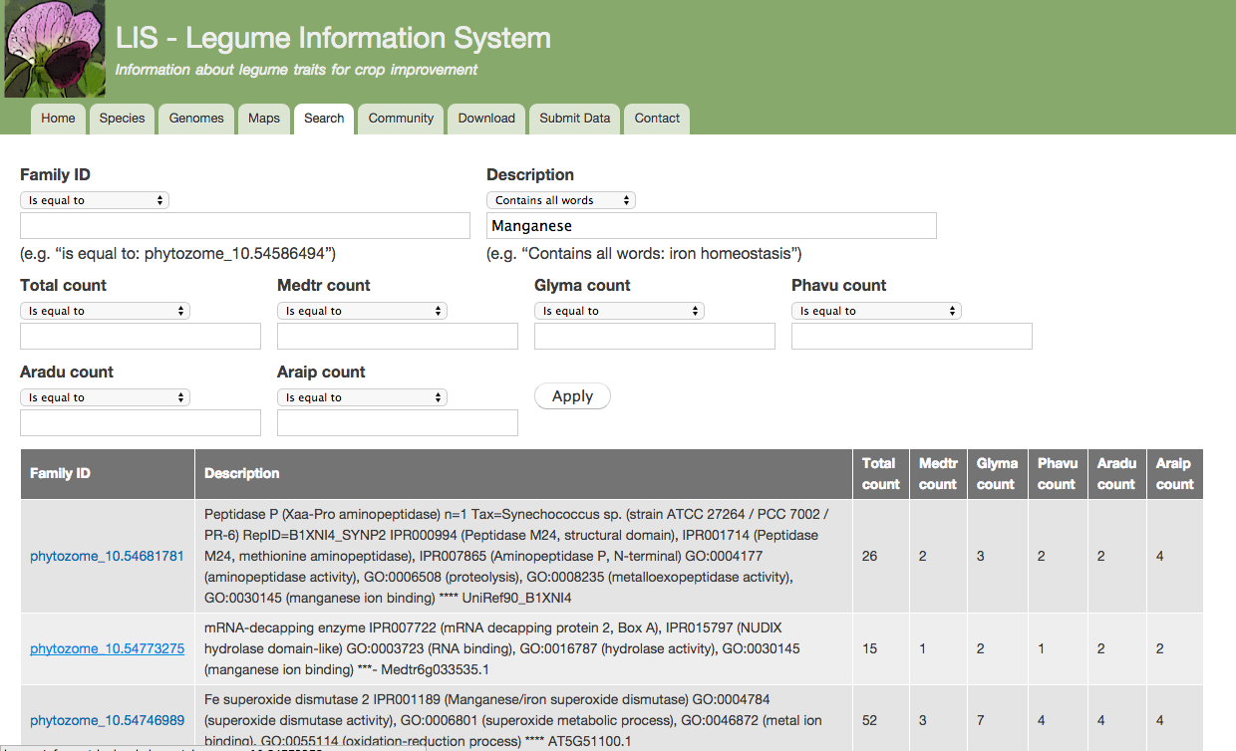
PhyloTree

Slide 27
PhyloTree

Slide 28
PhyloTree

Slide 29
PhyloTree

Slide 30
PhyloTree

Slide 31
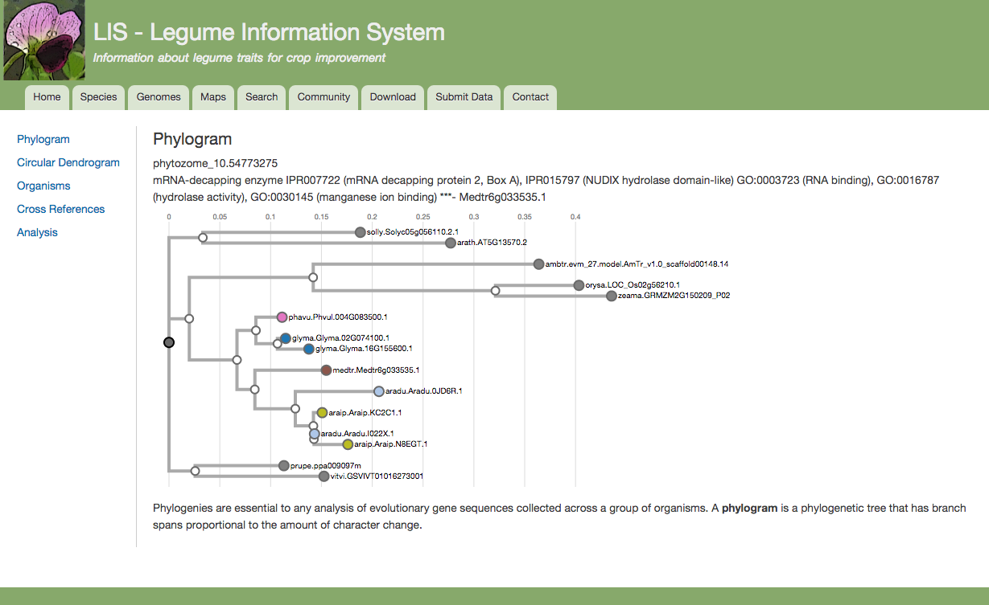
PhyloTree

Slide 32
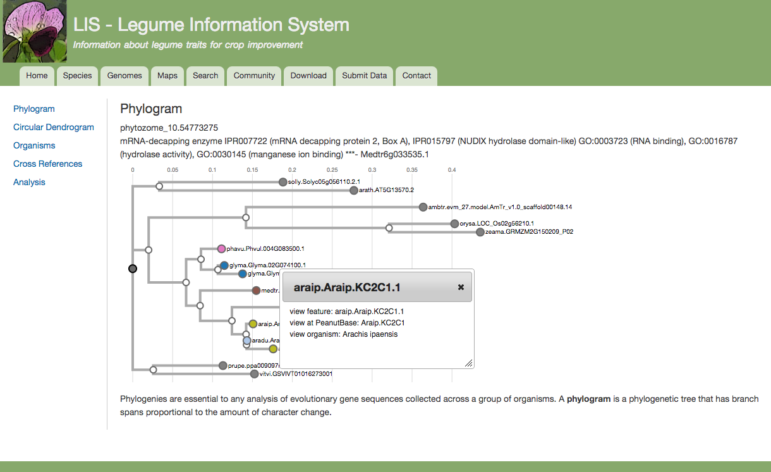
PhyloTree

Slide 33
PhyloTree

Slide 34
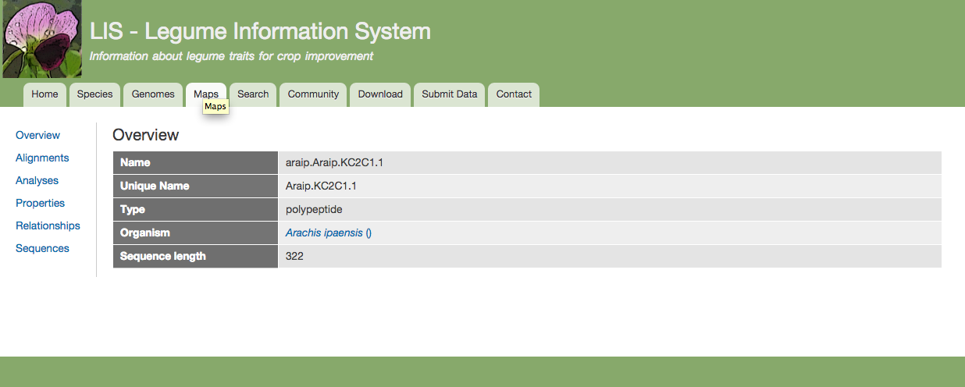
PhyloTree

Slide 35
PhyloTree

Slide 36
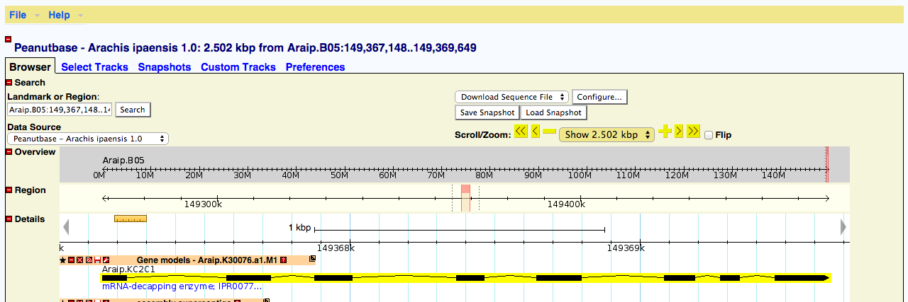
PhyloTree

Slide 37
PhyloTree

Slide 38
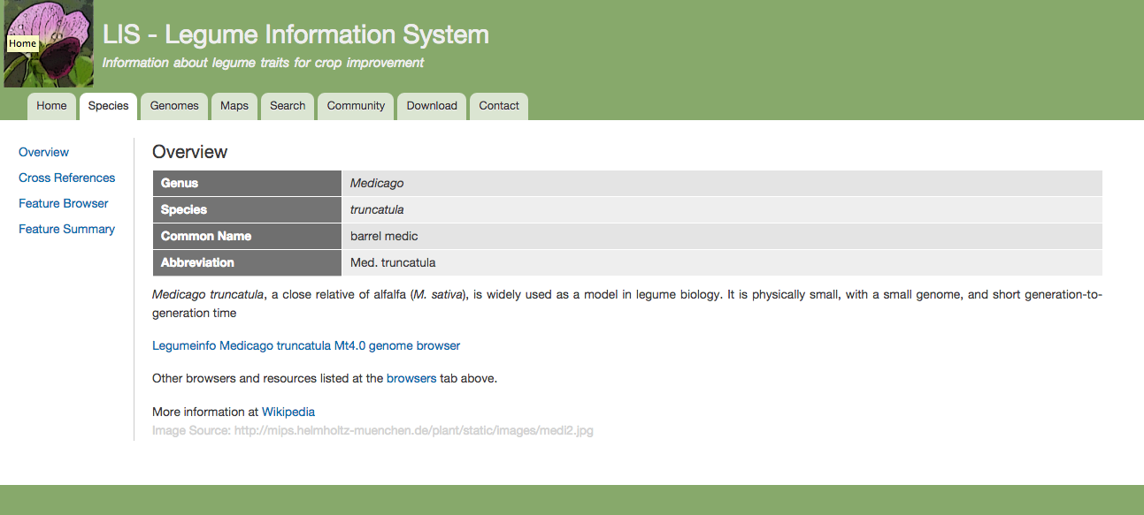
PhyloTree

Slide 39
PhyloTree
Status
Hosted at LegumeInfo.
Gene and gene family searches at both LegumeInfo and PeanutBase + homology through gene families link the two websites together.
Will be made available to all Tripal installations; the process of meeting Tripal standards has started.

Slide 40
Tripal extension modules
PhyloTree – in development at LegumeInfo (Iliana Toneva, Alex Rice)
QTL – in development at PeanutBase, based on QTL module at CoolSeasonLegume.org (Ethy Cannon, Stephen Ficklin, QC by Scott Kalberer)

Slide 41
Collecting, loading and displaying QTL data

Slide 42
Collecting, loading and displaying QTL data

Slide 43
Collecting, loading and displaying QTL data
QTL data and metadata is very complex.

Slide 44
Collecting, loading and displaying QTL data
QTL data and metadata is very complex.
The Chado schema is general-purpose and highly flexible.

Slide 45
Collecting, loading and displaying QTL data
QTL data and metadata is very complex.
The Chado schema is general-purpose and highly flexible.
No standards and few recommended practices for mapping QTL data onto Chado.

Slide 46
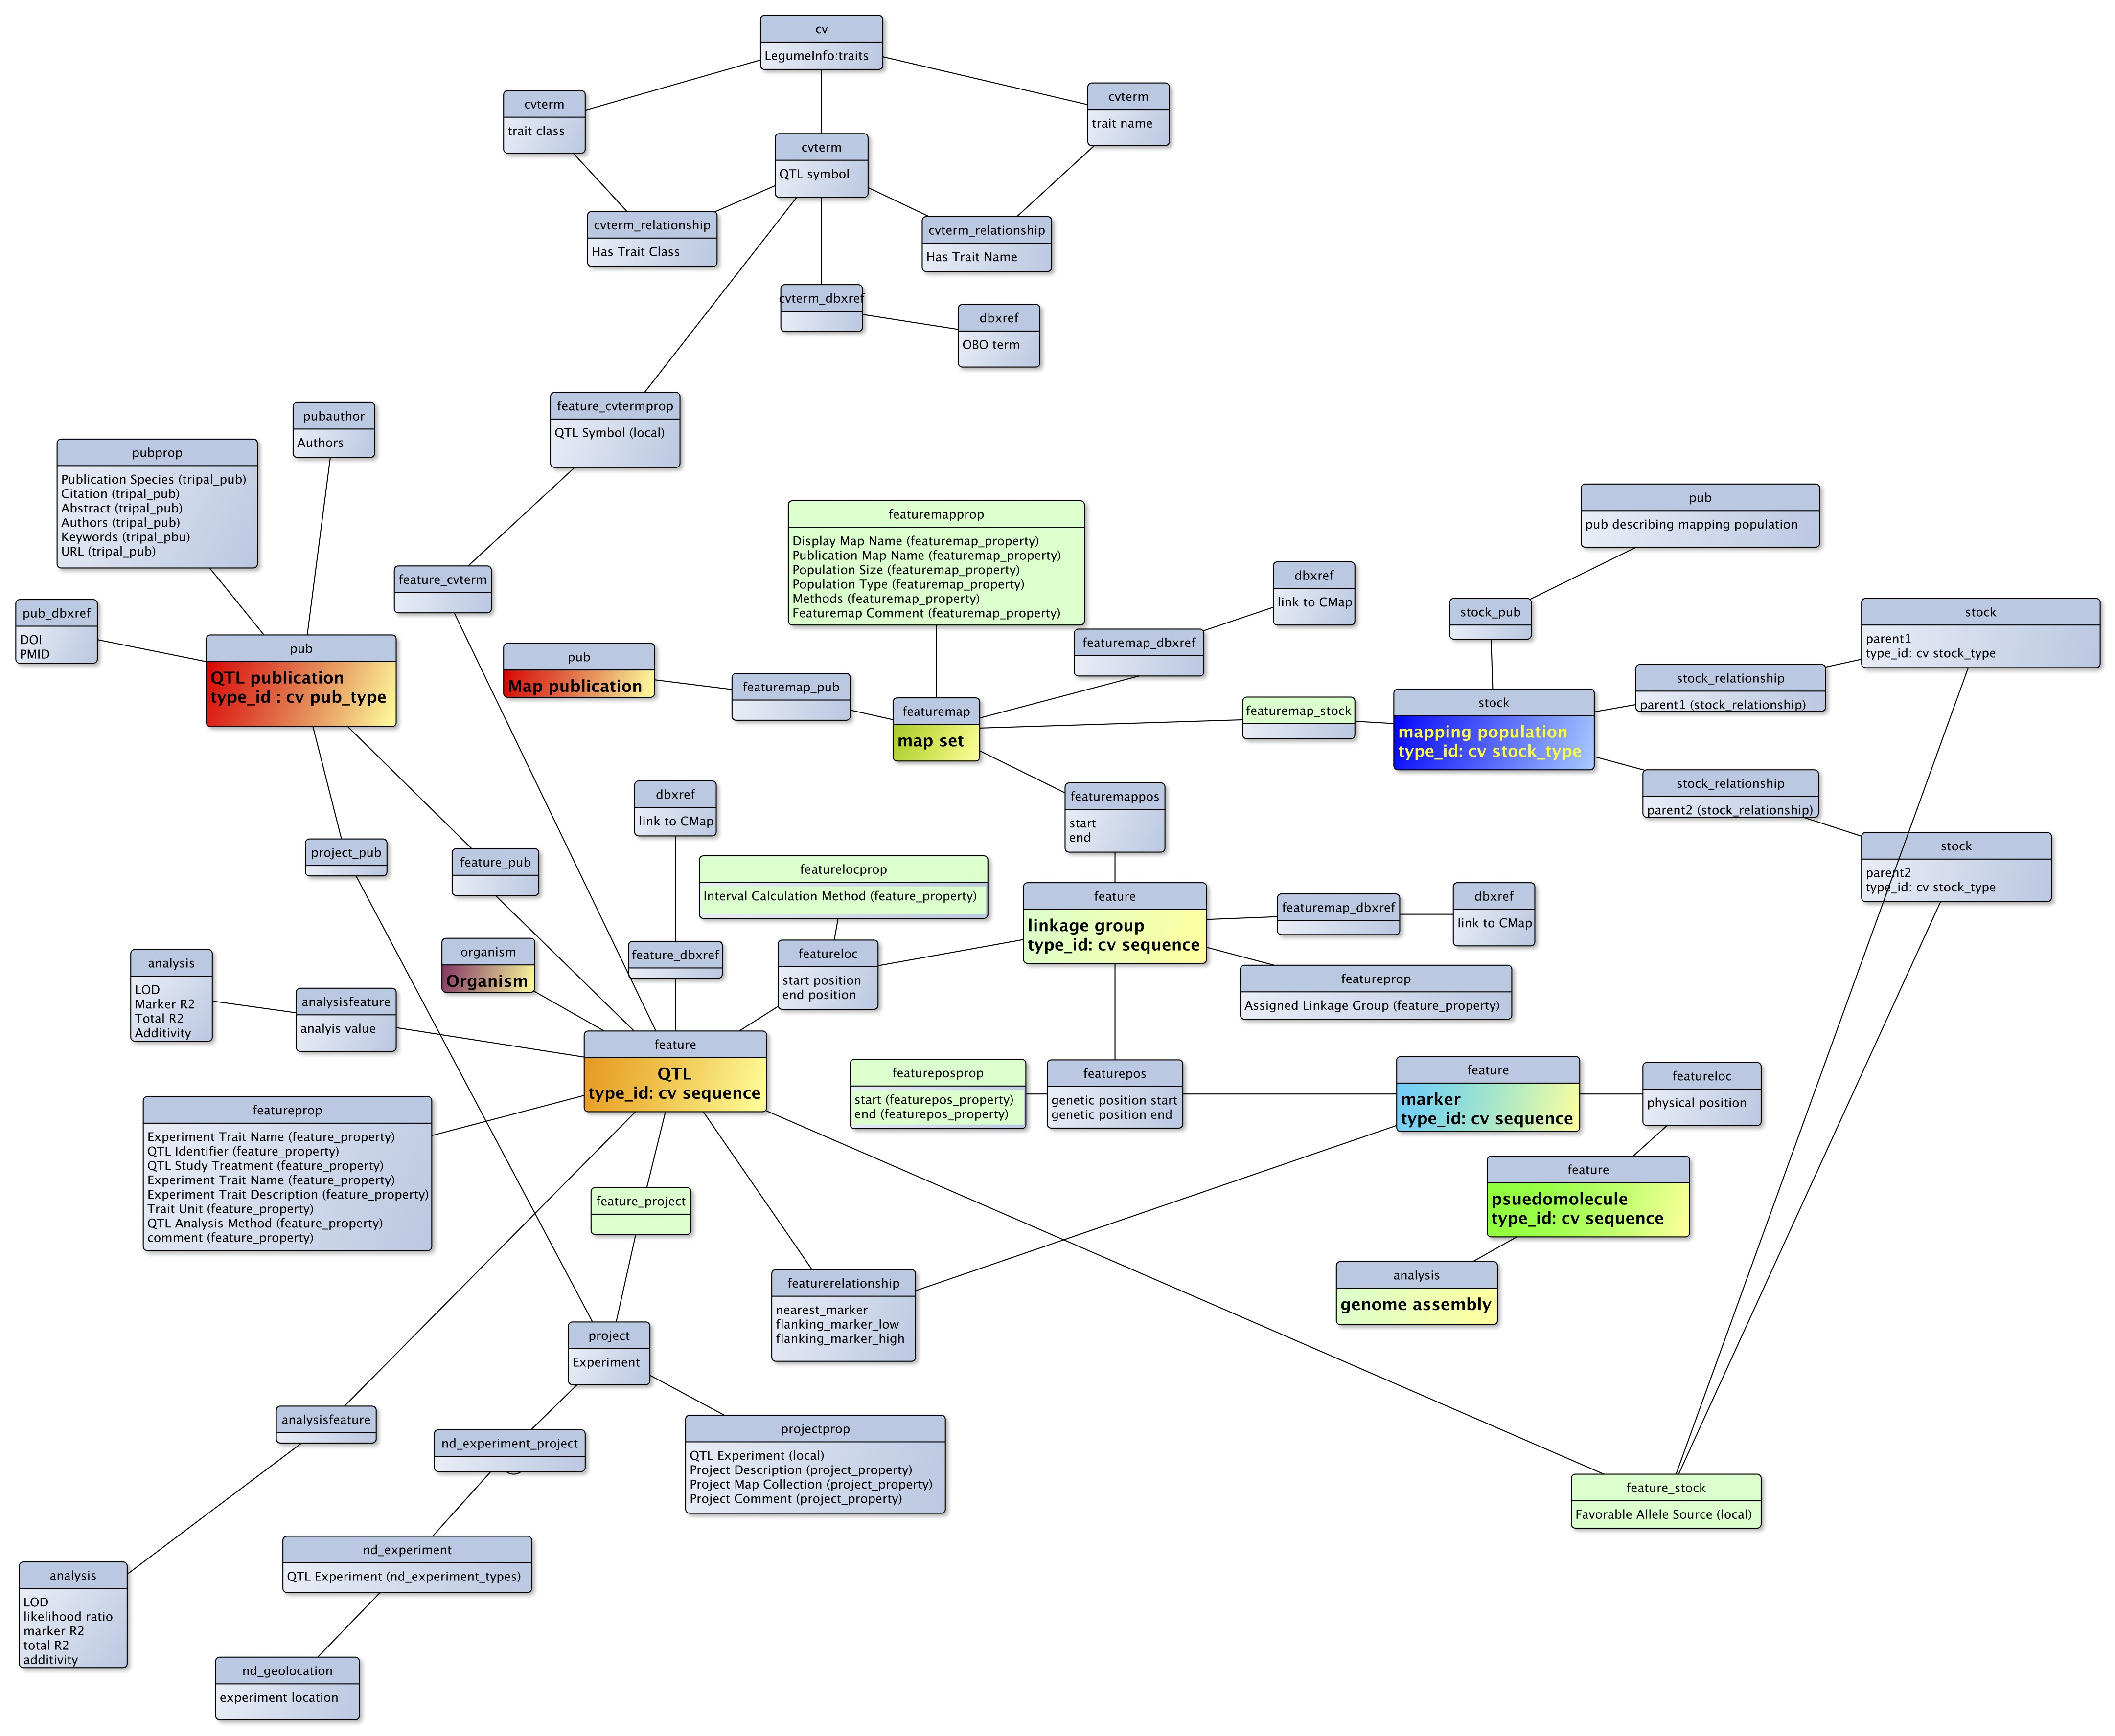

Slide 47
Collecting, loading and displaying QTL data
The challenge: the complexity of QTL data and metadata, and the lack of strong standards means the data is collected and displayed differently by each web resource.
There is a recomendation, Minimum Information about a QTL or Association Study (MIQAS), animal-centric.
Required: create a standard data collection template for plants, based on the MIQAS recommendation and what others are doing now.

Slide 48
Collecting, loading and displaying QTL data
“There’s more than one way to do it.” –Perl of Wisdom.

Slide 49
Collecting, loading and displaying QTL data
“There’s more than one way to do it.” –Perl of Wisdom.
Different QTL information is provided and collected by different communities.

Slide 50
Collecting, loading and displaying QTL data
“There’s more than one way to do it.” –Perl of Wisdom.
Different QTL information is provided and collected by different communities.
QTL data has changed over time.

Slide 51
Collecting, loading and displaying QTL data
“There’s more than one way to do it.” –Perl of Wisdom.
Different QTL information is provided and collected by different communities.
QTL data has changed over time.
We tried to find a consensus or “canonical” method, decided to mimic Genomic Database for Rosaceae’s data structure, but still managed to create something different.

Slide 52
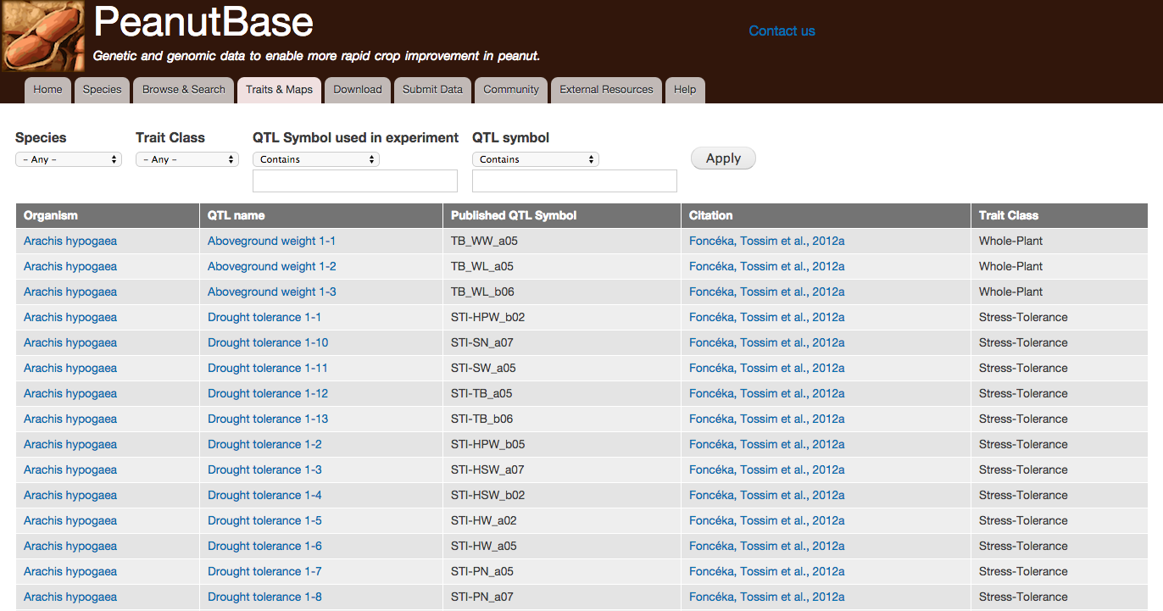
Tripal Extension module: QTL module (prototype) Ethy Cannon & Stephen Ficklin

Slide 53
Tripal Extension module: QTL module (prototype) Ethy Cannon & Stephen Ficklin

Slide 54
Tripal Extension module: QTL module (prototype) Ethy Cannon & Stephen Ficklin

Slide 55
Tripal Extension module: QTL module (prototype) Ethy Cannon & Stephen Ficklin

Slide 56
Tripal Extension module: QTL module (prototype) Ethy Cannon & Stephen Ficklin

Slide 57
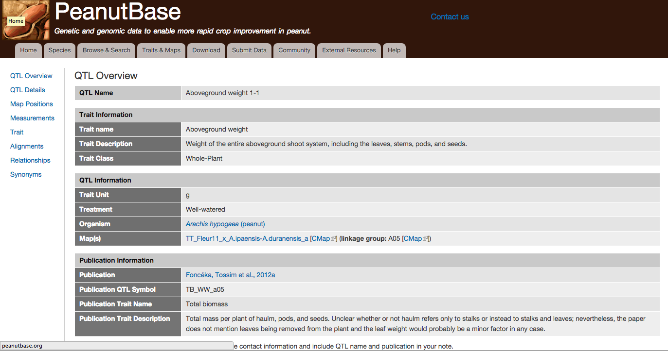
QTL module

Slide 58
QTL module

Slide 59
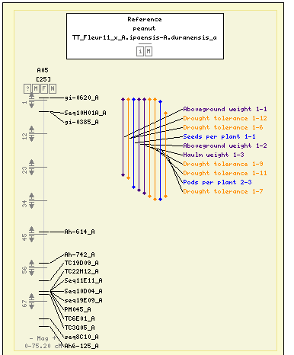
QTL module

Slide 60
QTL module

Slide 61
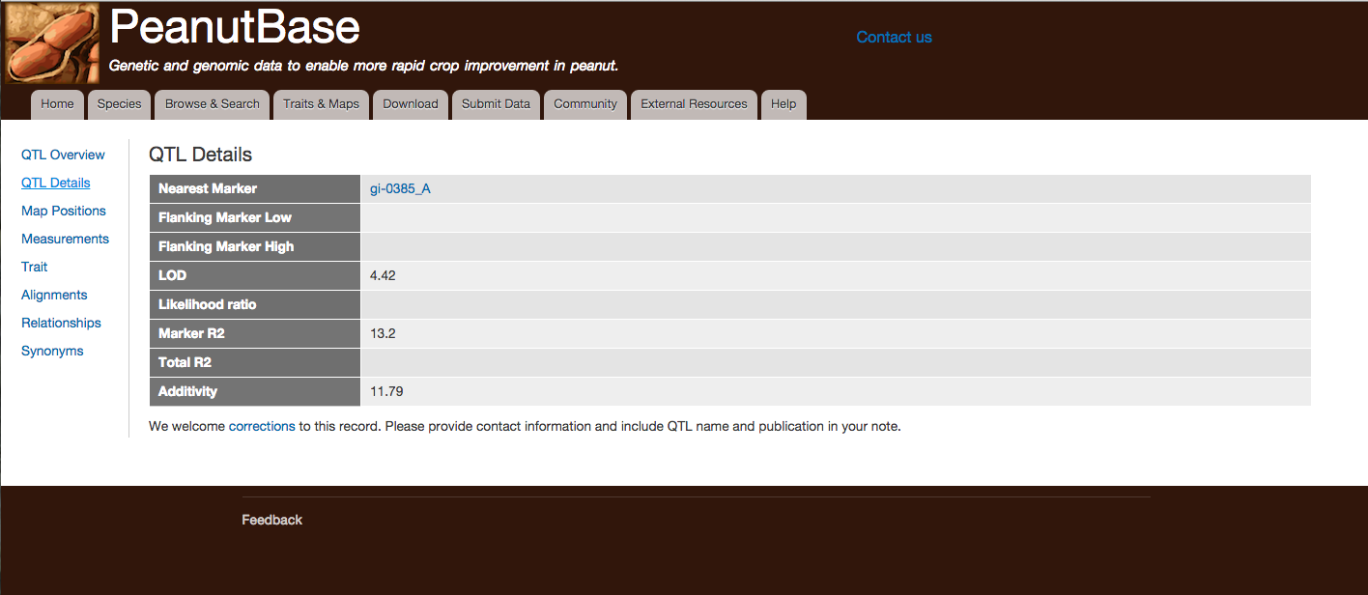
QTL module

Slide 62
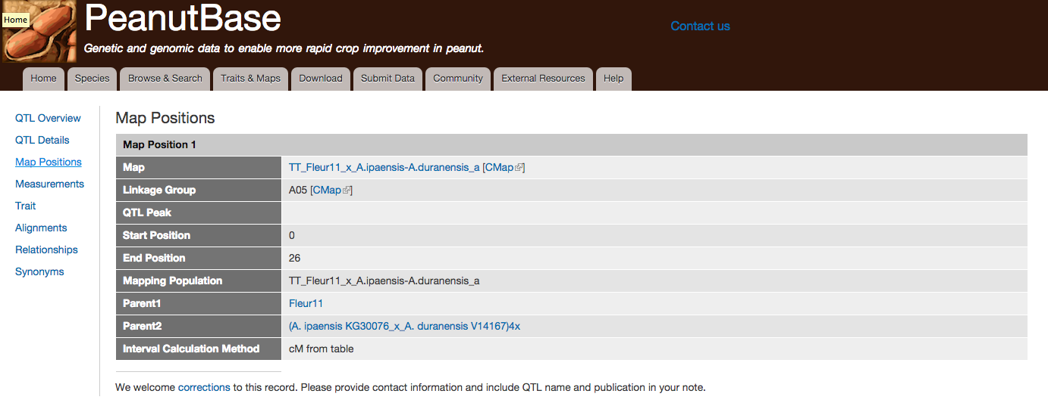
QTL module

Slide 63
QTL module
Status:
We have a prototype which is active at both PeanutBase and LegumeInfo.

Slide 64
QTL module
Status:
We have a prototype which is active at both PeanutBase and LegumeInfo.
Working with SoyBase as well as Tripal folks to define a standard data collection template.

Slide 65
QTL module
Status:
We have a prototype which is active at both PeanutBase and LegumeInfo.
Working with SoyBase as well as Tripal folks to define a standard data collection template.
First kickoff meeting to plan the publicly-available Tripal QTL module at PAG.
Sook Jung, Stephen Ficklin, Lacey Sanderson, Ethy Cannon

Slide 66
QTL module
Status:
We have a prototype which is active at both PeanutBase and LegumeInfo.
Working with SoyBase as well as Tripal folks to define a standard data collection template.
First kickoff meeting to plan the publicly-available Tripal QTL module at PAG.
Sook Jung, Stephen Ficklin, Lacey Sanderson, Ethy Cannon
Input welcome from anyone.

Slide 67


Who We Are
PeanutBase
Steven Cannon
Sudhansu Dash
Scott Kalberer
LegumeInfo
Andrew Farmer
Alan Cleary
Alex Rice
Jugpreet Singh
Iliana Toneva
Pooja Umale
Nathan Weeks
Genomic Database for Rosaceae
Dorrie Main
Sook Jung
CoolSeasonFoodLegume
Dorrie Main
Stephen Ficklin
Funding:
Peanut Foundation
USDA-ARS

