Slide 1
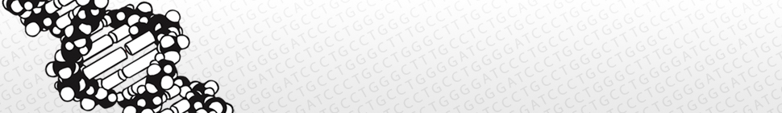
GMOD/GBrowse_syn
Sheldon McKay
iPlant Collaborative DNA Learning Center Cold Spring Harbor Laboratory

Slide 2
Outline
A few words on whole genome alignment
A brief survey of synteny browsers
A few challenges of rendering comparative data
Comparative genome browsing with GBrowse_syn

Slide 3
Hierarchical Genome Alignment Strategy
Raw genomic sequences
Mask repeats
(RepeatMasker, Tandem Repeats Finder, nmerge, etc
Identify orthologous regions
(ENREDO, MERCATOR, orthocluster, etc)
GBrowse_syn
Nucleotide-level alignment
(PECAN, MAVID, etc)
GBrowse_syn
Further processing
GBrowse

Slide 4
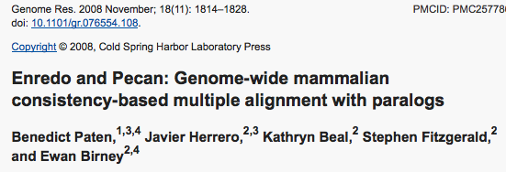


Slide 5
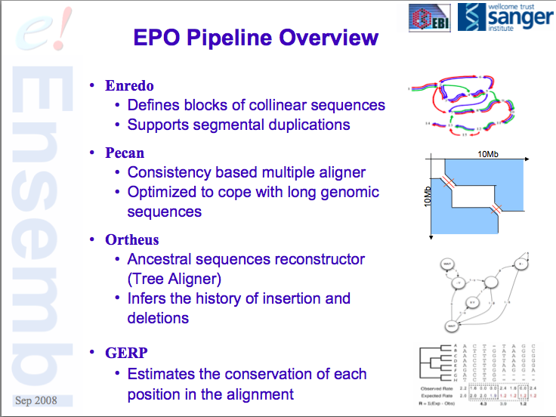

Slide 6
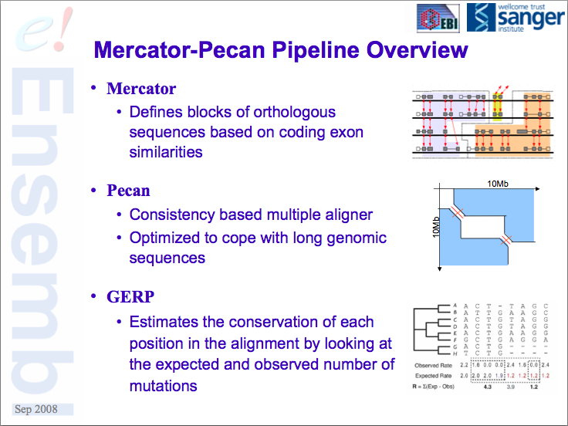

Slide 7
A Few Use Cases
Multiple sequence alignment data from whole genomes
Synteny or co-linearity data without alignments
Gene orthology assignments based on proteins
Self vs. Self comparison of duplications, homeologous regions, etc
Others

Slide 8
What is a Synteny Browser?
- Has display elements in common with genome browsers
Uses sequence alignments, orthology or co-linearity data
to highlight different genomes, strains, etc.
Usually displays co-linearity relative to a reference
genome.

Slide 9
A Brief Survey of GMOD-friendly Synteny Browsers
*

Slide 10

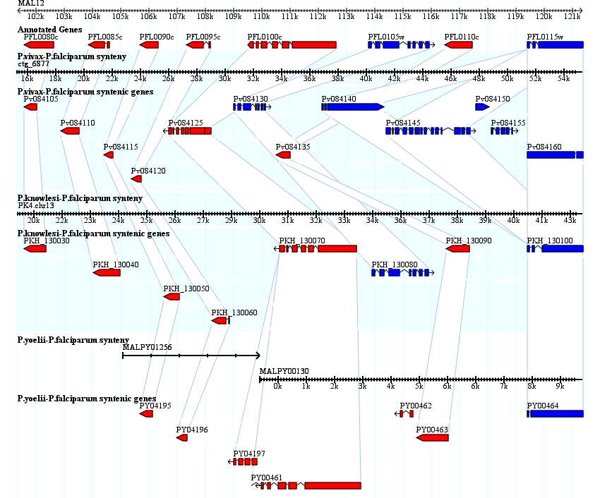



Wang H, Su Y, Mackey AJ, Kraemer ET and JC Kissinger . SynView: a GBrowse-compatible
approach to visualizing comparative genome data Bioinformatics 2006 22:2308-2309

Slide 11

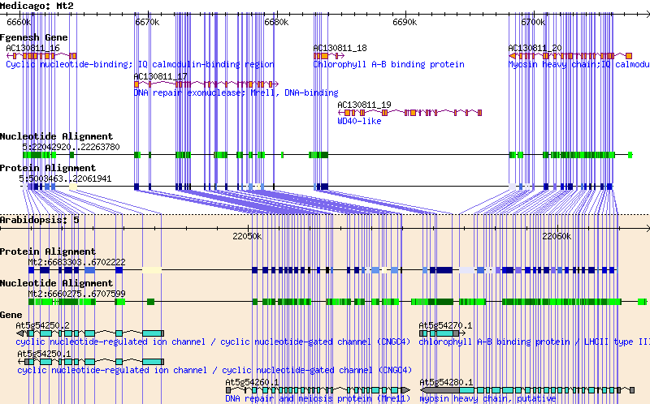
Pan, X., Stein, L. and Brendel, V. 2005. SynBrowse: a Synteny Browser for Comparative
Sequence Analysis. Bioinformatics 21: 3461-3468

Slide 12
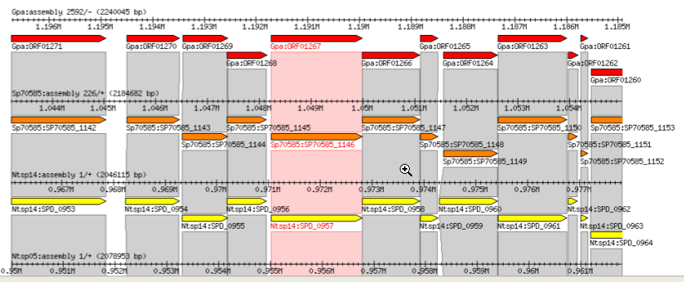
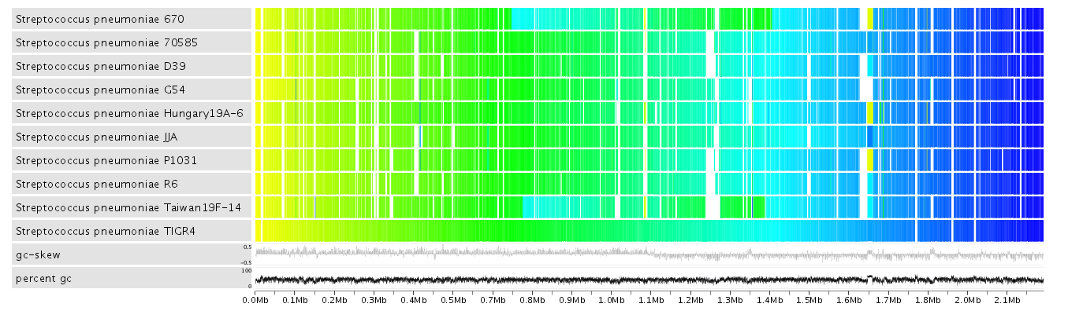

Crabtree, J., Angiuoli, S. V., Wortman, J. R., White, O. R. Sybil: methods and software
for multiple genome comparison and visualization Methods Mol Biol. 2007 Jan 01; 408: 93-108.

Slide 13
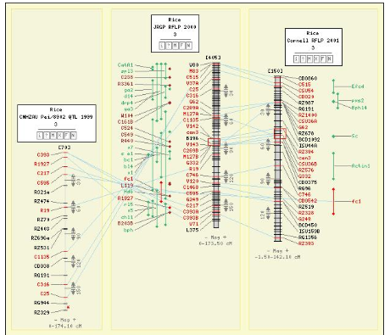
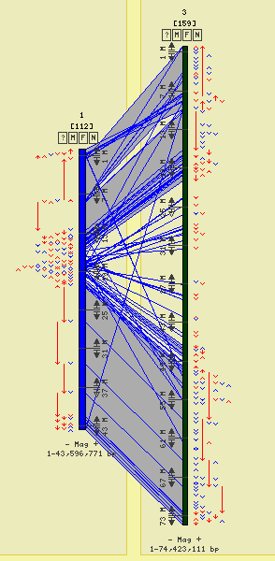
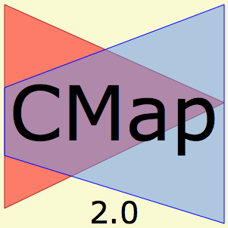



+ others...
Youens-Clark K, Faga B, Yap IV, Stein LD, Ware, D. 2009.
CMap 1.01: A comparative mapping application for the Internet. doi:10.1093

Slide 14

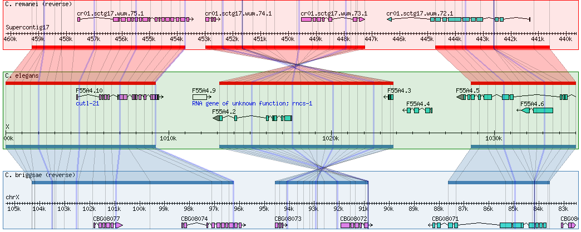





GBrowse_syn
+others…
McKay SJ, Vergara IA and Stajich, J. 2010. "Using the Generic Synteny Browser (Gbrowse_syn)"
in Current Protocols in Bioinformatics (Wiley Interscience) doi: 10.1002/0471250953.bi0912s31

Slide 15
How is GBrowse_syn different?
Does not rely on perfect co-linearity across the entire displayed region (no orphan alignments)
Offers “on the fly” alignment chaining
No upward limit on the number of species
Used grid lines to trace fine-scale indels (sequence insertion/deletions)
Integration with GBrowse data sources
Ongoing support and development

Slide 16
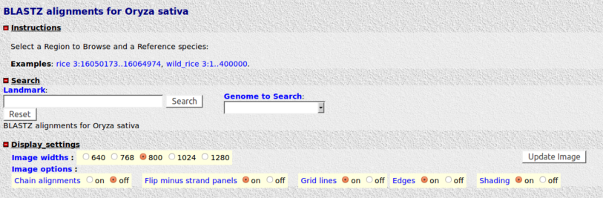
GBrowse-like interface

Slide 17
GBrowse_syn
GBrowse
Databases*
GBrowse_syn
alignment
database
*.syn
or
*.conf
*.synconf
Species config. Master config.

Slide 18
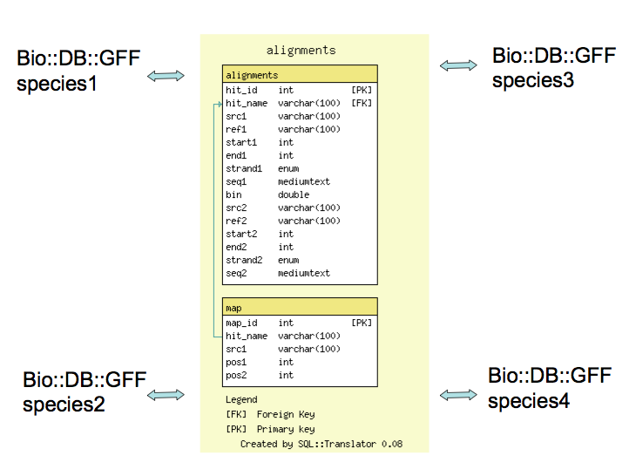

GBrowse_syn Architecture
[GBrowse]
[GBrowse]
[GBrowse]
[GBrowse]

Slide 19
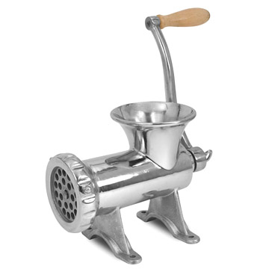
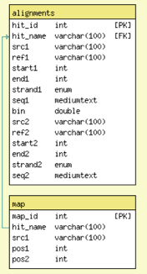
Getting Data into GBrowse_syn
CLUSTALW PECAN
MSF ad hoc tab-delimited
FASTA STOCKHOLM
GFF3 etc…
Loading scripts

Slide 20
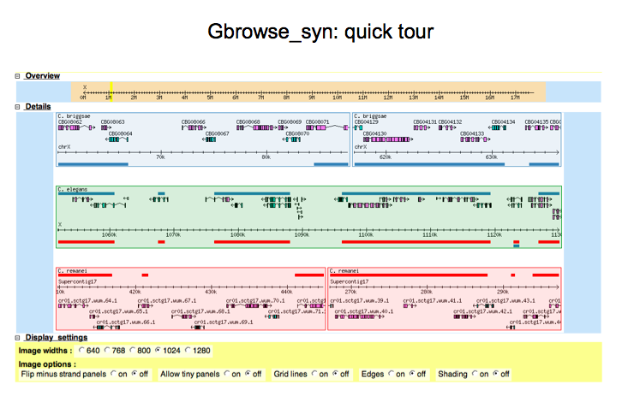

Slide 21
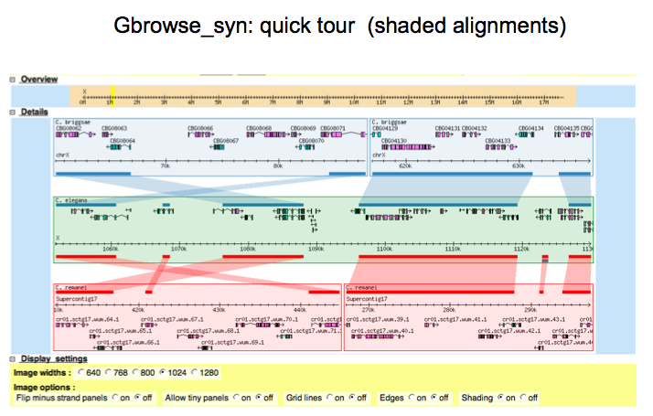

Slide 22
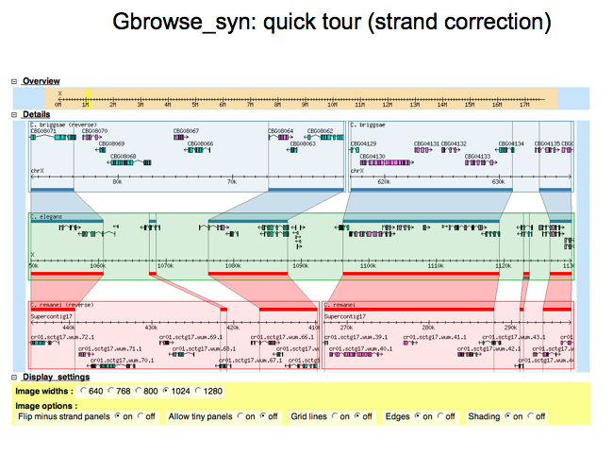

Slide 23
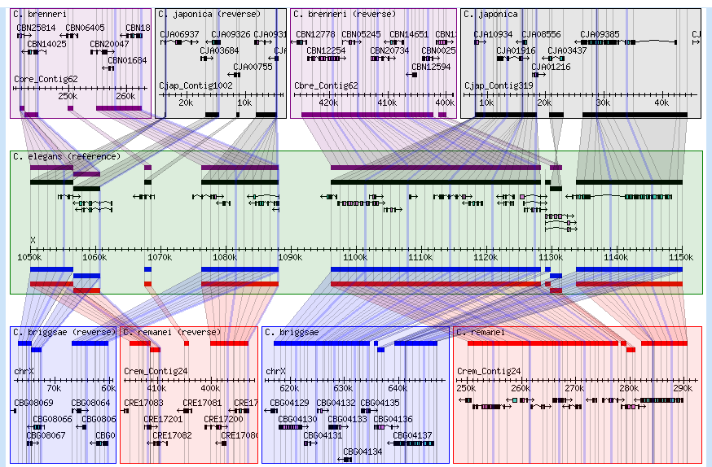
Optional “All in one” view

Slide 24
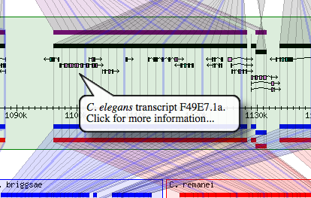
Adding markup to the annotations

Slide 25
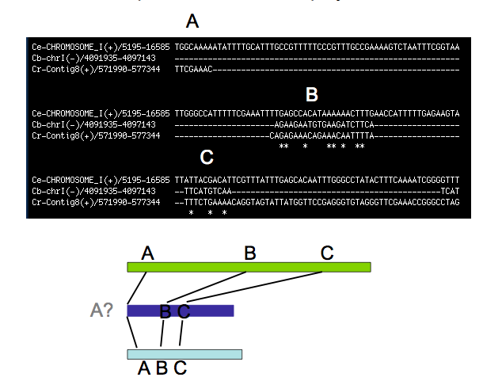
Problem : How to use Insertions/Deletion data

Slide 26
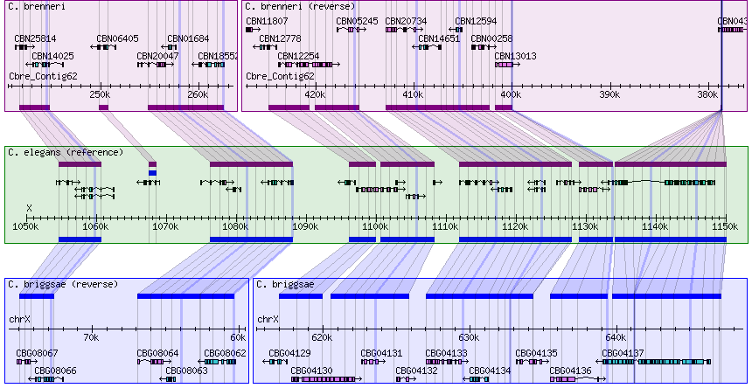
Tracking Indels with grid lines

Slide 27
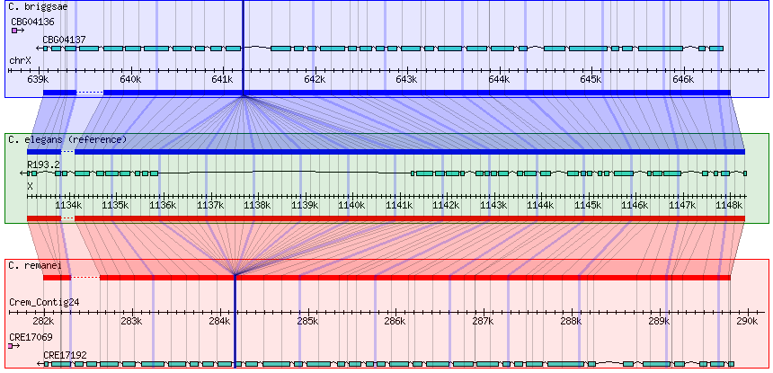
Evolution of Gene Structure

Slide 28
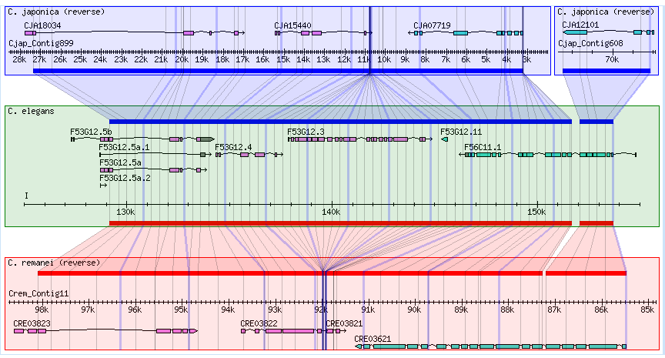
Putative gene or loss

Slide 29
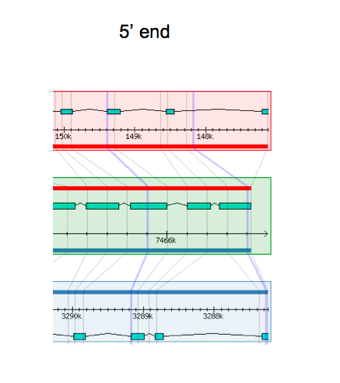
Comparing gene models

Slide 30
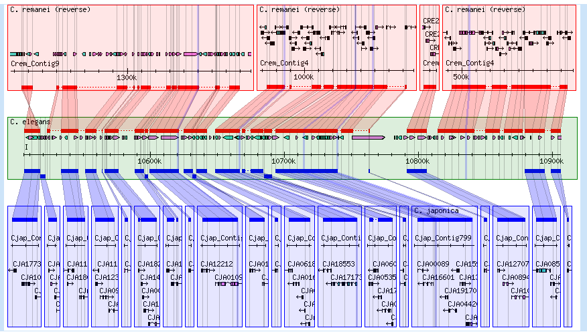
Comparing assemblies
Not bad
Needs work

Slide 31
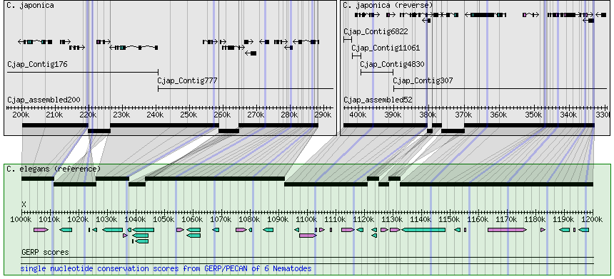
Example Mercator Alignment

Slide 32
Getting the most out of small aligned regions
or orthology-only data

Slide 33
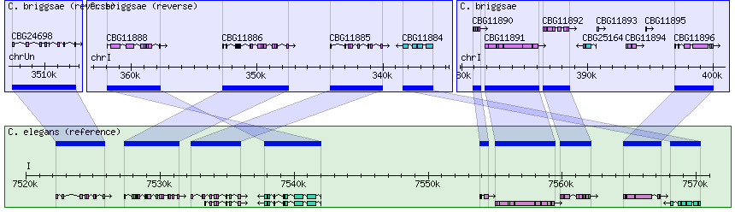
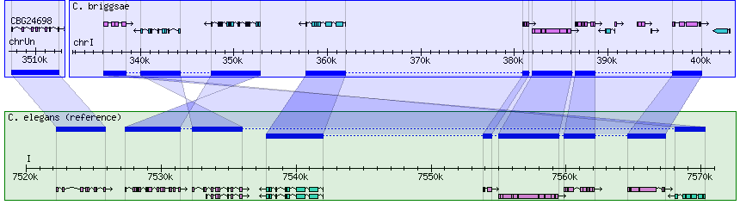
Gene Orthology
Chained Orthologs

Slide 34
2 panels merged
Inversion + translocation?

Slide 35
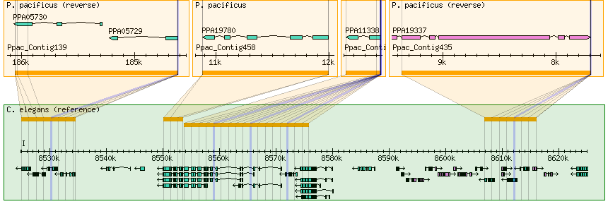
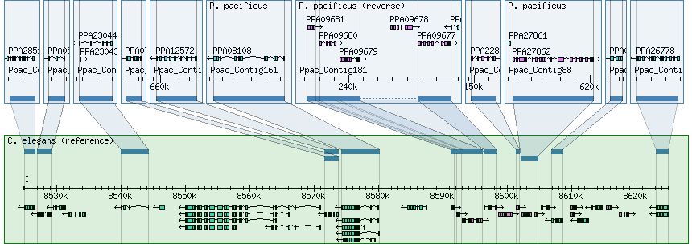
Pecan alignments
Protein orthology based Synteny blocks

Slide 36
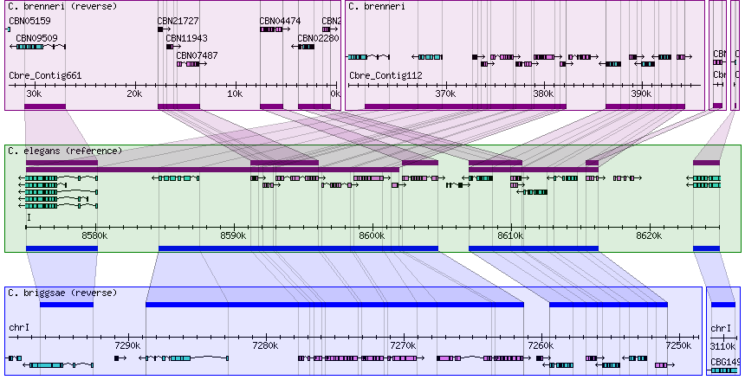
Duplications

